Slide 1
Statistical Machine Learning for defining the Design Space
Joan Borràs-Ferrís, Alba González-Cebrián, Joaquín Martínez-Minaya, Daniel Palací-López, Alberto Ferrer
Multivariate Statistical Engineering Group
Departamento de Estadística e IO Aplicadas y Calidad
Universitat Politècnica de València. Camino de Vera s/n. 46022. Valencia (Spain)
Notes:
I would like to thank the scientific committee for accepting this contribution to the conference.

Slide 2
Contents
Motivation
Discovering the Latent Subspace
Defining the Design Space
Forward Approach
Backward Approach
Industrial Case Study
Conclusions
1

Slide 3
Contents
Motivation
Discovering the Latent Subspace
Defining the Design Space
Forward Approach
Backward Approach
Industrial Case Study
Conclusions
1

Slide 4
Motivation
Quality by Testing
Raw material properties
Critical Quality Attributes
+
Process variables
2

Slide 5
Motivation
Quality by Design
Raw material properties
Critical Quality Attributes
+
Process variables
2

Slide 6
Motivation
Forward
Quality by Design
Backward
Raw material properties
Critical Quality Attributes
+
Process variables
Process variables
Design Space
2

Slide 7
Motivation
Forward
Quality by Design
Backward
Raw material properties
Critical Quality Attributes
$$y=f(x)$$
Process variables
2

Slide 8
Motivation
Forward
Quality by Design
Backward
Raw material properties
Critical Quality Attributes
$$y=f(x)$$
Process variables
2

Slide 9
Motivation
Forward
Quality by Design
Backward
Raw material properties
Critical Quality Attributes
$$y=f(x)$$
Process variables
2

Slide 10
Motivation
Forward
Quality by Design
Backward
Raw material properties
$$x=f^{−1}(y)$$
Critical Quality Attributes
Process variables
2

Slide 11
Motivation
In what situations is it possible to generate causal models?
First Principles
Design of Experiments (DoE)
X
Direct link
Y
Z
Link through Latent Space
Historical (Big) Data (happenstance data)
Jaeckle, C. M., & MacGregor, J. F. (1998). AIChE Journal.
3
Notes:
following the idea of Jaeckle and MacGregor, we can build causal models using Latent Variables Regression Model Inversion, such as PLS regression.

Slide 12
Contents
Motivation
Discovering the Latent Subspace
Defining the Design Space
Forward Approach
Backward Approach
Industrial Case Study
Conclusions
1

Slide 13
Discovering the Latent Subspace
$$SPE=e^{T}e$$
x₃
e
y₁
x₂
Partial Least Squares Model
x₁
t₂
t₁
In the latent space:
The latent variables are orthogonal to each other.
The dimensionality of the space is reduced (the information is compressed).
Not only models the relationship between X and y, but also provides model for both spaces
5
Notes:
The latent variables are orthogonal to each other.
The dimensionality of the space is reduced (the information is compressed).
Not only models the relationship between X and y, but also provides model for both spaces

Slide 14
Contents
Motivation
Discovering the Latent Subspace
Defining the Design Space
Forward Approach
Backward Approach
Industrial Case Study
Conclusions
1

Slide 15
Defining the Design Space Forward Approach
FORWARD
x₃
$$y=f(x)$$
y₁
x₂
- Bayesian linear modelling
- Random Forest
x₁
7

Slide 16
Defining the Design Space Forward Approach
Bayesian linear modelling
Model building
Fit MLR model
Compute the Joint Posterior Distribution of the model parameters: $f\left({β,Σ}/{XZ, y}\right)$
Given ${xz}_{new}$, compute the posterior predictive distribution $f\left({\hat{y}}/{{xz}_{new}, XZ,y}\right), by INLA.$
Finally, $P\left({\hat{y}∈A}/{x_{new}, XZ, y}\right)$can be computed to meet their specifications:
XZ
y
y
e
MLR
^
Model exploiting
$$P\left({\hat{y}∈A}/{x_{new}, XZ,y}\right)=\int_{A}{f\left({\hat{y}}/{x_{new}, XZ,y}\right)d\hat{y}}$$
Bano, G., Facco, P., Bezzo, F., & Barolo, M. (2018). AIChE Journal, 64(7), 2438-2449.
9

Slide 17
Defining the Design Space Forward Approach
Random Forest
Model building
Fit RF model
Parametrize the prediction error distribution (check normality)
Given ${xz}_{new}$, compute the the RF prediction,$\hat{y}$, and sample N_{MC}* error values from $N\left({\hat{μ}}_{e}, {\hat{σ}}_{e}\right).$
Calculate the percentage of samples that meet specifications.
X, Z
y
🌳
y
e
^
$${\hat{μ}}_{e}, {\hat{σ}}_{e}$$
e
Model exploiting
$$\hat{y}$$
8

Slide 18
Defining the Design Space Forward Approach
FORWARD
e
Defining the DS
$$LSL≤y_{des}$$
x₃
$$y=f(x)$$
y₁
x₂
- Bayesian linear modelling
- Random Forest
x₁
10

Slide 19
Defining the Design Space Forward Approach
FORWARD
Defining the DS
x₃
$$y=f(x)$$
y₁
x₂
- Bayesian linear modelling
- Random Forest
x₁
t₂
t₁
10

Slide 20
Defining the Design Space Forward Approach
FORWARD
Defining the DS
$$LSL≤y_{des}$$
x₃
$$y=f(x)$$
y₁
x₂
- Bayesian linear modelling
- Random Forest
x₁
t₂
t₁
10

Slide 21
Defining the Design Space Forward Approach
FORWARD
Defining the DS
$$LSL≤y_{des}$$
x₃
$$y=f(x)$$
y₁
x₂
- Bayesian linear modelling
- Random Forest
x₁
t₂
t₁
High Confidence Design Space
10

Slide 22
Defining the Design Space Backward Approach
Backward Approach PLS model inversion
$$LSL≤y_{des}$$
x₃
1
y₁
x₂
1
A
x₁
#Y
#Y
A
$y_{des}$ = Q • τ_{NS}
t₂
t₁
Design Space (without uncertainty)
Borràs-Ferrís, J., Palací-López, D., Duchesne, C., & Ferrer, A. (2022). Chemometrics and Intelligent Laboratory Systems.
11

Slide 23
Defining the Design Space Backward Approach
Backward Approach PLS model inversion
$$LSL≤y_{des}$$
x₃
1
y₁
x₂
1
A
$$y_{des}$$
x₁
#Y
#Y
A
t₂
t₁
Design Space (without uncertainty)
High Confidence Design Space
Borràs-Ferrís, J., Palací-López, D., Duchesne, C., & Ferrer, A. (2022). Chemometrics and Intelligent Laboratory Systems.
11

Slide 24
Contents
Motivation
Discovering the Latent Subspace
Defining the Design Space
Forward Approach
Backward Approach
Industrial Case Study
Conclusions
1

Slide 25
Industrial Case Study
Cereal extraction process:
nX = 8
nY = 1
$$LSL≤y_{des}$$
Z
Y
y_{DES}
n = 989
n = 989
y₁
Confidence level = 90%
13

Slide 26
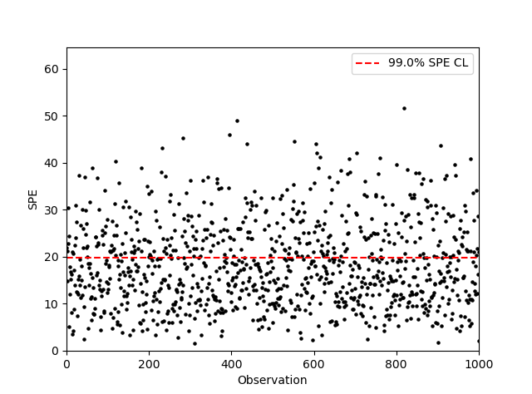
Industrial Case Study
x₃
Discretization in the Original Space
x₂
x₁
15

Slide 27
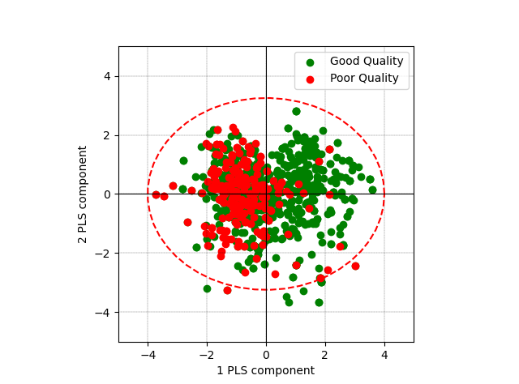
Industrial Case Study
PLS model with two components
R²: 26.73%
Q²: 25.63%
Score plot
14

Slide 28
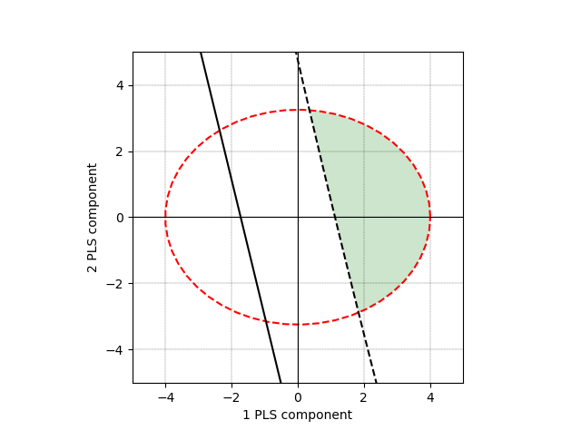
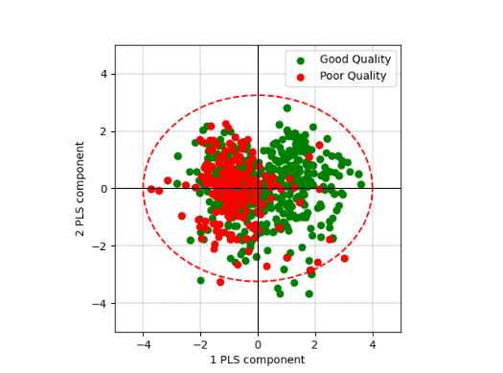
Industrial Case Study
Defining the Design Space
PLS inversion
Null Space
16

Slide 29
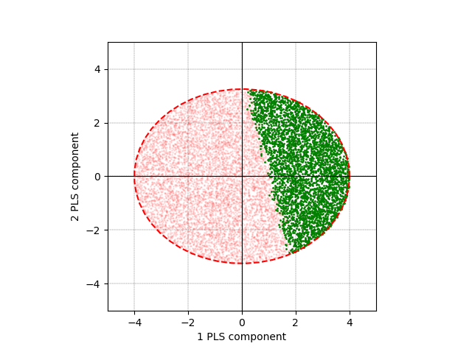
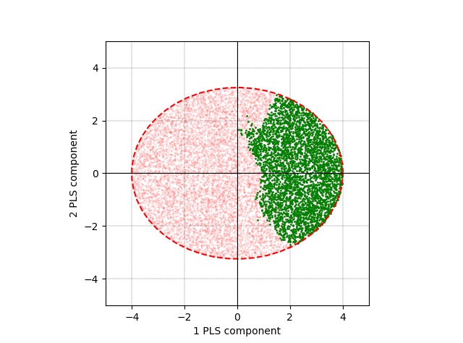
Industrial Case Study
Defining the Design Space
PLS inversion
Bayesian LM
Random Forest
Null Space
Confidence Limit
16

Slide 30
Industrial Case Study
Performance of the methods
M1
FNR_1
FPR_1
NPV_1
M2
Calibration = 90%
FNR_2
FPR_2
NPV_2
N = 983
Validation = 10%
FNR: Proportion of truly bad batches that are accepted (Type II risk).
FPR: Proportion of truly good batches that are rejected (Type I risk).
NPV: Proportion of accepted batches that actually are good.
M10
FNR_10
FPR_10
NPV_10
17
Notes:
The NPV is the proportion of batches that actually result in a good product out of all those within the High Confidence Design Space. And, therefore, this metric is directly connected to the definition of the High-Confidence DS itself.
Type I risk is defined as the proportion of truly acceptable batches of raw materials that is rejected by the customer under a given specification region; type II risk consists of the proportion of truly unacceptable batches of raw materials that is accepted by the customer under a given specification region [1].

Slide 31
Industrial Case Study
Performance of the methods
M1
FNR_1
FPR_1
NPV_1
M2
Calibration = 90%
FNR_2
FPR_2
NPV_2
FNR_CV
FPR_CV
NPV_CV
N = 983
Validation = 10%
FNR: Proportion of truly bad batches that are accepted (Type II risk).
FPR: Proportion of truly good batches that are rejected (Type I risk).
NPV: Proportion of accepted batches that actually are good.
M10
FNR_10
FPR_10
NPV_10
17

Slide 32
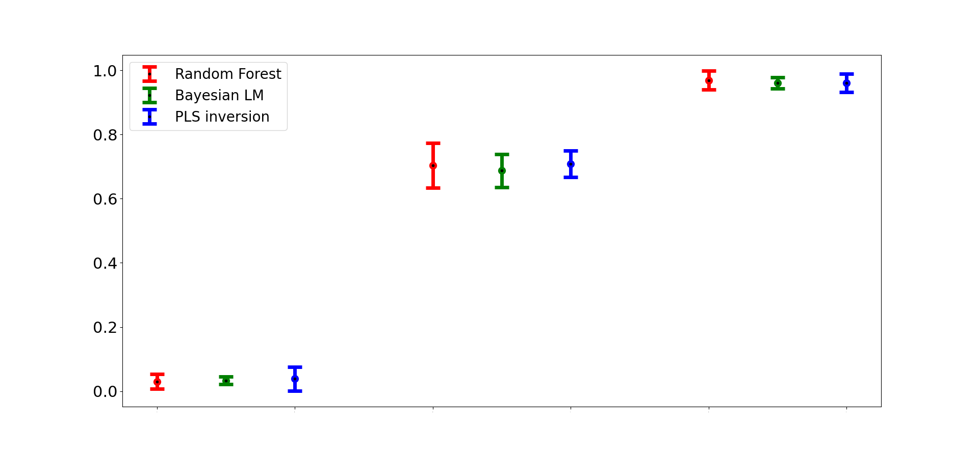
Industrial Case Study
Performance of the methods
FNR
FPR
NPV
18

Slide 33
Contents
Motivation
Discovering the Latent Subspace
Defining the Design Space
Forward Approach
Backward Approach
Industrial Case Study
Conclusions
19

Slide 34
Conclusions
The DS is a region where critical parameters ‘‘have been demonstrated to provide assurance of quality” and, for that, the uncertainty must be taken into account.
Historial data can be used to define the DS with the precaution of respecting the correlation structure from the past.
The Bayesian, Random Forest and PLS inversion yield to similar results, but:
Bayesian allows calculating rigorously the probabilistic Design space determination (unlike frequentist).
Random Forest handles efficiently non-linear relationships.
PLS inversion provides the analytical definition of the Design Space.
20

Slide 35
Thanks a lot for your attention!
Joan Borràs-Ferrís
joaborfe@eio.upv.es
The authors would like to express their gratitude to the European Social Fund for the co-finance.

