Slide 1
Optimization maintenance policies for items with their repair processes modelled by the extended Poisson processes
University of Kent
Student: Jiaqi Yin (jy236@kent.ac.uk)
Supervisor: Shaomin Wu (S.M.Wu@kent.ac.uk)

Slide 2
Content
Introduction
Related work
Turning points of a EPP
Influence of the turning point
Maintenance policy based on the turning point & Methods for estimating parameters
Summary and future work

Slide 3
Introduction
Maintenance policies aim to retain a higher operation efficiency and the economical savings. In order to design a maintenance policy for a system, it is important to understand how a system ages over time and how the maintenance action affects its state.
In our daily life, we may meet these situations:
With the usage of a car over time, it needs to be repaired more and more frequently, or it is easier to find some failures with each regular inspection.
When a baby grows to a child and to a teenager, his immunity becomes stronger and stronger. But if he becomes older and older, his immunity declines and it is easy to catch a cold.

Slide 4
Introduction
For a system, a common problem which we may meet in the real world is that, with the number of maintenance and the increase of age, times between failures of systems become shorter and shorter, while the repair time becomes longer and longer.
This phenomenon can be modelled by the geometric process (GP)
Definition 1
Given a sequence of non-negative random variables $\{X_{n}, n=1,2,…\}$ ,if they are independent and the cdf of $X_{n}$ is given by $F(a^{n−1}x)$ for n =1,2,… where $a$ is a positive constant, then $\{X_{n}, n=1,2,…\}$ is called a geometric process (GP).

Slide 5
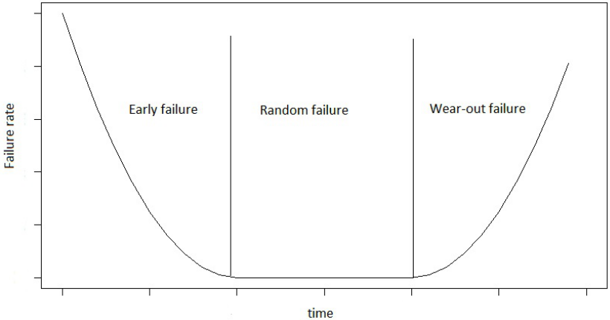
Related work
A GP can describe the failure intensity of a system which is stochastically increasing or decreasing. It can only describe one of the three stages in the Bathtub curve, but not two continuous stages
A GP has an infinite first moment when it is stochastically decreasing. Thus, a GP can not be applied for some conditions.
(baby)
(teenager)
(the elder)

Slide 6
Related work
To solve this problem, GP has been developed and it has several extensions
Definition 2
Given a sequence of non-negative random variables $\{X_{k}, k=1,2,…\}$ ,if they are independent and the cdf of $X_{k}$ is given by $F((αa^{k−1}+βb^{k−1})x)$ for k =1,2,… where $α+β≠0, a≥0 and 0<b≤1$, $a$and $b$are positive constants, then $\{X_{k}, k=1,2,…\}$ is called an extended poisson process (EPP).

Slide 7
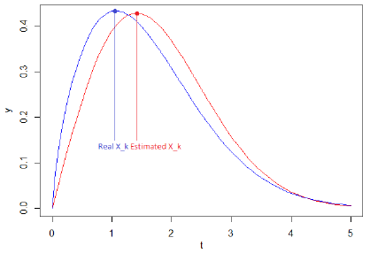
Turning point of the EPP
As the EPP has the property of non-monotonicity, this means that it will has a peak point or a valley point. In this case, we call it as a turning point.
Then there are two situations
(peak point) if the time interval between failures before the turning point becomes longer and longer and the time interval after the turning point becomes shorter and shorter, and
(valley point) if the time interval between failure before the turning point becomes shorter and shorter and the time interval after the turning point becomes longer and longer.
$E\left[X_{k^{∗}−1}^{(m)}\right]<E\left[X_{k^{∗}}^{(m)}\right] and E\left[X_{k^{∗}}^{(m)}\right]> E\left[X_{k^{∗}+1}^{(m)}\right]$,
$E\left[X_{k^{∗}−1}^{(m)}\right]>E\left[X_{k^{∗}}^{(m)}\right] and E\left[X_{k^{∗}}^{(m)}\right]< E\left[X_{k^{∗}+1}^{(m)}\right]$,

Slide 8
Turning point of the EPP
$E\left[X_{k^{∗}−1}^{(m)}\right]<E\left[X_{k^{∗}}^{(m)}\right] and E\left[X_{k^{∗}}^{(m)}\right]> E\left[X_{k^{∗}+1}^{(m)}\right]$,
$E\left[X_{k^{∗}−1}^{(m)}\right]>E\left[X_{k^{∗}}^{(m)}\right] and E\left[X_{k^{∗}}^{(m)}\right]< E\left[X_{k^{∗}+1}^{(m)}\right]$,

Slide 9
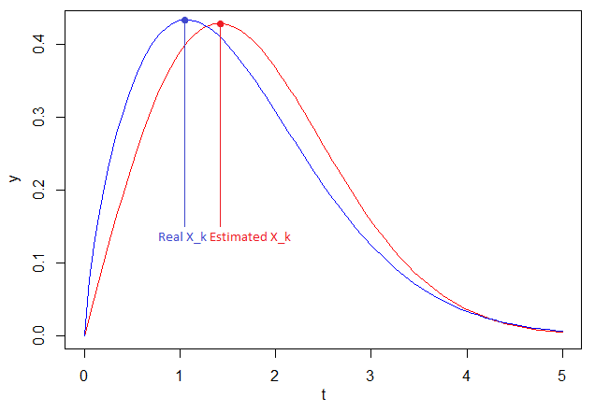
Influence of the turning point
If a people want to buy some health products in Holland & Barrett…
Similar situation for a system, if we take maintenance actions too early, we will waste too much money; if we take actions too late, then we may miss the best chance.

Slide 10
Maintenance policy based on the turning point
Methods for setting parameters:
The bootstrap method
The $δ$-method
Block replacement policy
The expected cost is given
With the RF approximation method, it would be
Then we may get the interval of the expected cost

Slide 11
Summary and future work
In this research, we discuss the GP and its extensions. The main contribution is that, we consider the turning point for such GP-like processes with non-monotonicity, such as the extended poisson process (EPP). Besides, we also consider the influence of the turning point to the EPP and discuss the maintenance policy based on this influence.
In this research, we only consider the case of the EPP. Therefore, we plan to deeply discuss other GP-like models with turning points, such as the doubly geometric process (DGP) in the future. Also, we will try to deeply explore the optimization of maintenance policy based on the influence of turning point.

