Slide 1
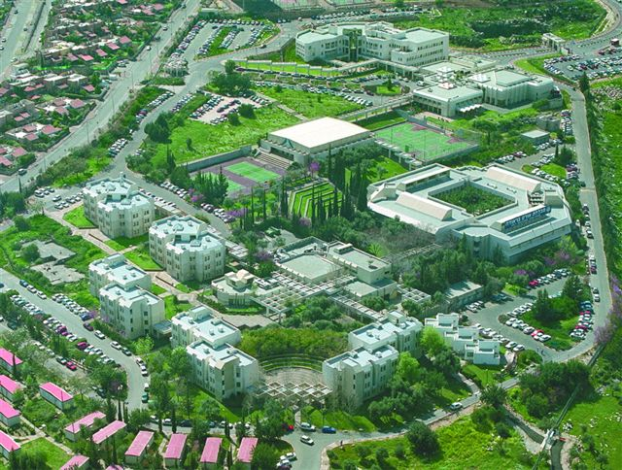
Processing new types of quality data: analysis of partitioning metric space data
Yariv N. Marmor
Emil Bashkansky
BRAUDE - College of Engineering,
Karmiel, ISRAEL
Valencia - ENBIS 2023 September, 13

Slide 2
Yariv N. Marmor, Emil Bashkansky " Processing new types of quality data" Quality and Reliability Engineering International , 36 (8), 2621-2638, 2020
 | 2.1 Nominal data | 2.2 Ordinal data | 2.3 Ranked/ prioritized data | 2.4 Strings | 2.5 Tree-structured data | 2.6 Product or process distribution
3.1 Similarity/dissimilarity and closeness/distance | 4.1 4.1.1 | 4.1 4.1.2 | 4.1 4.1.3 | 4.1 4.1.4 | 4.1 4.1.5 | 4.1 4.1.6
3.2 Metrological aspects | 4.2 4.2.1 | 4.2 4.2.2 | 4.2 4.2.3 | 4.2 4.2.4 | 4.2 4.2.5 | 4.2 4.2.6
3.3 Data aggregation or fusion and location measure | 4.3 4.3.1 | 4.3 4.3.2 | 4.3 4.3.3 | 4.3 4.3.4 | 4.3 4.3.5 | 4.3 4.3.6
3.4 Dispersion measure and variation analysis | 4.4 4.4.1 | 4.4 4.4.2 | 4.4 4.4.3 | 4.4 4.4.4 | 4.4 4.4.5 | 4.4 4.4.6
3.5 Data partitioning |  |  | * |  |  | *
3.6 Data clustering…

Slide 3
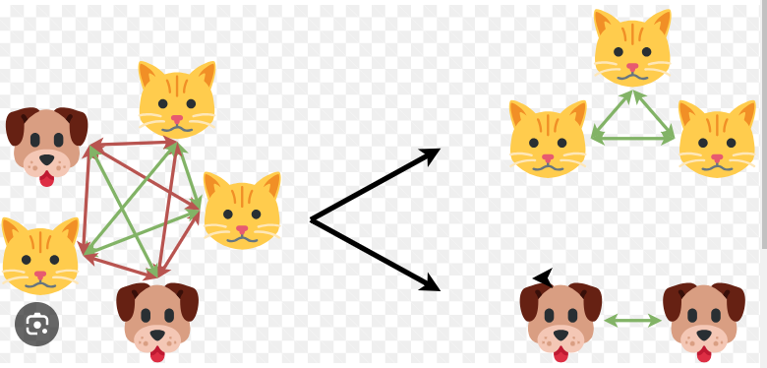
Data/objects partition

Slide 4
Examples of distance metrics

Slide 5
Data/objects partition: degrees of connection (dc) split

Slide 6
Data/objects partition: sum of distances (SD) split
A*
*C
B*
*D
Segment 1
Segment 2
Sum of Distances:
Intra
{
(SD)
=
d(
A,B)+
d(
C,D)
}
intra
Sum of Distances:
Inter
{(SD)
=
d(
A,C)+
d(
A,D)+
d(
B,C)+
d(
B,D)
}
inter
Sum of Distances: Total
{
(SD)
=
d(
A,B)+
d(
C,D)+
d(
A,C)+
d(
A,D)+
d(
B,C)+
d(
B,D)
}
total

Slide 7
Segregation power index - SP

Slide 8
Example 1: Distribution of quality costs proportions by the four main categories (Rosenfeld et.al, 2019)
 | Company 1 | Company 2 | Company 3 | Company 4 | Company 5 | Company 6 | Company 7 | Company 8
Prevention Costs | 0.19 | 0.05 | 0.07 | 0.19 | 0.11 | 0.31 | 0.19 | 0.23
Appraisal Costs | 0.22 | 0.15 | 0.13 | 0.35 | 0.47 | 0.12 | 0.32 | 0.23
Internal Failure Costs | 0.14 | 0.28 | 0.18 | 0.27 | 0.19 | 0.14 | 0.27 | 0.27
External Failure Costs | 0.45 | 0.52 | 0.62 | 0.19 | 0.23 | 0.43 | 0.22 | 0.27

Slide 9
Hellinger distances and SP calculation
4
 | Company 1 | Company 2 | Company 3 | Company 4 | Company 5 | Company 6 | Company 7 | Company 8
Company 1 | 0.000 | 0.198 | 0.169 | 0.214 | 0.222 | 0.122 | 0.189 | 0.152
Company 2 | 0.198 | 0.000 | 0.094 | 0.290 | 0.290 | 0.265 | 0.265 | 0.240
Company 3 | 0.169 | 0.094 | 0.000 | 0.328 | 0.320 | 0.230 | 0.302 | 0.266
Company 4 | 0.214 | 0.290 | 0.328 | 0.000 | 0.120 | 0.269 | 0.030 | 0.104
Company 5 | 0.222 | 0.290 | 0.320 | 0.120 | 0.000 | 0.317 | 0.127 | 0.191
Company 6 | 0.122 | 0.265 | 0.230 | 0.269 | 0.317 | 0.000 | 0.244 | 0.178
Company 7 | 0.189 | 0.265 | 0.302 | 0.030 | 0.127 | 0.244 | 0.000 | 0.077
Company 8 | 0.152 | 0.240 | 0.266 | 0.104 | 0.191 | 0.178 | 0.077 | 0.000
SD _{intra} = 1.727 | dc _{intra} = 12 | MD _{intra} = SD _{intra}/12 = 0.144
SD _{inter} = 4.082 | dc _{inter} = 16 | MD _{inter} = SD _{inter}/16 = 0.255
SD _{total} = 5.809 | dc _{total} = 28 | SP = 1.773

Slide 10
Examples of 2 preference chains consisting of 4 alternatives

Slide 11
Example 2: Preference/prioritization chains
 | A₁ | A₂ | A₃ | A₄ |  |  | A₁ | A₂ | A₃ | A₄
A₁ | 0 | 1 | -1 | -1 |  | A₁ | 0 | -1 | 1 | 1
A₂ | -1 | 0 | -1 | -1 |  | A₂ | 1 | 0 | 1 | 1
A₃ | 1 | 1 | 0 | 1 |  | A₃ | -1 | -1 | 0 | -1
A₄ | 1 | 1 | -1 | 0 |  | A₄ | -1 | -1 | 1 | 0
C₁
C₂
0) | -1 | 1 | 1 | 1 | 0 | 1 | 1 | -1 | -1 | 0 | -1 | -1 | -1 | 1 | (0
0) | 1 | -1 | -1 | -1 | 0 | -1 | -1 | 1 | 1 | 0 | 1 | 1 | 1 | -1 | (0

Slide 12
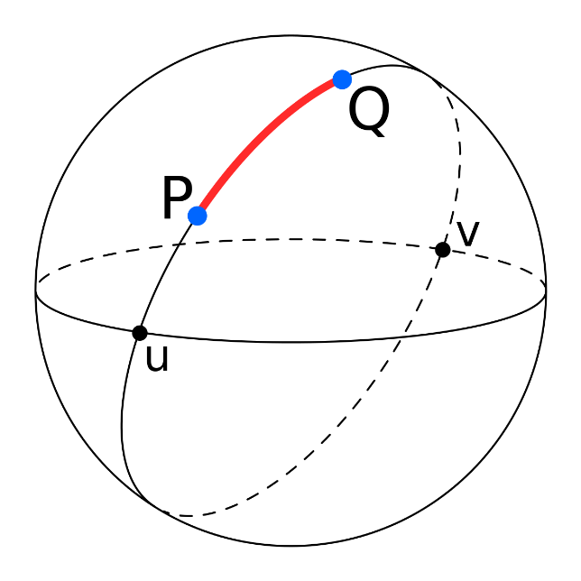
Distance metric
based on cosine similarity

Slide 13
Five experts/judges have prioritized alternatives with judges no. 2 and no. 3 being women, while judges no.1, no.4 and no.5 were men (Vanacore et.al, 2019)
 |  | Judge j
 |  | 1 | 2 | 3 | 4 | 5
Judge i | 1 | 0 | 0.59 | 0.73 | 0.33 | 0.38
 | 2 | 0.59 | 0 | 0.46 | 0.45 | 0.44
 | 3 | 0.73 | 0.46 | 0 | 0.65 | 0.61
 | 4 | 0.33 | 0.45 | 0.65 | 0 | 0.37
 | 5 | 0.38 | 0.44 | 0.61 | 0.37 | 0
2 .
. 1
. 4
3 .
. 5
MD _{intra} = [d_{2,3} + (d_{1,4} + d_{1,5} + d_{4,5})]/4 = 0.385
MD _{inter} = [(d_{2,1} + d_{2,4} + d_{2,5}) + (d_{3,1} + d_{3,4} + d_{3,5})]/6 = 0.578
SP = MD _{inter} / MD _{intra} = 1.502

Slide 14
SP distribution under given null/ homogeneity hypothesis H₀
Does not depend on the location parameter of the origin data distribution
Does not depend on the scale parameter of the origin data distribution
Almost independent on shape parameter, especially for SP >1
Depends only on the type of partition, i.e., vector (n₁, n₂,…, n_{k,}…, n_{m} )
(2,2)

Slide 15
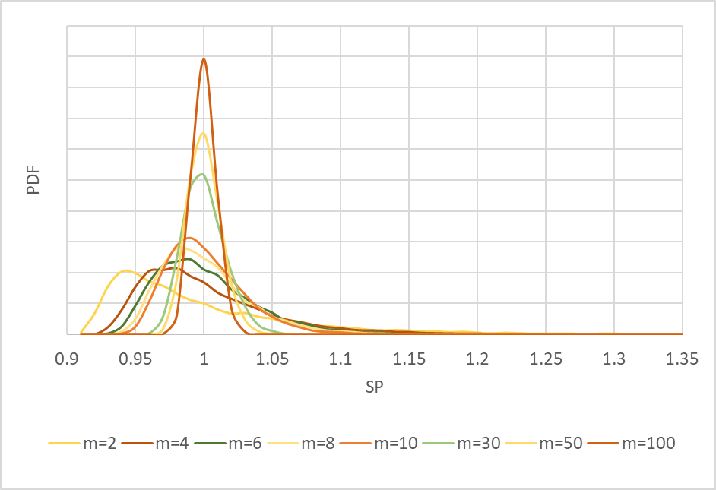
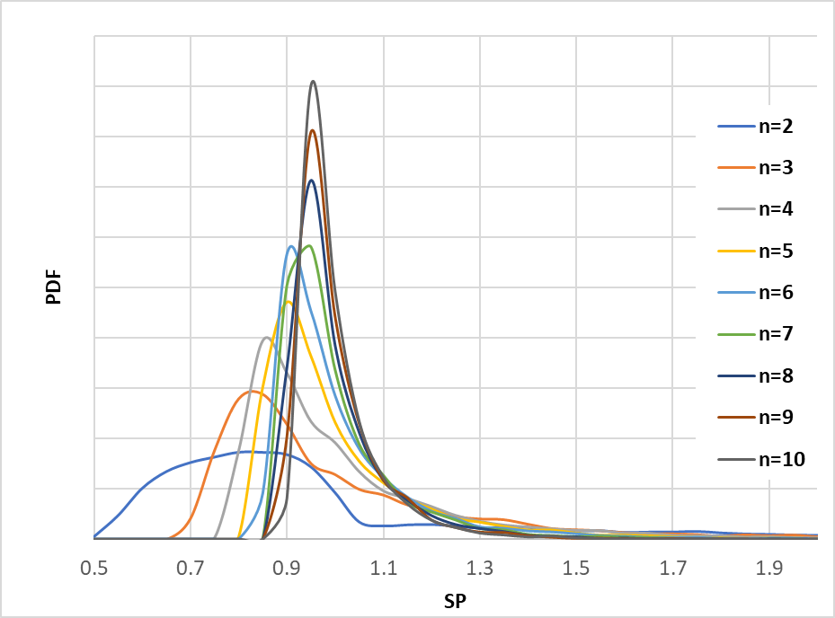
How amount of data influence SP distribution under H₀
(10,10,…10)
(n, n)
n = 10
m = 2

Slide 16
Five experts/judges have prioritized alternatives with judges no. 2 and no. 3 being women, while judges no.1, no.4 and no.5 were men (Vanacore et.al, 2019)
 |  | Judge j
 |  | 1 | 2 | 3 | 4 | 5
Judge i | 1 | 0 | 0.59 | 0.73 | 0.33 | 0.38
 | 2 | 0.59 | 0 | 0.46 | 0.45 | 0.44
 | 3 | 0.73 | 0.46 | 0 | 0.65 | 0.61
 | 4 | 0.33 | 0.45 | 0.65 | 0 | 0.37
 | 5 | 0.38 | 0.44 | 0.61 | 0.37 | 0
2 .
. 1
. 4
3 .
. 5
MD _{intra} = [d_{2,3} + (d_{1,4} + d_{1,5} + d_{4,5})]/4 = 0.385
MD _{inter} = [(d_{2,1} + d_{2,4} + d_{2,5}) + (d_{3,1} + d_{3,4} + d_{3,5})]/6 = 0.578
SP = MD _{inter} / MD _{intra} = 1.502

Slide 17
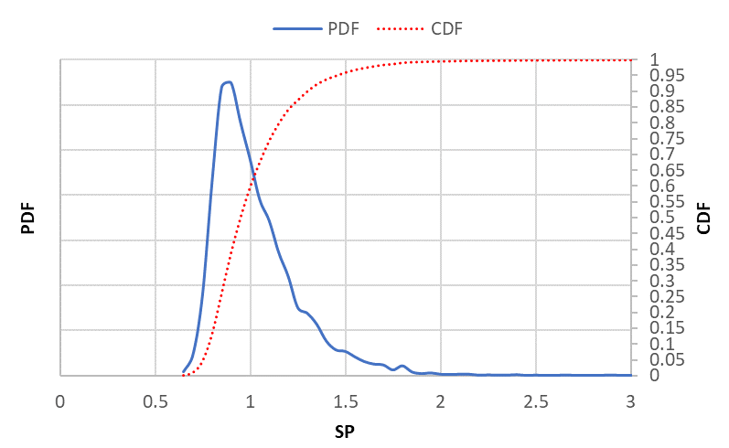
The null hypothesis:
“Gender equality and the absence of real preferences between alternatives”
SP_{0.95} = 1.476 and p – value for calculated SP =1.502 equals 4.39%

Slide 18
Modus operandi – 10 steps
Decide on the population of objects under study (OUS).
Make assumption about the type of the expected distribution of these objects within a homogeneous population.
Choose distance metric suitable to this distribution
Decide on the criterion that, in your opinion, can influence (heterogeneity hypothesis) and which levels serve as the basis for dividing/separating objects into groups (partition).
Provide corresponding data partitioning/division
Calculate SP
Simulate SP distribution under H₀ in accordance with partition vector (n₁, n₂,…, n_{k,}…, n_{m} ) and the chosen distance metric. Every cycle of simulation process includes:
Random generation of N data from a population of OUS (in accordance to step 1) characterized by the assumed distribution (in accordance to step 2).
Distance matrix calculation (according to step 3)
Partitioning these distances to inter and intra components in accordance to steps 4 and 5
SP calculation and back to a.
Determine the alpha risk - α of homogeneity hypothesis H₀ rejection.
Find (1-α) percentile of simulated SP distribution, or alternatively, p – value of calculated SP.
Make final conclusion about the expediency of the made partition and its discrimination/separation/segregation power by usual statistical methods according to previous step results.

Slide 19
Thank You for your attention!
E-mail: ebashkan@braude.ac.il

