Slide 2
dPCA: A Python Library for Dynamic Principal Component Analysis
pySPC: A python library for multivariate statistical process control and dynamic principal component analysis
Sebastian O. N. Topalian, Henrik H. Hansen, Davide Cacciarelli & Murat Kulahci

Slide 3
Agenda
Why Python?
A brief description of pySPC and dPCA
Example of conventional multivariate SPC (mSPC) by Henrik H. Hansen
Example of Variational and Orthogonal Autoencoders for mSPC by Davide Cacciarelli
Example of dynamic Principal Component Analysis
Outlook
Conclusions
Notes:
Ask them to raise their hands, how many use primarily R and how many use primarily Python, how many use primarily Outlook

Slide 4


Why Python? – Personal Reflections
Millenials + Gen Z
“I don’t want to play with you anymore”

Slide 5
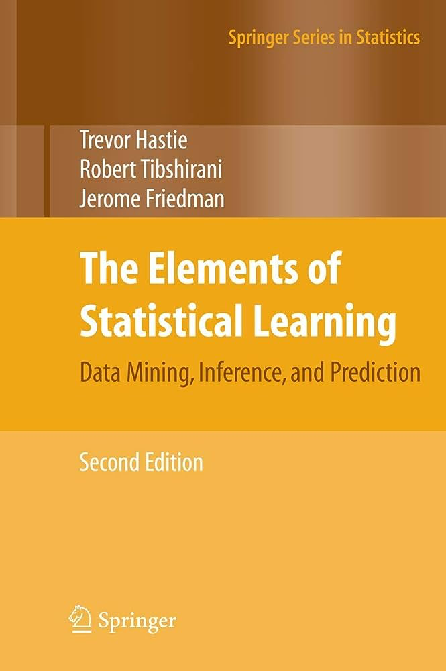


But both are Turing complete, so why Python?
Demand for general purpose
programming
Deep Learning
Image Analysis
Natural Language Processing
General Programming
Convenience
Structured Data
Statistics
Infrastructure
Remembering both syntaxes
or switching is tedious
Notes:
Bart De Ketelaere talk about intersection of AI and Statistics, also provides one of the reasons for this tug of war. Marketing
Emilio Cano “Both are more or less interchangeable within data science and visualisation tools”

Slide 6
pySPC + dynamicPCA
Multivariate SPC based on ”Statistical Quality Control” by Douglas C. Montgomery.
Multivariate SPC based on variational and orthogoal autoencoders (VAE / OAE).
Sparse dynamic principal component analysis based on Vanhatalo et. al.
pySPC – available at https://github.com/hviidhenrik/pySPC
dynamicPCA - pip install dynamicPCA or available at https://waterboy96.github.io/dPCA/
Notes:
We are working on making it pip installable

Slide 7

pySPC base SPC methods
Feedwater pump example
Henrik Hviid Hansen
Henrik Hviid Hansen

Slide 8
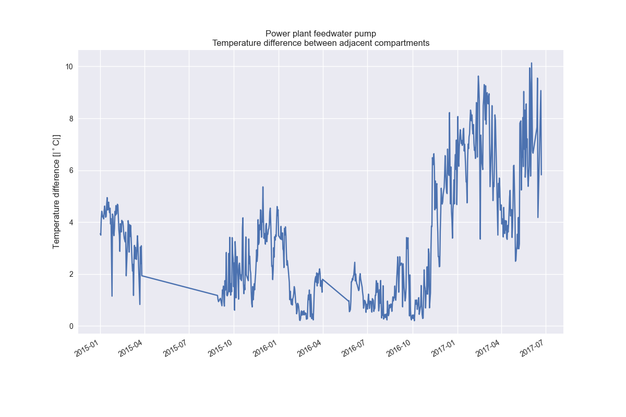
Feedwater pump data
Data originates from a feedwater pump at a Danish combined heat and power plant
The pump had a leak which can be detected by a high difference in water temperatures between two adjacent compartments
Suitable for SPC monitoring – the temperature difference seen below was discovered as a useful indicator of a leak by chance, and earlier approaches using multivariate SPC methods had been used up until that point. Therefore, we can use this to test out multivariate methods and confirm their findings using this temperature difference.

Slide 9
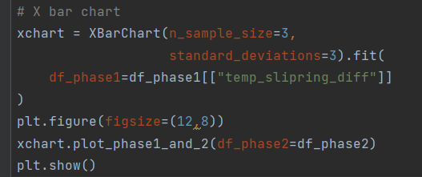
Feedwater pump data
Data originates from a feedwater pump at a Danish combined heat and power plant
The pump had a leak which can be detected by a high difference in water temperatures between two adjacent compartments
Suitable for SPC monitoring – the temperature difference seen below was discovered as a useful indicator of a leak by chance, and earlier approaches using multivariate SPC methods had been used up until that point. Therefore, we can use this to test out multivariate methods and confirm their findings using this temperature difference.

Slide 10
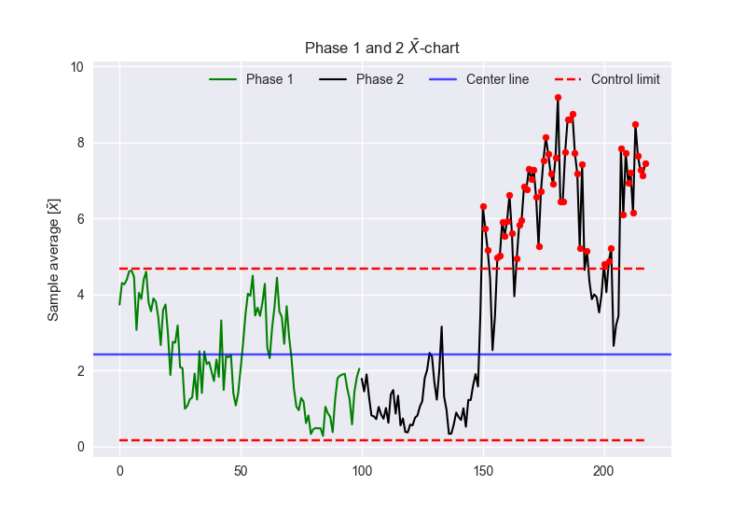
Feedwater pump data
Data originates from a feedwater pump at a Danish combined heat and power plant
The pump had a leak which can be detected by a high difference in water temperatures between two adjacent compartments
Suitable for SPC monitoring – the temperature difference seen below was discovered as a useful indicator of a leak by chance, and earlier approaches using multivariate SPC methods had been used up until that point. Therefore, we can use this to test out multivariate methods and confirm their findings using this temperature difference.

Slide 11
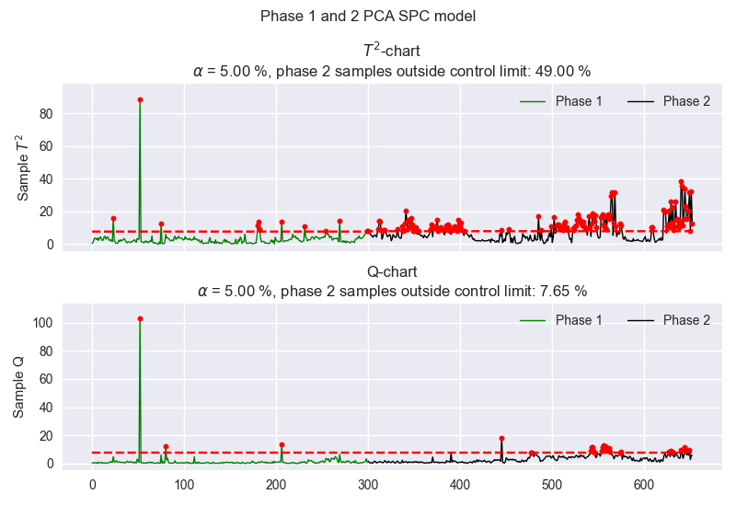
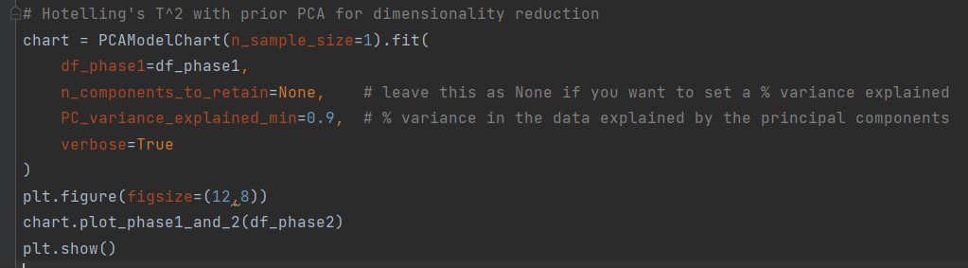
Multivariate PCA based method
We have here used Hotelling’s T^2 and Q (SPE) with a prior PCA to reduce dimensionality (24 variables)
T^2 warns of deviations from the multivariate mean, whereas Q indicates datapoints that defy the correlation structure of the phase 1 data
We here see that the T^2 value spikes during phase 2, in which we know there was a leak. This shows that the method is able to detect the leak.

Slide 12

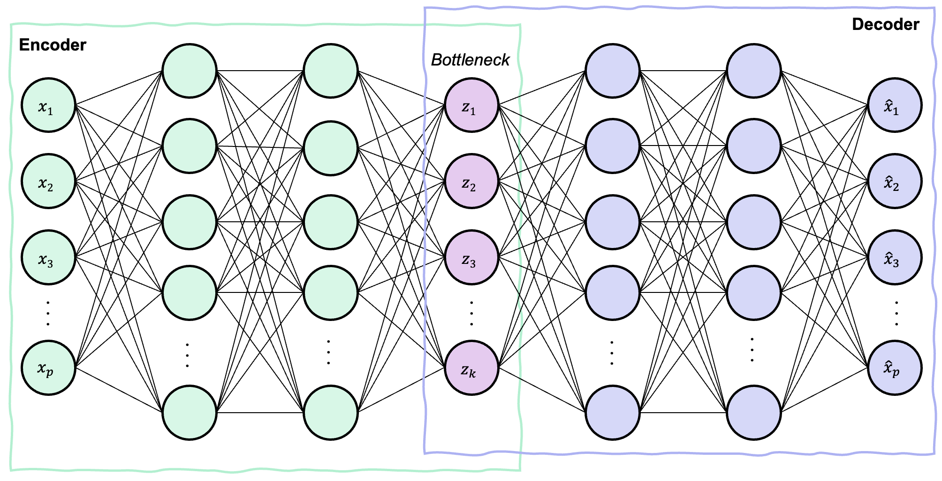
Autoencoders: Overview
An autoencoder (AE) is a neural network composed of two parts:
An encoder network that map the input data into a low-dimensional representation (bottleneck).
A decoder network that tries to reconstruct the input data.
In the current implementation, it is possible to use two types of AEs to perform fault detection and diagnosis:
Orthogonal AE (OAE): a regular AE that impose an orthogonal regularization to obtain uncorrelated features in the bottleneck.
Variational AE (VAE): aim to learn a probabilistic model of the data, modeling the distribution in the latent space with a mean and log-variance for each data point.

Slide 13
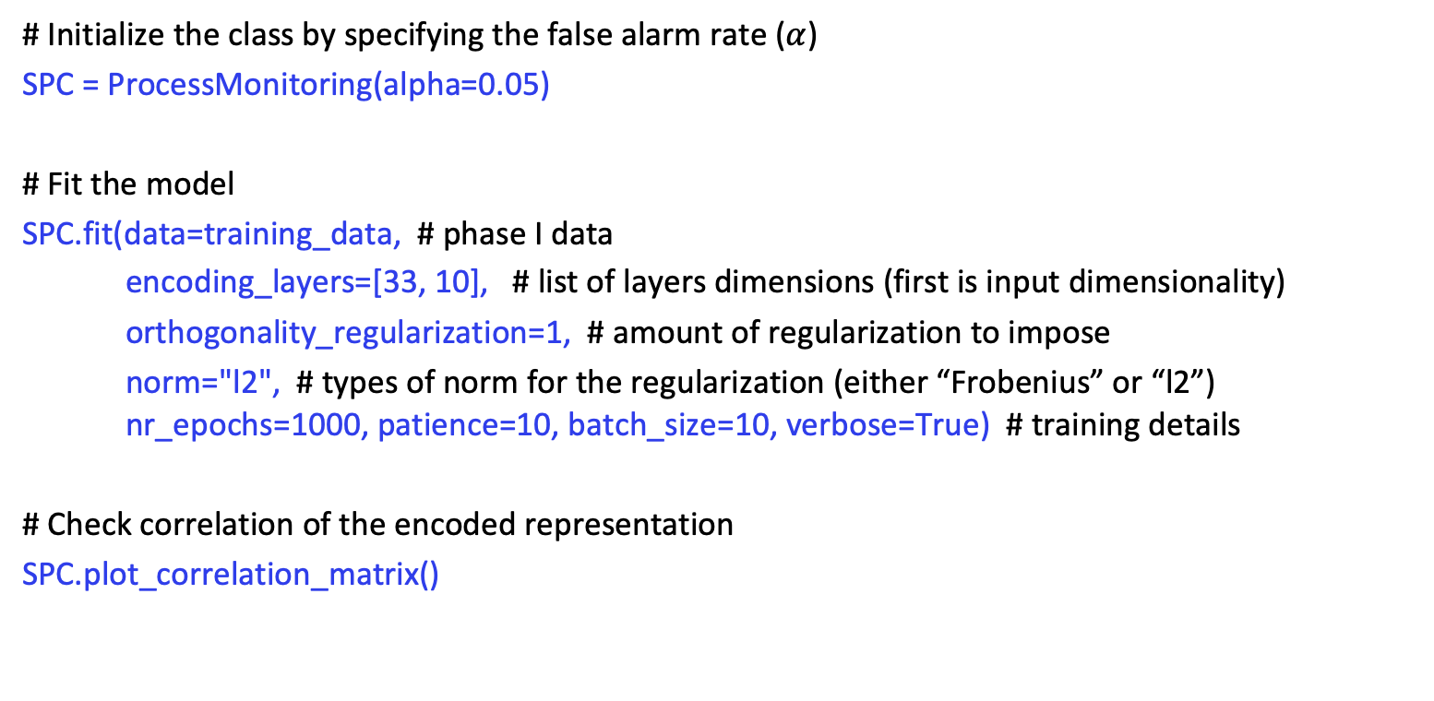
Phase I (training)
# Initialize the class by specifying the false alarm rate ($α$)
SPC = ProcessMonitoring(alpha=0.05)
# Fit the model
SPC.fit(data=training_data, # phase I data
encoding_layers=[33, 10], # list of layers dimensions (first is input dimensionality)
orthogonality_regularization=1, # amount of regularization to impose
norm="l2", # types of norm for the regularization (either “Frobenius” or “l2”)
nr_epochs=1000, patience=10, batch_size=10, verbose=True) # training details
# Check correlation of the encoded representation
SPC.plot_correlation_matrix()

Slide 14
Phase II (inference)
Detection
# Plot phase 2 control charts (you can also plot phase 1 by using SPC.plot_phase1(log_scale=True))
y_test_pred = SPC.plot_phase2(data=testing_data, log_scale=True)
Diagnosis
# Select an out-of-control observation
out_of_control_obs = testing_data.iloc[161, :]
# Diagnosis on the T2 chart using integrated gradients (integral can be approximated with trapezoidal rule or monte carlo)
SPC.t2_contribution_plots(ooc_observation=out_of_control_obs, method="monte_carlo", samples=1000)
# Diagnosis using the residuals
SPC.spe_contribution_plots(out_of_control_obs)

Slide 15
Plots obtained with the previous code

Slide 16
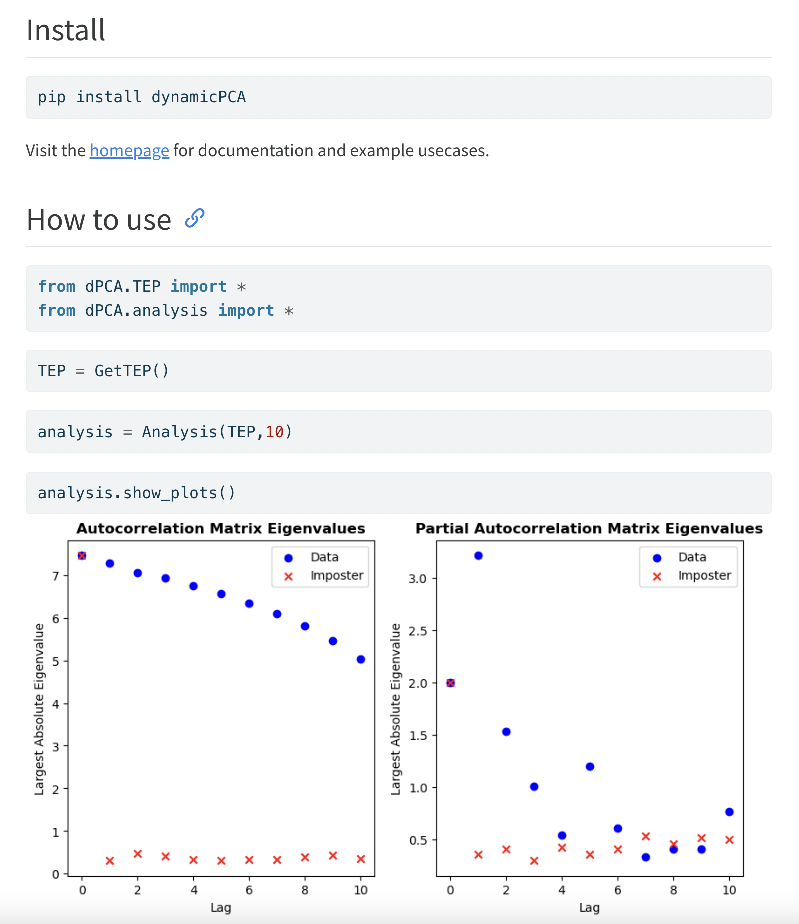
Based on:
E. Vanhatalo, M. Kulahci and B. Bergquist
For each lag:
Calculate Autocorrelation Matrix (ACM)
Calculate Partial ACM
Calculate eigenvectors & values
Look at the pattern over time
Skree plots
Investigate eigenvectors and coefficients
Notes:
Marco Cattaldo talk about finding delays for soft sensing

Slide 17
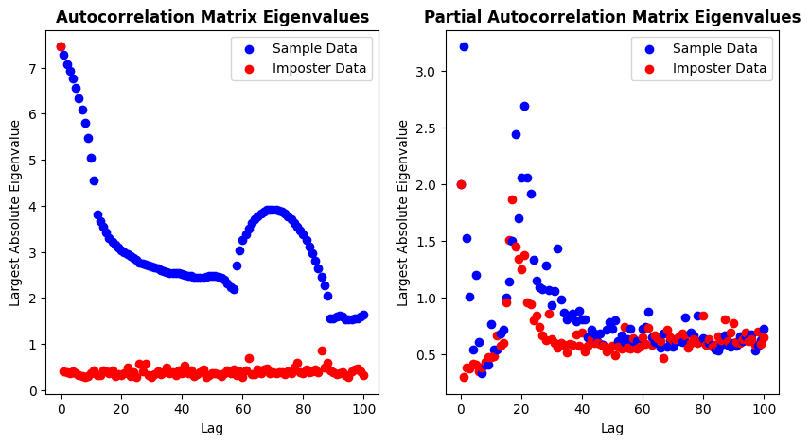

Slide 18
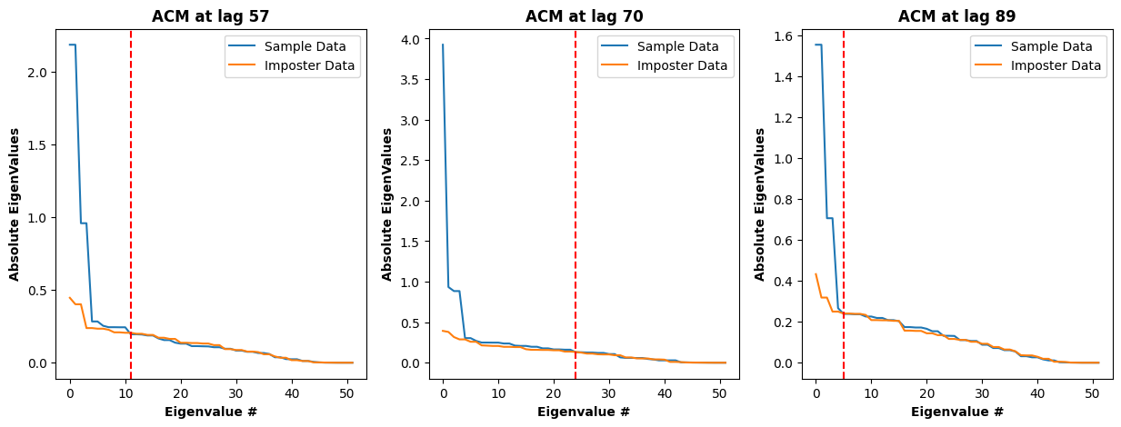
Skree Plots

Slide 19


Outlook
(JAX)
JAX provides just in time compilation (JIT) and can run on a GPU – A lot faster for large datasets
Module for interpretability for PCA
Better documentation
More examples and use cases
Passed along to the next generation (if they want it…)

Slide 20

Concluding Remarks
Thank you ENBIS
Reach me at sebtop@kt.dtu.dk
Henrik H. Hansen
Davide Cacciarelli
Murat Kulahci

