Slide 1
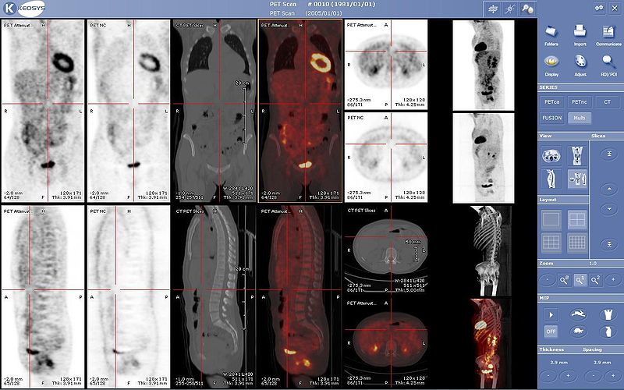
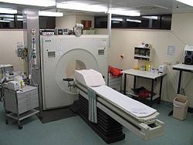
The Benefits of Classification: An Appointment Case Study
Yariv N. Marmor (PhD)
Boris Shnits (PhD)
Illana Bendavid (PhD)
BRAUDE - College of Engineering,
Karmiel, ISRAEL
Valencia - ENBIS 2023 September, 13
Positron Emission Tomography (PET)

Slide 2
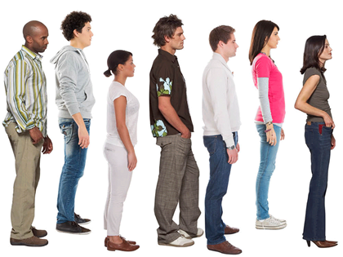
Motivation
Calls
Appointment Scheduling
A₁
A₂
A₃
A₄
A₅
A₆
A₇
Actual Performance
Lateness
Idleness
t₁
t₂
t₃
t₄
t₅
t₆
A₁/S₁
A₂
S₂
A₃
S₃
A₄
S₄
A₅
S₅
A₆/S₆
A₇/S₇

Slide 3
Motivation
Assumption:
Reduce treatment time variance will lead to better (expected) appointments (Kuiper et al., 2019).
Data mining (regression) will lead to variance reduction (better prediction) (Golmohammadi et al., 2023).
Better appointment will lead to better operational performance. (Christopher et al., 2022)
Appointment needs to be simple and easy to use (Savelsbergh & Smilowitz, 2016).
The more complex classification the more complex to operate in practice.

Slide 4
Methodology steps
Classify patients by their service duration in a nested / hierarchal way:
“Best” classifier (using CART) – F options.
Folding tree in steps to get “Less Good” classifiers.
End with F classifications for each patient service duration.
Use appointment algorithm (AA)
Start with the "best" classifier (of the previous step)
Repeat AA for different "days sequence" (random patients) until the operational outcomes meet an accuracy criterion (e.g., HW/μ<0.005).
Repeat last point with the next "best" (not used) classifier
Repeat last point until the operational outcomes change (for the worse) statistically from the "best" classification.
We identify the best practical classification as the one we used last (in the previous step) before we got statistically changes in performance.

Slide 5
Key Performance Indicator (KPI)
EoD – End of Day
The expected time the last customer/patient finishes service/treatment.
Utilization
The ratio between the sum of services duration done during regular shift hours and the shift length multiplied by number of servers.
OT – Over Time
The sum of services duration done after regular shift hours
IT – Idle Time
The sum of idle times between services
OL – Offered Load
The sum of expected service duration

Slide 6
Case Study - Data
Data – Mayo Clinic (October 2021):
1,168 PET Scans; ~60 per day
Patient age (avg=65.7; sd=13.5)
Patient gender (36.6% females; 63.4% males)
Patient weight (avg=84.4kg; sd=20.9)
Patient height (avg=1.72m; sd=0.099
Scanner type (2 fast scanners which handle 54% of scans; 2 slow which handle 46% of scans)
Patient scan description (area to scan)
Scan duration
Remark:
Since we have two type of scanners (faster and slower), we normalized the duration, so it fits the slower scanner times.
Appointment scheduling is based on QoS (Quality of Service), meaning the (expected) probability of appointment to start on time.

Slide 7
Case Study - CART
5-Cross Validation
20% for test

Slide 8
Case Study – Patient Classification by CART “Size”
l | Number of Classifications (in color- patient classification number) |  |  |  |  |  |  |  |  |  |  |  |  |  |  | t_{l}
 | 15 | 14 | 13 | 12 | 11 | 10 | 09 | 08 | 07 | 06 | 05 | 04 | 03 | 02 | 01
1 | 1 | 1 | 1 | 1 | 1 | 1 | 1 | 1 | 1 | 1 | 1 | 1 | 1 | 1 | 1 | 17.9
81 | 1 | 1 | 1 | 1 | 1 | 1 | 1 | 1 | 1 | 1 | 1 | 1 | 1 | 1 | 1 | 28.5
82 | 2 | 2 | 2 | 2 | 2 | 2 | 2 | 2 | 2 | 2 | 2 | 2 | 2 | 2 | 1 | 24.3
186 | 2 | 2 | 2 | 2 | 2 | 2 | 2 | 2 | 2 | 2 | 2 | 2 | 2 | 2 | 1 | 41.9
187 | 3 | 3 | 3 | 3 | 3 | 3 | 2 | 2 | 2 | 2 | 2 | 2 | 2 | 2 | 1 | 26.5
309 | 3 | 3 | 3 | 3 | 3 | 3 | 2 | 2 | 2 | 2 | 2 | 2 | 2 | 2 | 1 | 44.4
310 | 4 | 4 | 4 | 4 | 4 | 4 | 3 | 2 | 2 | 2 | 2 | 2 | 2 | 2 | 1 | 29.6
342 | 4 | 4 | 4 | 4 | 4 | 4 | 3 | 2 | 2 | 2 | 2 | 2 | 2 | 2 | 1 | 47.1
343 | 5 | 4 | 4 | 4 | 4 | 4 | 3 | 2 | 2 | 2 | 2 | 2 | 2 | 2 | 1 | 33.0
359 | 5 | 4 | 4 | 4 | 4 | 4 | 3 | 2 | 2 | 2 | 2 | 2 | 2 | 2 | 1 | 57.2
360 | 6 | 5 | 5 | 5 | 5 | 5 | 4 | 3 | 3 | 3 | 3 | 3 | 3 | 2 | 1 | 29.5
477 | 6 | 5 | 5 | 5 | 5 | 5 | 4 | 3 | 3 | 3 | 3 | 3 | 3 | 2 | 1 | 42.8
478 | 7 | 6 | 6 | 6 | 6 | 6 | 5 | 4 | 4 | 4 | 3 | 3 | 3 | 2 | 1 | 26.9
687 | 7 | 6 | 6 | 6 | 6 | 6 | 5 | 4 | 4 | 4 | 3 | 3 | 3 | 2 | 1 | 43.8
688 | 8 | 7 | 7 | 6 | 6 | 6 | 5 | 4 | 4 | 4 | 3 | 3 | 3 | 2 | 1 | 31.1
889 | 8 | 7 | 7 | 6 | 6 | 6 | 5 | 4 | 4 | 4 | 3 | 3 | 3 | 2 | 1 | 49.5
890 | 9 | 8 | 8 | 7 | 7 | 7 | 6 | 5 | 5 | 5 | 4 | 3 | 3 | 2 | 1 | 23.2
900 | 9 | 8 | 8 | 7 | 7 | 7 | 6 | 5 | 5 | 5 | 4 | 3 | 3 | 2 | 1 | 42.3
901 | 10 | 9 | 8 | 7 | 7 | 7 | 6 | 5 | 5 | 5 | 4 | 3 | 3 | 2 | 1 | 37.5
976 | 10 | 9 | 8 | 7 | 7 | 7 | 6 | 5 | 5 | 5 | 4 | 3 | 3 | 2 | 1 | 55.8
977 | 11 | 10 | 9 | 8 | 8 | 8 | 7 | 6 | 5 | 5 | 4 | 3 | 3 | 2 | 1 | 41.7
1028 | 11 | 10 | 9 | 8 | 8 | 8 | 7 | 6 | 5 | 5 | 4 | 3 | 3 | 2 | 1 | 53.2
1029 | 12 | 11 | 10 | 9 | 9 | 9 | 8 | 7 | 6 | 6 | 5 | 4 | 3 | 2 | 1 | 35.7
1137 | 12 | 11 | 10 | 9 | 9 | 9 | 8 | 7 | 6 | 6 | 5 | 4 | 3 | 2 | 1 | 51.6
1138 | 13 | 12 | 11 | 10 | 10 | 10 | 9 | 8 | 7 | 6 | 5 | 4 | 3 | 2 | 1 | 45.1
1155 | 13 | 12 | 11 | 10 | 10 | 10 | 9 | 8 | 7 | 6 | 5 | 4 | 3 | 2 | 1 | 52.6
1156 | 14 | 13 | 12 | 11 | 11 | 10 | 9 | 8 | 7 | 6 | 5 | 4 | 3 | 2 | 1 | 48.6
1163 | 14 | 13 | 12 | 11 | 11 | 10 | 9 | 8 | 7 | 6 | 5 | 4 | 3 | 2 | 1 | 57.0
1164 | 15 | 14 | 13 | 12 | 11 | 10 | 9 | 8 | 7 | 6 | 5 | 4 | 3 | 2 | 1 | 56.8
1168 | 15 | 14 | 13 | 12 | 11 | 10 | 9 | 8 | 7 | 6 | 5 | 4 | 3 | 2 | 1 | 59.4

Slide 9
PMSN (Paced Multi Server Numerical-based) Algorithm
Calls
Identify Patient Type
Type 2
Type 3
Type 4
Type 1
Type 3
Type 4
Type 5

Slide 10
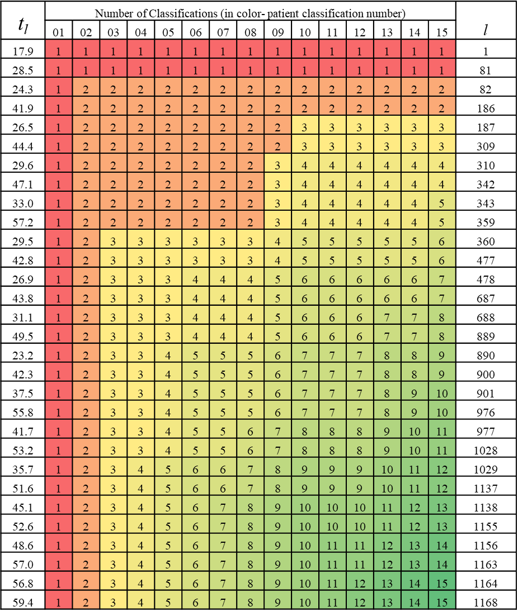
PMSN (Paced Multi Server Numerical-based) Algorithm
Calls
Identify Patient Type
Type 2
Type 3
Type 4
Type 2
Type 3
Type 4
Type 2
47.1
26.5
57.2
24.3
44.4
Randomly get realization
(assume 5 classes classifier)

Slide 11
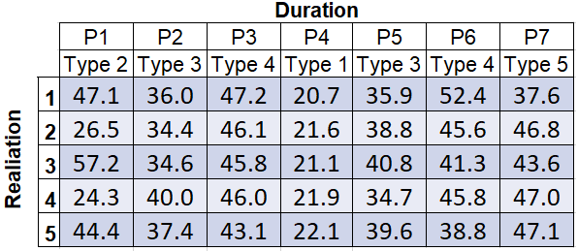
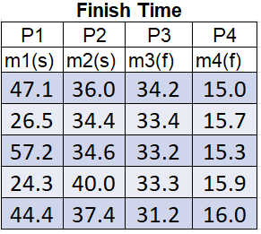
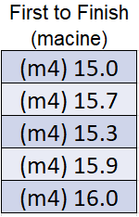
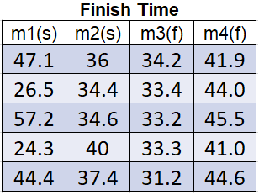
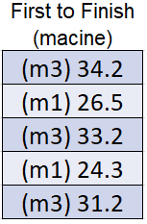
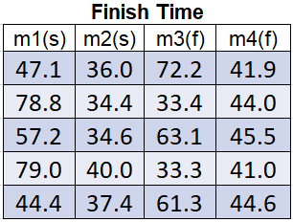
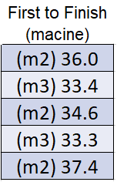
PMSN (Paced Multi Server Numerical-based) Algorithm
Considering fast pace (1.38)
=> A5=15.9 (80%)
15.9+35.9/1.38=41.9
=> A6=33.2
=> A1=A2=A3=A4=0; A5=15.9; A6=33.2; A7=36

Slide 12
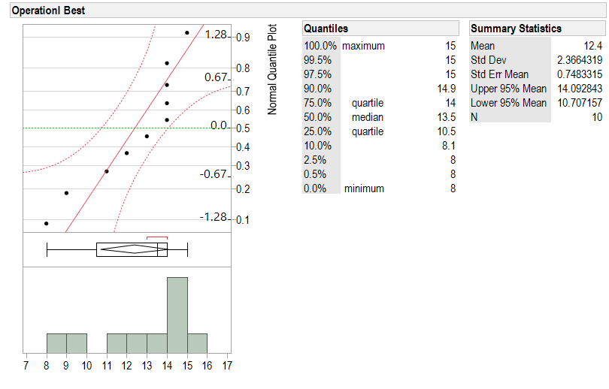
Case Study – Results (Operational Best)
Avg=12.4
Median = 13.5
Range 8-15
Line with markings– the expected EoD; Clear line – threshold to stop. QoS=0.7
12

Slide 13
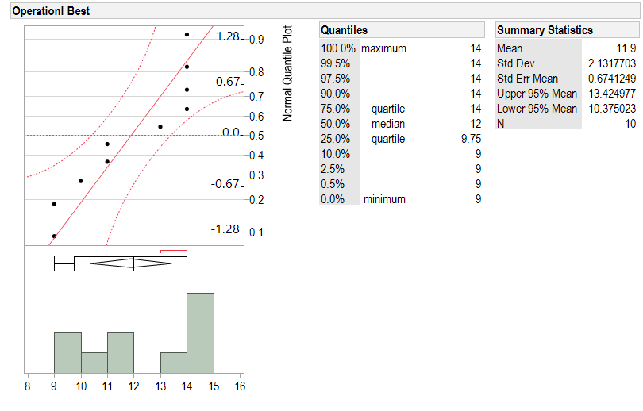
Case Study – Results (Operational Best)
Avg=11.9
Median = 12
Range 9-14
Line with markings– the expected EoD; Clear line – threshold to stop. QoS=0.8
13

Slide 14
Case Study – Results (EoD) for QoS=0.95
With the effect of Offered Load
Findings:
EoD increases with the distance to the best classifier.
The EoD is less robust with Offered Load when closer to best classifier.
14

Slide 15
Case Study – Results (Utilization) for QoS=0.95
With the effect of Offered Load
Findings:
Utilization decreases with the distance to the best classifier.
The Utilization is more robust with Offered Load when closer to best classifier.
15

Slide 16
Conclusion and Future Research
We introduce an algorithm for finding the best practical classifier that is easier to implement.
Looking for the best classifier does not always translate into the best performance in practice.
The complexity is needed in lower QoS and less needed in a high QoS system.
For some KPIs, the best practice classifier is robust (i.e., Utilization), but sometimes it is the least robust option (i.e., EoD).
Future research questions:
Can we get the same results with repeated CART algorithm?
Is there a connection between R-Square and the effect on our algorithm (big changes result in big effect)?
16

Slide 17
Questions / remarks?
E-mail: myariv@braude.ac.il
17

