Slide 1
Repeatability and Reproducibility of Categorical Measurements (Classification)
Yariv N. Marmor
Emil Bashkansky
Tamar Gadrich
BRAUDE College of Engineering, Karmiel
Leuven - ENBIS 2024
16/09/2024, 13:50

Slide 2
The Purpose of the Presentation
To propose the model of estimating different components of classification precision, when it is provided by defined number of collaborators (classifiers) according to fixed and random model of their selection.

Slide 3
Definition of “categorical” measurement
“Classification of the analyzed property value of the objects under study (OUS) into one of K exclusive categories forming a comprehensive spectrum (scale) of the studied property will be considered as categorical measurement.” (*)
Note 1: The results of classification are presented by so-called categorical data. In cases where the spectrum of possible values consists only of two categories such data are binary, and the appropriate activity is also often called testing.
Note 2: In this presentation categories are not ordered (nominal scale)
* T. Gadrich, E. Bashkansky, (2016) " A Bayesian approach to evaluating uncertainty of inaccurate categorical measurements", Measurement 91, 186–193.

Slide 4
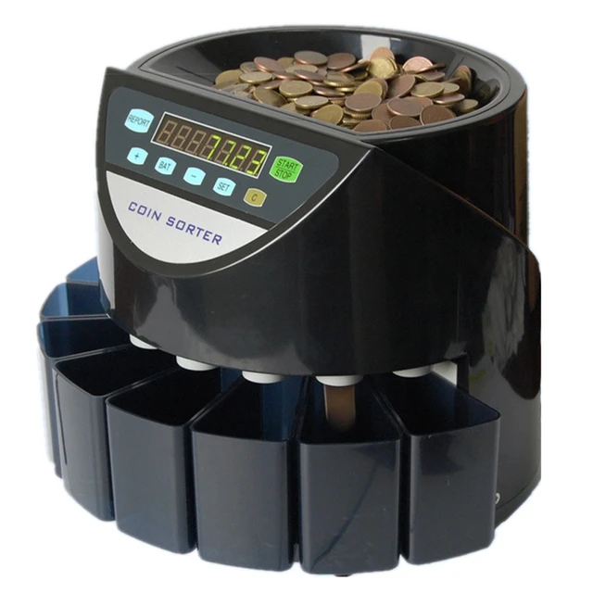
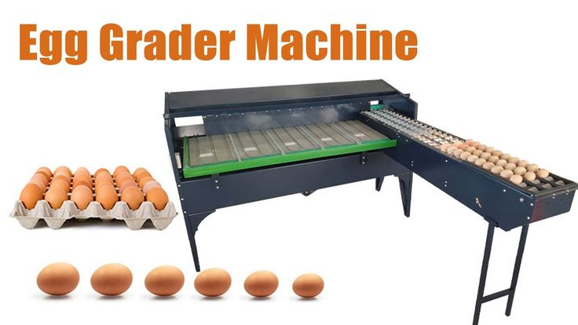
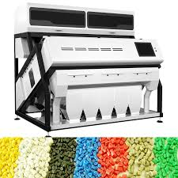
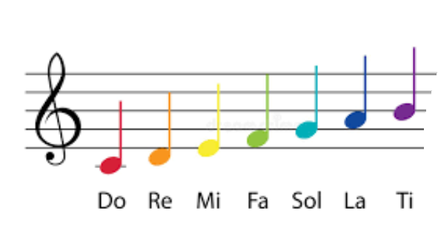
Examples of Classifiers ( K > 2 )
Coins sorting machine
Egg classification machine
Plastic color sorting
machine
Google language detector
Musical tone recognition

Slide 5
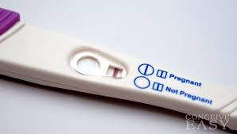
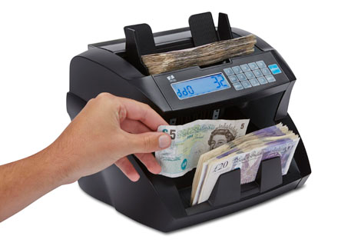
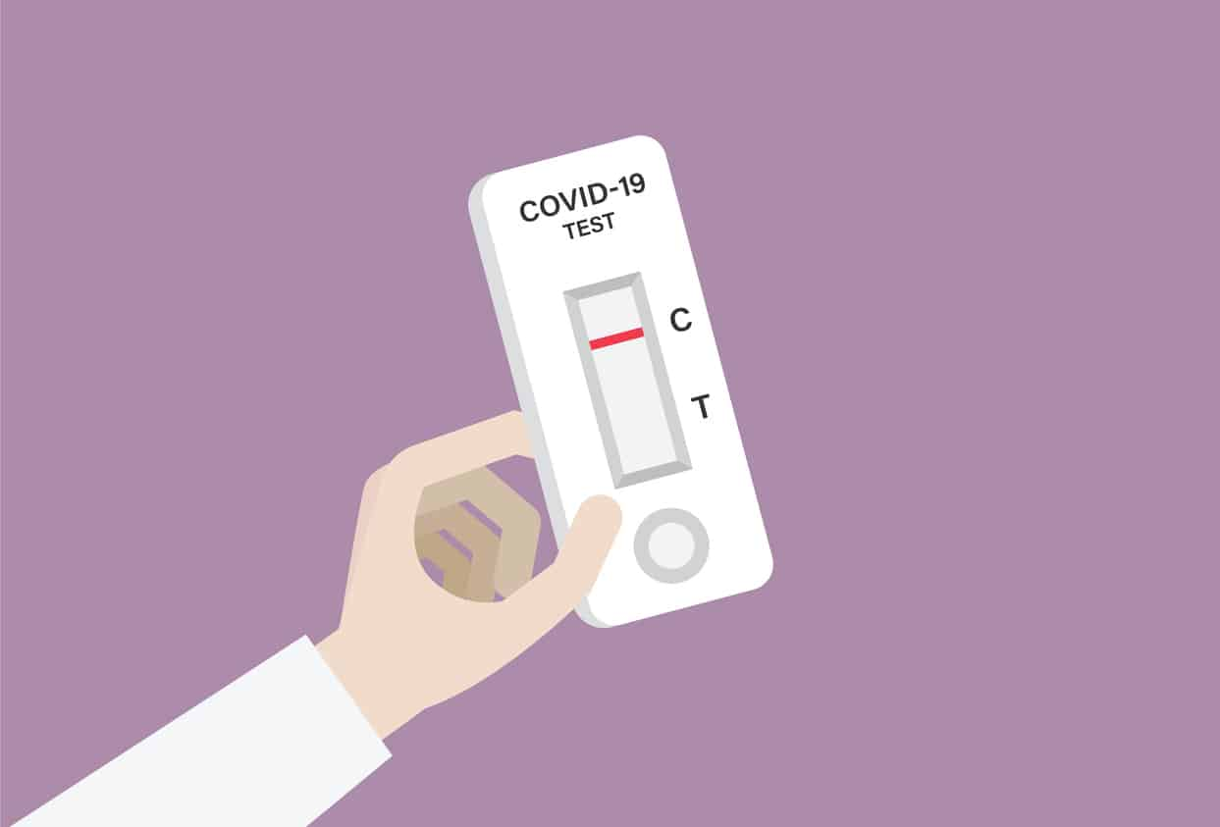
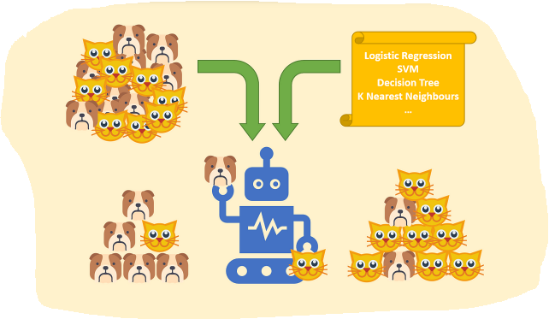
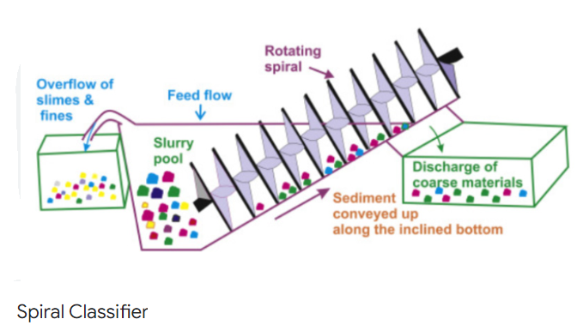
Examples of Binary Classifiers (K = 2 )
Counting machine:
bank notes are classified as forged or accepted
Pregnancy tester
Spam
filtering
Covid - 19 tester
Classification algorithm
Spiral classifier

Slide 6
Ability of Classifier (General Case)
The conditional probabilities that an object will be classified as category k, given that its actual/true category is i - $P_{k\left|i\right.}$
$1≤i,k≤K$; $\sum_{k=1}^{K}{P_{k\left|i\right.}}=1$
Ideal classifier: $every P_{k\left|i\right.}=0, except of P_{i\left|i\right.}$
6

Slide 7
Classification (Confusion) Matrix and Repeatability for the General Case of K Categories
$P=\left(\begin{matrix}p_{1|1} & p_{2|1} & ⋯ & p_{k|1} & ⋯ & p_{K|1} \\ p_{1|2} & p_{2|2} & ⋯ & p_{k|2} & ⋯ & p_{K|2} \\ ⋯ & ⋯ & ⋯ & ⋯ & ⋯ & ⋯ \\ p_{1|i} & p_{2|i} & ⋯ & p_{k|i} & ⋯ & p_{K|i} \\ ⋯ & ⋯ & ⋯ & ⋯ & ⋯ & ⋯ \\ p_{1|K} & p_{2|K} & ⋯ & p_{k|K} & ⋯ & p_{K|K}\end{matrix}\right)$
$I=\left(\begin{matrix}1 & 0 & ⋯ & 0 & ⋯ & 0 \\ 0 & 1 & ⋯ & 0 & ⋯ & 0 \\ ⋯ & ⋯ & ⋯ & ⋯ & ⋯ & ⋯ \\ 0 & 0 & ⋯ & 1 & ⋯ & 0 \\ ⋯ & ⋯ & ⋯ & ⋯ & ⋯ & ⋯ \\ 0 & 0 & ⋯ & 0 & ⋯ & 1\end{matrix}\right)$
$Repeatability=\left[\begin{matrix}{Repeatability}_{1} \\ {Repeatability}_{2} \\ ⋯ \\ {Repeatability}_{i} \\ ⋯ \\ {Repeatability}_{K}\end{matrix}\right]$ - (for the same classifier)
${Repeatability}_{i}=\frac{K}{K−1}\sum_{k=1}^{K}{\left[p_{k|i}∙\left(1−p_{k|i}\right)\right]}$ = $\frac{K}{K−1}(1−\sum_{k=1}^{K}{\left[p_{k|i}\right]^2)}$ = $VAR_{within}$
$$0≤VAR_{within}≤1$$

Slide 8
The Closeness of Agreement between classifications obtained by different Classifiers participating in collaborative study (from here on - Classifiers effect )
$Classifiers effect=\left[\begin{matrix}{Classifier effect}_{1} \\ {Classifier effect}_{2} \\ ⋯ \\ {Classifier effect}_{i} \\ ⋯ \\ {Classifier effect}_{K}\end{matrix}\right]$
Where:
${Classifiers effect}_{i}=\frac{K}{K−1}\sum_{k=1}^{K}{VAR\left(p_{k|i}\right)}$
$VAR \left(p_{k|i}\right)$ = classic variation of $p_{k|i}$ between collaborators/classifiers
According to ISO 5725:2023 “Accuracy (trueness and precision of measurement methods and results)” (differ from that in the Gauge R&R studies): Reproducibility = Repeatability + $Classifier$ effect
Reproducibility describes the total precision of classification procedure (i.e., categorical measurements)

Slide 9
H0 - Homogeneity Hypothesis: Acceptance and Rejecting ( for the fixed group of classifiers)
H0 : all classifiers’ counts are drawn from the same population characterized by vector (p1, p2,…, pk ,…pK).
If SP (segregation/separation power) statistics is less than some critical value,
H₀ is not rejected. Otherwise, see (*) for unbiased estimators of variation components, i.e.: repeatability, classifier’s effect and total precision.
*T. Gadrich, E. Bashkansky, I. Kuselman (2013) “Comparison of biased and unbiased estimators of variances of qualitative and semi-quantitative results of testing”, Accreditation and Quality Assurance, 18 (2), 85-90
*T. Gadrich, E. Bashkansky, R. Zitikis, (2015) “Assessing variation: a unifying approach for all scales of measurement”, Quality and Quantity, 49 (3) , 1145-1167

Slide 10
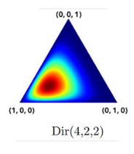
Random Dirichlet - Multinomial (DM) Model - 1
L classifiers are randomly sampled from the population which classification abilities related to category i are distributed according to the Dirichlet distribution:
$f\left(p_{1|i},p_{2|i},⋯,p_{K|i}\right)=\frac{1}{B\left(α\right)}\prod_{k=1}^{K}{{p_{k|i}}^{α_{k|i}−1}}$ ( $\sum_{k=1}^{K}{p_{k|i}}$ $=$1 )
where: $α_{i}=\left(α_{1|i},α_{2|i},⋯,α_{K|i}\right)$ - parameters of the Dirichlet distribution characterizing the i-th category classification;
E ($p_{k|i}$) = $α_{k|i}$/ $α_{0|i}$ ;
$α_{0|i}=\sum_{k=1}^{K}{α_{k|i}}$ - concentration parameter (*)
* Location is determined by repeatability, and dispersion ($α_{0|i}$) is determined by degree of variation between classifiers.

Slide 11
Repeatability (within) and Classifiers (between-$classifier$s) effect
${Repeatability}_{i}=\frac{K}{K−1}\sum_{k=1}^{K}{E\left[p_{k|i}∙\left(1−p_{k|i}\right)\right]= }\frac{K}{K−1}\frac{α_{0|i}}{α_{0|i}+1}\left[1−\sum_{k=1}^{K}{\frac{α_{k|i}^{2}}{α_{0|i}^{2}}}\right]$
${Classifier effect}_{i}=\frac{K}{K−1}\sum_{k=1}^{K}{VAR\left(p_{k|i}\right)}=\frac{K}{K−1}\frac{1}{α_{0|i}+1}\left[1−\sum_{k=1}^{K}{\frac{α_{k|i}^{2}}{α_{0|i}^{2}}}\right]=\frac{Repeatability }{α_{0|i}}$
${Reproducibility}_{i}=\frac{K}{K−1}\left[1−\sum_{k=1}^{K}{\frac{α_{k|i}^{2}}{α_{0|i}^{2}}}\right]$
$$α_{0|i}\overset{→}{}0$$ | $$α_{0|i}\overset{→}{}∞$$
Repeatability = 0 | $Classifiers$ effect =0
$${Classifiers effect}_{i}=\frac{K}{K−1}\left[1−\sum_{k=1}^{K}{\frac{α_{k|i}^{2}}{α_{0|i}^{2}}}\right]$$ | $${Repeatability}_{i}=\frac{K}{K−1}\left[1−\sum_{k=1}^{K}{\frac{α_{k|i}^{2}}{α_{0|i}^{2}}}\right]$$
11

Slide 12
Random Dirichlet - Multinomial (DM) Model - 2
From an experiment consisting of N repeated classifications of each property that actually belongs to the category i
$\left(n_{1|i}^{\left(l\right)},n_{2|i}^{\left(l\right)},…,n_{K|i}^{\left(l\right)} | p=\left(p_{1|i},p_{2|i},,…,p_{K|i}\right)\right)$ $\sim Multinomial(N,p=\left(p_{1|i},p_{2|i},,…,p_{K|i}\right))$
where $p=\left(p_{1|i},p_{2|i},,…,p_{K|i}\right)\sim Dirichlet(α_{i})$
Estimator of classification matrix of the l-th classifier $\left(l=1,2,…,L\right).$
${\hat{P}}^{\left(l\right)}=\left(\begin{matrix}{\hat{p}}_{1|1}^{(l)} & {\hat{p}}_{2|1}^{(l)} & ⋯ & {\hat{p}}_{k|1}^{(l)} & ⋯ & {\hat{p}}_{K|1}^{(l)} \\ {\hat{p}}_{1|2}^{(l)} & {\hat{p}}_{2|2}^{(l)} & ⋯ & {\hat{p}}_{k|2}^{(l)} & ⋯ & {\hat{p}}_{K|2}^{(l)} \\ ⋯ & ⋯ & ⋯ & ⋯ & ⋯ & ⋯ \\ {\hat{p}}_{1|i}^{(l)} & {\hat{p}}_{2|i}^{(l)} & ⋯ & {\hat{p}}_{k|i}^{(l)} & ⋯ & {\hat{p}}_{K|i}^{(l)} \\ ⋯ & ⋯ & ⋯ & ⋯ & ⋯ & ⋯ \\ {\hat{p}}_{1|K}^{(l)} & {\hat{p}}_{2|K}^{(l)} & ⋯ & {\hat{p}}_{k|K}^{(l)} & ⋯ & {\hat{p}}_{K|K}^{(l)}\end{matrix}\right)$ where ${\hat{p}}_{k|i}^{(l)}=\frac{n_{k|i}^{(l)}}{N}$

Slide 13
Unbiased Estimators
Unbiased estimator for repeatability (within) variation:
${\hat{Repeatability}}_{u\left(i\right)}=\frac{N}{N−1}\frac{1}{L}\sum_{l=1}^{L}{{\hat{Repeatability}}_{i}}=$ =$\frac{N}{N−1}\frac{1}{L}\sum_{l=1}^{L}{\frac{K}{(K−1)}\sum_{k=1}^{K}{{\hat{p}}_{k|i}^{(l)}∙\left(1−{\hat{p}}_{k|i}^{(l)}\right)}}$
Unbiased estimator for between classifiers variation:
$\hat{{Classifier effect}_{u(i)}}=\frac{K}{K−1}\sum_{k=1}^{K}{\frac{1}{L−1}\sum_{l=1}^{L}{{\left({\hat{p}}_{k|i}^{(l)}−\frac{1}{L}\sum_{l=1}^{L}{{\hat{p}}_{k|i}^{(l)}}\right)}^{2}}}$
$−\frac{{\hat{Repeatability}}_{u(i)}}{N}$
Unbiased estimator for total classification variation:
$\hat{{VAR}_{TOTAL}}= \frac{K}{K−1} \sum_{k=1}^{K}{\frac{1}{L−1}\sum_{l=1}^{L}{{\left({\hat{p}}_{k\left|i\right.}^{\left(l\right)}−\frac{1}{L}\sum_{l=1}^{L}{{\hat{p}}_{k\left|i\right.}^{\left(l\right)}}\right)}^{2}}}+$
+ $\frac{1}{L}\sum_{l=1}^{L}{\frac{K}{K−1}\sum_{k=1}^{K}{{\hat{p}}_{k\left|i\right.}^{\left(l\right)}∙\left(1−{\hat{p}}_{k\left|i\right.}^{\left(l\right)}\right)}}$

Slide 14
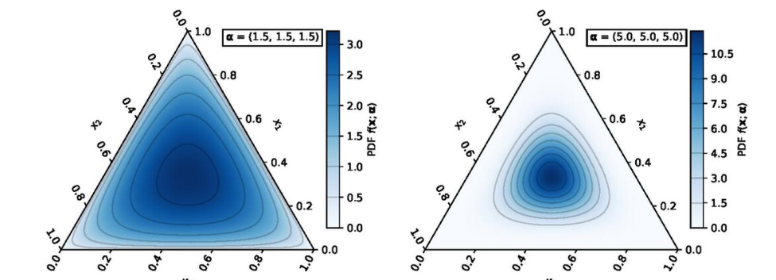
How to estimate vector $α_{i}=\left(α_{1|i},α_{2|i},⋯,α_{K|i}\right)$, characterizing Population Distribution of classification abilities?
It is considered that the key parameter is $α_{0|i}$ , characterizing the so called “Dirichlet noise”.
We propose to estimate $α_{0|i}$ by help of Repeatability to Classifiers effect ratio:
$${\hat{α}}_{k\left|i\right.}={\hat{α}}_{0\left|i\right.}\frac{1}{L}\sum_{L=1}^{L}{{\hat{p}}_{k|i}^{(l)}}$$
$${\hat{α}}_{0\left|i\right.}=\frac{\text{Repeatabilit}{\text{y}}_{u(i)}}{Classifier effect_{u(i)}}$$
and then
14

Slide 15
Simulation Study for K = 3
The population was $p=\left(0.8200, 0.1667,0.0133\right)$ (*)
Accordingly, we simulated for different $α$and $α_{0}$:
$α=\left(2.46, 0.5, 0.04\right)$, i.e., $α_{0}=3$
$α=\left(8.2, 1.667, 0.133\right)$, i.e., $α_{0}=10$
$α=\left(16.4,3.333,0.267\right)$, i.e., $α_{0}=20$
$α=\left(24.6, 5.0, 0.4\right)$, i.e., $α_{0}=3$0
While
L = 5, 10, 20, 30 or 100
N = 1000
* E. Bashkansky, S. Dror, R. Ravid, P. Grabov (2007) “Effectiveness of a Product Quality Classifier”, Quality Engineering, vol. 19, issue 3, pp.235-244

Slide 16
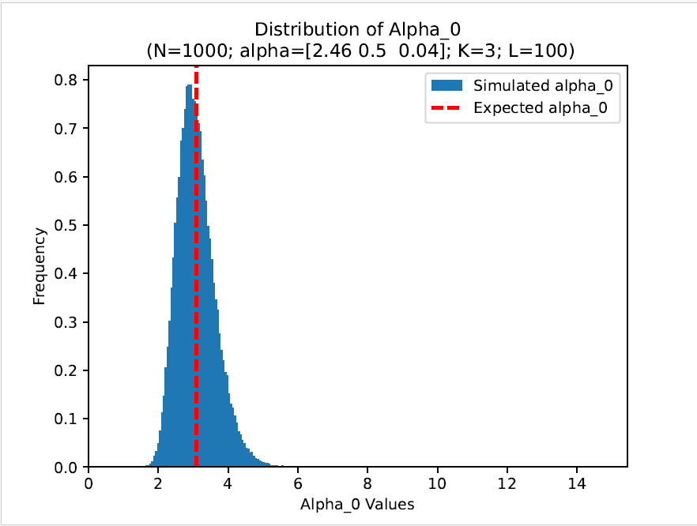
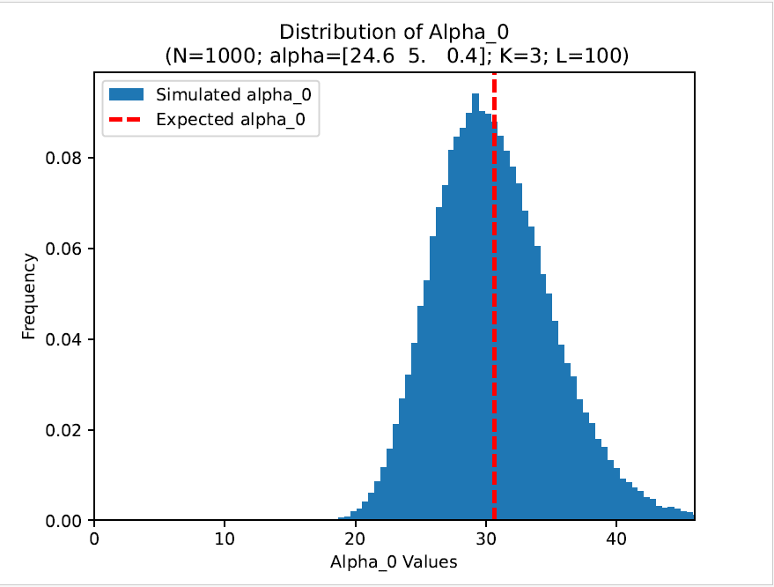
Influence of α ₀ magnitude
α 0 = 3
α 0 = 30
16

Slide 17
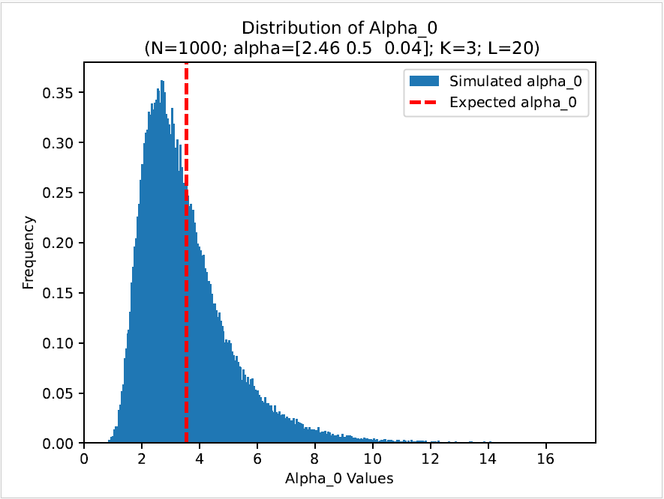
Influence of the number of classifiers - L
L = 20
L = 100
α 0 = 3

Slide 18
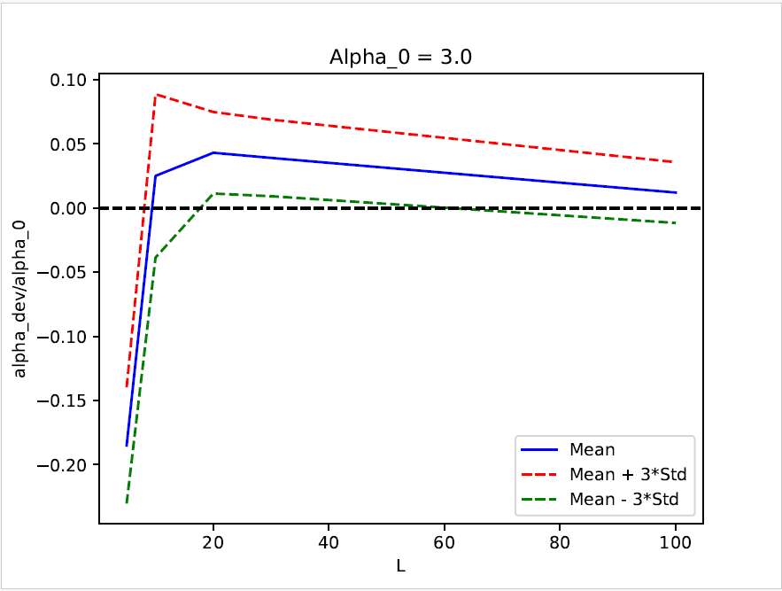
How the number of classifiers L influences
the relative deviation of α ₀ estimator
L = 30 brings quite good results!

Slide 19
Summary
Classification precision is particularly crucial in scenarios where the cost of false output is high, e.g. medical diagnosis, search engine results, product quality control etc.
A statistical model for analyzing classification's precision and its intra and inter components from collaborative studies is presented.
Unbiased estimators of repeatability, classifiers’ effect and total precision are provided for both the fixed and the random model.
Using simulation, it was found that the greatest influence on the accuracy and effectiveness of the model estimations in a random model is exerted mainly by the number of classifiers.

Slide 20
Thank You for Your Attention!
E-mail: myariv@braude.ac.il

