Slide 1






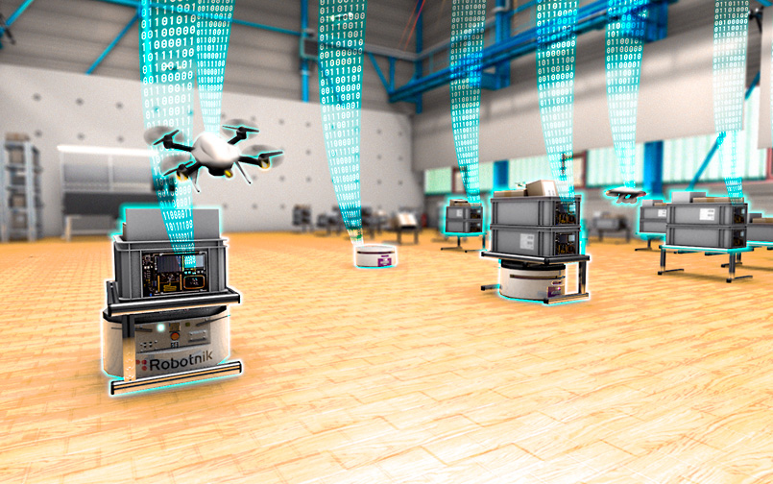
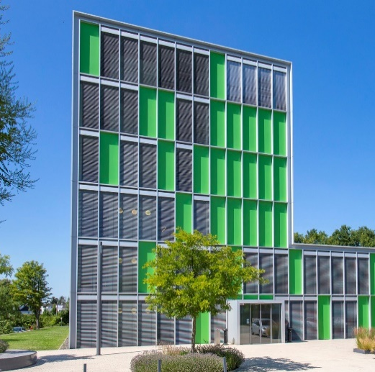
Dataset Bias in Human Activity Recognition
for Industrial Processes
Nilah Ravi Nair, M.Sc., Lena Schmid, M.Sc.,
Dr. Fernando Moya Rueda, Prof. Markus Pauly, & Prof. Gernot A. Fink, Dr. Christopher Reining
Notes:
Based on our work Representation Biases in Time-Series Human Activity Recognition with Small Sample Sizes representing my collegues from diverse background

Slide 2
“Data as The New Oil Is Not Enough”
– Nisha Talagala, Forbes, 2022
https://www.forbes.com/sites/nishatalagala/2022/03/02/data-as-the-new-oil-is-not-enough-four-principles-for-avoiding-data-fires/
Notes:
Talk about how the current industries are data driven. Fav quote when referring to the current research and industrial environment.
Provenance: Know where your data came from
Privacy: Know who it came from and what laws to follow to use it
Protection: Don’t lose the data :-)
Preparation: Know how to refine the data, and remember how you refined the data so that you can do it again and again consistently

Slide 3








Sources of “Unrefined„ Data
Images from freeicons.io
Notes:
For instance, when you buy something online, you buy it based on data in specific peoples review, the data is further sent to the logistics center and they pick the item package it and then send it off to deliver it to you, all which you know of from home.
In a similar example, the motion information of an picker in logistics environment can help with ergonomic evaluation, item placement planning and even support with robotics.

Slide 4

Outline
Human Activity Recognition
Biases in Human Activity Datasets
  Types of Biases
  Representation Biases
Our Research

Slide 5
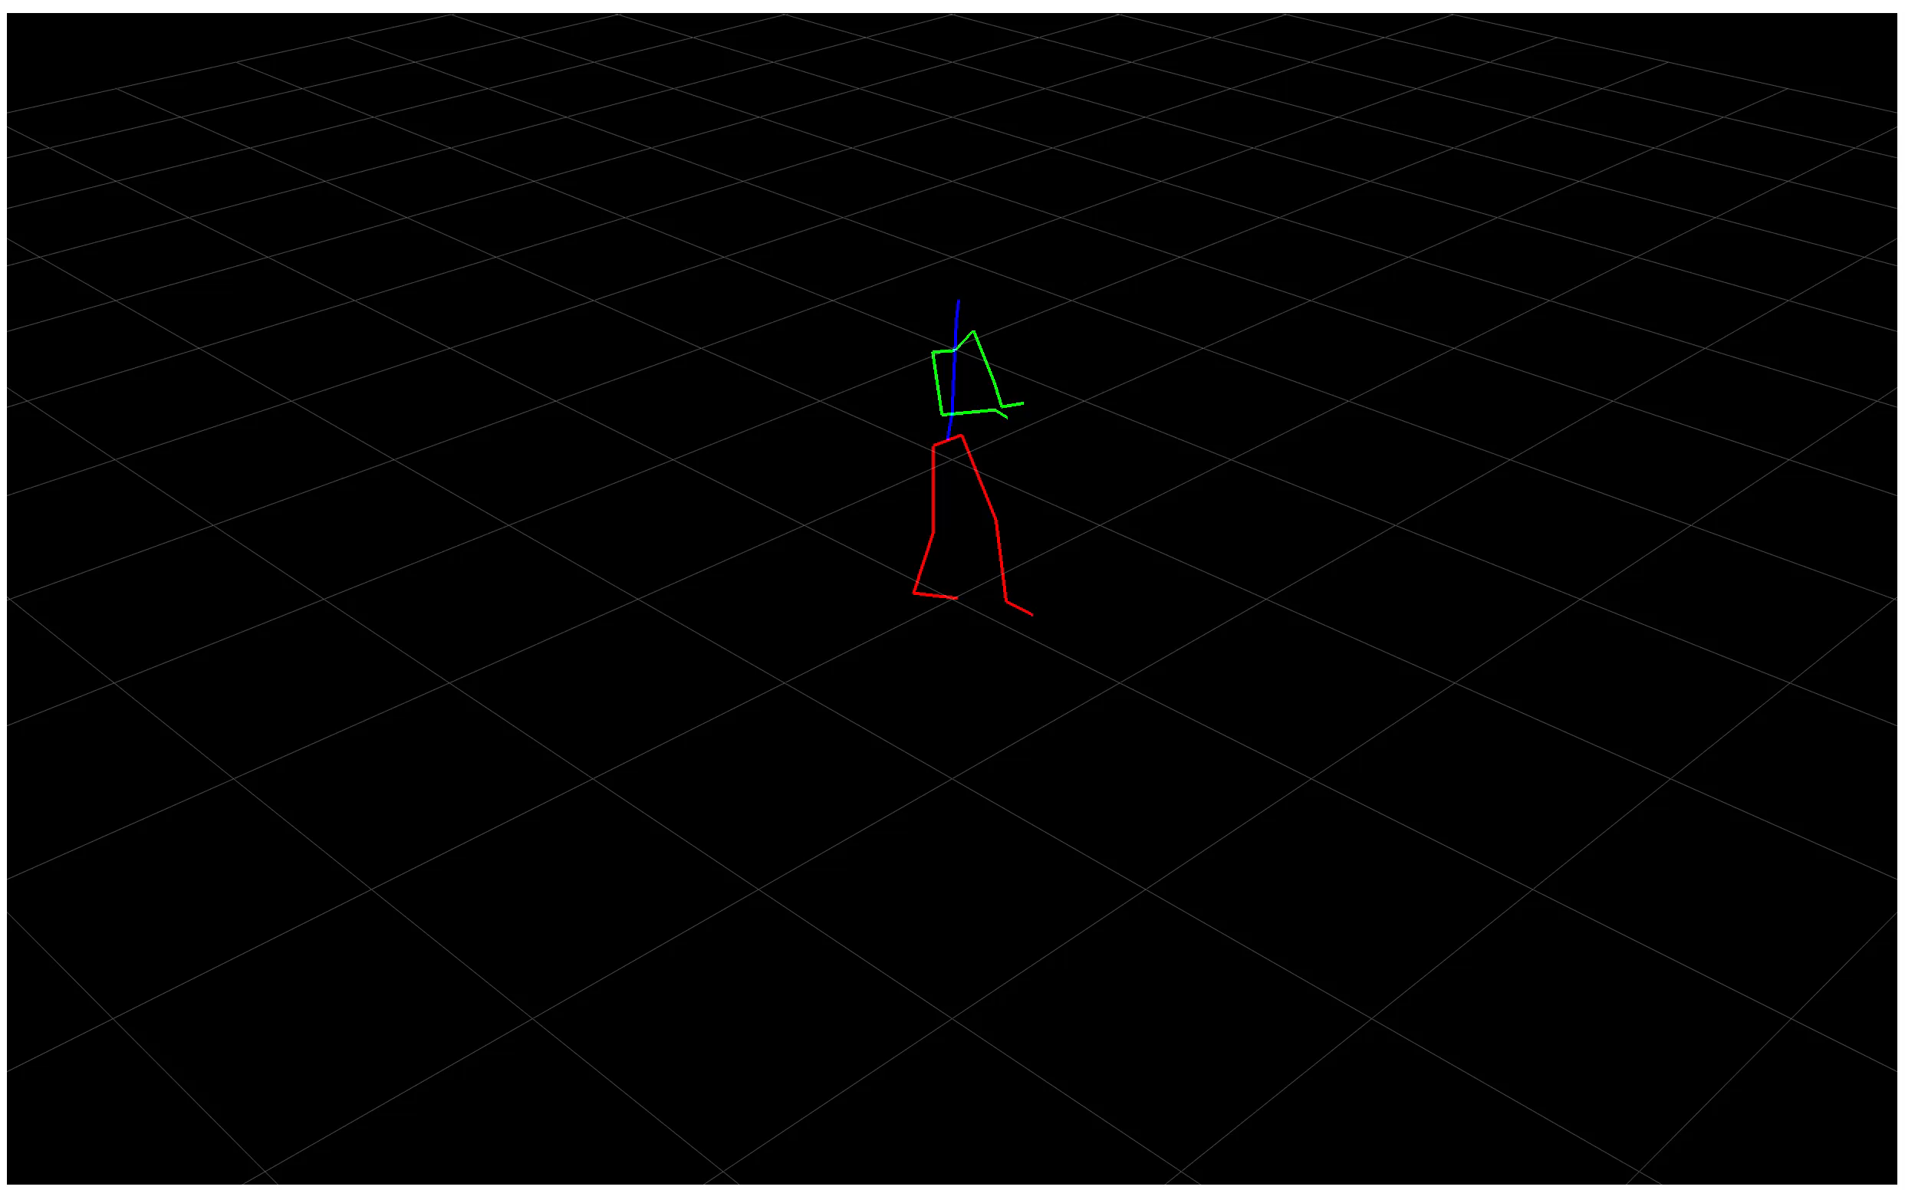
Human Activity Recognition: What?

Slide 6
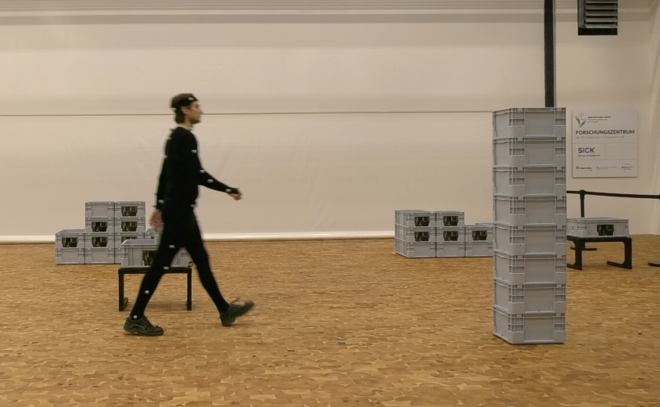
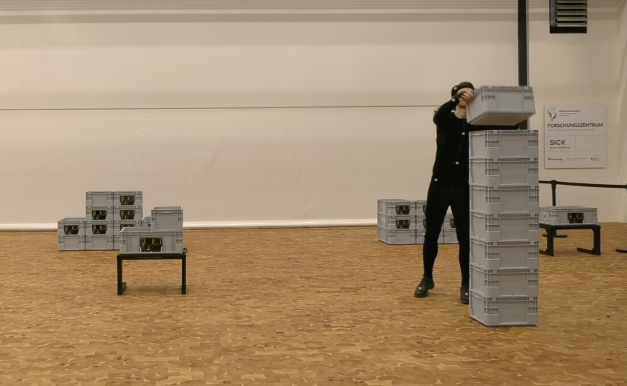
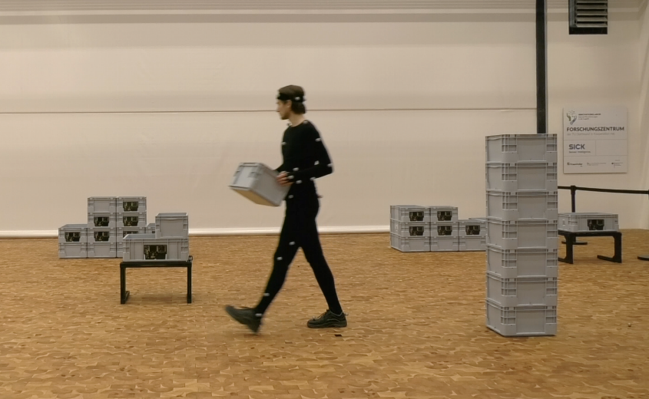
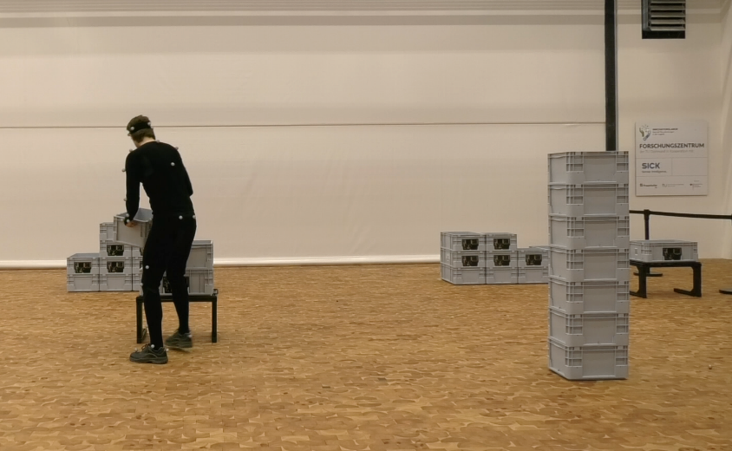
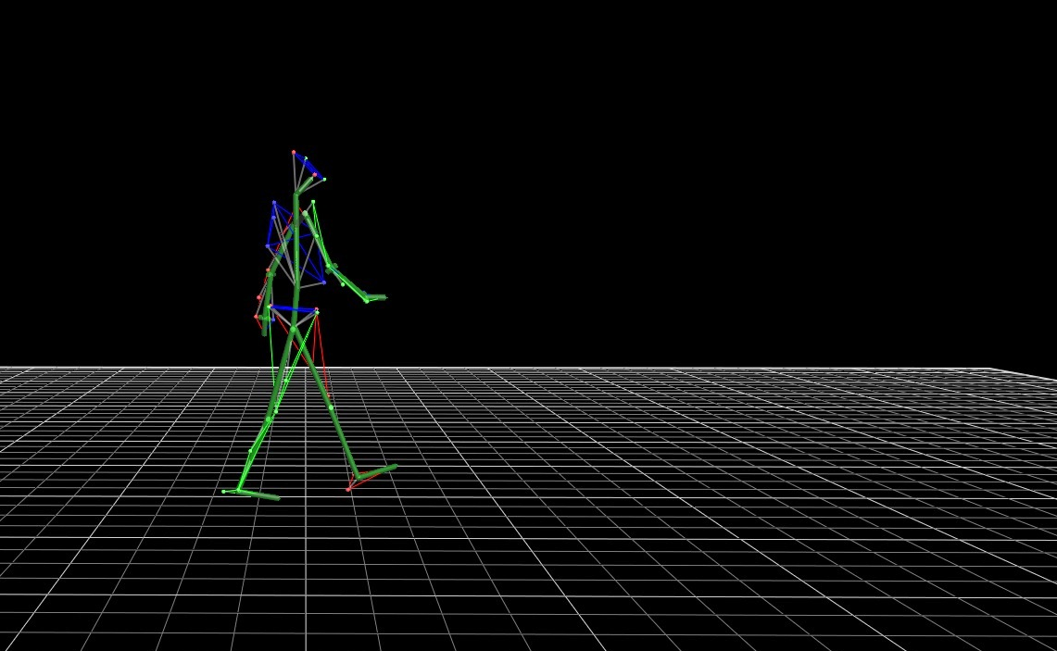
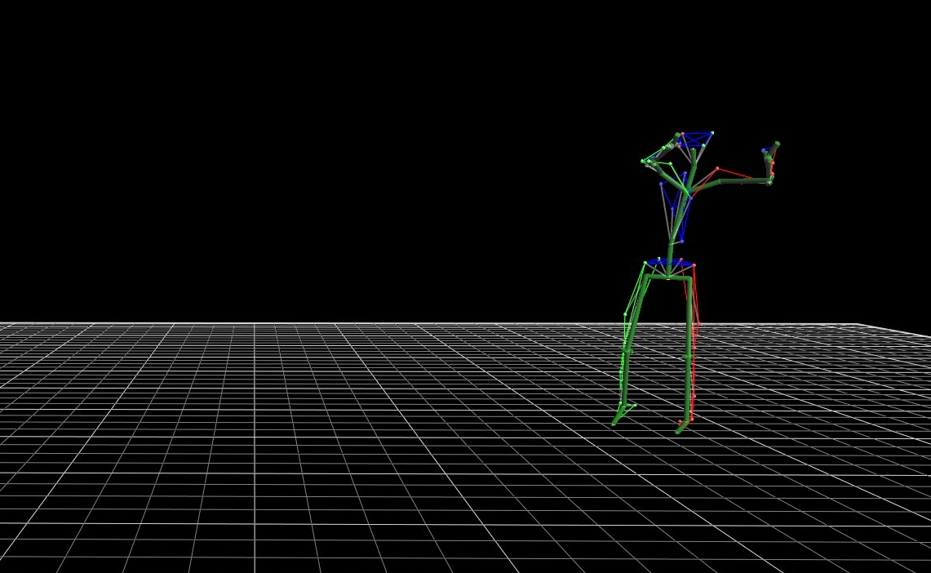
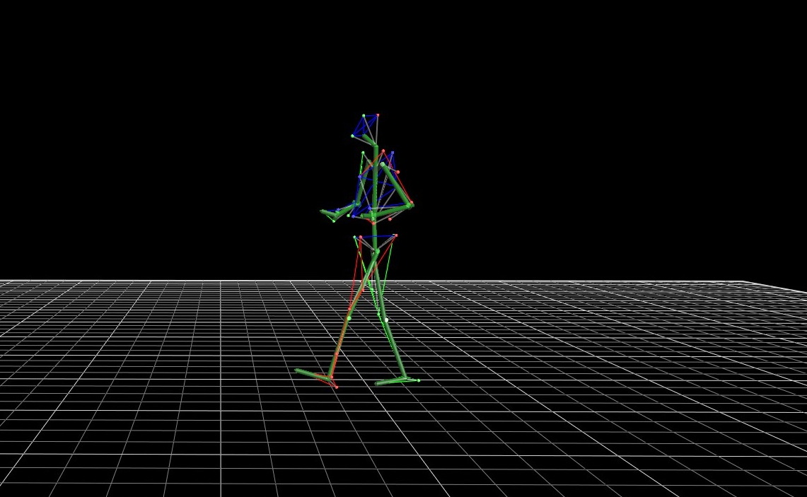
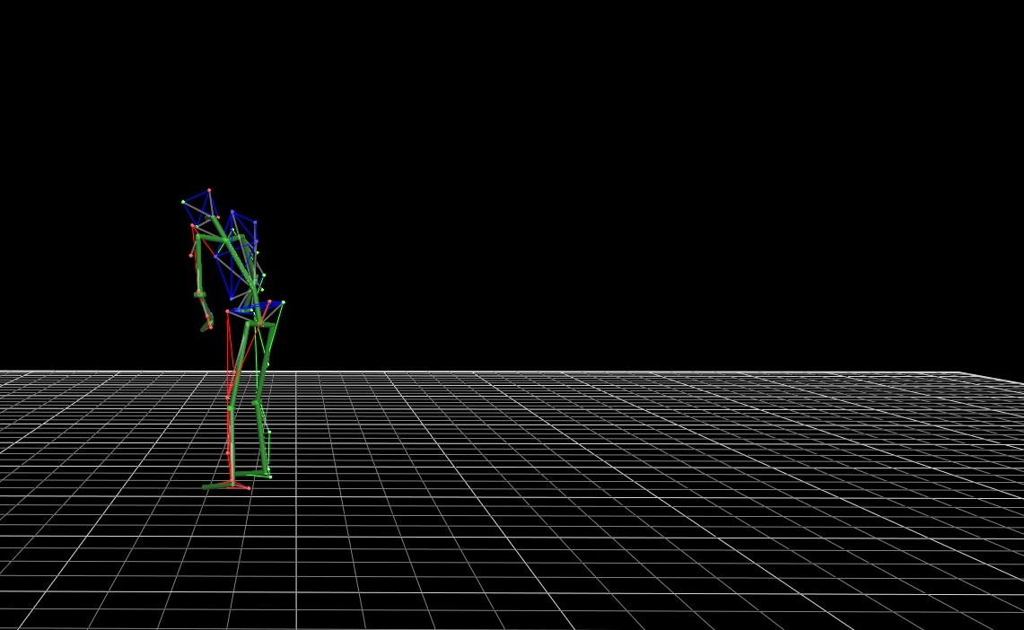
Human Activity Recognition: What?
Walking
Lifting Box
Walking with box
Putting down box

Slide 7

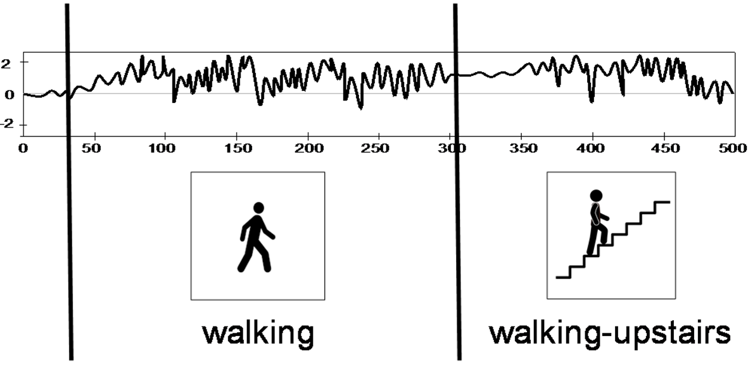
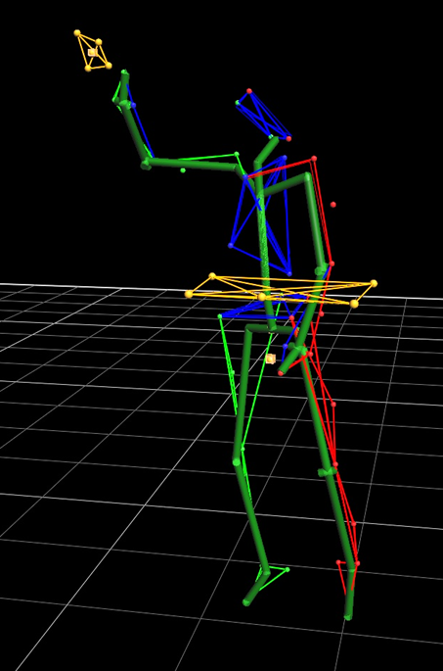
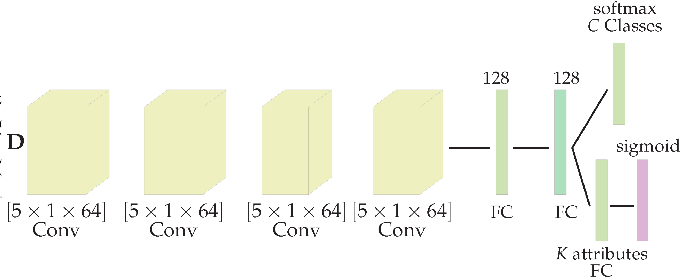
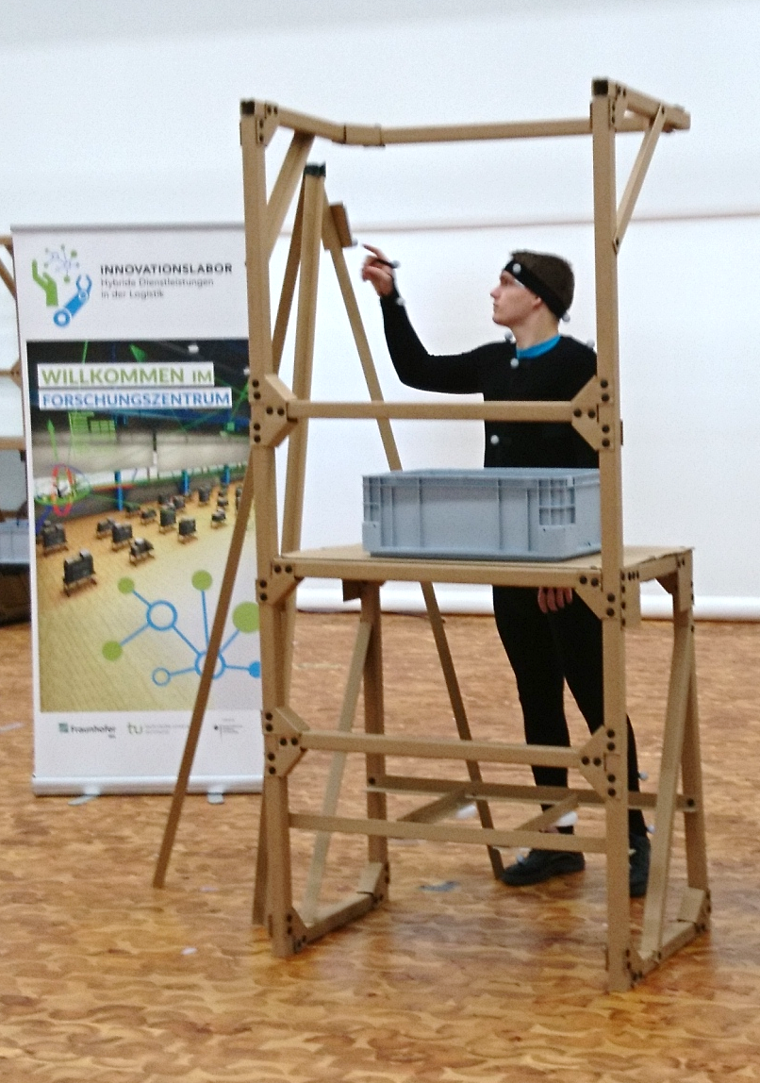
Human Activity Recognition: How?
Accel. X(m/s²)
Niemann, Friedrich, et al. "Lara: Creating a dataset for human activity recognition in logistics using semantic attributes." Sensors 20.15 (2020): 4083.

Slide 8

Human Activity Recognition: Why?
Process Anomaly Detection
Ergonomic Evaluation
Safety-training for robots
Process Optimisation
Subject Re-Identification
Benchmarking Warehousing Performance

Slide 9
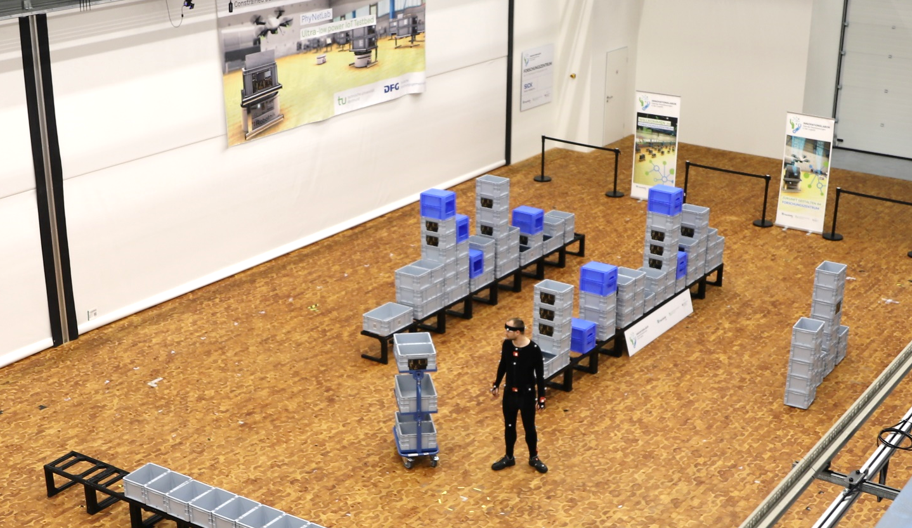
Human Activity Recognition: Research with Industry

Slide 10
Outline
Human Activity Recognition
Biases in Human Activity Datasets
  Types of Biases
  Representation Biases
Our Research

Slide 11
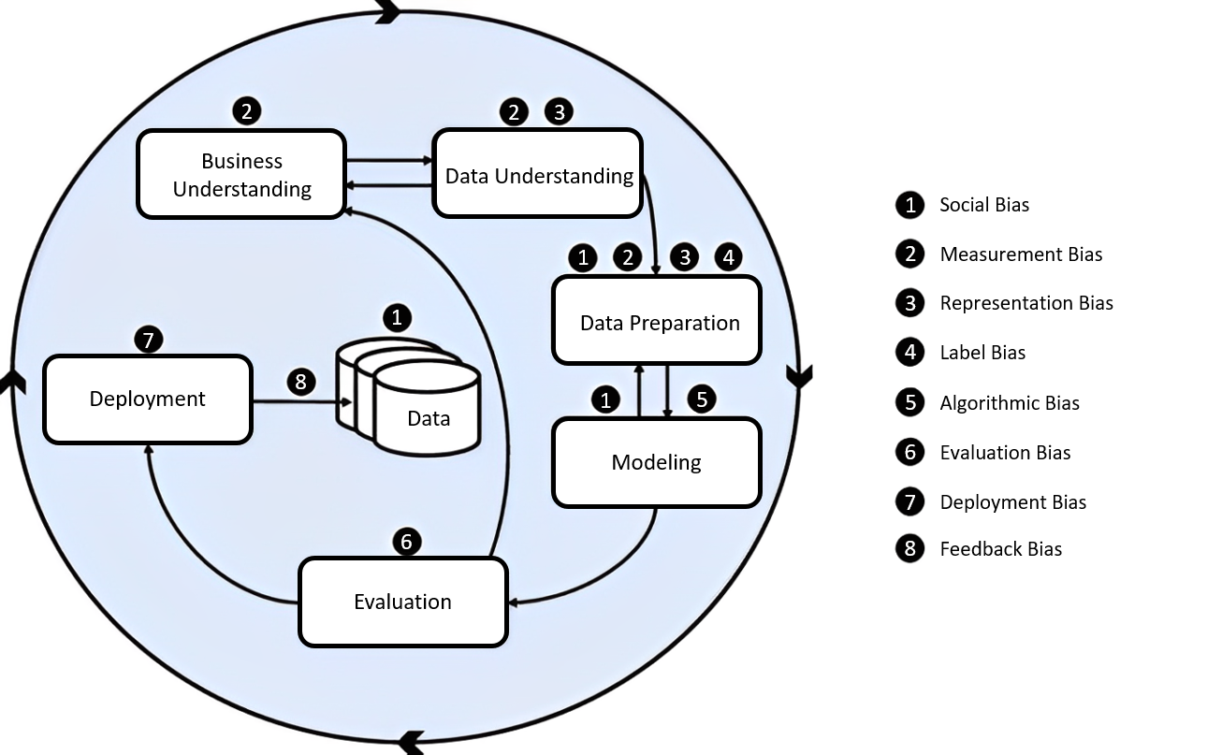
Biases in Human Activity Datasets: Types
Image from van Giffen, B., Herhausen, D., Fahse, T.: Overcoming the pitfalls and perils of algorithms: A classification of machine learning biases and mitigation methods. Journal of Business Research 144, 93–106 (2022)
Notes:
SocialBias Available data reflects existing bias in the relevant population prior to the creation of the ML model.
Measurement BiasChosen features and labels are imperfect proxies for the real variables of interest.
Representation BiasThe input data is not representative for the relevant population, which leads to systematic errors in ML model predictions.
Label BiasLabelled data systematically deviate from the underlying truth categories.
Algorithmic BiasInappropriate technical considerations during modeling lead to systemic deviation of the outcome.
Evaluation BiasA non-representative testing population or inappropriate performance metrics are used to evaluate the ML model.
Deployment BiasThe ML model is used and interpreted in a different context than it was built for.
FeedbackBiasThe outcome of the ML model influences the training data such that a small bias can be reinforced by a feedback loop.

Slide 12
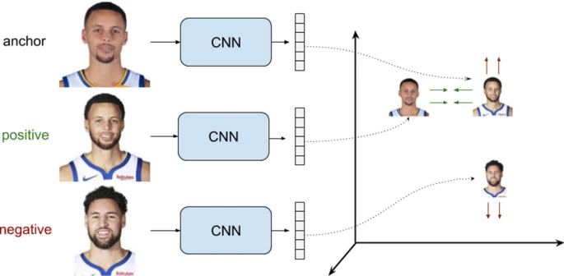
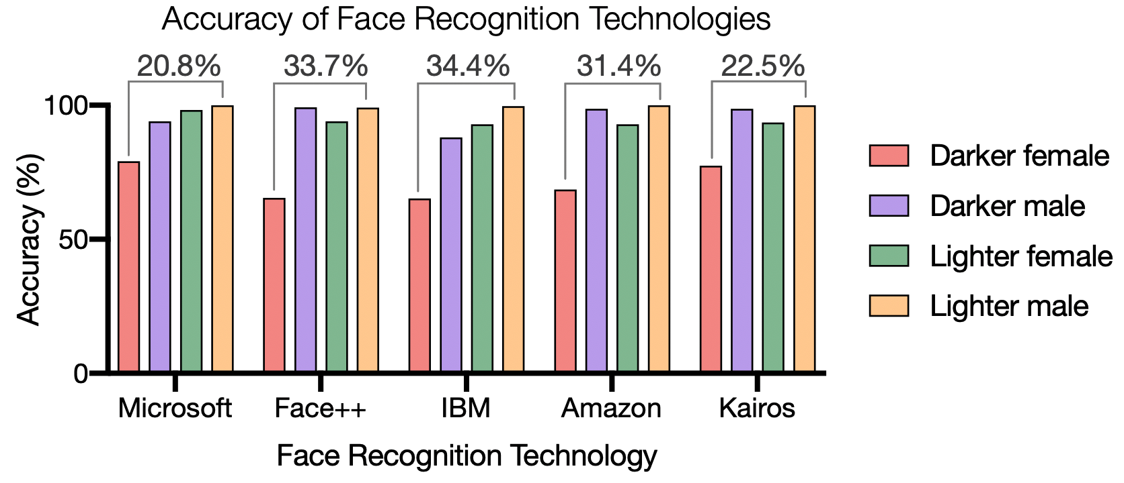
Biases in Human Activity Datasets: Representation Bias
Under-representation of a part of the population that an application targets and
the subsequent failure to generalize as representation bias.
van Giffen, B., Herhausen, D., Fahse, T.: Overcoming the pitfalls and perils of algorithms: A classification of machine learning biases and mitigation methods. Journal of Business Research 144, 93–106 (2022)
Wehrli, S., Hertweck, C., Amirian, M. et al. Bias, awareness, and ignorance in deep-learning-based face recognition. AI Ethics 2, 509–522 (2022).
http://gendershades.org/overview.html

Slide 13
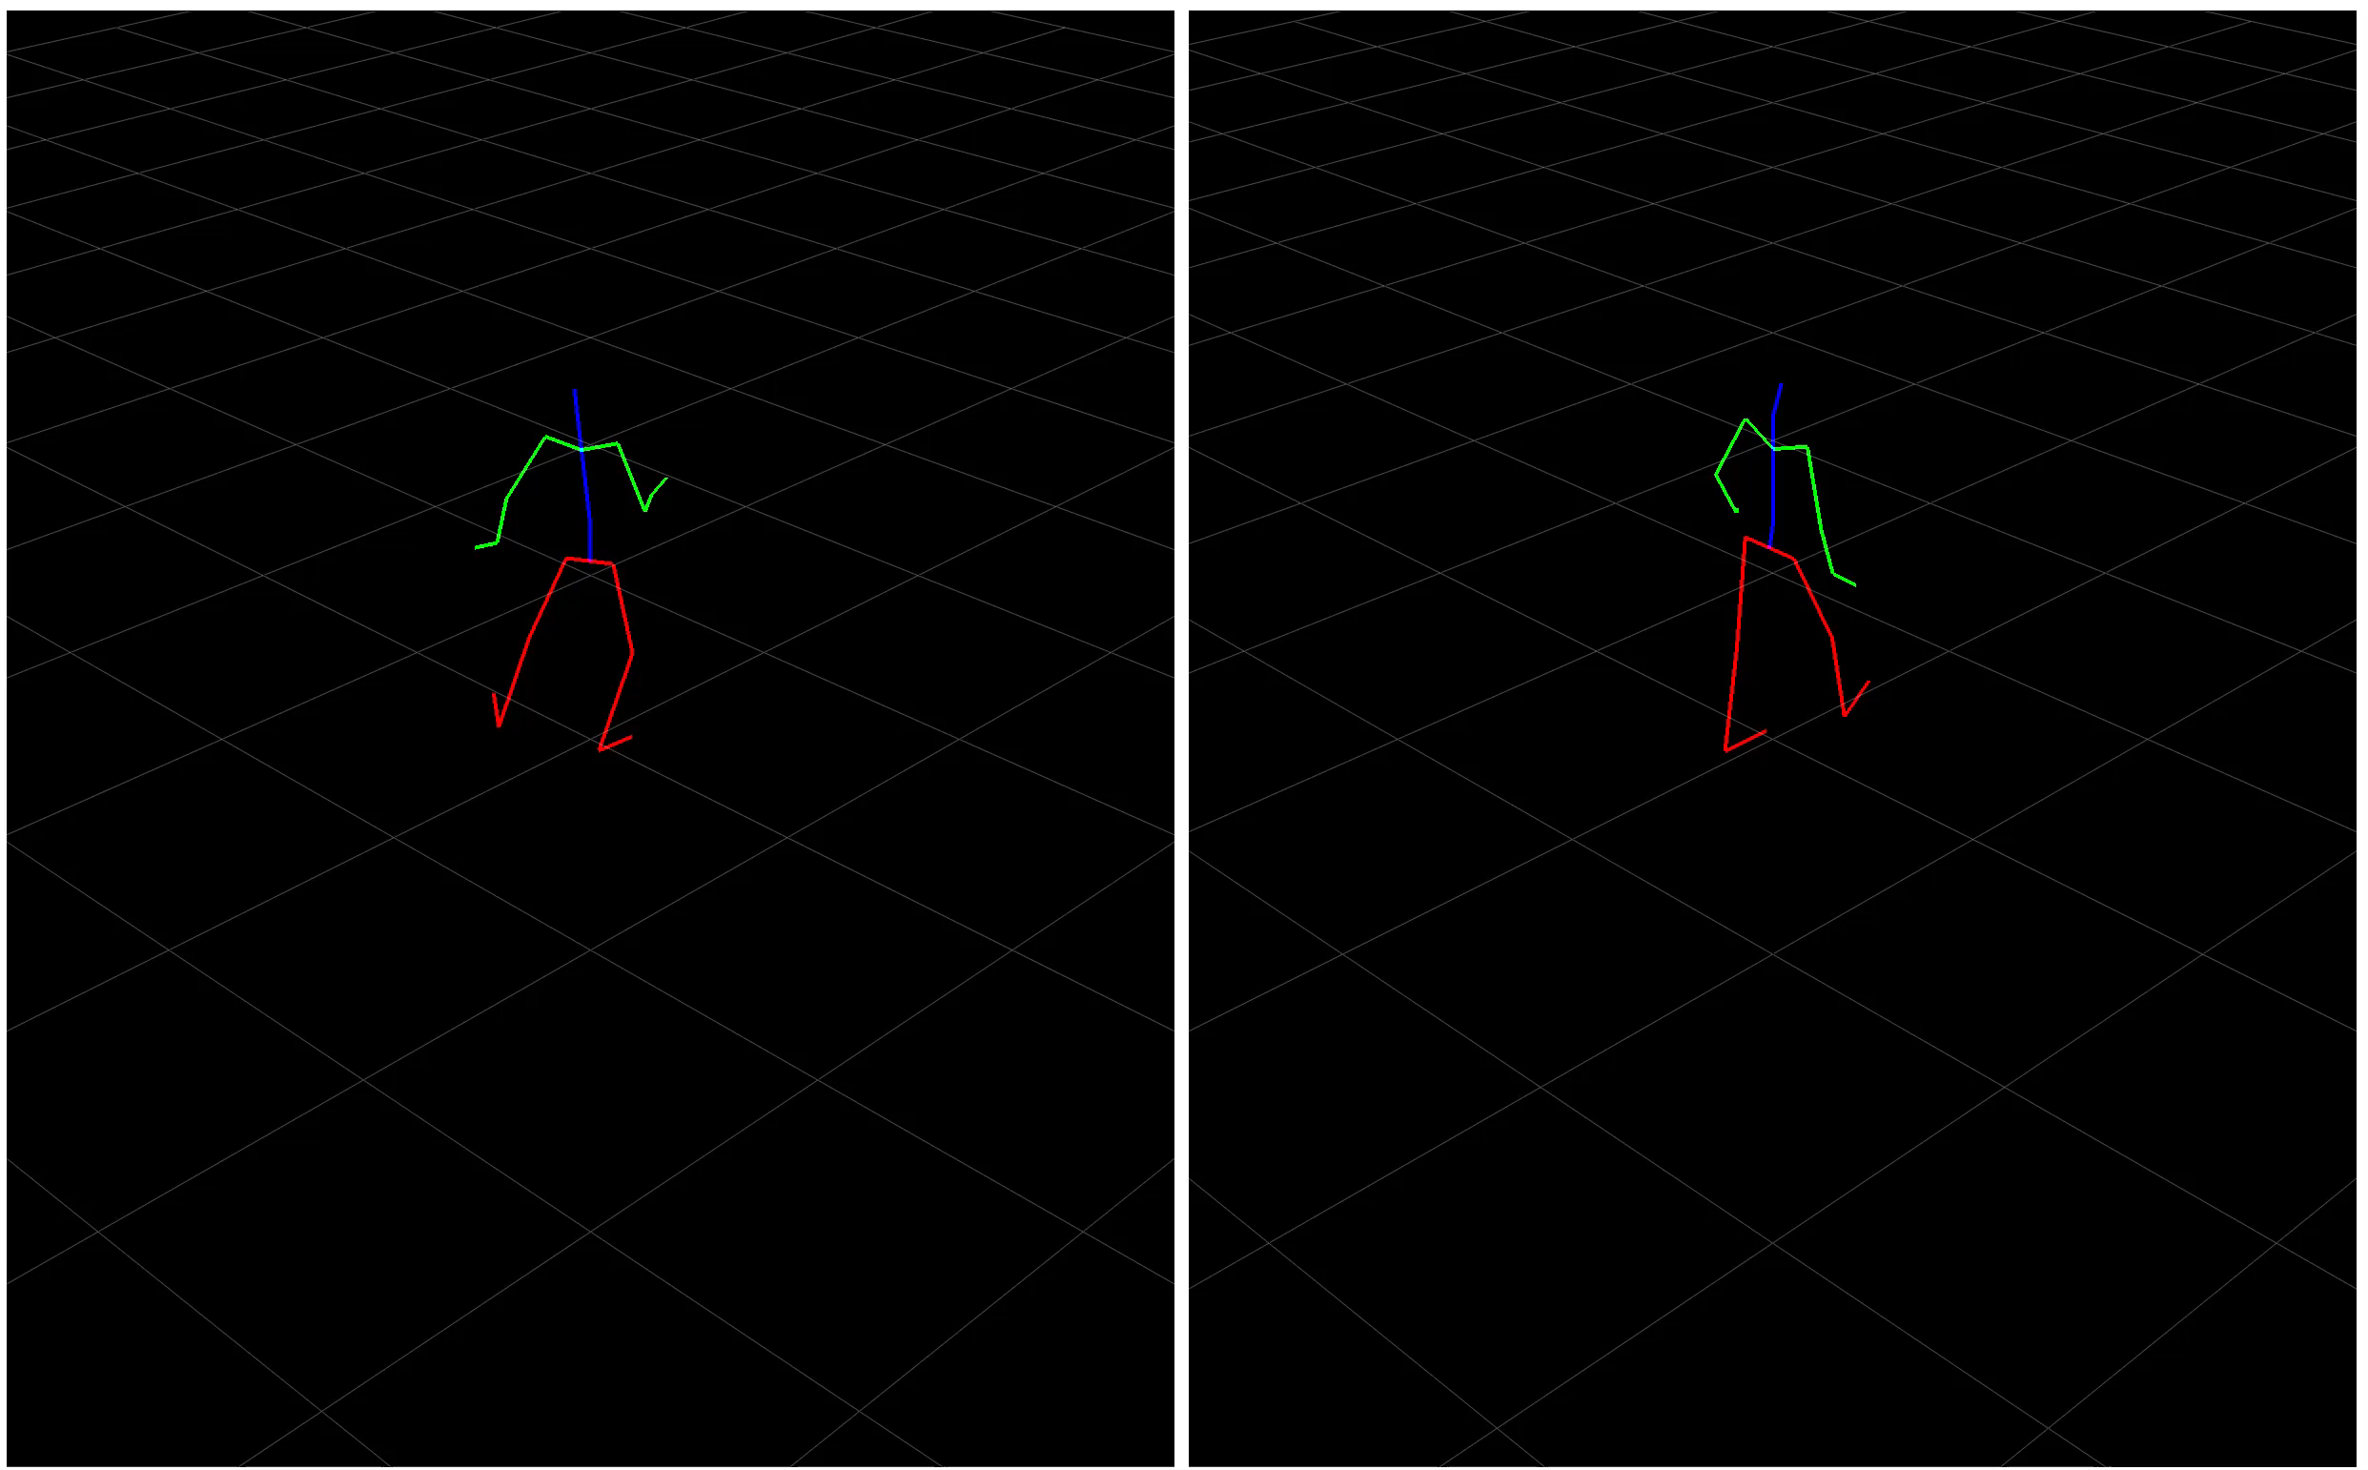
Biases in Human Activity Datasets: Representation Bias

Slide 14
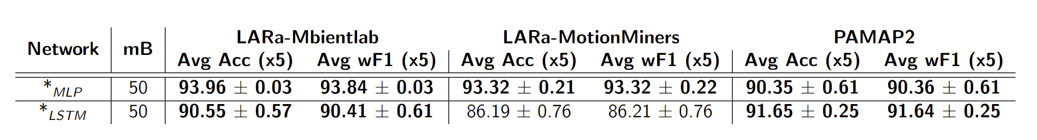
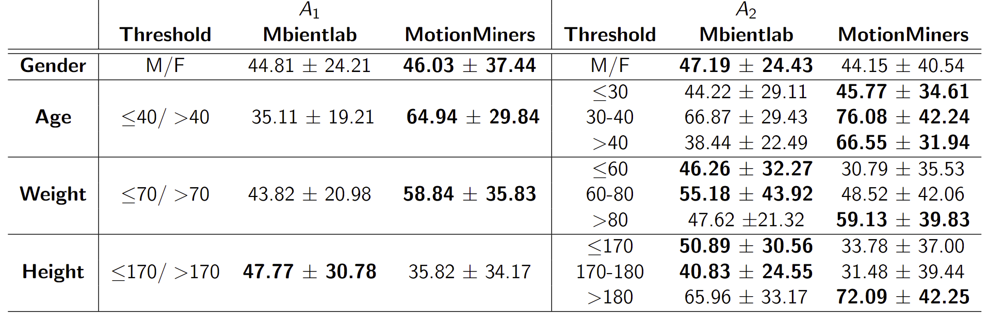
Biases in Human Activity Datasets: Representation Bias
Our work refers to the biases caused or influenced by subject characteristics represented in the dataset as representation bias.
Nair, Nilah Ravi, et al. "Multi-Channel Time-Series Person and Soft-Biometric Identification." International Conference on Pattern Recognition. Cham: Springer Nature Switzerland, 2022.

Slide 15
Outline
Human Activity Recognition
Biases in Human Activity Datasets
  Types of Biases
  Representation Biases
Our Research

Slide 16
Our Research
RQ1: Do the physical characteristics of humans influence activity recognition performance?
RQ2: What physical characteristics should be considered when selecting subjects to create a robust classifier?
RQ3: Can we develop a metric for representation bias in activity recognition classifiers?
Notes:
To answer these questions the first thing we require are datasets.

Slide 17
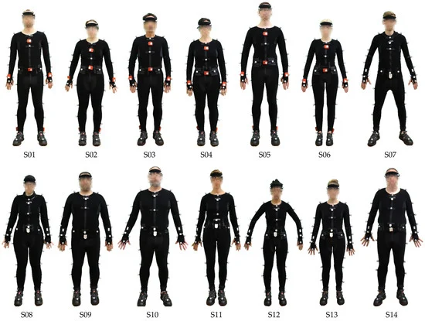
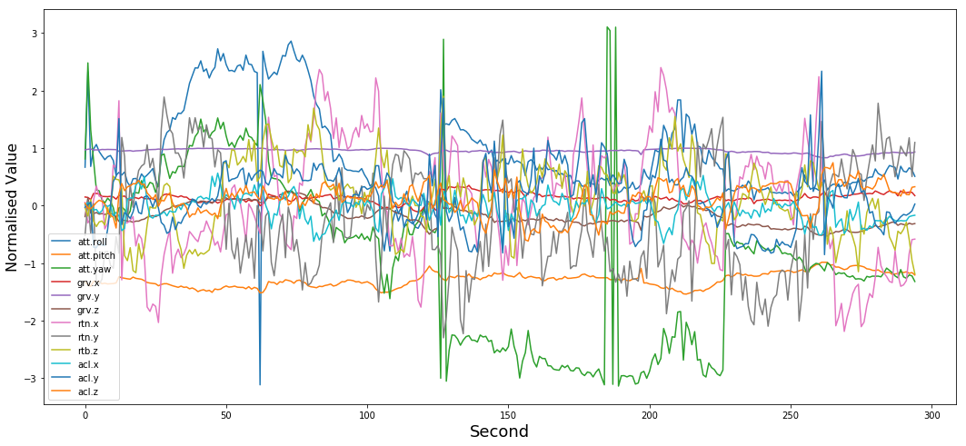
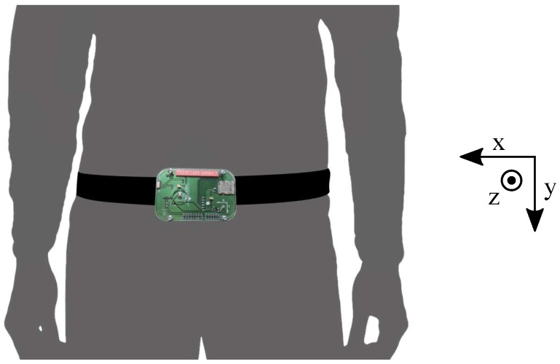
Our Research: Datasets
Criteria:
Large number of subjects
Subject Characteristics available
Various activities of daily living
Selected Datasets:
Mobiact
MotionSense
Sisfall
LARa (MoCap)
https://github.com/mmalekzadeh/motion-sense?tab=readme-ov-file#readme
Sucerquia, Angela, José David López, and Jesús Francisco Vargas-Bonilla. "SisFall: A fall and movement dataset." Sensors 17.1 (2017): 198.
Niemann, F.; Reining, C.; Moya Rueda, F.; Nair, N.R.; Steffens, J.A.; Fink, G.A.; ten Hompel, M. LARa: Creating a Dataset for Human Activity Recognition in Logistics Using Semantic Attributes. Sensors 2020, 20, 4083. https://doi.org/10.3390/s20154083
Notes:
Only few datasets gave details pertaining to subjects. The selected ones provide age, gender, height and weight.

Slide 18
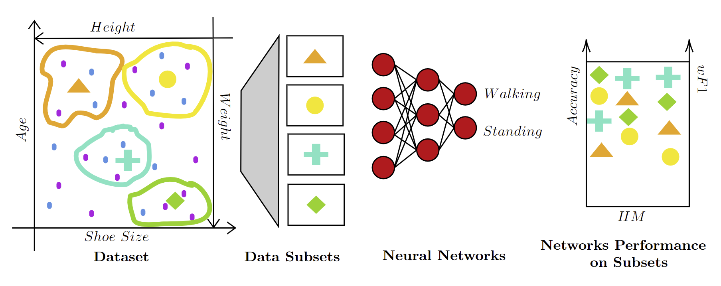
Our Research: Method
Heterogenity measure quantifies the diversity or non-uniformity of qualities within a
dataset, providing insight into the range and distribution of qualities present
Nunes, A., Trappenberg, T., Alda, M.: The definition and measurement of heterogeneity. Translational psychiatry 10(1), 299 (2020)

Slide 19
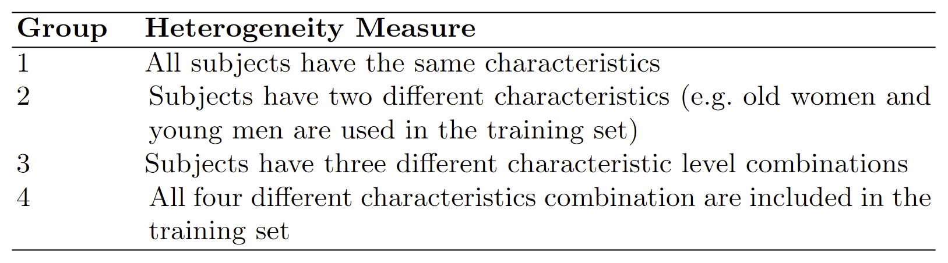
Our Research: Evaluation Stratergy
young
old
Age
A
0
25
50
B
Gender
Male
Female
Heterogenity Measure= 4 levels

Slide 20
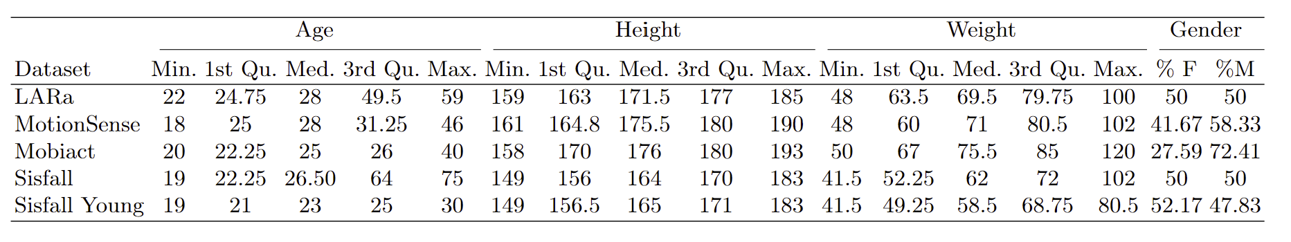
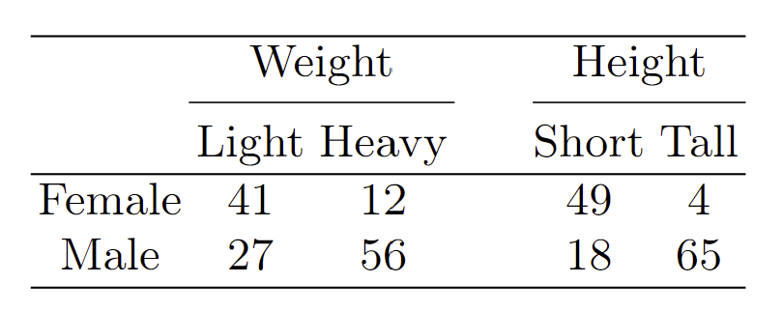
Our Research: Statistical Analysis of Datasets

Slide 21
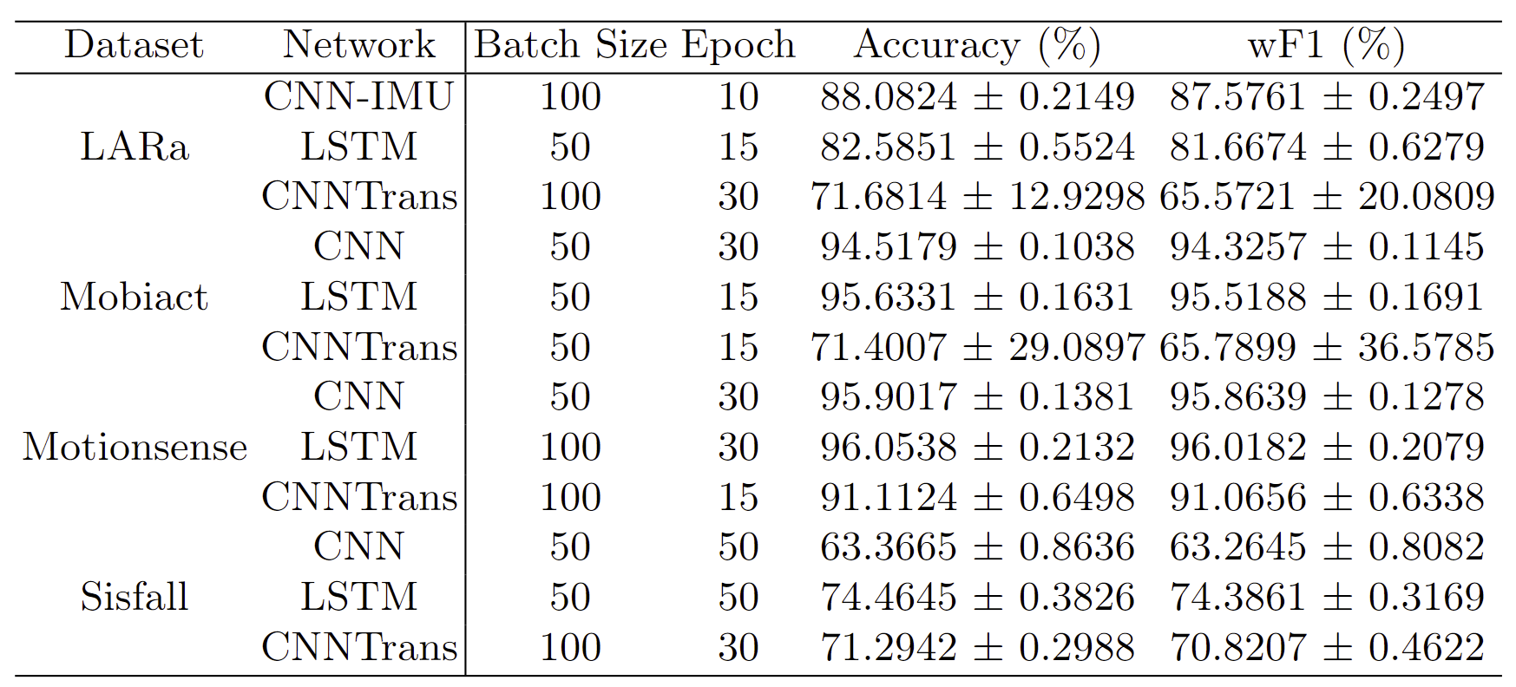
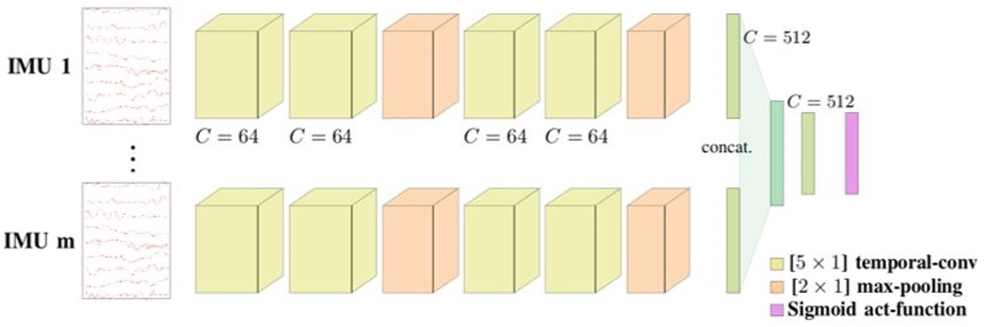
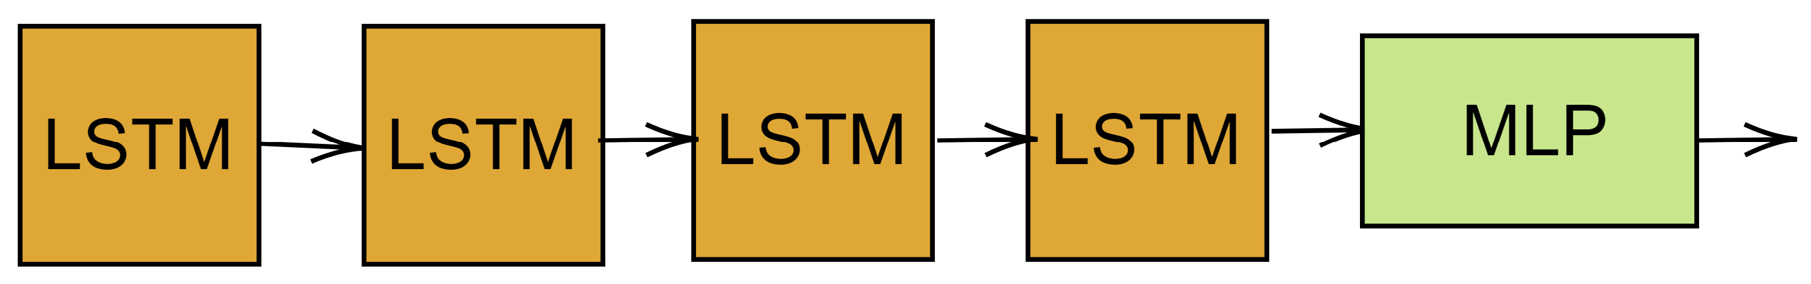
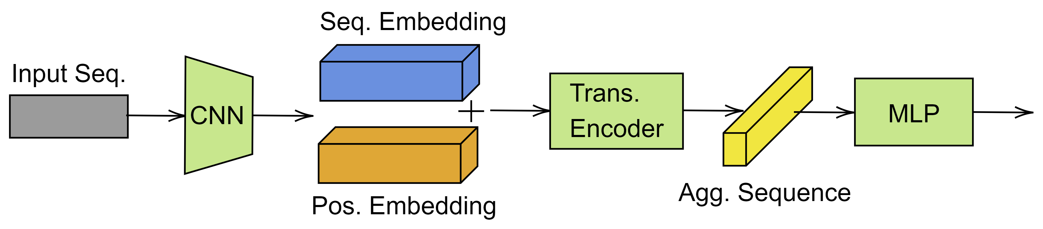
Our Research: Network
F. M. Rueda and G. A. Fink: Learning attribute representation for human activity recognition.
Gohar, Q. Riaz, M. Shahzad, M. Z. Ul Hasnain Hashmi, H. Tahir and M. Ehsan Ul Haq: Person reidentification using deep modeling of temporally correlated inertial motion patterns.
Shavit, Yoli, and Itzik Klein. "Boosting inertial-based human activity recognition with transformers.".

Slide 22
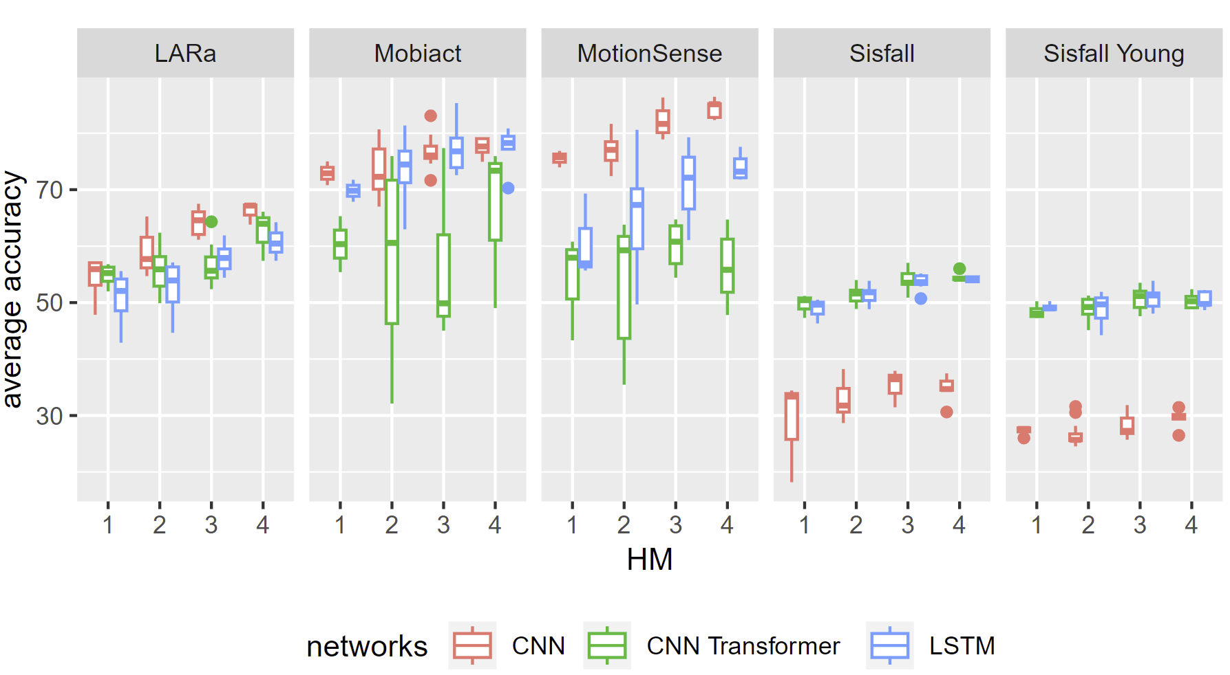
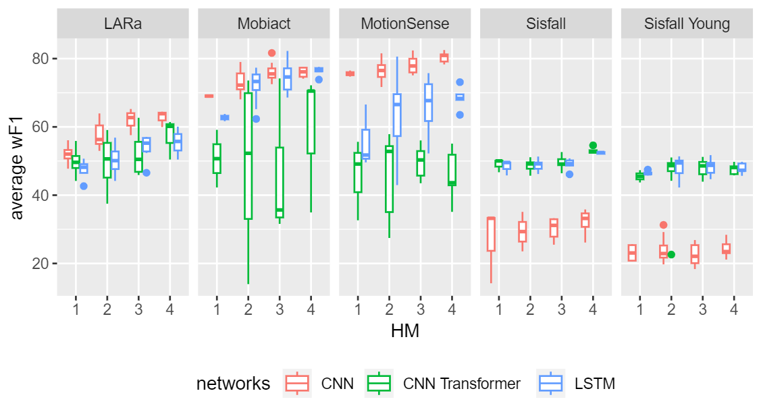
Our Research: Result
Notes:
Similar results were found in the wf1 and precision recall.

Slide 23
Conclusions
RQ1: Do the physical characteristics of humans influence activity recognition performance?
YES!
RQ2: What physical characteristics should be considered when selecting subjects to create a robust classifier?
Based on available datasets – Age and Gender
RQ3: Can we develop a metric for representation bias in activity recognition classifiers?
Prefer an Evaluation Strategy over a Metric for Dataset Curation.

Slide 24
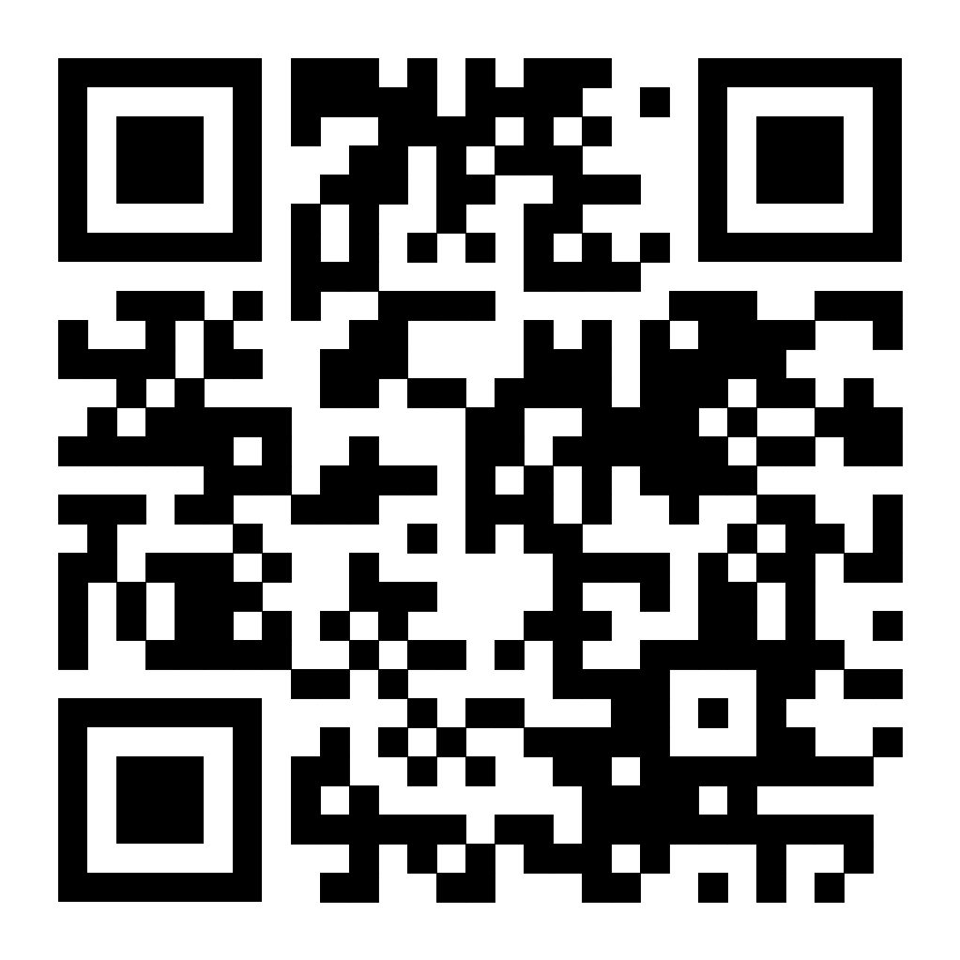
Dataset Bias – Initial Archive Work

Slide 25
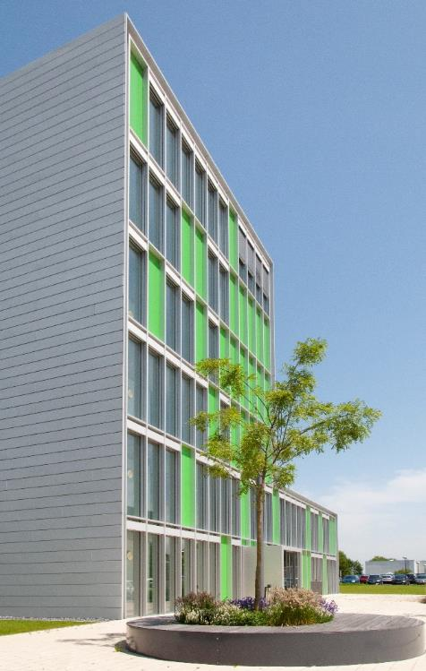

Contact
Lehrstuhl für Förder- und Lagerwesen FLW
LogistikCampus
Joseph-von-Fraunhofer-Straße 2-4
44227 Dortmund
Nilah Ravi Nair, M.Sc.,
nilah.nair@tu-dortmund.de
www.flw.mb.tu-dortmund.de

Slide 26
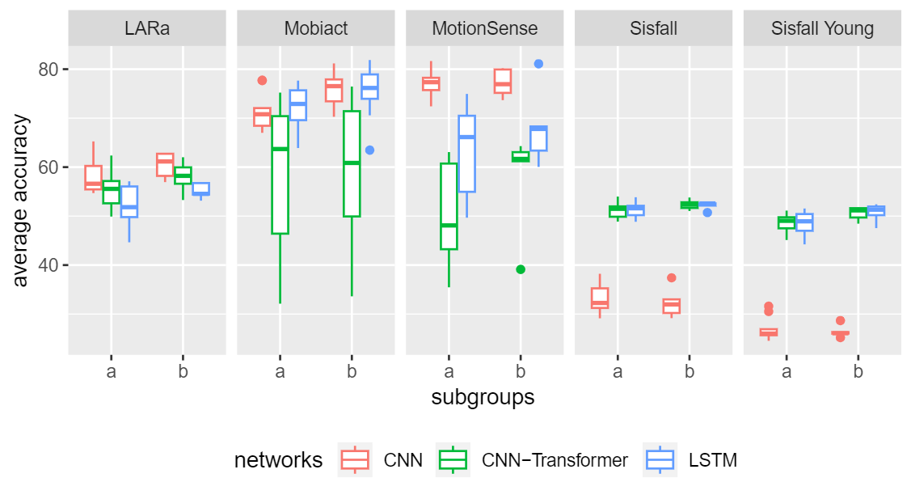
Heterogeneity Level 2

