Slide 1
Enabling Scientists and Engineers to deploy and exploit Data Science in the Process Industries
Hadley Myers
JMP Senior Systems Engineer
ENBIS 2021 Online Spring Meeting

Slide 2
Motivation
Huge demand on statisticians and data scientists
“Crises” can happen at any moment.
Simultaneous emergencies require them to split time and become experts in every process.
New data requires continuous improvement of existing models.

Slide 3
Motivation
Ideal Situation
Combine subject matter knowledge with data analytic know-how.
Equip domain experts with statistical tools needed to solve problems.
Overcome resistance to change:
Predicated on fear of unknown / want of understanding.
Learning resources to overcome fear.
See last slide.
Statisticians support as managers / overseers / advocates.
Enable the use of analytic techniques.
Work to establish a culture of analytics.
Free them up to work on the harder problems.

Slide 4
Situation
Manufacturing Case Study
Pharmaceutical company was scrapping 15% of batches due to non-conformance to release specification
Company breathed a sign of relief whenever a good batch was released
QA would investigate failing batches, verify that all process steps had operated within specification, and conclude there was no assignable cause
Statisticians analyzed data and built explanatory models using R.
Domain experts, with no coding or statistical experience, left out of process.

Slide 5
Example
Company manufacturing pharmaceutical tablets
spec limit: Dissolution ≥ 70

Slide 6
Example
Company manufacturing pharmaceutical tablets

Slide 7
Risks to Organizations?
When subject matter experts don’t have data analytic skills
Wasted costs from scrap batches.
Difficulty filling customer orders.
Lack of predictability.
Unable to take on new customers.
Negative impact on profitability.
Negative impact on availability of capital to invest in other projects.
Or to use for new hires.
Negative impact on dividends returned to investors.

Slide 8
Risks to Organizations?
Hidden Factory Costs
Warranty
Rejects
Inspection
Scrap
Rework
Engineering change orders
Long cycle times
Expediting costs
Working Capital
Excess Inventory
Long Set-ups
Excessive Material Orders/Planning
Time value of money
Late delivery
Lost Customer Loyalty
Lost sales

Slide 9
Risks to Individuals?
When subject matter experts don’t have data analytic skills
Delayed milestones, cost overruns and missed deadlines.
Annoyed and dissatisfied customers.
Anger and frustration among employees.
Overworked and underappreciated.
Retention issues.
Loss of competitive advantage.

Slide 10
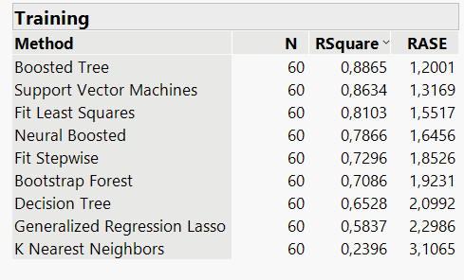
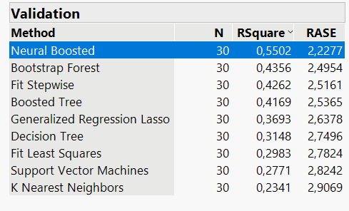
Solution
The path forward
Quickly pulled records on batches run over the last month.
Unclear which modeling method was most appropriate.
Only way to truly know is to try multiple methods.
Choose best model on validated data.

Slide 11
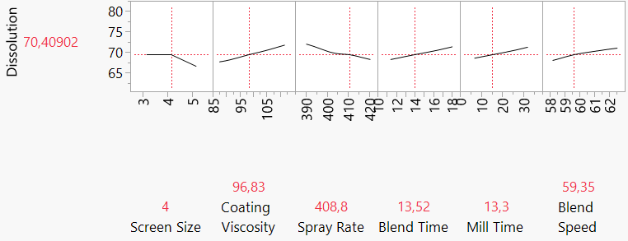
Solution
The path forward
Used results to identify key factors driving quality.

Slide 12
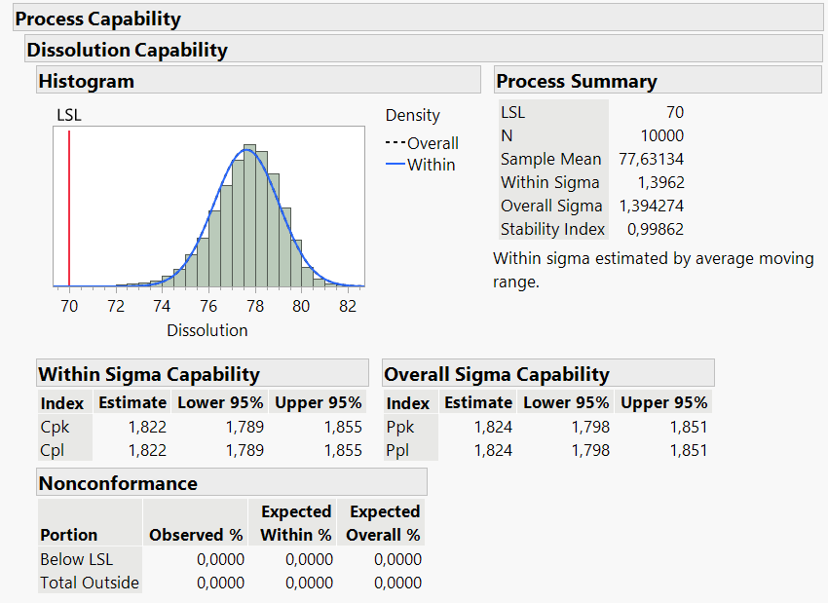
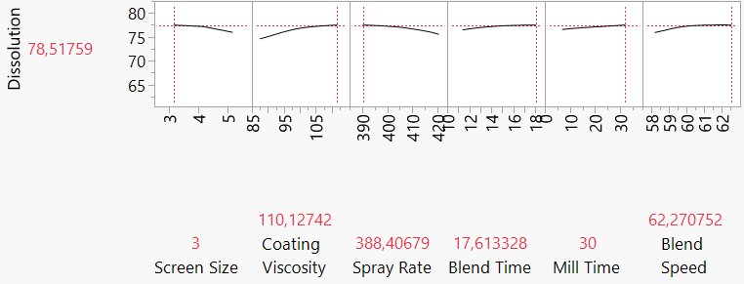
Solution
Results
Found settings and improved control of these factors to increase product quality.
Incidence of scrap batches reduced to zero.

Slide 13
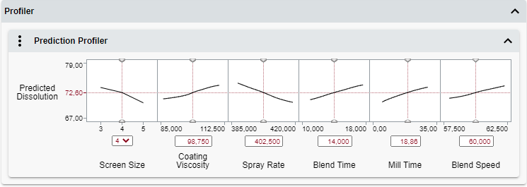
Solution
Made solution available for use by others
https://bit.ly/2Rdyzr0

Slide 14
Summary
Key takeaways:
Serious risks of not-using data science:
Budget overruns, missed deadlines, “hidden-factory” costs, loss of competitive advantage.
Resistance to change:
Predicated on fear, lack of experience/understanding.
Predominant among process experts without data science backgrounds.
Advantage gained by equipping Subject Matter Experts with analysis capabilities.
Best able to understand and evaluate insights from analytics.
Statisticians manage/support efforts, advocate for the use of analytics.

Slide 15
For free learning resources, visit
https://bit.ly/3bew7Hx

