Slide 1
Interpretability & Verification in AI

Slide 2
32 years old, from Marseille, in MathWorks from 3 years
Pierre Harouimi
Application Engineer
MathWorks, Inc.
Notes:
Document en PJ sur la plateforme Webikeo
Envoie du PDF + liens intéressants + prochain évènement MathWorks :

Slide 3
Interpretability & Verification in AI
Some real-world usages
Retail credit granting
Abnormal heartbeats
Autonomous driving
Why was my loan refused?
Is fairness respected?
Is there any biais from drift detection?
Am I well classifying my patient?
Under what conditions will my anomalies detection model fail?
How will my model behave once embedded in the car?
What are the main drivers in my model?
Notes:
With an approach called machine learning, this is flipped around – you feed data and the desired output, and the computer writes the program for you. There are even some techniques where you don’t need to know the output, just the data.
Now, it’s not quite accurate to call the thing the computer creates a program. ...

Slide 4
Main key points of this presentation
Keep on focusing on domain expertise
Interpretability and Verification becomes essential in industries
MATLAB is in the middle of a whole ecosystem

Slide 5
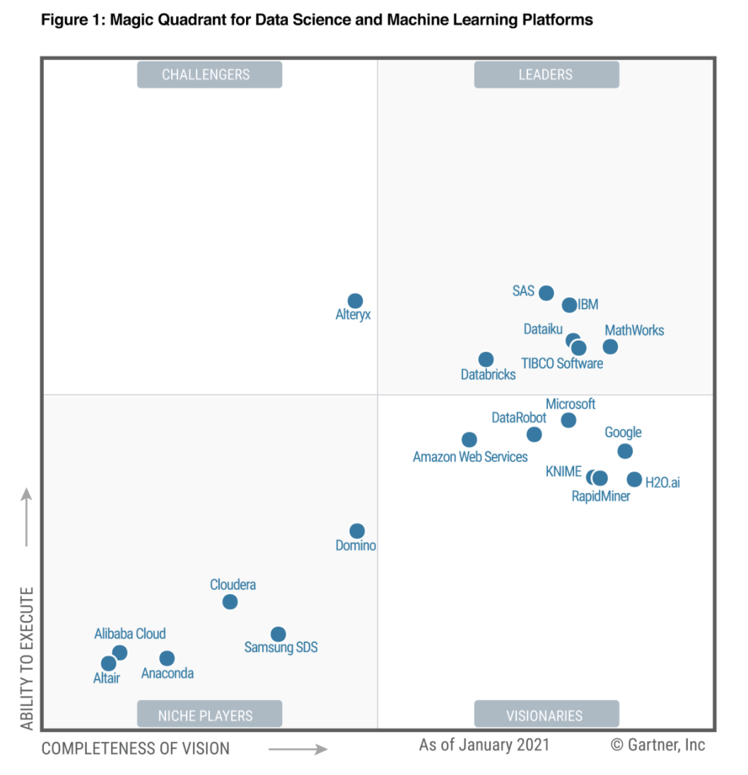
MathWorks Is a Leader in 2021 Gartner Magic Quadrant
For Data Science and Machine Learning
MathWorks benefits from deep domain expertise
Verifiable and reliable ML: Safety is typically critical in the asset-centric domains
https://www.gartner.com/reviews/market/data-science-machine-learning-platforms

Slide 6
Interpretability & Verification in AI
AI Interpretability: Whiten the black-box
Validated & Verified AI: The new « V&V »
V

Slide 7
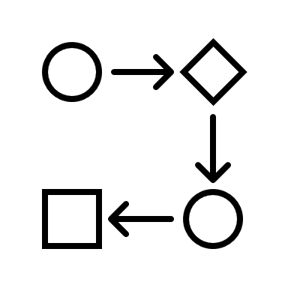
AI Interpretability: Whiten the black-box
Typical AI Workflow
Domain Expert
Access, Generate & Preprocess Messy (Big) Data
Features Extraction & Selection
Build/Validate Machine/Deep Learning model on subset of data
Verified AI: Interpretability & Unit Testing
Scale Model to all data on cluster

Slide 8
AI Interpretability: Whiten the black-box
Typical AI Workflow
Data Scientist / Engineer
Access, Generate & Preprocess Messy (Big) Data
Features Extraction & Selection
Build/Validate Machine/Deep Learning model on subset of data
Verified AI: Interpretability & Unit Testing
Scale Model to all data on cluster

Slide 9
AI Interpretability: Whiten the black-box
Typical AI Workflow
Data / IT Engineer
Access, Generate & Preprocess Messy (Big) Data
Features Extraction & Selection
Build/Validate Machine/Deep Learning model on subset of data
Verified AI: Interpretability & Unit Testing
Scale Model to all data on cluster

Slide 10
AI Interpretability: Whiten the black-box
MATLAB focus on domain expertise
Typical AI Workflow
Until satisfied Accuracy & Explainability
Access, Generate & Preprocess Messy (Big) Data
Features Extraction & Selection
Build/Validate Machine/Deep Learning model on subset of data
Verified AI: Interpretability & Unit Testing
Scale Model to all data on cluster

Slide 11
AI Interpretability: Whiten the black-box
Don’t worry, domain expertise remains the most important!
You can prototype very quickly Machine/Deep/Reinforcement Learning models without coding with apps
You can use off the shelf interpretability functions and apps to explain these models
You can build easily oriented-object testing frameworks
➔ Your domain expertise still remains the most valuable in the AI workflow: preprocessing data & features extraction are not really overperfoming AI
Notes:
Trial and error = méthode essai-erreur
RL is a type of ML that learns through trial and error. It allows you to learn a behavior or accomplish a task.
When these problems get really complex, we can leverage deep learning to accomplish our goal.

Slide 12
AI Interpretability: Whiten the black-box
Questions we need to ask about Black box models
Why was a customer’s loan application declined?
Are there any fairness and ethical bias issues with the model?
Under what conditions will our Fraud detection model fail?
What are the main drivers in the model?
Is the model consistent with known relationships?
How do I account for highly correlated predictors?
How does the model behave under different environments?
How are account level variables affecting impact of macro-economic variables?

Slide 13
AI Interpretability: Whiten the black-box
Performance vs Explainability
NNs (eg. Deep Learning)
SVMs
Boost and Ensamle
Random Forest
K-NN
Typical Performance
Decision Tree
Logistic Regression
Linear Regression
Model Explainability

Slide 14
AI Interpretability: Whiten the black-box
Use case: Arrythmia Detection
Goal: Detect abnormal heartbeats from ECG – Correctly classify heartbeats from ECG data as “abnormal” or “normal”
How: Apply machine learning modelling & interpretability algorithms to see what features are driving those models
Data: 8 derived features from Holter recordings of an ECG (intervals, ratios, means & amplitudes)
Arrythmia
https://archive.physionet.org/physiobank/database/html/mitdbdir/intro.htm#selection

Slide 15
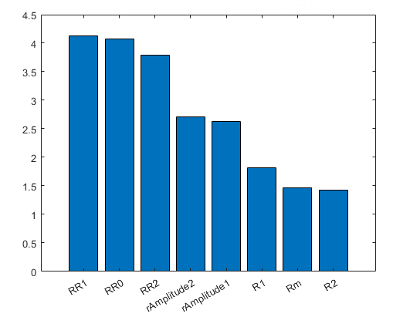
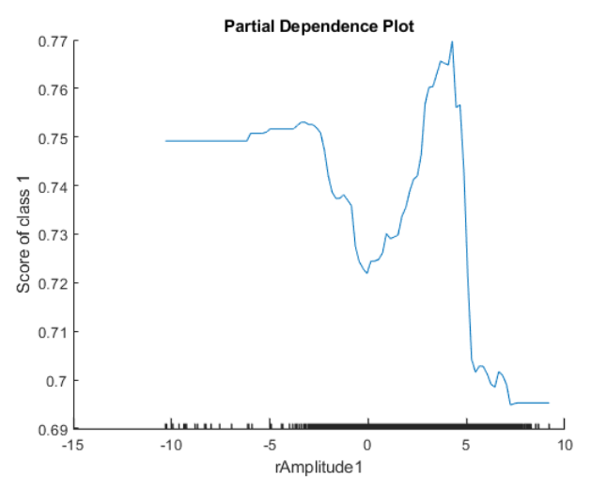
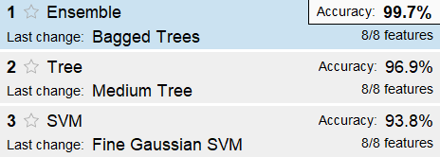
Use case: Arrythmia Detection
1 - Build machine learning models on all features
Use machine learning classification app to select & validate the best model: bagged trees, validation accuracy = 99.8%
Interpretability:
Predictor Importance: rAmplitude should not be pertinent
Partial Dependency Plot (PDP): 5% increase of proba to be abnormal
➔ Biais in the model…
Notes:
Le concept est très simple: nous mesurons l'importance d'une entité en calculant l'augmentation de l'erreur de prédiction du modèle après avoir permuté l'entité. Une caractéristique est "importante" si le mélange de ses valeurs augmente l'erreur de modèle, car dans ce cas, le modèle s'est appuyé sur la caractéristique pour la prédiction. Une fonctionnalité est "sans importance" si le mélange de ses valeurs laisse l'erreur de modèle inchangée, car dans ce cas, le modèle a ignoré la fonctionnalité pour la prédiction
Un PDP visualise les relations entre les caractéristiques et les réponses prévues dans un modèle entraîné.
Techniquement, le tracé de dépendance partielle peut être considéré comme une version de l'analyse de sensibilité qui crée soit un tracé linéaire, soit un tracé de surface pour visualiser la relation entre la réponse prévue par rapport à une seule entité ou à une paire d'entités.
Il est également intéressant de noter que la ligne ou la surface dans PDP est la valeur moyenne.

Slide 16
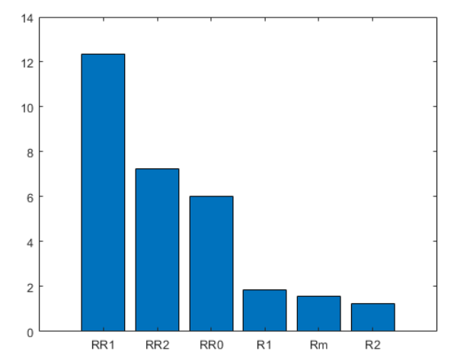
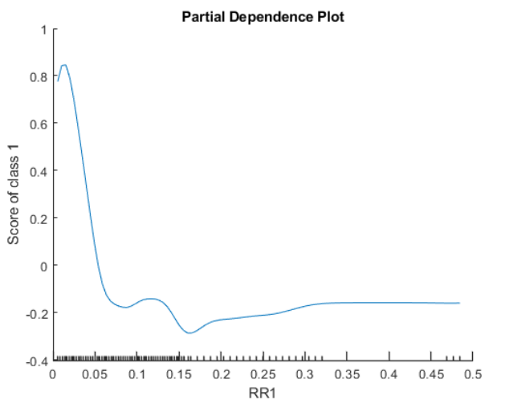
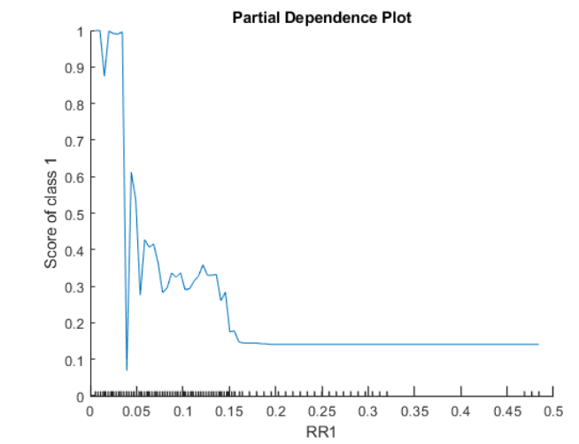
Use case: Arrythmia Detection
2 – Retrain models without rAmplitude 1 & 2
Use machine learning classification app to select & validate the best model: bagged trees, validation accuracy = 99.9%
Interpretability:
Predictor Importance: RR1 most pertinent
Partial Dependency Plot (PDP): Coherent with theo
Compare with other model to validate: Same behavior for fineGaussian model
Notes:
Un PDP visualise les relations entre les caractéristiques et les réponses prévues dans un modèle entraîné.
Techniquement, le tracé de dépendance partielle peut être considéré comme une version de l'analyse de sensibilité qui crée soit un tracé linéaire, soit un tracé de surface pour visualiser la relation entre la réponse prévue par rapport à une seule entité ou à une paire d'entités.
Il est également intéressant de noter que la ligne ou la surface dans PDP est la valeur moyenne.

Slide 17
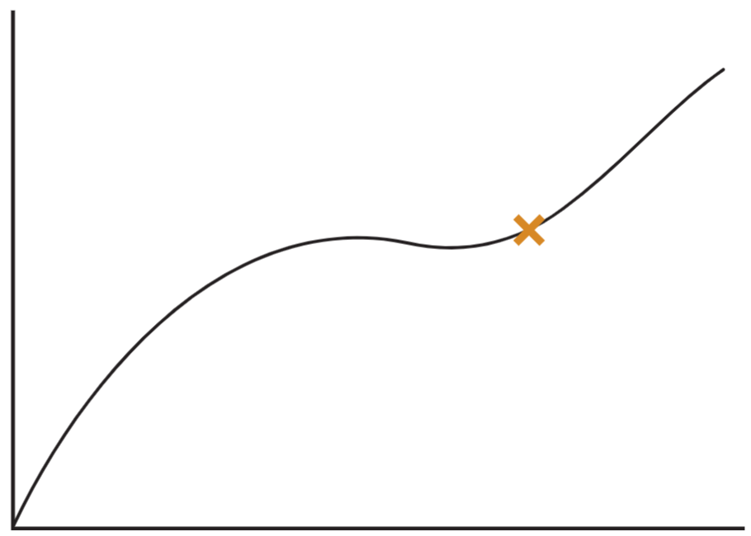
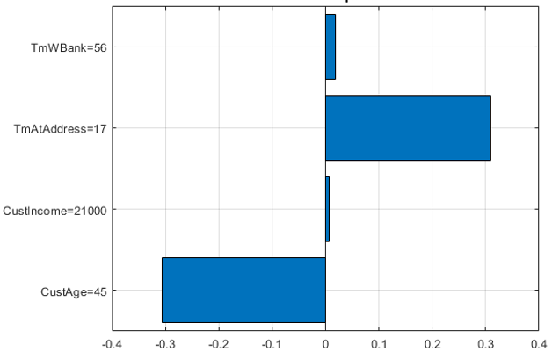
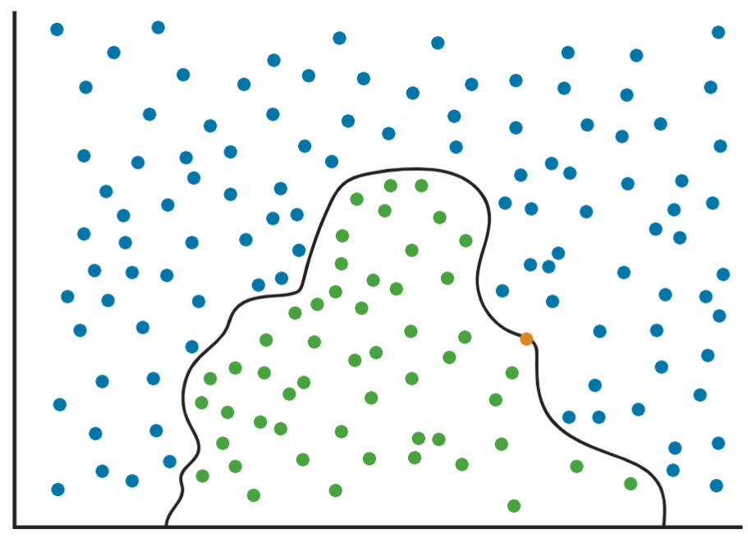
Use case: Arrythmia Detection
LIME
Approximate complex model near Point of Interest with simple model
“Explain” using weights of simple model
1
2
Notes:
LIME is “local interpretable mode-agnostic explanation”
Local Surrogate models sont des modèles interprétables qui sont utilisés pour expliquer les prédictions individuelles des modèles d'apprentissage automatique de la boîte noire. Les modèles Local Surrogate sont entraînés pour approximer les prédictions du modèle de boîte noire sous-jacent. Au lieu de former un modèle de substitution global, LIME se concentre sur la formation de modèles de substitution locaux pour expliquer les prédictions individuelles.
Ici, on voit des résultats sensiblement similaires à ceux de la Feature Importance, avec les impacts positifs ou négatifs.

Slide 18
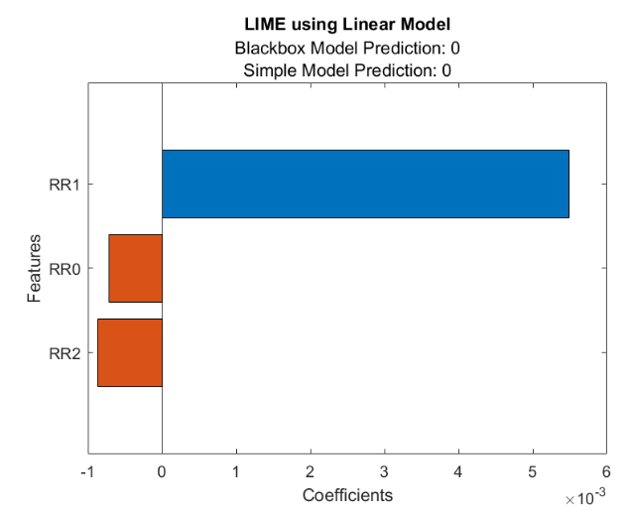
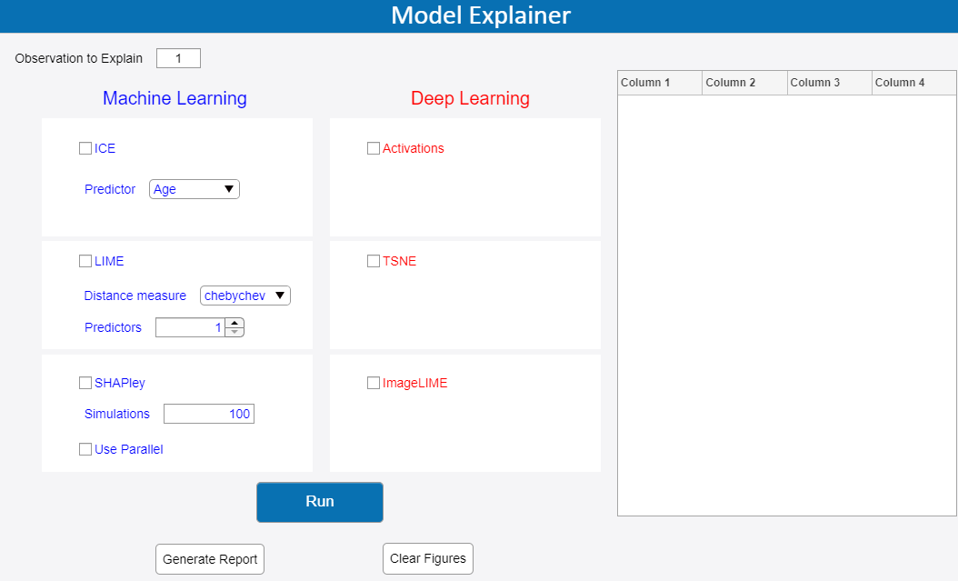
Use case: Arrythmia Detection
3 – What happens when the model is wrong?
Select some individual observations with wrong prediction
Apply LIME function to see what factors are most important for these obs
Bonus: Use Model Explainer App to interpret the model faster & interactively
Notes:
We see here that our Blackbox model predictions do not match up with our linear approximation. Linear surrogate models only try to mimic the Blackbox model and are by no means a 1:1 matching. In situations like this, the validity of the linear model compared to our Blackbox one should be taken with a grain of salt, and we may need to change the hyperparameters of our LIME object to match up with Blackbox(add more predictors, etc)

Slide 19
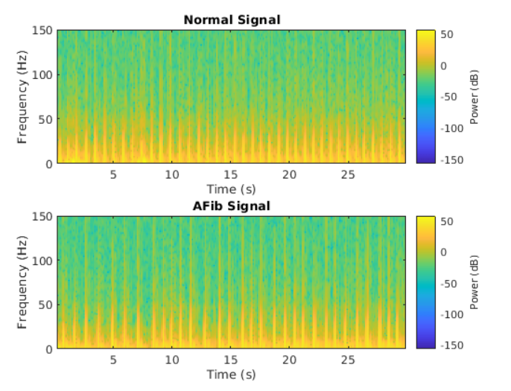
Use case: Arrythmia Detection
4 – To go further…
Signal analysis to transform sequential data to images
Build machine & deep learning models
Apply image interpretability algorithms like Grad-CAM, LIME, etc.
Classified as “keyboard” due in part to the presence of the mouse
Incorrectly classified “coffee mug” as “buckle” due to the watch
Notes:
L'attribution est similaire en ce qu'elle détermine les parties de l'image qui affectent le plus la prédiction.
Contrairement au LIME, qui est indépendant du modèle, bon nombre de ces techniques reposent sur une back propagation à travers un réseau profond
Dans ces deux exemples, nous voyons que
(à gauche) la présence du clavier aide le modèle à déterminer qu'il s'agit d'une image de souris. Cela peut ou non être une manière valable de prendre cette décision
(à droite) cette image est incorrectement prédite par le modèle comme une «boucle» lorsque nous la considérons comme une «tasse». Quelle est la bonne: le modèle ou la vérité terrain? Cela variera d'un cas à l'autre et différents recours seront nécessaires

Slide 20
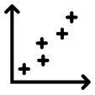
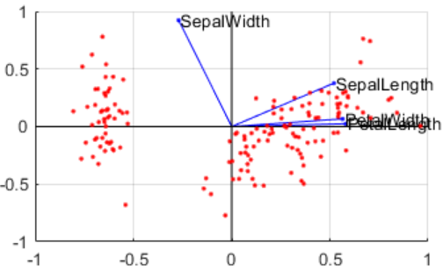
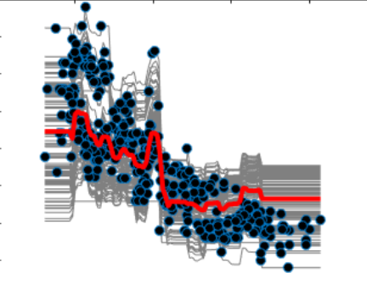
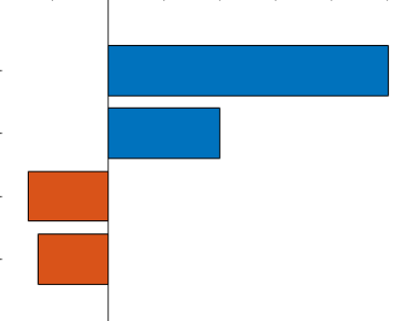
AI Interpretability: Whiten the black-box
Different interpretability methods
Intrinsic
Post hoc
Specific
Predictor Importance
(trees & ensemble)
Regression
Tree Models
Occlusion Sensitivity CAM, Grad-CAM
Activation
Correlation
Partial Dependence Plot
Agnostic
ACP
Individual Conditional Exp
Accumulated Local Effects
tSNE
LIME
Local methods
Shapley values
GAM
MRMR

Slide 21
Interpretability & Verification in AI
Validated & Verified AI: The new « V&V »
AI Interpretability: Whiten the black-box
V
Notes:
Local Surrogate models sont des modèles interprétables qui sont utilisés pour expliquer les prédictions individuelles des modèles d'apprentissage automatique de la boîte noire. Les modèles Local Surrogate sont entraînés pour approximer les prédictions du modèle de boîte noire sous-jacent. Au lieu de former un modèle de substitution global, LIME se concentre sur la formation de modèles de substitution locaux pour expliquer les prédictions individuelles.
Ici, on voit des résultats sensiblement similaires à ceux de la Feature Importance, avec les impacts positifs ou négatifs.

Slide 22
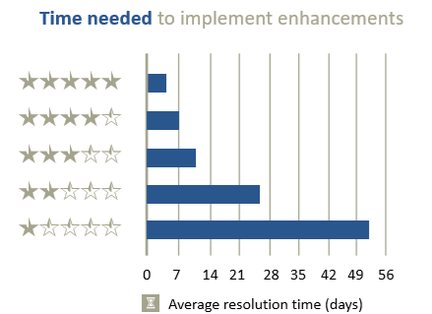
Validated & Verified AI: The new « V&V »
Code Maintenance – The hidden cost of development
How do you ensure code doesn’t break over time?
How do you keep new features from breaking existing features?
How do you maintain confidence that your code is working as expected?
Maintainability rating
Notes:
One of the biggest underestimated costs of software development is the actual cost of code maintenance. This includes code updates to prevent the code from breaking, fixing it efficiently when it does, and building overall confidence in the software.

Slide 23
Validated & Verified AI: The new « V&V »
Test early, test often, test automatically
Reduce Risk of code breaking
Document expect behavior
Catch problems early
Improve code quality
Notes:
Next, we have a really important topic -> testing.
Now, most of us generally test the code we write by running it once or twice with some example inputs and, for many people, that’s usually good enough.
But how many of you have made a change in your code and accidentally forgotten to test it, only to find the error show up later?
That’s definitely a scary surprise.
As your code matures and your work becomes more important and safety-critical, this informal way of testing code is very much not good enough.
Formal code testing, as in writing extra code to test your actual code, is crucial to reducing the first of code break, catching problems early, and improving your code quality. Furthermore, these tests can help inform co-authors and developers what the expected behaviour should be of your code.
By testing early, you can discover problems in your code closer to the time that you developed your code. This is a big efficiently win -> fixing problems when they happen, when you’re most likely to understand what might have caused the issue (versus 6 months to 1 year later).
Many people ask themselves: “Do I need testing?”
The real question is: “Do I care if my code actually works?”
If the answer is yes, then you need testing!
If the answer is no, well… that’s a bit sad… but, in that case, you might not need testing. This is sometimes the case when you’re writing a one-off script to accomplish some task you’ll never have to repeat again. But be careful not to fall into the trap of thinking all of your code is simply a one-off algorithm or unique. You can oftentimes generalize and reuse algorithms (and therefore need to test them) to save time and effort in the long run.
[also see https://uk.mathworks.com/videos/matlab-unit-testing-framework-74975.html]

Slide 24
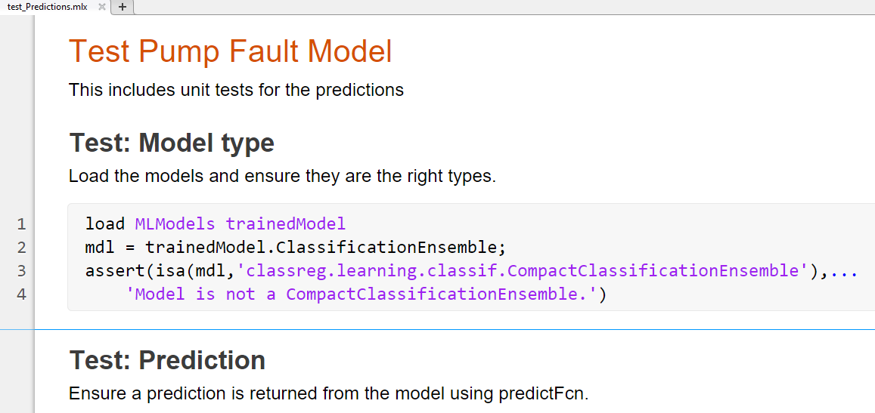
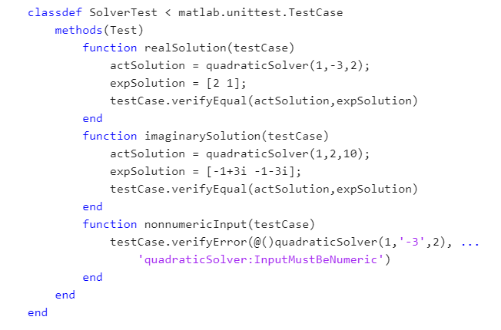
Validated & Verified AI: The new « V&V »
Testing Framework
Script-based test
Function-based test
Class-based test
Notes:
The MATLAB Unit Testing Framework is incredibly flexible in how it can be developed. You can write your tests as a script, function, or class, and, as discussed earlier, the tests integrate with Projects and test running and reporting can be automated via Continuous Integration servers.

Slide 25
Validated & Verified AI: The new « V&V »
Benefits of Continuous Integration (CI)
Repeatability
Quality
Speed
Collaboration
Audit Ready
Consistent, repeatable environment
Automate testing of latest changes
Test early, test often
Identify integration issues quickly
Trace issues to the source
Notes:
What are the benefits of continuous integration?
Repeatability: CI provides consistent, repeatable, automated build and test processes, giving you confidence that your software always behaves as expected.
Quality: CI automates your testing, so you never forget to run your tests or run your tests on old, out-of-date code.
Speed: CI helps you catch issues earlier in the development, when they're easier and less expensive to fix.
Collaboration: CI streamlines the process of integrating the work of multiple developers, helping you catch those tricky integration issues.
Audit Ready: CI workflows provide an extensive audit trail. For every, you easily identify what changed, when it changed, who made the change, who reviewed the change, and any number of other details. This can make it easier to find the source of a problem and who the right person to fix it might be.

Slide 26
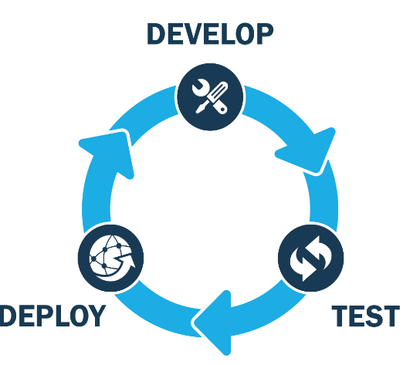
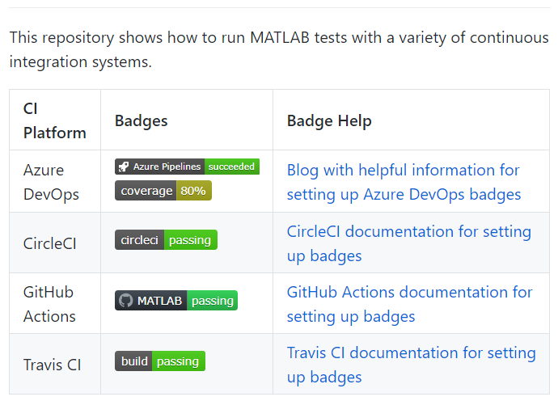
Validated & Verified AI: The new « V&V »
Automated Testing – Continuous Integration (CI)
Coverage & Test reports
Unit Testing Frameworks
MATLAB Github CI examples
Notes:
Now, even though you’ve written your tests, they’re only good if you remember to run them.
That’s where Continuous Integration servers come in. They are designed to automatically build, test, integrate, and deploy code, while keeping track of the testing history. This helps ensure that, not only does your code work now, but it has either been consistently working or, if it has not been consistently working, what version of the code introduced errors or instability.
This can significantly reduce the time it takes to find and fix bugs before they make it into widespread use.

Slide 27
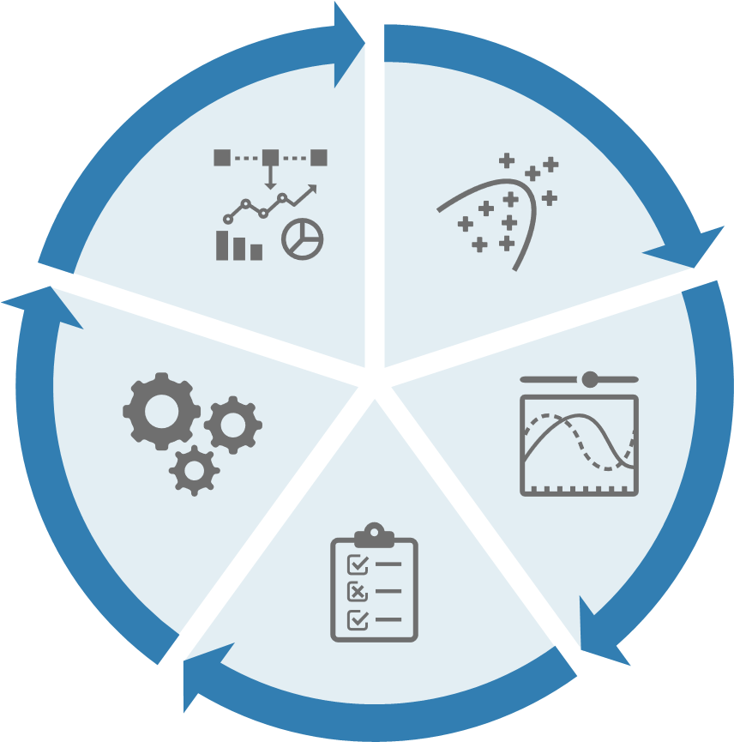
MATLAB is a strong brick of a whole automated ecosystem in industries
Modelling
Production
Scaling
CI/CD
Testing/Reporting

