Slide 1



An investigation of the utilisation of different data sources in manufacturing with application in injection moulding
G. Ø. Rønsch, M. Kulahci & M. Dybdahl,
International Journal of Production Research (2021),
DOI: 10.1080/00207543.2021.1893853
Georg Ørnskov Rønsch
Industrial PhD student
LEGO System A/S and DTU Compute
Supervisor: Murat Kulahci, DTU Compute

Slide 2

Best use of data from Injection Moulding
Time resolved Machine sensor signals
Machine Process Data
In mould sensors
(Pressure and Temperature)
?
Additional add-on sensors
Product Quality
Process Monitoring and Control
Machine and Mould Maintenance
Increase Productivity
In the current work we will investigate whether additional prediction power (for online prediction of quality) can be achieved by utilizing machine or cavity profiles compared to what can be achieved by using the standard available aggregated process data. It will also be evaluated if the cost of the additional prediction power can be justified by the expected gain in productivity.

Slide 3
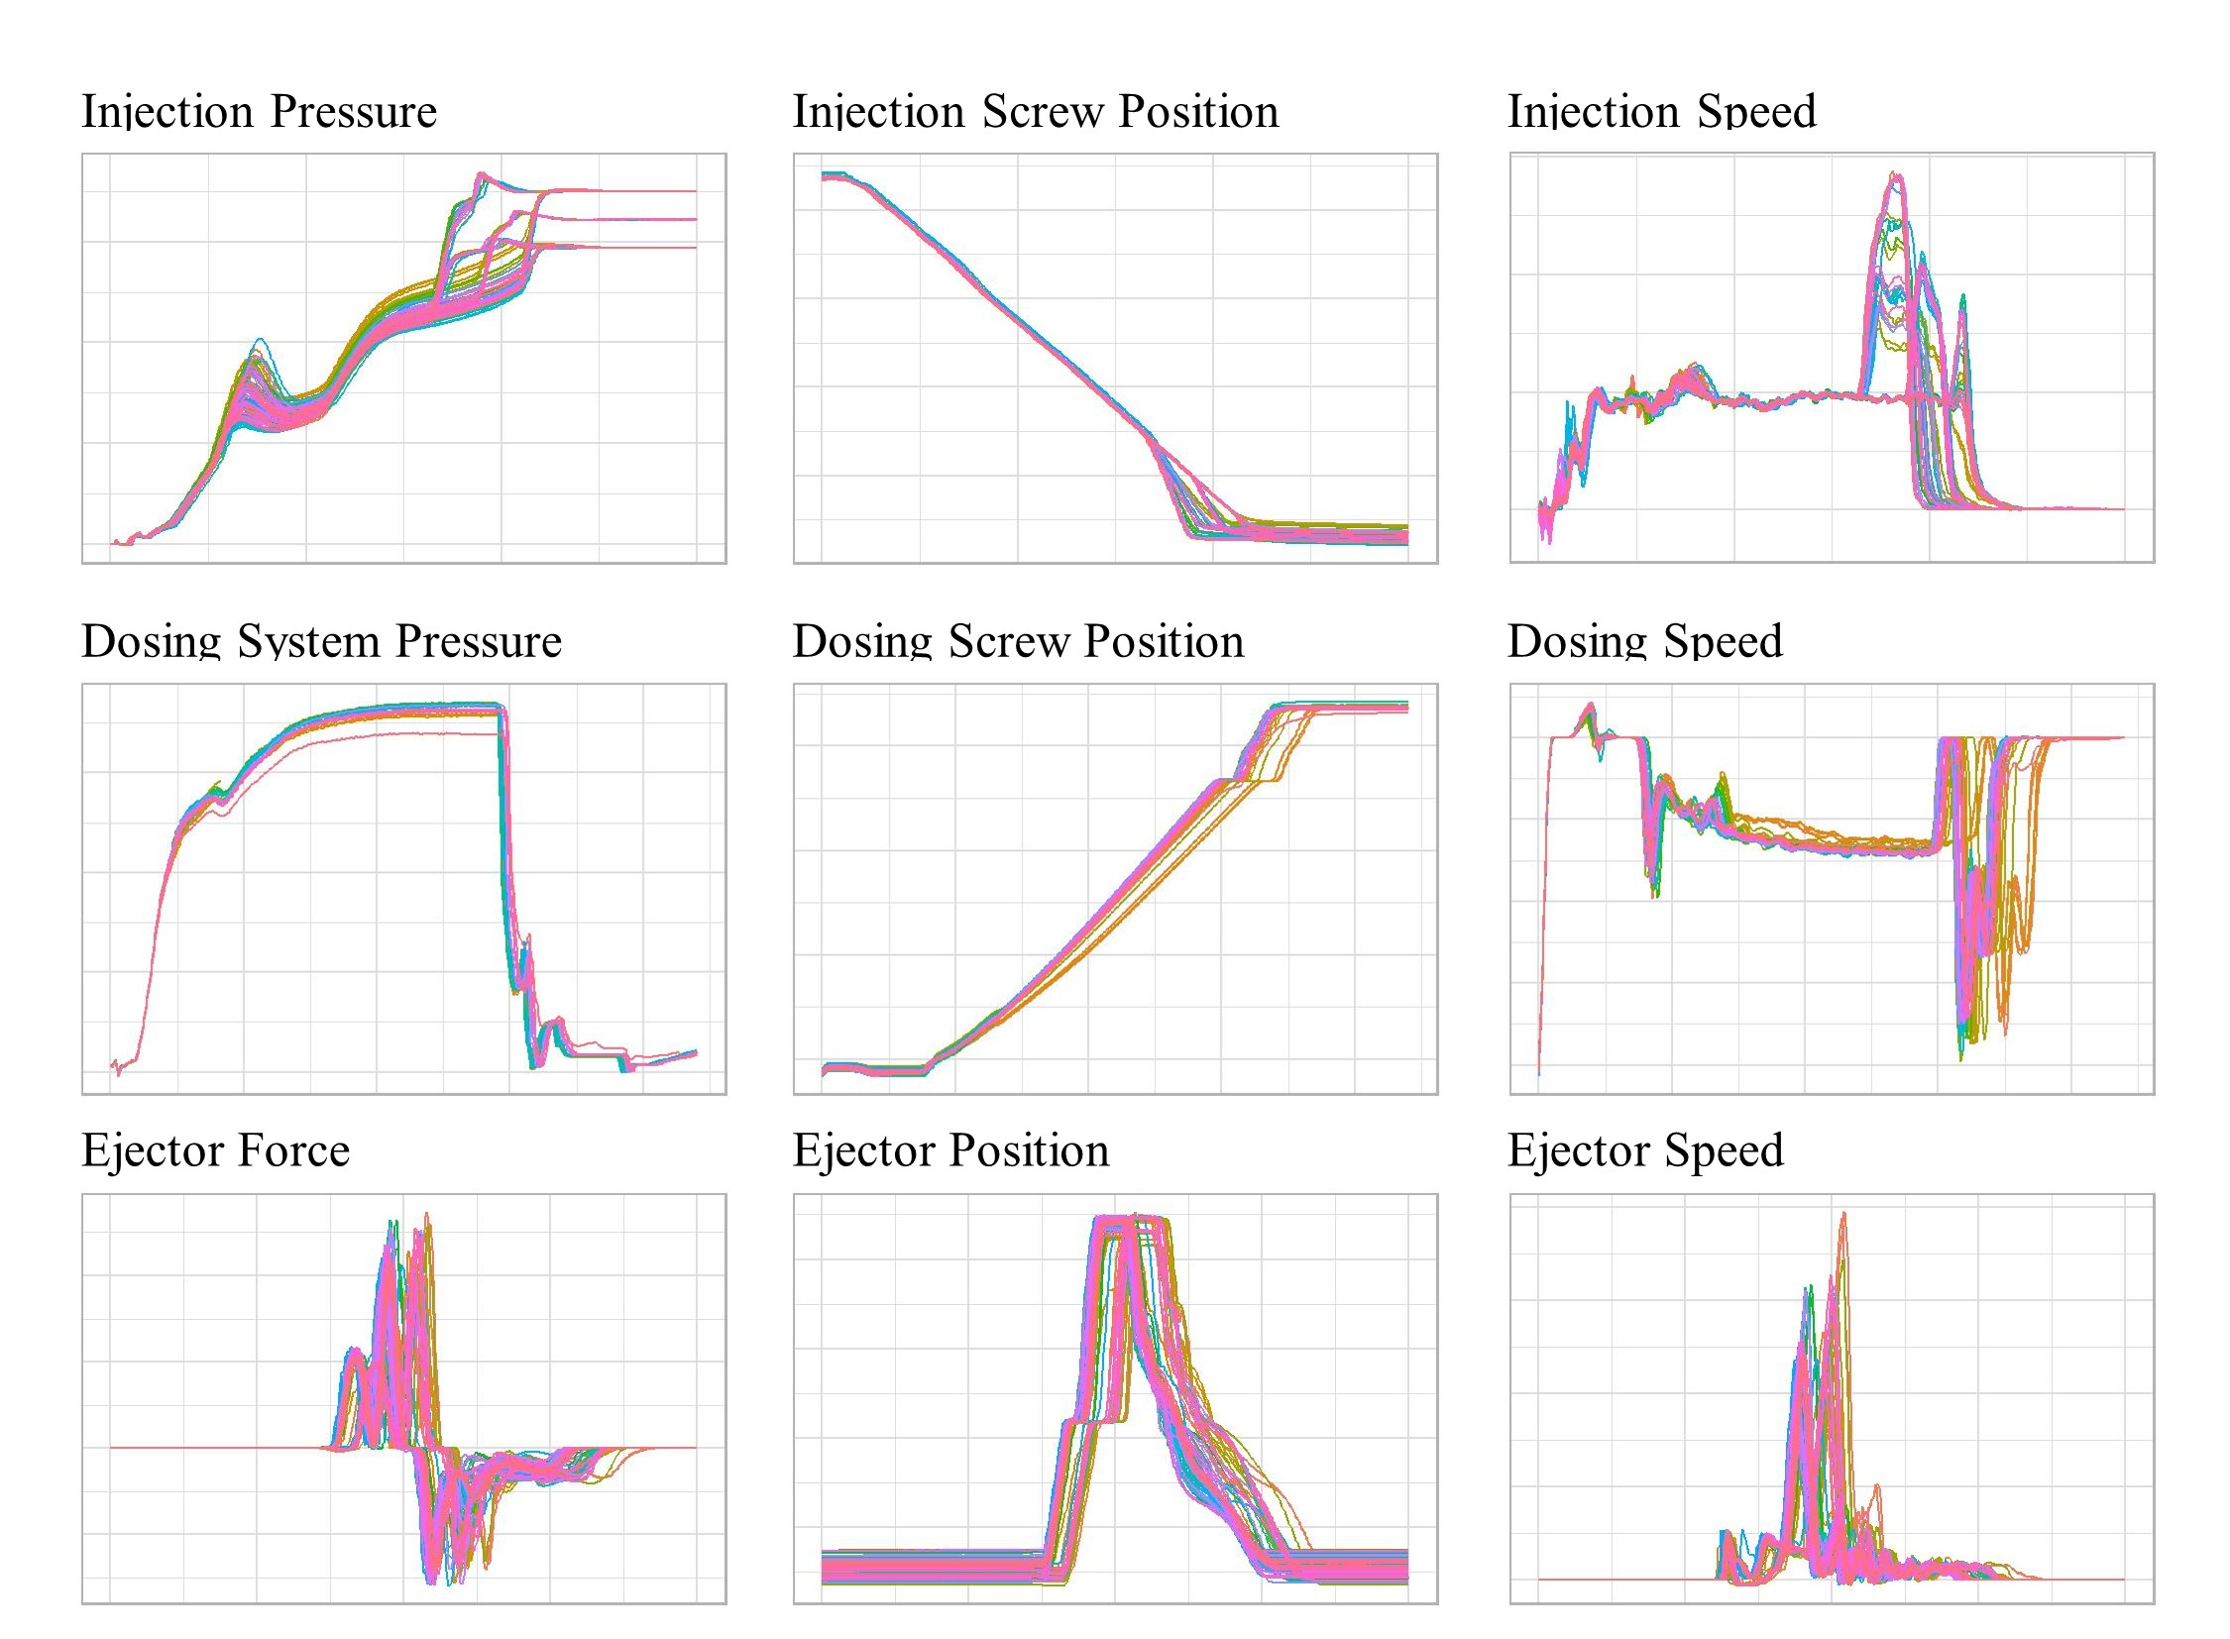
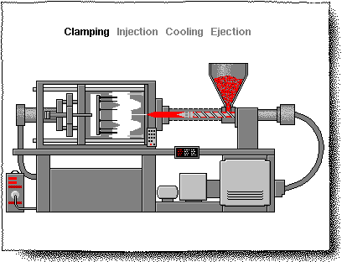
Injection moulding data
Process data
Machine Profiles
Measure:
Pressure
Temperature
Time
Distance
Holding press
Barrel temp
Injection time
Cushion
Parameter:
Example:
Peak
Difference
Average
https://www.docsity.com/en/news/education-2/plastic-processing-techniques-explained-interesting-gifs/%3Cbr+/%3E/

Slide 4
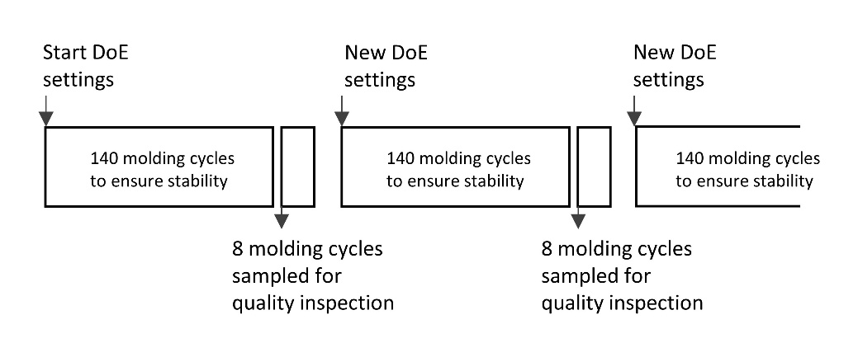
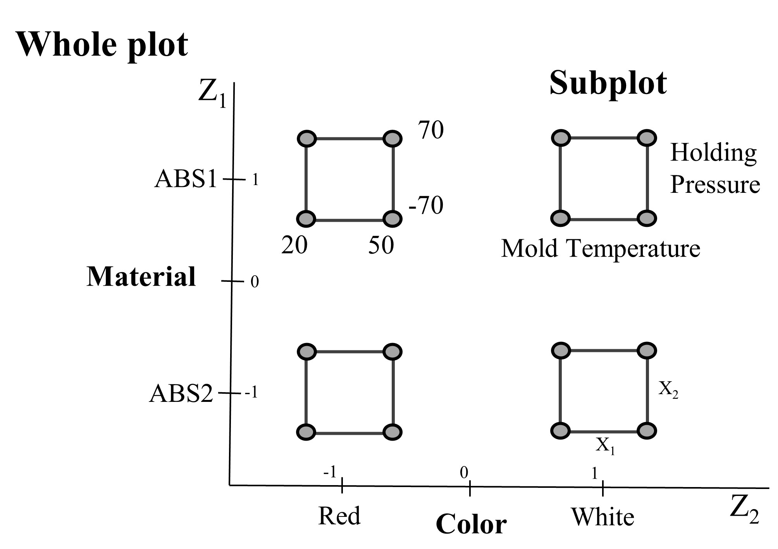
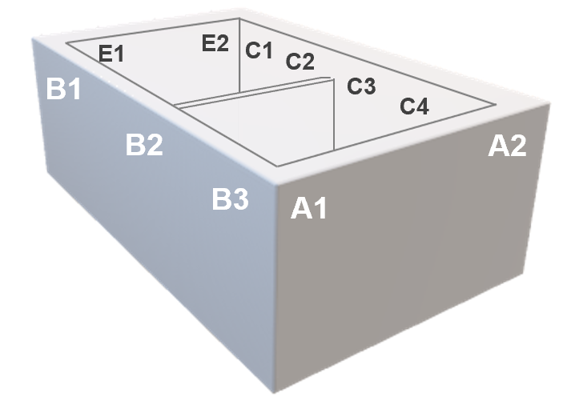

Experimental setup – Scope: Predict element dimensions
Shape of the molded element and measuring points
The design used is a replicated split plot design in the form of ${2 × 2}^{2}×2^{2}$ resulting in 32 test runs
4

Slide 5
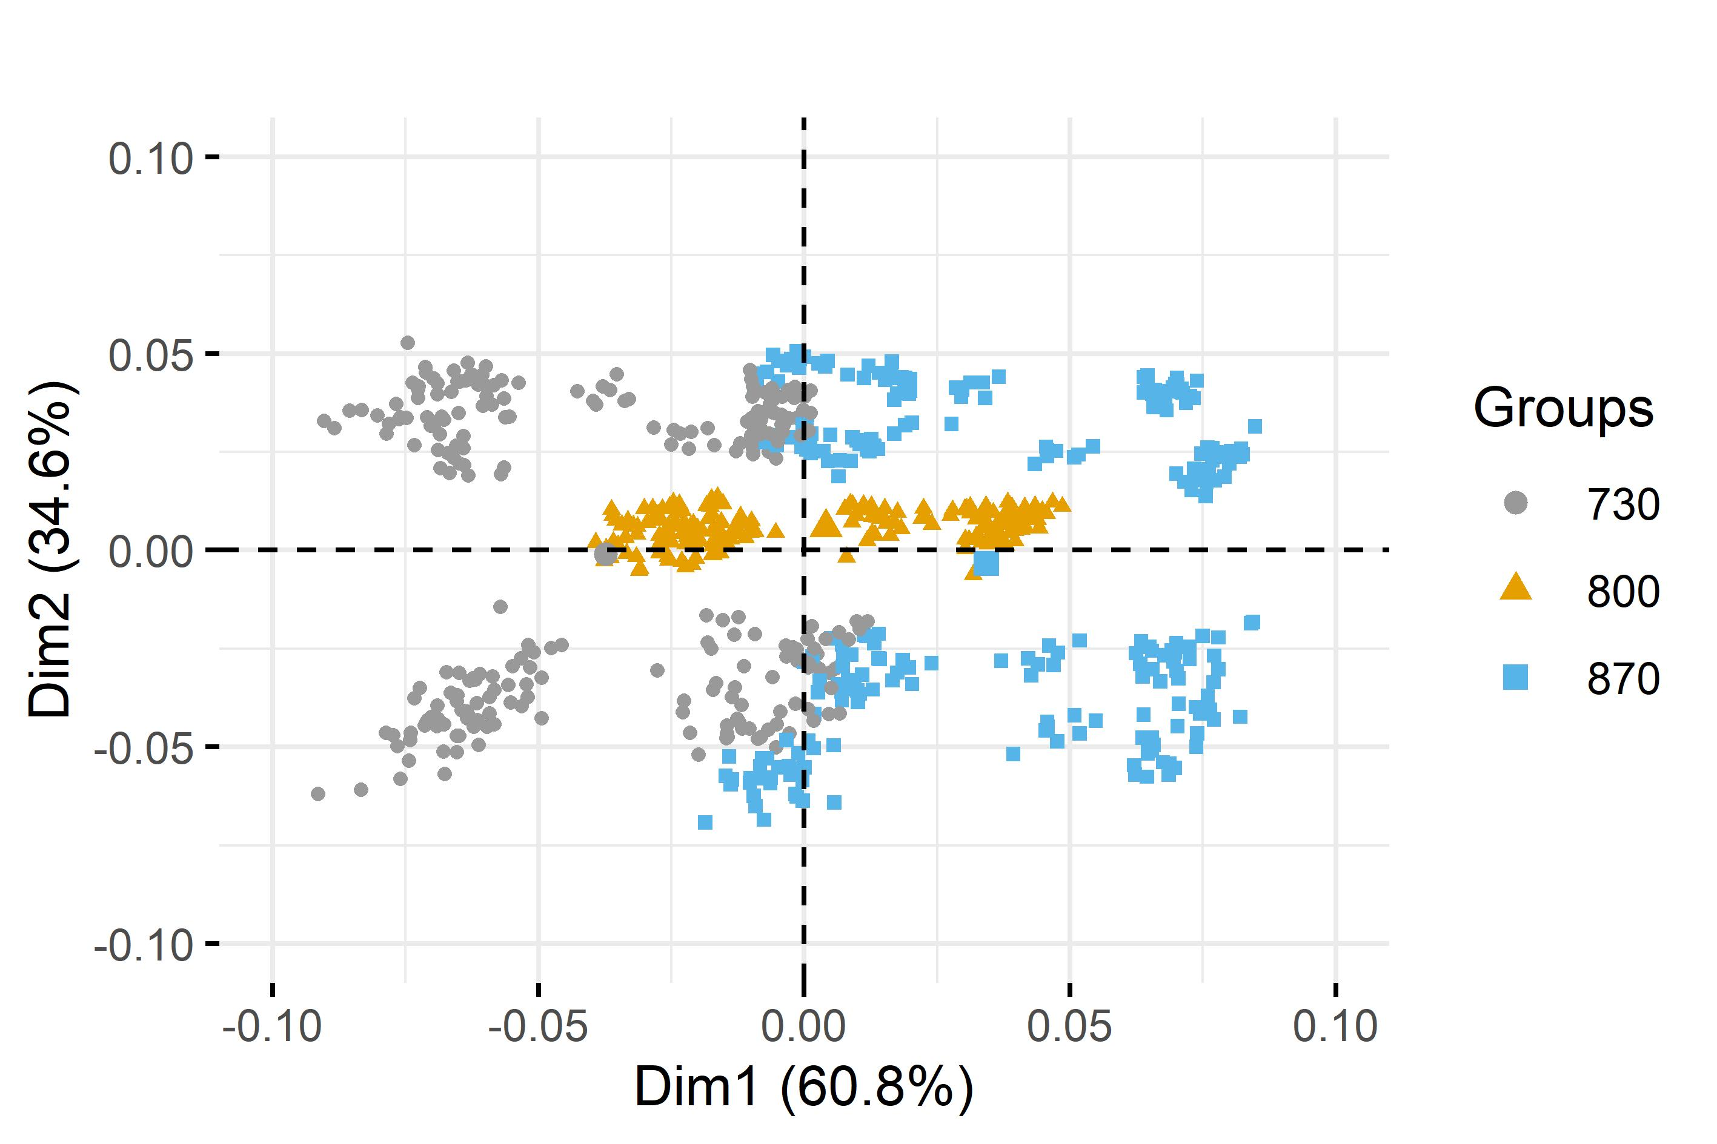
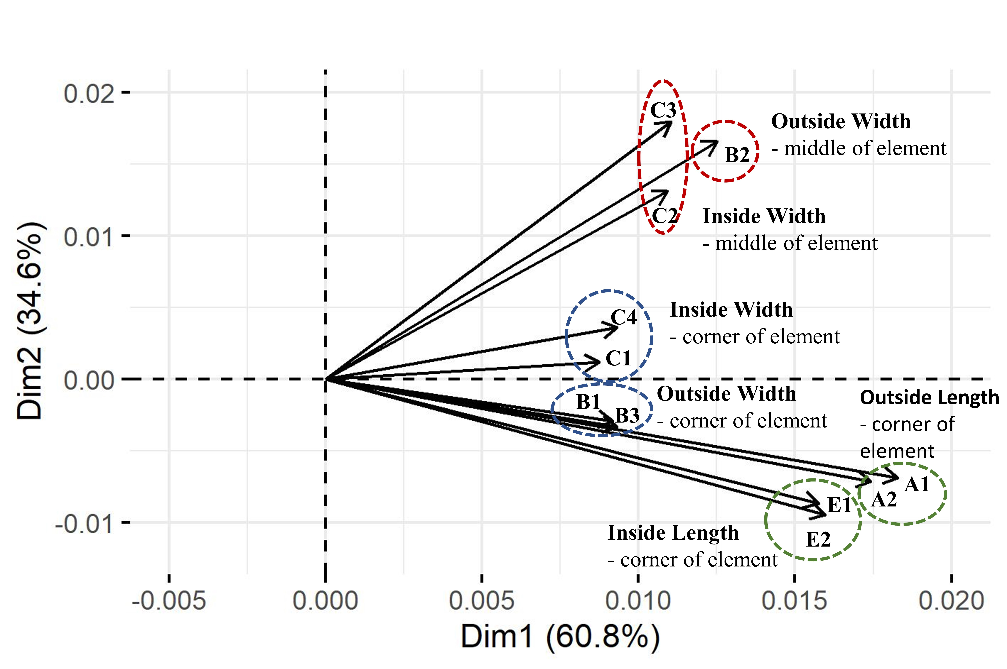
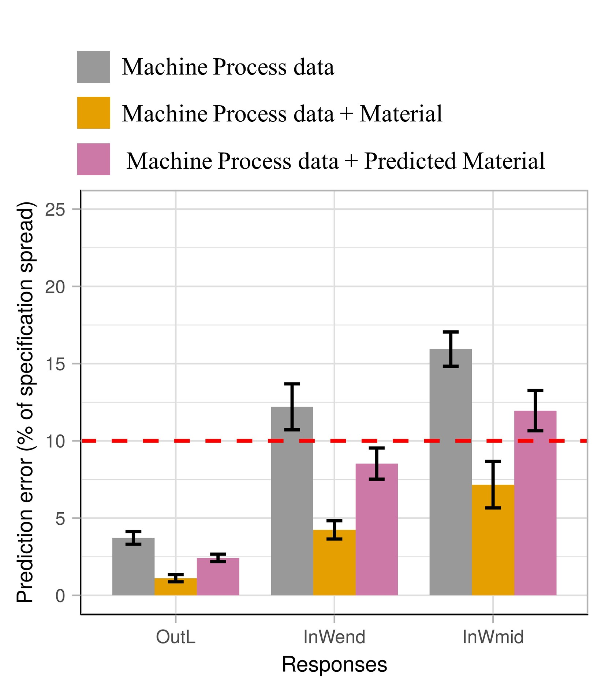
Results and reflections
Objective:
Predict element dimensions

Slide 6
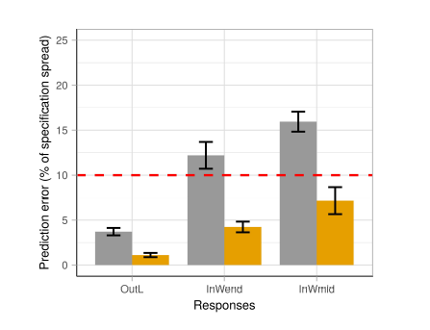

Linear models
-using process data to predict dimension of the produced elements
25
20
15
The readily available engineered process variables can bring you a long way.
Prediction error (% of specification spread)
10
5
0
(A1, A2)
Insight width mid
(InWmid - C2, C3)
Outside length
(OutL - A1, A2)
Insight width end
(InWend - C1, C4)
Responses
Better results could be obtained by using the DoE settings
Copyright © 2019 The LEGO Group
6

Slide 7
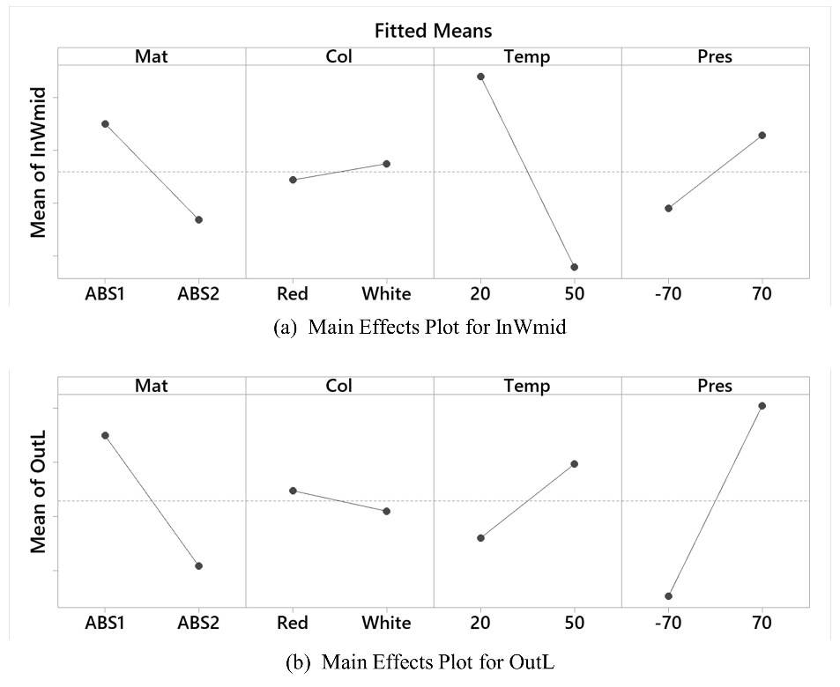
Evaluation of responses
DoE created and analyze in Minitab 19
7

Slide 8
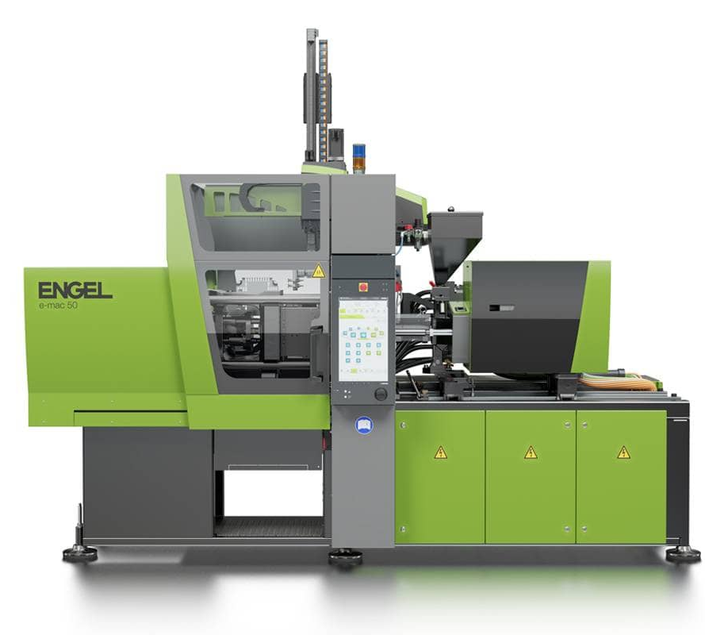

Raw material flow
- source of raw material is unknow at the injection moulding machine
Raw material storage silo
ABS 2
ABS 1

Slide 9
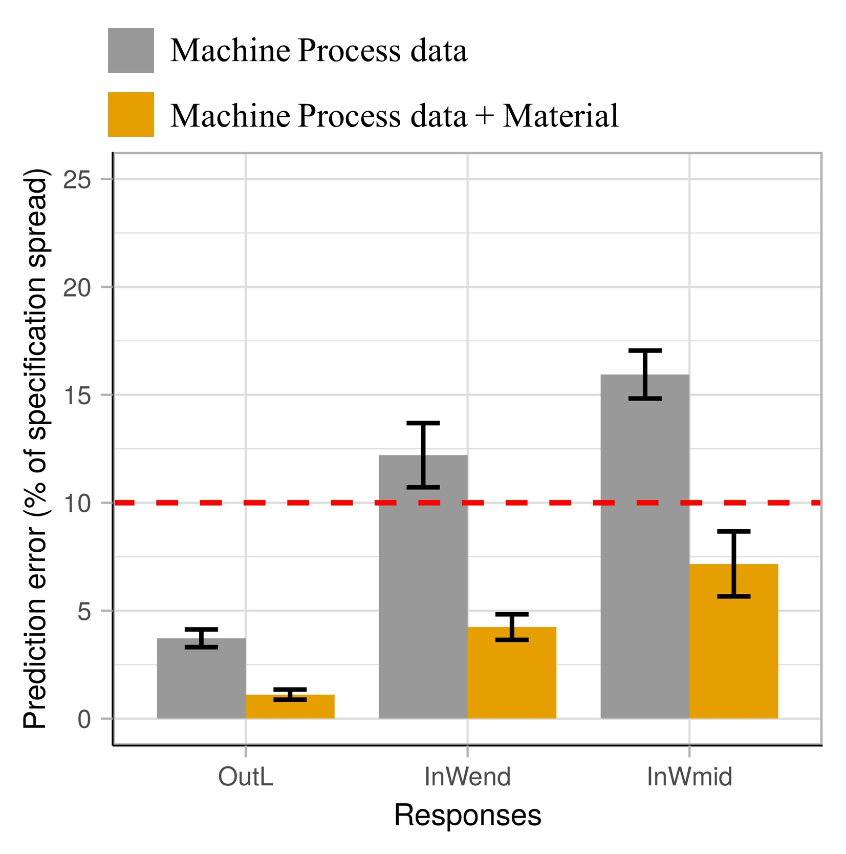
Linear models
-using process data and material information from DoE
Adding additional information to the readily available engineered process variables improves the model.
“This is indicating that information of material variation is not captured by the standard variables”

Slide 10
Raw material flow
- source of raw material is unknow at the injection moulding machine
Potential solutions:
Change material storage and handling system to achieve traceability.
Use NIR/IR at the machine or central placed in the feeding system to detect change in material (might also be possible to monitor variations over time).
Extract information of material variation from machine in-built sensors.
Raw material storage silo
ABS 2
ABS 1

Slide 11
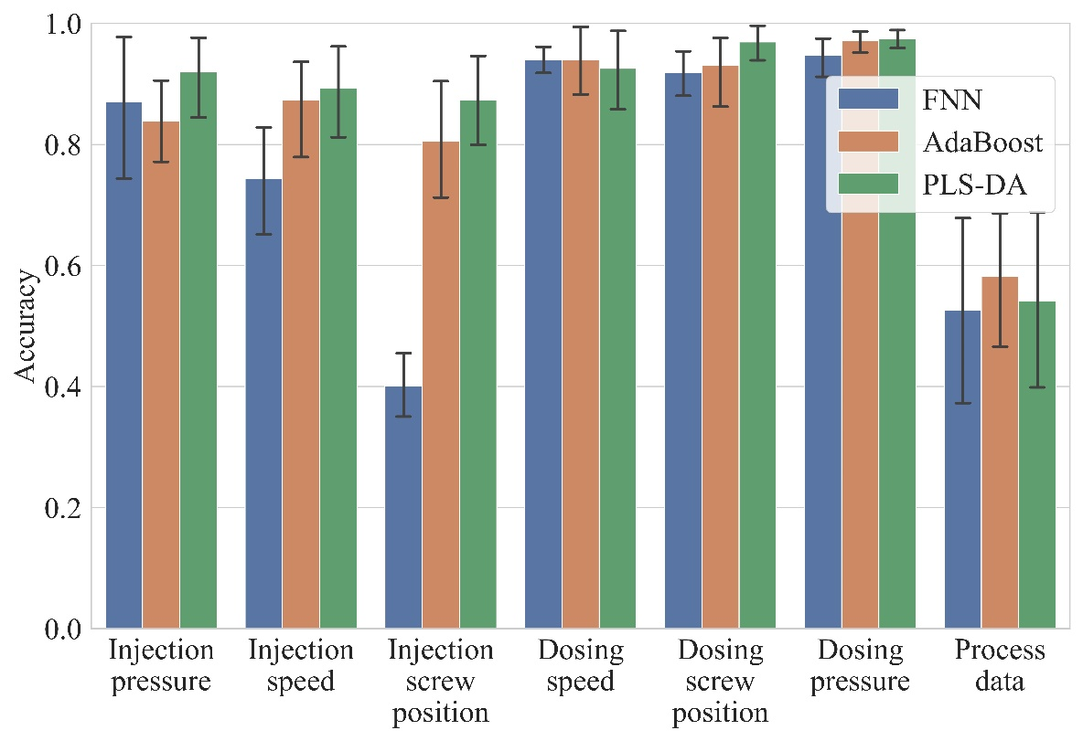
Material classification
ABS from vendor 1 or 2?
PLS-DA created in R using the “mdatools” package, AdaBoost using “adabag” and FNN using “keras”
11

Slide 12
Combined models
-using process data and predicted material information
Adding a prediction of material vendor to the readily available engineered process variables improves the model.
“This is indicating that information of material variation is present in the underlaying complex machine data”

Slide 13
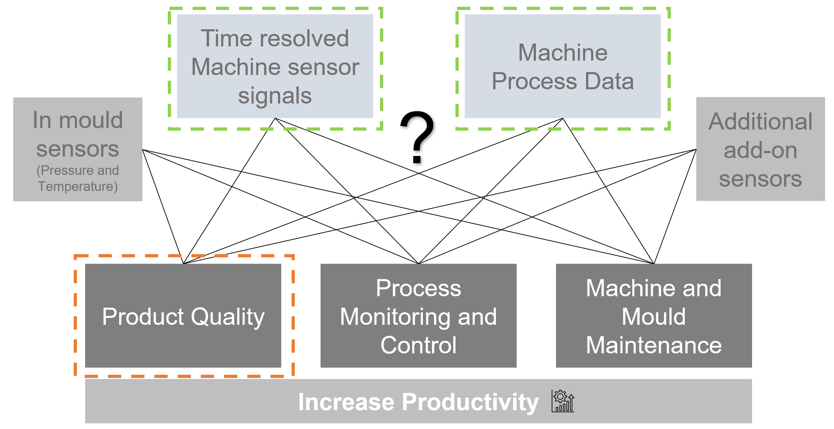
Reflections
Have a clear purpose before stating the data investigation – what is it you want to achieve?
What is the simplest data utilization that can support your goal?
The readily available engineered process variables can bring you a long way.
Consider the whole “cost of data utilization chain”, that include: connection, data collection, data storage, analytics and action/reaction.
G. Ø. Rønsch, M. Kulahci & M. Dybdahl (2021), An investigation of the utilisation of different data sources in manufacturing with application in injection moulding, International Journal of Production Research, DOI: 10.1080/00207543.2021.1893853

