Slide 1
Big DoE: Sequential and Steady Wins the Race?
David Wong-Pascua | Senior Scientist, CatSci
Phil Kay | Learning Manager, SAS
Ryan Lekivetz | Principal Research Statistician Developer, SAS
Ben Francis | Systems Engineer, SAS

Slide 2
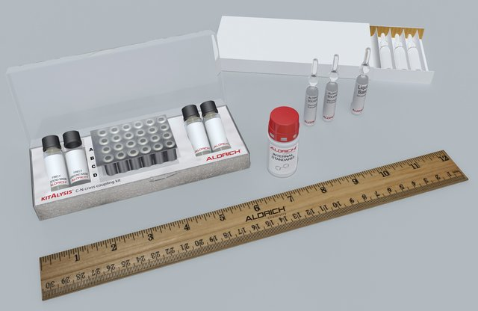
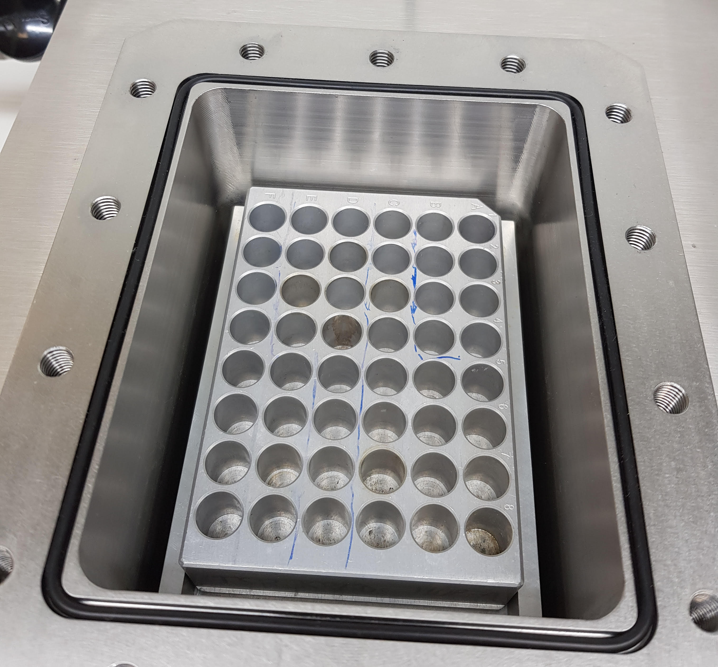

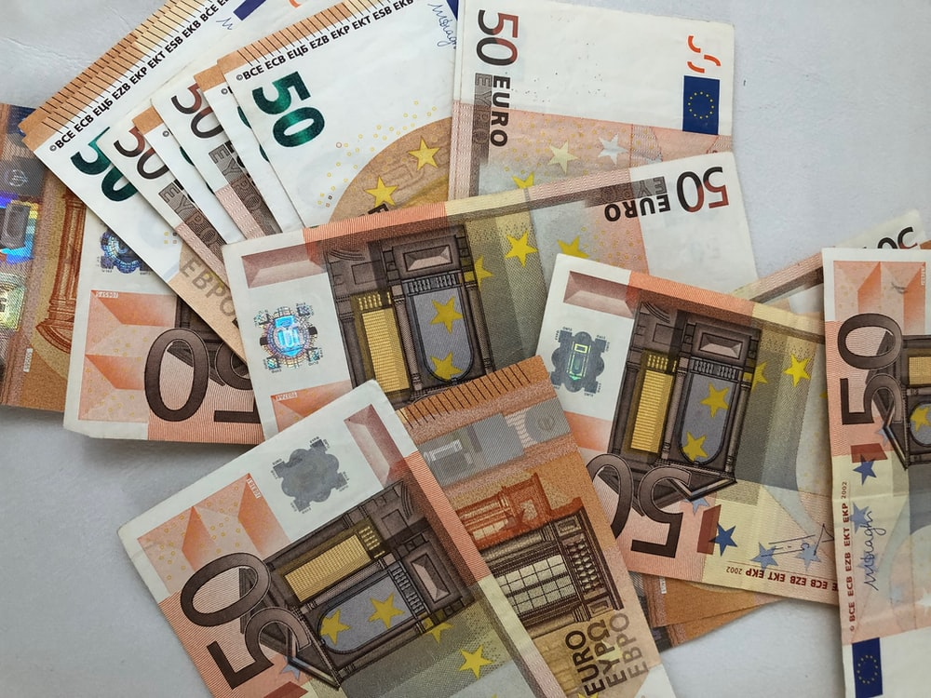
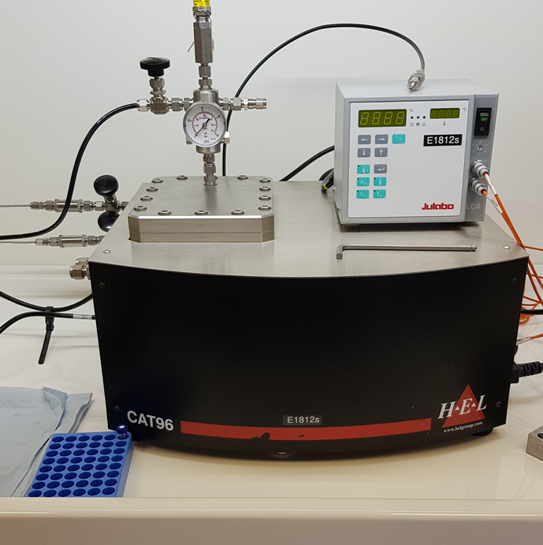


Motivation
Process Optimization - Big Challenges
Notes:
David
Upstream of process optimization, there is a challenge in the selection of categorical variables
Many (categorical) factors are involved in catalyst screening:
Metal precursor, ligand, reagent, solvent, additive
High order interactions are common
Materials are expensive
Price of gold = 1863 USD/oz., price of rhodium = 19750 USD/oz.
Price of Josiphos J001 ligand = 4210 USD/oz.

Slide 3
Perera et al. (2018) A platform for automated nanomole-scale reaction screening and micromole-scale synthesis in flow
Notes:
David

Slide 4
DoE Approaches
The Constraints and Metrics
  Does it reduce resource requirements? Saving Time and Money
    Allowed to design an experiment with 480 runs in total (10 x 48 well plates).
    ~10% of the runs performed in the paper.
  Does it get it right first time? Delivering an Immediately Applicable & Viable Solution
    How many of the 80 high yield (>95%) combinations were tested/predicted by the model generated?
    With 10% of the runs, the expectation is at least 8 high yield combinations.
  Does it get it right every time? Better Understanding of the System Overall
    What was the test R² of the final model generated? Can we provide process insight?
    Using the full 4,608 dataset, the best test R² was 0.89. (Boosted Tree)
Notes:
David

Slide 5
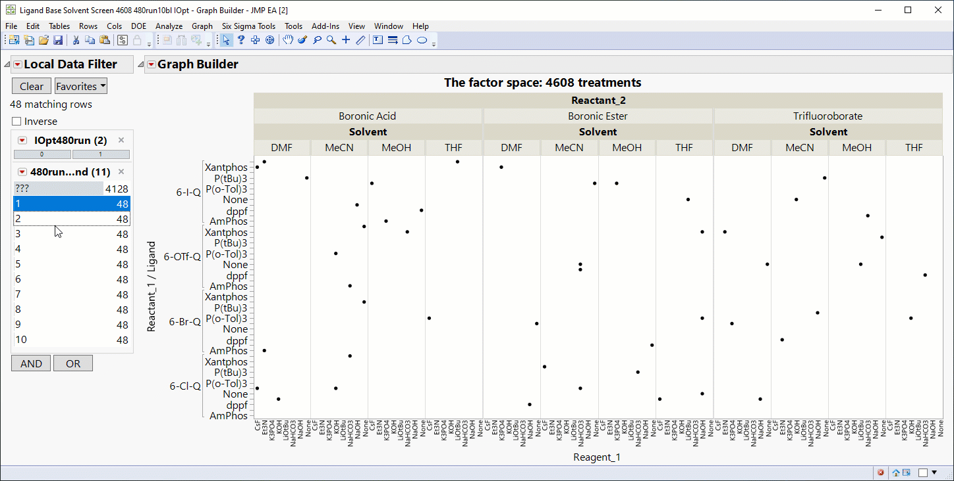
Conservative DoE Approach
Notes:
Ben
You see here that the first approach was to explore the entire design space.
Notice there’s no yield detailing here.
So, after every round of 48 runs, we’re asking the question “what area hasn’t been explored?”
The 480 runs and 10 “rounds” from the experiment were labelled in the complete 4608 row table
The remaining 4128 rows are labelled as the test data
Here we can see the runs from the experiment from rounds 1 to 10
The 480 runs explore the entire factor space
- 480 run I-optimal in 10 block design

Slide 6
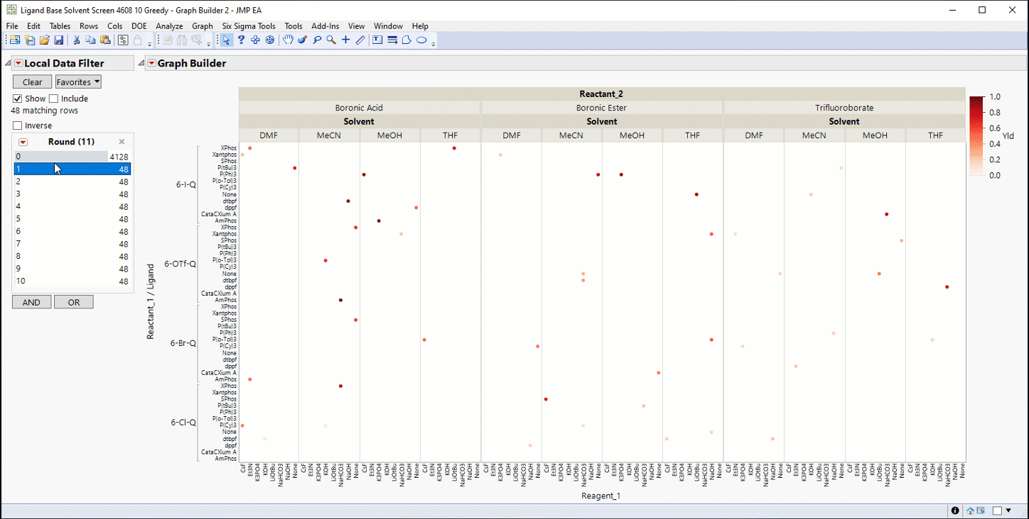
Greedy DoE Approach
Notes:
Ben
The second approach was to exploit high yielding regions of the design space.
After each round, a model is built, and the next round consists of the 48 of the highest predicted yield runs.
The intention becomes “let’s exploit the seemingly highest yielding region”
Here we see the treatments that were run through rounds 1 to 10
The experiment has focussed on a smaller region of the factor space
- 48 run I-optimal, select 48 highest predicted yield experiments up to 10 rounds.

Slide 7
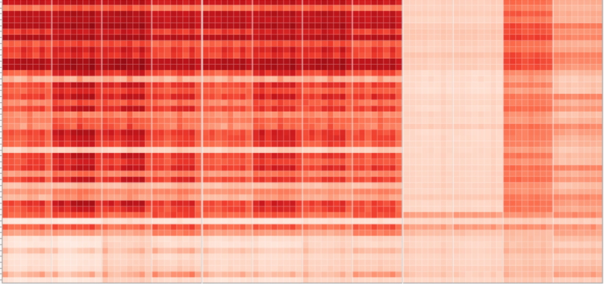
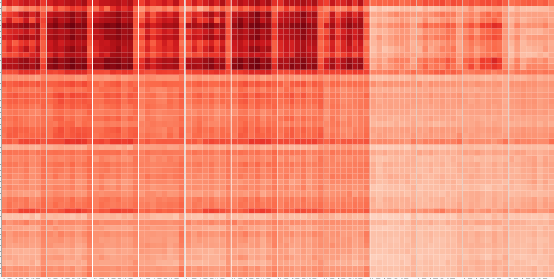
Summary of Approaches
Metrics
Conservative
Correctly predicted 13/80 highest yielding combinations.
Final R² was 0.73.
Greedy
Correctly predicted 33/80 highest yielding combinations.
Final R² was 0.33.
All 4608 Runs
Notes:
The final best model from the Greedy approach looks good in this focus region
But is poor elsewhere in the factor space
And clearly does not capture important behaviours in the system

Slide 8

Hybrid DoE Approach
Notes:
Ben
We considered an approach that leveraged the benefits of exploration and exploitation.
The Hybrid DoE first seeks to build an effective initial model, this required three rounds of 48 runs.
Then the next round consists of 48 runs selected from regions that are above a predicted yield threshold.
Collect > Model > Repeat…but increasing the predicted yield threshold.
Optimization vs. Exploration (Greedy vs. Conservative)
Initial, 144 run Bayesian D-optimal (3 blocks), MEs with If Possible 2FIs
10 total well plates (blocks), analyse with XGBoost > choose 48 next experiments from candidate set of designed experiments and predicted yield experiments above a threshold (starting at 50 then increase 5 each round)
Slowly explore the (predicted) higher yield regions

Slide 9
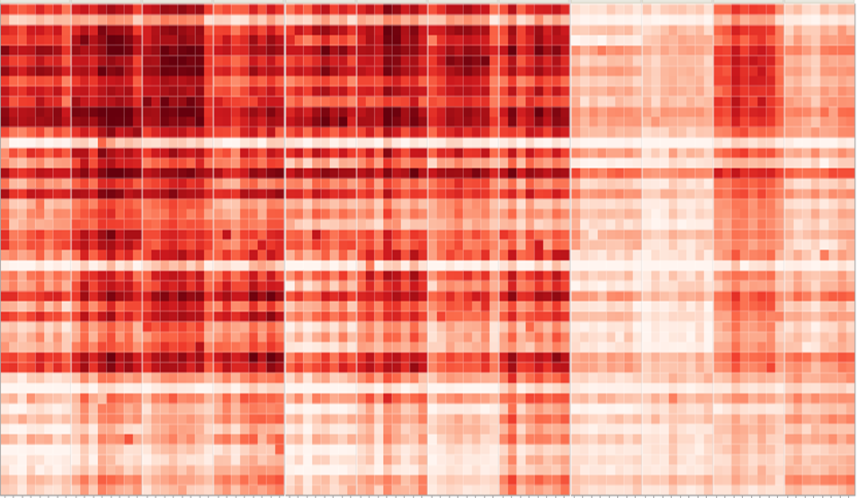
Summary of Approaches
Metrics
Hybrid
Correctly predicted 27/80 highest yielding combinations.
Final R² was 0.69.
All 4608 Runs
Notes:
The final best model from the Greedy approach looks good in this focus region
But is poor elsewhere in the factor space
And clearly does not capture important behaviours in the system

Slide 10
Summary of Approaches
Considerations in Application
  Conservative
    Exploration.
    Strong understanding the entire factor space; how and why combinations work well.
  Greedy
    Exploitation.
    Specific understanding of one high yield region in factor space; confirms those combinations work well.
  Hybrid
    Best of Both.
    Better understanding of the factor spaces associated with high yield; how and why combinations work well, better alternatives.
Notes:
David

Slide 11
Conclusion
Process Optimization - Big Challenges - Clear Value
Notes:
Clear value on offer:
10-fold reduction in resources for experimentation.
Met specifications and provides high yielding solution.
Provides deep process understanding.

Slide 12



Want to explore this work further?
Discovery Summit 2021 Presentation
Explore the data at JMP Public
Try JMP for free
Email ben.francis@jmp.com
Notes:
Clear value on offer:
10-fold reduction in resources for experimentation.
Met specifications and provides high yielding solution.
Provides deep process understanding.

Slide 13
Want to explore this work further?
Email ben.francis@jmp.com
Discovery Summit 2021
Presentation
Explore the data at
JMP Public

Slide 14
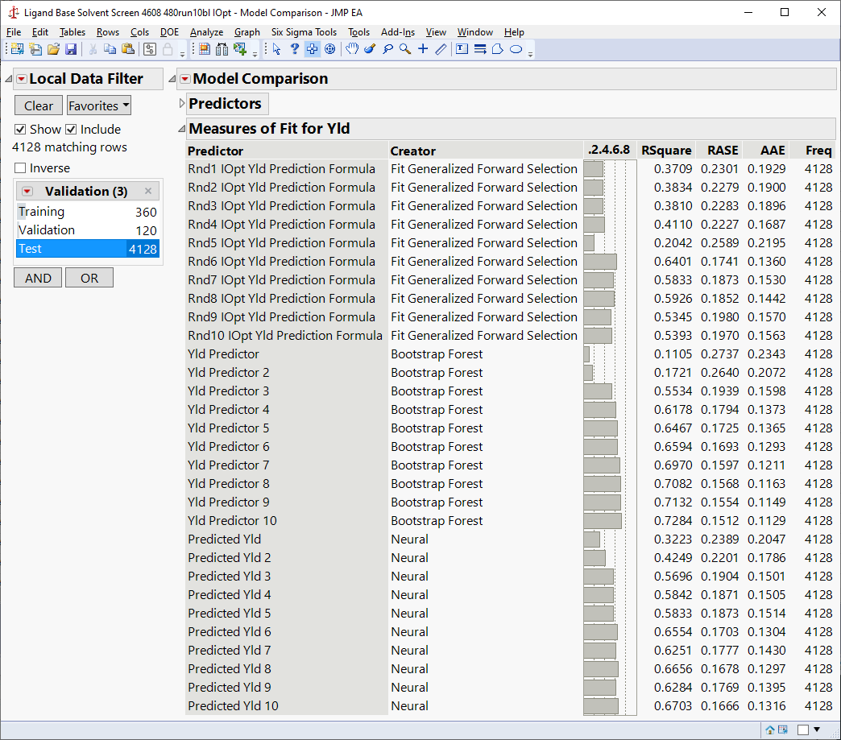
Conservative: Comparing ML and Regression Models by Round
Notes:
At each round we have fit the best standard regression and ML models
Now we used Model Comparison on the 4128 rows of data in the test set
We compared the fit against this data in terms of Rsquare for each method at each round
The standard method - regression with forward selection – is unstable and underperforms machine learning after the first round
And it appears to be getting worse after 6 rounds – overfitting?
The ML methods improve fairly steadily with more data
Neural Networks perform better in the early rounds
Bootstrap Forrest performs slightly better in the later rounds
You need machine learning (JMP Pro) methods for these problems

