Slide 1
Perspectives on Statistical Consulting: Skills, Challenges, and Evolving Roles
Invited Session at ENBIS’25 (Piraeus)
AHLEMEYER-STUBBE, Andrea (Ahlemeyer-Stubbe)
BIKKER, Jan-Willem (CQM)
MORENO MUÑOZ, Alejandro (Werfen)
PUIG DE DOU, Ignasi (Datancia)
VIVES-MESTRES, Marina (Universitat de Girona)
Notes:
Welcome to our dynamic panel discussion on statistical consulting. Today's session will explore essential skills, real-world challenges, and how our field continues to evolve.

Slide 2
What Do You Think?
Join the conversation!
We want to hear from you before our panelists share their insights
Join at menti.com and enter the code:
4896 8999

Slide 3
Meet the Panelists

Slide 4
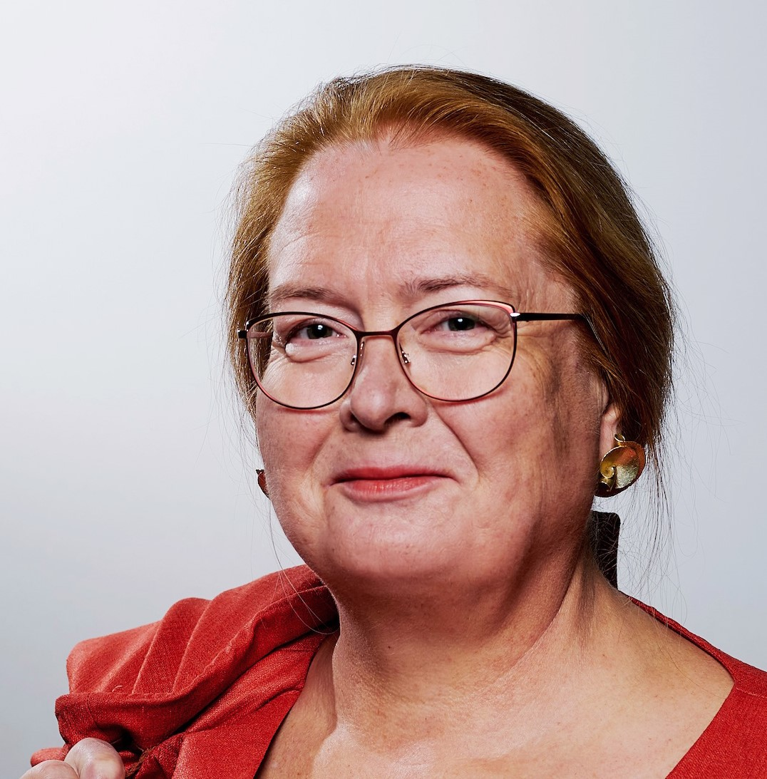
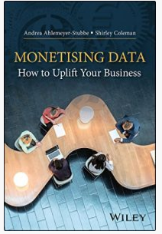
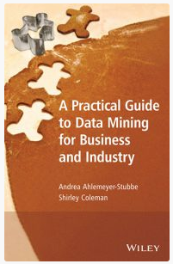
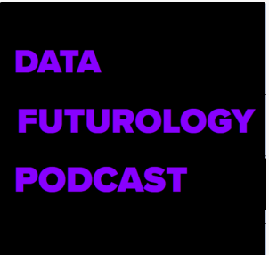
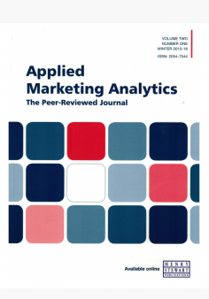
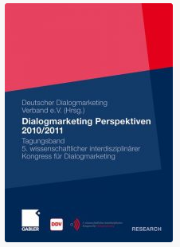
Andrea Ahlemeyer-Stubbe
Expert for:
AI and predictive modelling
Big data
Analysis-based strategy development
Data-driven marketing
Data Mining
DBM
CRM, digital and social CRM
Testing
> 30 years experience 48 publications
Key learning for succes:
Publication (excerpt)
Use your clients and your domain knowledge
Clients love complex solutions, but simple solutions are what get used and earn money
The economic benefit must be clearly recognisable from the solution approach.
Habit and ‘we've always done it this way’ are powerful enemies.
Book:
Monetising Data – How to Uplift your Business John Wiley & Sons Ltd 2018
Book:
A Practical Guide to Data Mining for Business and Industry John Wiley & Sons Ltd 2014
Andrea Ahlemeyer-Stubbe
Diplom-Statistikerin
Podcast
Analytics and Marketing
Felipe Flores, Data Futurology Podcast, 2020
Paper
Applied Marketing Analytics, Henry Stuart Publications,
2024, 2023, 2022, 2021, 2020, …
Paper:
Vollautomati-sches Predictive Targeting
DDV (Hrsg.), Dialogmarketing Perspektiven 2010/ 2011, Tagungsband
Industries:
Automotive – Service providers – Energy suppliers – Retail (mail order, e-commerce) – Consumer goods/furniture (branded goods) – Medicine – Trade fair organisers –Government institutions – Tourism – PublishingAdvertising research
Notes:
BKR
Short introduction from each participant
Include: Background, experience, and personal mantra
Examples: "Always document the solution", "Insist on added value"
Optional: Link introduction to answers at mentimeter

Slide 5
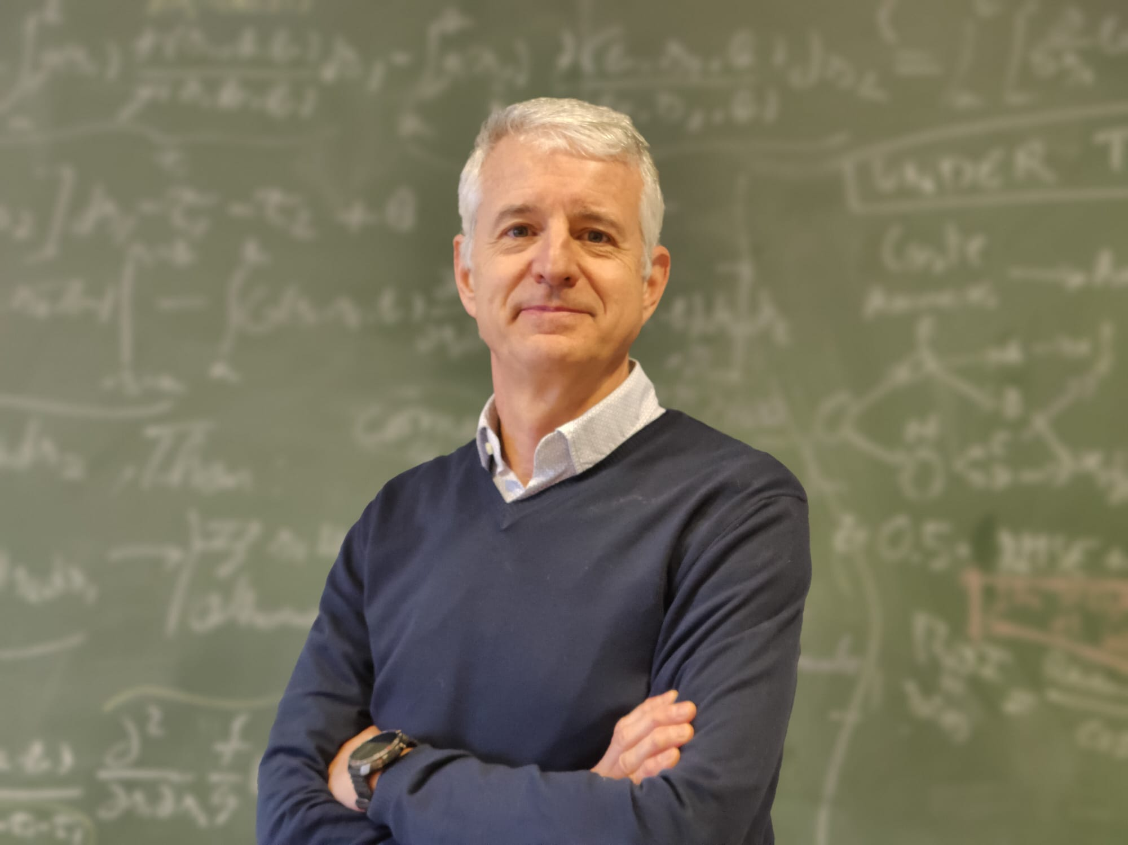
Ignasi Puig de Dou from Datancia
Mechanical Engineer by education
Worked for 23 years in Supply Chain activities in large corporations: Accenture and Hewlett-Packard
Updated my statistics toolkit with an MSc and PhD (WiP) 10 years ago
Founded Datancia, a small size Statistical and Machine Learning Consultin firm
Notes:
BKR
Short introduction from each participant
Include: Background, experience, and personal mantra
Examples: "Always document the solution", "Insist on added value"
Optional: Link introduction to answers at mentimeter

Slide 6


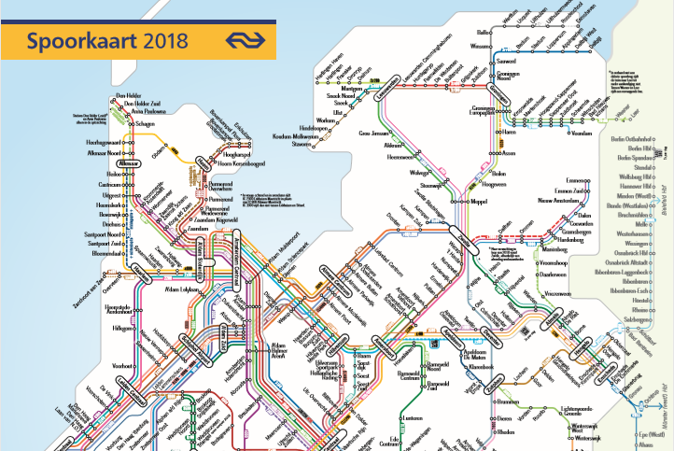
Jan-Willem Bikker from CQM
CQM:
Founded in 1979 as staff department of Philips; Eindhoven (NL)
~45 consultants with a quantitative background; ~450 customers, ~4500 projects
Bringing simplicity in complicated processes
About Jan-Willem
Statistical consultant since 2006, mostly innovation. Learnt the trade from experienced colleagues
Diverse areas: SPC / Engineering to biostatistical research, semiconductors to beer packaging
100s of projects for 10s of companies
Mantra: Use domain knowledge in your projects!
Supply chain optimization
Product & Process Innovation
Transport planning
The best thing about being a statistician is that you get to play in everyone’s backyard.
- John Tukey
Notes:
BKR
Short introduction from each participant
Include: Background, experience, and personal mantra
Examples: "Always document the solution", "Insist on added value"
Optional: Link introduction to answers at mentimeter

Slide 7
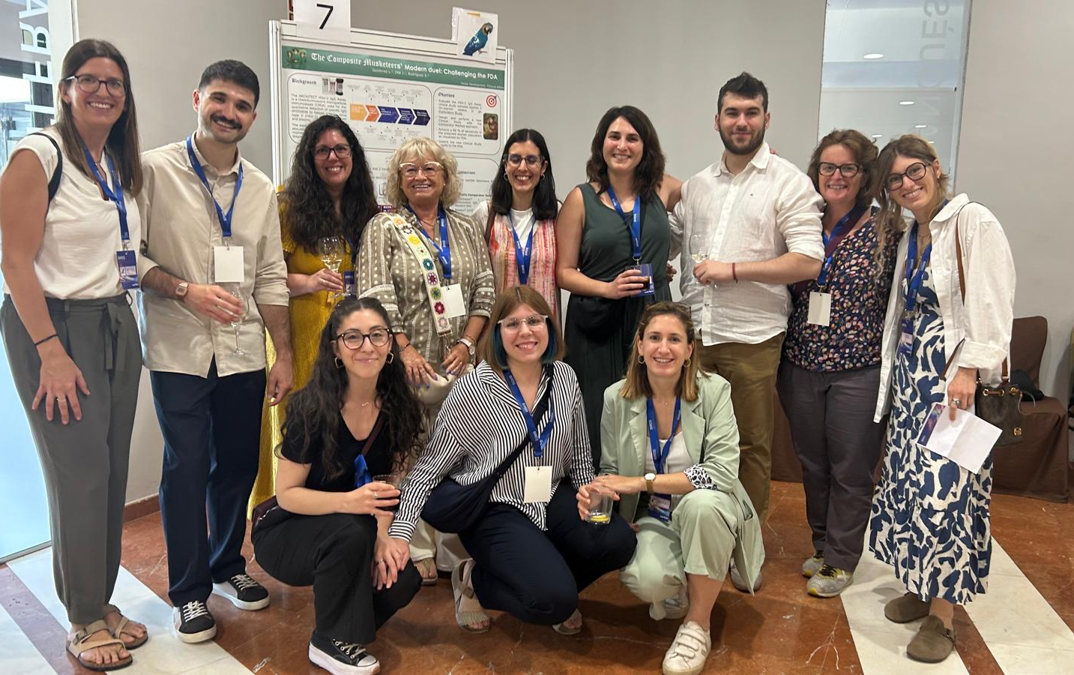
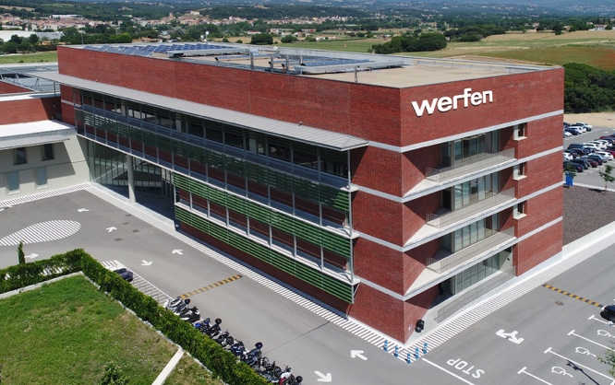
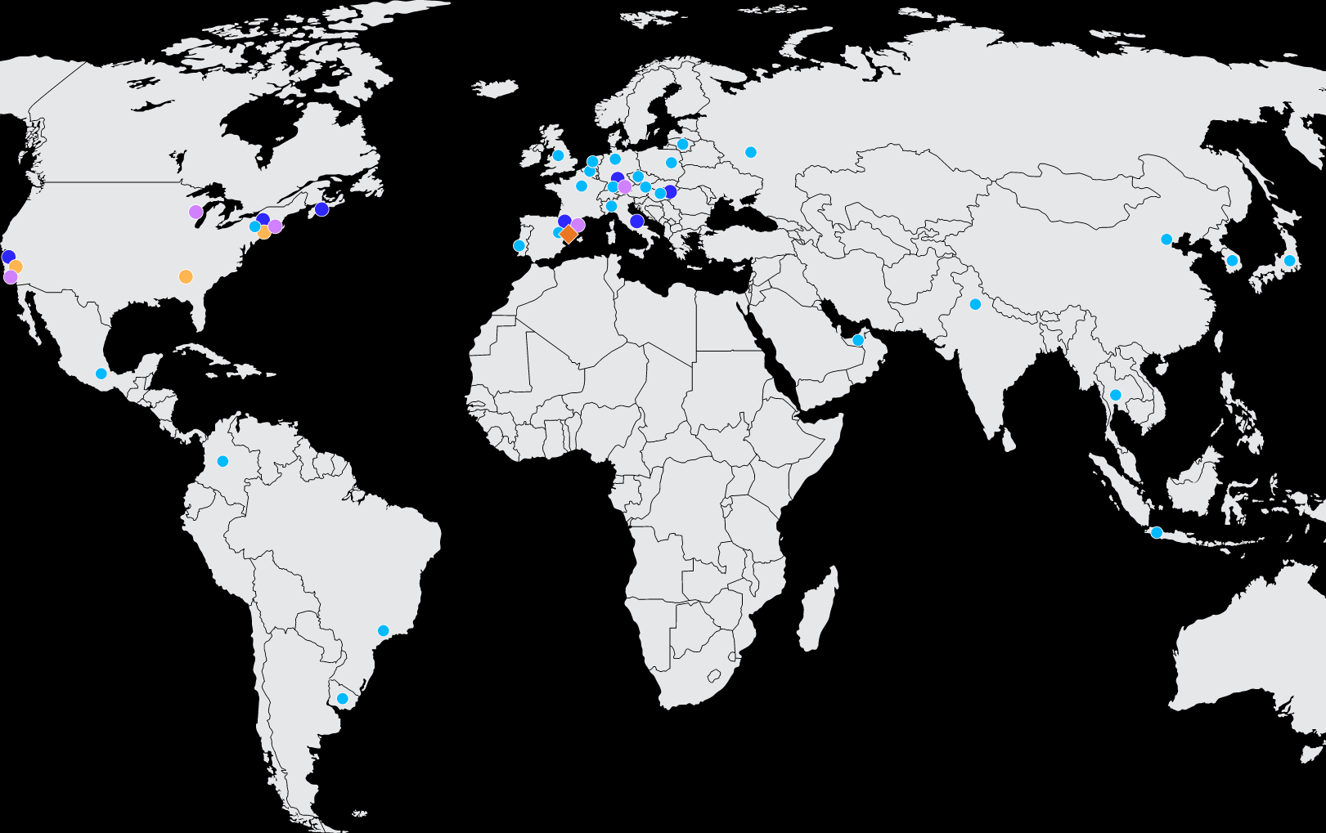
Consultant inside a company
Alejandro Moreno Muñoz
My background
Biostatistics and Biotechnology
Before being statistician, working as a scientist in the laboratory for 4 years
Master’s in Biostatistics and Bioinformatics
Master’s in Biotech and Pharma Industry
Bachelor’s in Biotechnology
My role in the company
Statistician in the Immunoassay Technology Center of Werfen, Barcelona
Support on statistics and data analysis related tasks
Involved in activities of Development, Clinical Studies, Regulatory Submissions, Manufacturing and Quality
Maintain statistical training and documentation
Involved in the development of data analysis software tools
My company, Werfen
Worldwide In Vitro Diagnostics (IVD) Company
Development of reagents, instruments and software solutions for the IVD field
Founded in 1966 with headquarters in Barcelona
6890 employees, operations in 30 countries and distributors in more than 100 territories
5 main business lines: Hemostasis, Acute Care, Transfusion, Autoimmunity and Transplant
Notes:
Short introduction from each participant
Include: Background, experience, and personal mantra
Examples: "Always document the solution", "Insist on added value"
Optional: Link introduction to answers at mentimeter

Slide 8
Consulting Practice
What best practices help you manage client or internal projects effectively?

Slide 9
Consulting Practice – Internal consultant Alejandro
Use of Jira Software Project Management Tool to manage requests: centralize and share information easier, generate KPIs...
Develop practical guidelines to assist the scientists to design experiments or analyze data on their own (e.g., a guideline to establish manufacturing specifications based on statistical rationale)
Promote the use of specialized and user-friendly statistical software (custom or commercial) to increase the empowerment of the scientist on performing data analysis
Remind the people of my availability to help them as well as be communicative to make them feel they have statistical support and thus not be afraid of apply new, more complex or more rigorous statistical techniques
Notes:
analysis (e.g., develop an outliers’ detection Shiny app customized to our needs, our wording, etc.)

Slide 10
Consulting Practice – Medium sized firm Jan
A finite budget keeps me disciplined: only work on the important parts, only go so deep
Keep the communication going with clients to handle setbacks, view opportunities for follow-ups
Get help from colleagues, reach consensus with colleagues and external team members, support them too
Try to do what’s best for the customer within the given budget: what would I do if I stood in the customer’s shoes? – Formulate conclusions, results to that level
Company documentation on best practices of project management, with internal support + courses
Notes:
Jan

Slide 11
Consulting Practice - Small firm Ignasi
Listen to your customer. Do not take things for granted and make no assumptions about the problem at hand unless stated by the client.
Challenge often is to set the project objective.
Explain your ideas on how to approach the problem to other colleagues. No need to look for advice, just framing your ideas aloud let you see if the approach is correct or completely wrong.
Be formal on taking notes of what has been talked and decisions made.
Notes:
Ignasi

Slide 12
Consulting Practice - Independent consultant Andrea
Clarify expectations, timeline, budget, internal allocated resources and the subsequent area of application.
Assess the current situation with several participants. Often, individuals do not know what is already in use or has been used. Departments only ever see their own area. Sometimes, there is already an almost complete solution in the neighbouring department. Be open for other ideas and views.
Inform decision-makers and project participants regularly about successes or obstacles. Problems and difficulties must be discussed promptly. Always record decisions.
Notes:
Ignasi

Slide 13
Consulting Practice – Summary
Project management & communication
Centralize requests, clarify objectives, budgets, and decisions, and keep stakeholders updated.
Empowering scientists & colleagues
Provide guidelines, promote user-friendly software, and build confidence through support and collaboration.
Customer focus
Listen to client needs, communicate openly, and adapt solutions with their perspective in mind,.
Collaboration & discipline
Work within budget, use cross-department insights, and stay open to new ideas.
Notes:
When we think about what really makes projects work, a few things stand out. First, having good structure—using tools to track requests and keeping communication clear so everyone knows the goals, budgets, and decisions. Second, making sure scientists feel empowered by giving them practical guidelines and easy-to-use software, so they can take ownership of their analyses. Third, always looking at things from the customer’s point of view—asking ourselves what we would expect in their shoes. And finally, working closely with colleagues, sharing ideas, and staying disciplined with our time and resources. Those practices together are what help us move projects forward effectively.

Slide 14
Mentoring and Talent
What challenges do you face when recruiting or mentoring new professionals?

Slide 15
Mentoring and Talent – Medium sized firm Jan
Vision on excelling in applying math
Project staffing: mix of senior & junior; learning on the job
Finding new colleagues on senior level more difficult; otherwise, steady inflow MSc / PhD of 0-few years experience
CQM community
Customer value
Financial results
Top talent
Notes:
What is preferred: an excellent math with les communication or a less math with a very high communication/social skills?

Slide 16
Mentoring and Talent – Internal consultant Alejandro
When mentoring, to adapt the statistical techniques from a general perspective (or from another area) to my company’s context (misalignment frequently comes from the way things are named in one or another context)
When recruiting, to find people with a mixed profile between biology and statistics. E.g., a trained person in statistics that also knows the research from the laboratory perspective
Notes:
Difficulty to find people talking the same language than the scientists (even very senior profiles)
Differentt language in different stat context.

Slide 17
Mentoring and Talent – Independent consultant Andrea
We need people who can put themselves in each other's shoes.
Project staffing: mix of senior & junior; analytical, communication and social skills are important
It is important to focus on results, business success beats sophisticated methods.
Notes:
What is preferred: an excellent math with les communication or a less math with a very high communication/social skills?

Slide 18
Mentoring and Talent – Small firm Ignasi
With all the hype on IA it is challenging to bring new graduates into “classical” statistical models/machine learning, still very relevant in a lot of businesses.

Slide 19
Mentoring and Talent – Summary
AI hype vs. classical stats
Staffing & recruitment
Mentoring & adaptation
Hard to attract graduates to traditional methods, though still crucial in business.
Mix of senior and junior staff, but senior hires remain challenging.
Tailor statistical techniques to company context and bridge terminology gaps.
Interdisciplinary profiles
Recruit statisticians with complementary domain knowledge (e.g., biology + lab experience).
Notes:
With the current hype around AI, it is increasingly difficult to attract new graduates to classical statistical methods, even though these remain highly relevant in many business applications. Staffing strategies often rely on a mix of senior and junior professionals, with younger MSc and PhD graduates entering steadily, but senior recruitment proving much more challenging. Effective mentoring plays a key role, as adapting statistical techniques to the company’s context—and clarifying terminology differences—helps new staff apply their knowledge effectively. Looking ahead, recruiting people with hybrid profiles, such as statisticians who also understand biology and laboratory research, will be essential to ensure teams can address complex interdisciplinary challenges.

Slide 20
Lifelong Learning
How do you approach lifelong learning and professional development?

Slide 21
Lifelong Learning – Small firm Ignasi
Enjoy what you do. When you have a hobby, you naturally look for improving your skills. If you feel passionate about your profession, you will naturally look for keeping your knowledge up-to-date.
Put aside time. Time for keeping up is never a priority unless you force it to be.
Make sure you are in an organization that value learning.

Slide 22
Lifelong Learning – Independent consultant Andrea
Very important to develop a network
Reserve a space and time like at ENBIS, hear form other problems and how they solve it.
Speak with a lot of people, and borrow as much as possible from other fields.
Reach the good solution (80%) not the nice one.
Train yourself to be a good sales person. Go to courses to learn to explain complex things very easy.

Slide 23
Lifelong Learning – Internal consultant Alejandro
Getting second opinions from other statisticians on the approaches or analyses I have applied (e.g., via consulting)
Maintain a regular contact with statisticians from other sites of my company
Gain visibility internally and externally (e.g., presentations or trainings on statistical topics)
Demonstrate and communicate the value of applying the statistics to the different teams and management of the company
Notes:
Cutommer expect you to be excellent, the consultant have to know the solution.
Need to Excel on both Stats and client side domain knowledge

Slide 24
Lifelong Learning – Medium sized firm Jan
Regularly step outside the comfort zone from time to time; in projects, acquisition. With help of my colleagues when needed.
Open culture in which it is ok to admit something is hard (or went wrong), and get help
We attend external courses on communication skills; attending conferences; have off-site days to share experiences.
On quantitative skills (stats, ML), we spend time on reading, webinars, internal presentations. A few of us spend time on it as a hobby.
Fortunate to have a wide variety of customers, projects, and problems! And smart and experienced colleagues.
Notes:
Also ENBIS in which social events are as important as all talks together

Slide 25
Lifelong Learning – Summary
Networking
Practical solutions
Continuous learning
Visibility & impact
Build strong connections and learn from other fields.
Aim for good, usable results and communicate clearly.
Dedicate time to training, growth, and stepping outside comfort zones.
Gain recognition and demonstrate the value of statistics.
Notes:
Building a strong professional network is essential: attending events like ENBIS, sharing problems, and learning from other fields helps broaden perspectives and find practical solutions. Success often comes from reaching a good solution rather than the perfect one, and from developing strong communication skills—explaining complex ideas simply, gaining sales skills, and enjoying continuous learning driven by passion. It is crucial to reserve time for training, step outside the comfort zone, and foster an open culture where challenges can be shared and help is sought. Continuous development involves courses, conferences, webinars, and internal exchanges, while diverse projects and colleagues provide valuable experience and second opinions. Finally, maintaining connections with other statisticians, gaining visibility through presentations, and clearly demonstrating the value of statistics both internally and externally are key to professional growth.

Slide 26
Changes in the Field
What changes have you seen in the past two years?
What do you expect in the next two?

Slide 27
Changes in the Field – Independent consultant Andrea
Development of AI, perception that experts are not needed, neither skills. People think GPT has the right answer, and this is a problem
Clients think: We have a sophisticated tool, then you do not need to think (cross thinking, deep thinking...) or the is no need for an expert.
Very difficult for an indpeendent consultant, clients search for tools or bigger consultant companys
More difficultis to get new clients,
There are legal implications/fraud/mistrust. It develop in the last 15 years, but it gets worst after corona).

Slide 28
Changes in the Field – Small firm Ignasi
AI has created a high interest in data analysis. Statistics has jumped into the wagon and lost sight in the always-existing problems in enterprises.
AI will play its role and the hype will subsidize.
Notes:
Example of car with extras or basic car. Do we need them? It is a selling thing

Slide 29
Changes in the Field – Medium sized firm Jan
We all started using ChatGPT for coding, and many for generating texts (emails, proposals,...)
Trend of adoption of MBSE – model based system engineering in R&D: knowledge is described and stored in models (as opposed to documents) that are integrated into platforms. This enables what-if scenarios, tolerance analysis, optimizing of design.
Techniques: Gaussian processes + random forest variants getting closer to the traditional statistical problems (e.g. prediction intervals and causal effects). Limited adoption of complex ML black box models; classic statistical models for prediction often prefered.

Slide 30
Changes in the Field – Internal consultant Alejandro
In the past two years... AI’s peak; in my field at least, regulatory agencies have become more inclined to accept
In the next two years... with the increasing presence of AI in the daily work, statisticians (and related roles) will have to work harder on demonstrating their value while not showing themselves as opposed to the AI.

Slide 31
Changes in the Field – Summary
AI hype challenges expertise
Impact on consultants and trust
AI integration with traditional methods
Harder to find clients, rising concerns about fraud and credibility.
Need to combine AI/ML tools with statistical rigor and demonstrate value.
Perception that experts and deep thinking are no longer needed.
Notes:
The rapid rise of AI has created the perception that expertise and critical thinking are no longer needed, as people assume tools like GPT provide the right answers. This undermines the role of independent consultants, making it harder to build trust with clients and raising concerns about fraud and credibility. At the same time, AI has generated strong interest in data analysis, with statistics embracing new methods such as Gaussian processes, random forest variants, and model-based systems engineering. Yet, traditional statistical approaches remain important, particularly for interpretable predictions. Moving forward, statisticians must demonstrate their unique value by complementing AI rather than opposing it, ensuring rigorous, reliable, and practical solutions for enterprises.

Slide 32
Share Your Experience
Anyone willing to share a recent consulting challenge or a key lesson learned?

Slide 33
A piece of advice…
Andrea
Ignasi
Alejandro
Good communication beats perfect stats. Invest as much time and efford in your personal and sales skills as in methods and data prepareation
Try to build a network of colleagues you can rely on and set the discipline to discuss projects toghether.
Jan
Be involved in the search next projects; then you’ll play in all those interesting and diverse backyards!
Communicate Always with a rational behind

Slide 34
Wrap-up
Structured and collaborative project management
Developing people and skills
Balancing rigor and pragmatism
Statistics in the AI era
Clear goals, transparent communication, practical tools, and teamwork keep projects on track.
Mentoring, hybrid profiles, continuous learning, and networking ensure effective growth and adaptation.
Focus on workable solutions, strong communication, and demonstrating the value of statistics in practice.
Embrace new methods while highlighting interpretability and trust, showing how statistics complements AI.
Notes:
The rapid rise of AI has created the perception that expertise and critical thinking are no longer needed, as people assume tools like GPT provide the right answers. This undermines the role of independent consultants, making it harder to build trust with clients and raising concerns about fraud and credibility. At the same time, AI has generated strong interest in data analysis, with statistics embracing new methods such as Gaussian processes, random forest variants, and model-based systems engineering. Yet, traditional statistical approaches remain important, particularly for interpretable predictions. Moving forward, statisticians must demonstrate their unique value by complementing AI rather than opposing it, ensuring rigorous, reliable, and practical solutions for enterprises.

Slide 35
Useful Resources
Recommended books/courses/tools
The Elements of Statistical Learning (2nd edition, 2009, Hastie, Tibshirani, Friedman, https://hastie.su.domains/ElemStatLearn/
Gaussian process: Surrogates, 2020, Gramacy, https://bobby.gramacy.com/surrogates/
Random forests e.g. Estimation and Inference of Heterogeneous Treatment Effects using Random Forests, 2018, Wager & Athey, https://www.tandfonline.com/doi/full/10.1080/01621459.2017.1319839
Stata manuals: this statistical tool has really good manuals and intros, even if you use R or Python. https://www.stata.com/features/documentation/
Statistics Done Wrong, The woefully complete guide, by Alex Reinhart https://www.statisticsdonewrong.com/
Aspects of statistical consulting not taught by academia (2006). R Kenett, P Thyregod. Statistica Neerlandica 60 (3), 396-411
Recommended websites
Westgard web with tools, technologies and training for Healthcare Laboratories: https://westgard.com/
Web resources for helping communicating statistical concepts: esci-web dances, Seeing Theory
Blog of Andrew Gelman for insightful comments, https://statmodeling.stat.columbia.edu/
Notes:
Applied people publish less, so sharing is needed.

Slide 36
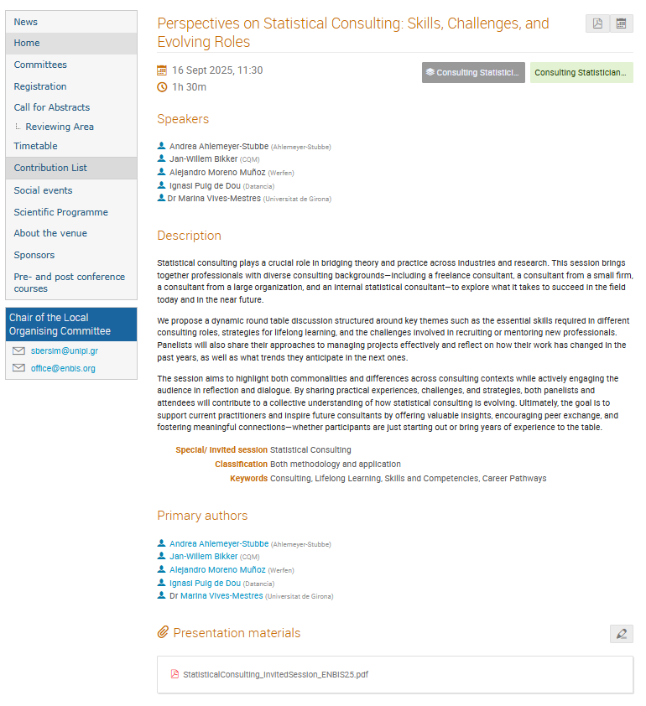
Access the Presentation

Slide 37
Thank You – Get in touch
Contact details:
Andrea linkedin.com/in/andreaahlemeyerstubbe
Jan linkedin.com/in/jan-willem-bikker
Alejandro linkedin.com/in/alejandro-moreno-muñoz-biotechnologist/
Ignasi linkedin.com/in/ignasipuig
Marina linkedin.com/in/marina-vives-mestres
The presentation is available on the ENBIS website:
https://conferences.enbis.org/event/63/contributions/966/

