Slide 1
The Diminishing Returns of Forecasting Models’ Complexity in Industrial Applications
Piraeus, Greece - ENBIS 2025 16/09/2025, 09:40
Yariv N. Marmor (BRAUDE - College of Engineering ,Karmiel)
Notes:
The topic of forecasting models' contribution to Industrial Application is very interesting, and I found that many people shy from implementing forecasting models at all. Or pay too much time at finding the cutting edge instead of fixing the operational problem. I will present some insights in this presentation.

Slide 2
Research Hypothesis / Assumptions
Complex Models vs. System Performance Predictive models focus on specific system components. Yet they may not significantly impact overall system performance.
Internal Variability Real-system complexity introduces variability that diminishes advantages of sophisticated models.
Tailored Implementation Tools must be matched to specific goals and working environments.
Notes:
This research is based on several key assumptions:
Complex prediction models can reduce forecast errors, but they don't always improve overall system performance. Sometimes the improvement is small or doesn't exist when models become too complex. For example, in inventory management, demand predictions are useful, but if you must order large minimum quantities, better predictions may not help much.
When the system itself is complex and forecasts are far from the final goals we want to achieve, we may not need complex forecasting methods.
We should design data science solutions to match business objectives, not just to use the most advanced models available.

Slide 3
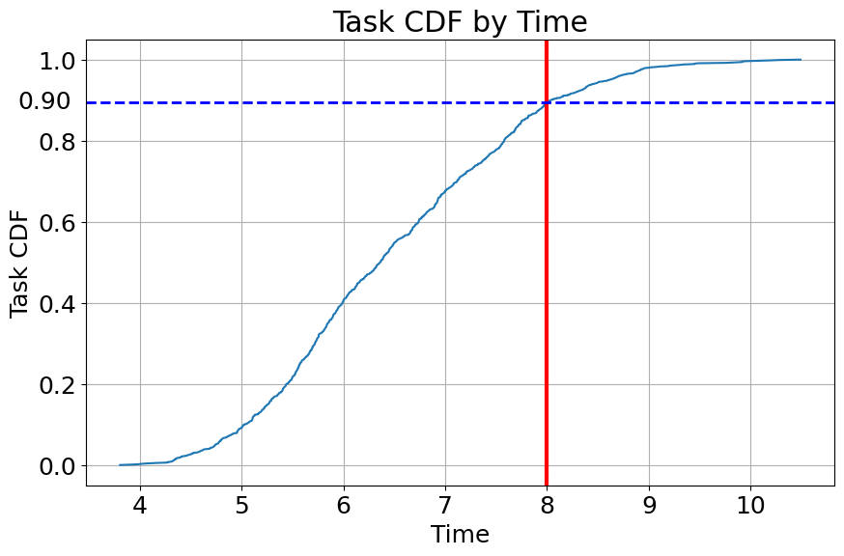
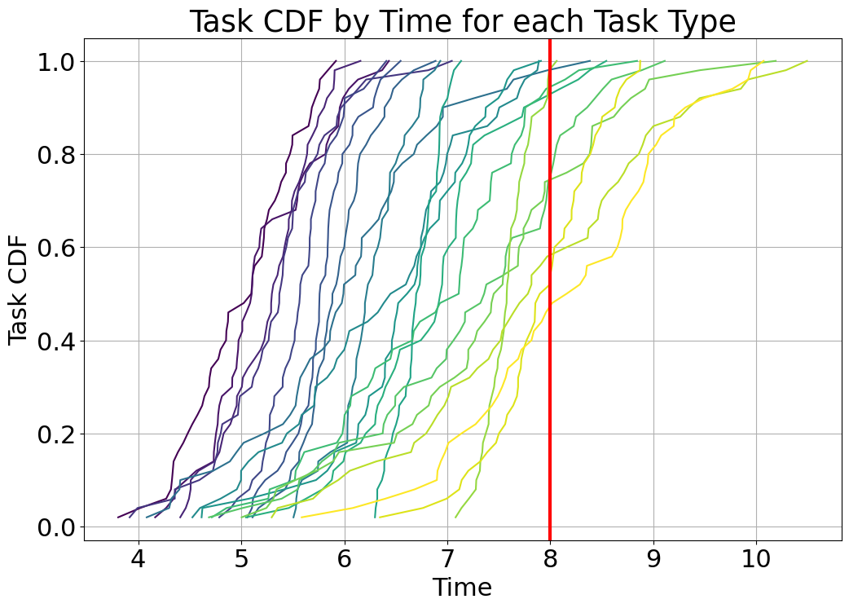
Example / Motivation
Worker has daily task that must be finished within 8 hours in order to be consider as succesful. She wants to better schedule her tasks.
A Good prediction but no help in scheduling (assuming all tasks are needed).
R²=0.632
Notes:
Let's look at a simple example. A worker needs to complete tasks within her 8-hour workday for the tasks to be considered successful. She wants to schedule her tasks better. The graph shows that 90% of tasks take less than 8 hours to complete. This means 10% of her tasks fail to meet the time requirement.
When we analyze the factors that affect task duration, we can explain 63.2% of the variance. We can also identify different groups of tasks where the time distribution is narrower. However, the graph shows we cannot group tasks in a way that guarantees they will finish in less than 8 hours. This means we cannot improve the scheduling model at all, even though we explained the variance quite well.

Slide 4
Prediction (Regression) Models – Literature review
Machine Learning Approaches
Decision Tree (DT)
Adaptive Boosting model (AdaBoost)
Logistic Regression (LR)
Stochastic Gradient Descent (SGD)
Random Forest (RF)
Gradient Boosting classifier (GBM)
Extra Tree Classifier (ETC)
Gaussian Naive Bayes (G-NB)
Support Vector Machine (SVM)
Deep Learning Methods
Deep Convolutional Neural Networks (DCNN)
Generative Adversarial Network (GAN)
Sequential model
And more…
Notes:
The literature on forecasting models (or regression, as some in the machine learning field calls it) continues to grow. I present here some central models in the field, both in data mining/machine learning and deep learning.
In this research, we focus on decision trees or CART and Deep Learning for forecasting/regression.

Slide 5
Prediction (Regression) Models – Literature review
Common Prediction Metrics
R-squared (R²)
Mean Absolute Error (MAE)
Mean Squared Error (MSE)
Root Mean Squared Error (RMSE)
Mean Absolute Percentage Error (MAPE)
Machine Learning Applications
Scheduling and resource allocation
Process monitoring and KPI tracking
Quality prediction and improvement
Maintenance needs identification
Notes:
We don't always agree on the metrics for model success in research. Success metrics for forecasting depend heavily on the weight given to error and whether the metric grows exponentially with error or if we want a normalized value. I particularly like the R-squared metric because it allows comparison of success between different models (ranging from 0 to 1).
We can also see there's a need for forecasting models in broad areas of manufacturing and service in the Industry 4.0 era.
We will focus in this research on sequencing problem.

Slide 6
Research Methodology
System Analysis: Identify what needs to be predicted to improve system performance.
Metric Selection: Determine crucial operational metrics for the organization.
Tool Selection: Choose appropriate prediction tools with varying complexity levels.
Problem Solving: Apply prediction estimators and calculate system performance.
Comparison: Compare performance across different complexity levels.
Notes:
We chose a simple methodology for this research with five stages:
Stage 1: Identify what we want to predict in order to improve the system. For example, in the case I'll present later, we want to predict the production or service duration of an item in the system.
Stage 2: Identify the metric we want to improve in system performance. For example, how much time is needed until the product reaches market or how long a customer needs to wait for service.
Stage 3: Try tools suitable for making the forecast. In our example, we chose decision trees (CART) which allow flexibility in tree development, but we could equally choose deep learning with constraints on the number of layers and neurons in each layer.
Stage 4: Use forecast results to solve the organizational problem. In our example, how to schedule tasks/items/customers in the system so they wait as little time as possible. We can use advanced linear programming models here, but in the deterministic case, the solution is relatively simple, because it's known that arranging operations in ascending order of production/service duration leads to an optimal solution for average waiting time.
Stage 5: Compare performance between different models. In our case, we can compare different complexity levels of the same model. Later we'll want to examine different forecasting models.

Slide 7
Case Study Design
Data Generation 32 production duration groups (5 Boolean columns) across 100,000 items. Normal distribution with varying means and standard deviations starting from ({20,0.5},{10,2}) and increase by steps. 5 dummy Boolean columns (to allow overfitting).
Predictive Models
Decision Tree Model: Full tree generated and pruned to varying sizes. Predictions saved for each item across all tree sizes
Deep Learning Model: Performed deep learning training with a range of training iterations (epochs) to optimize model performance
Performance evaluation to minimize average waiting time (SPT – shortest process time first): Random selection of 10 Items. Sorting by expected duration. 1000 replications (items mix).
Notes:
To test the model, we generated synthetic stochastic data of 32 groups of durations (represented in 5 Boolean columns) for 100,000 items with varying ratios between variance and mean. We add 5 dummy columns to allow overfitting.
For each parameter environment, we built a full decision tree model and then pruned it repeatedly to get less complex models.
And we build a deep leaning model with the same neurons structure but with extended interation.
We examined the results of scheduling 10 random items when we arrange them by expected duration (what's called SPT – Shortest Processing Time First) and examined the waiting metric.
Of course, we wanted to examine the variance of the result, so we repeated the same sequence of items, this time drawn from within a subset of durations. This gives us 1000 different repetitions and allows us to examine the confidence level of each result. Note that this is a result valid for 10 specific items, so we repeated it several times with different combinations of items.

Slide 8
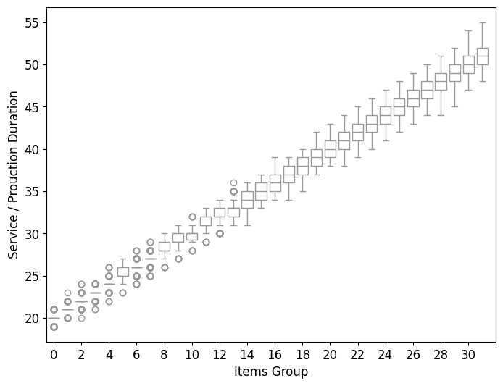
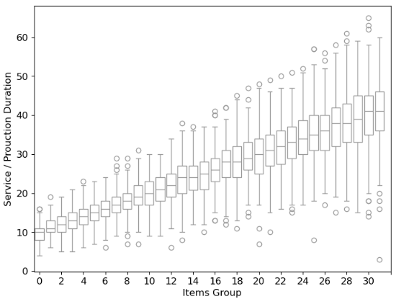
Item Duration Distribution
Low Variability (μ=20, σ=0.5)
High Variability (μ=10, σ=2)
Notes:
We can see how the data is distributed throughout the items.
In the low variability it is easy to spot different item groups that could be forecast separately, but it is much harder task in the high variability option.

Slide 9
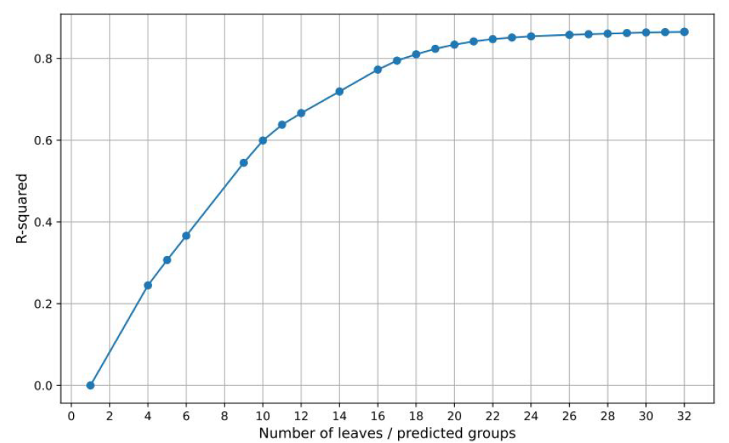
Model Complexity vs. Accuracy - Diminishing Returns
Decision Tree Model
R-squared increases with model complexity. (number of leaves) But gains diminish after certain threshold.
Notes:
Here we can see that the decision tree prefer the 32 groups option, but the effect of complexity of the explained variance is diminishing after 16 groups quit dramatically.

Slide 10
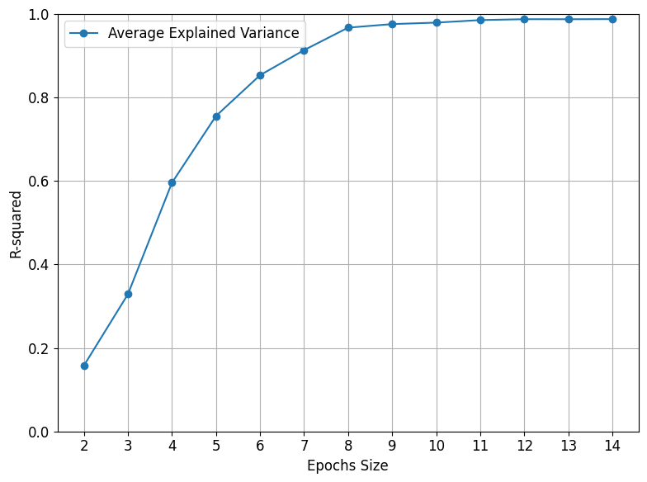
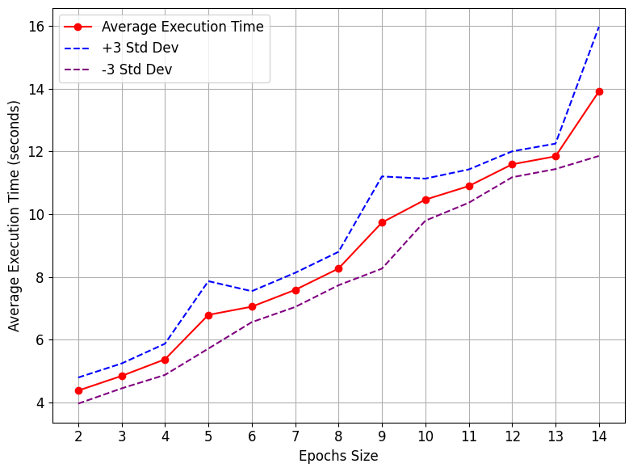
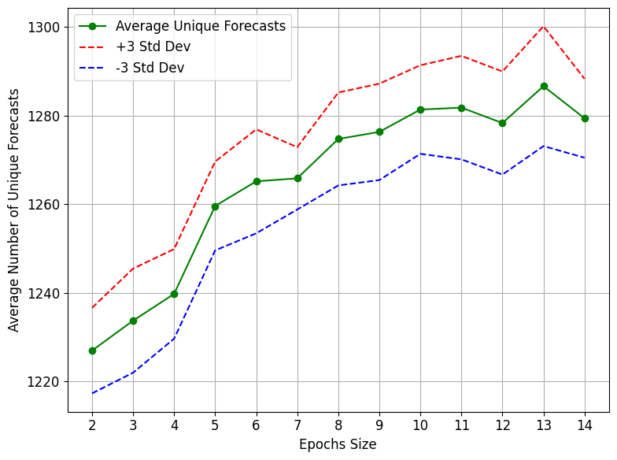
Model Complexity vs. Accuracy - Diminishing Returns
Deep Learning Model
R-squared increases with model complexity (number of training rounds). But gains diminish after certain threshold.
Number of training rounds takes more time and more “predictors”
(25 repetitions)
Notes:
The same results we see in deep learning and number of iterations.
We can see that iteration takes time and produce more groups of items (which suggests overfitting).

Slide 11
Waiting Time Evaluation (simple example with 4 items)
Index | F1 | F2 | D | X
3 | 20 | 22 | 35 | 3
1 | 21 | 18 | 20 | 2
2 | 26 | 28 | 30 | 1
4 | 32 | 25 | 25 | 0
Waiting Time (F1) = 3*35+2*20+1*30+0*25=
175
Sort by F1
Index | F1 | F2 | D
1 | 21 | 18 | 20
2 | 26 | 28 | 30
3 | 20 | 22 | 35
4 | 32 | 25 | 25
Waiting Time(mean)=(175+155)/2=165
Norm Waiting Time (F1)= 175/165=1.06
Norm Waiting Time (F2)= 155/165=0.94
Index | F1 | F2 | D | X
1 | 21 | 18 | 20 | 3
3 | 20 | 22 | 35 | 2
4 | 32 | 25 | 25 | 1
2 | 26 | 28 | 30 | 0
Sort by F2
Waiting Time (F2) = 3*20+2*35+1*25+0*30=
155
F1- Forecast 1
F2 – Forecast 2
D – Actual Duration
X – delayed items
Notes:
Let us explain how we calculated the waiting time for each experiment. We randomly selected 10 items. Here is an example with 4 items.
Each item has two forecasts: one from the first model and one from the second model.
First, we sort the table by forecast 1. Then we calculate the total waiting times as follows: the first item comes before the other 3 items, so we add 3 times its duration to the total waiting time. The second item comes before 2 items, and so on. The total expected waiting time is 175 time units. Note that we use the actual duration, not the forecasted duration, because we sort the items beforehand, but we calculate the waiting time after we know the real durations.
We do the same calculation for the second forecast and get 155 time units.
We then normalize these results to find the relative improvement of the prediction model.

Slide 12
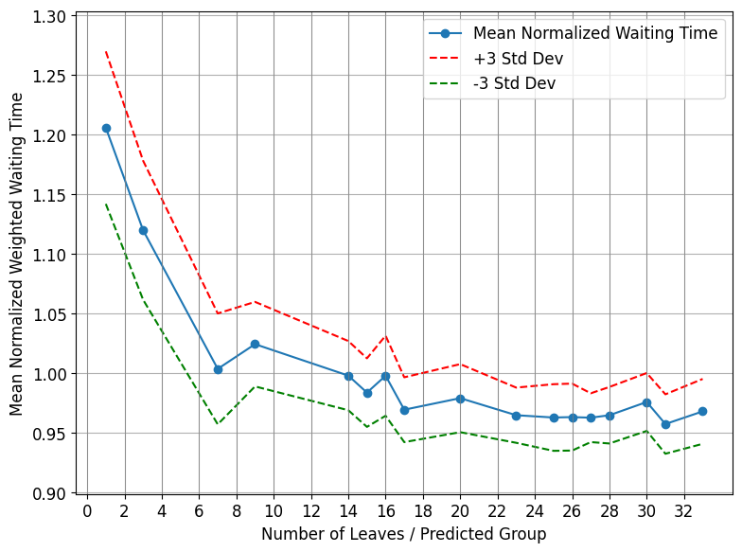
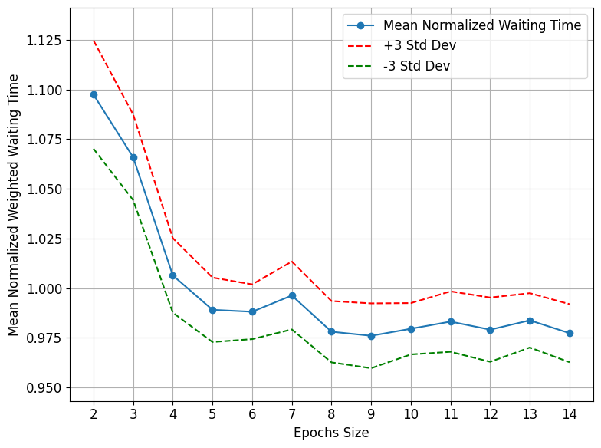
Waiting Time Results - High Variability Environment (μ=10, σ=2)
Decision Tree Model
Deep Learning Model
Statistical significance only in configurations with 2 groups or fewer.
Statistical significance only in configurations with 3 rounds or fewer.
Notes:
We can see there's a significant advantage to complexity (there's a confidence interval of three standard deviations on each side) up to a certain complexity (here, for example, 2 leaves in the decision tree and 3 round of iterations in the deep learning model), and from there, there's no statistically significant difference in results.

Slide 13
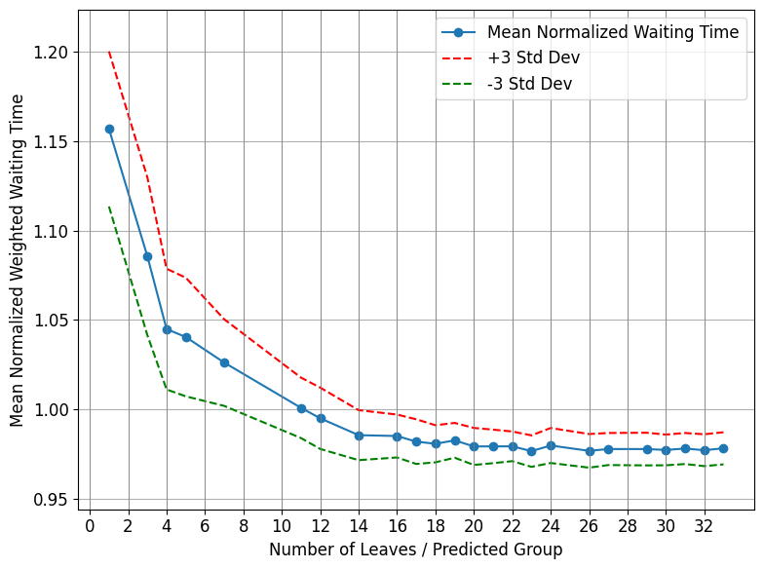
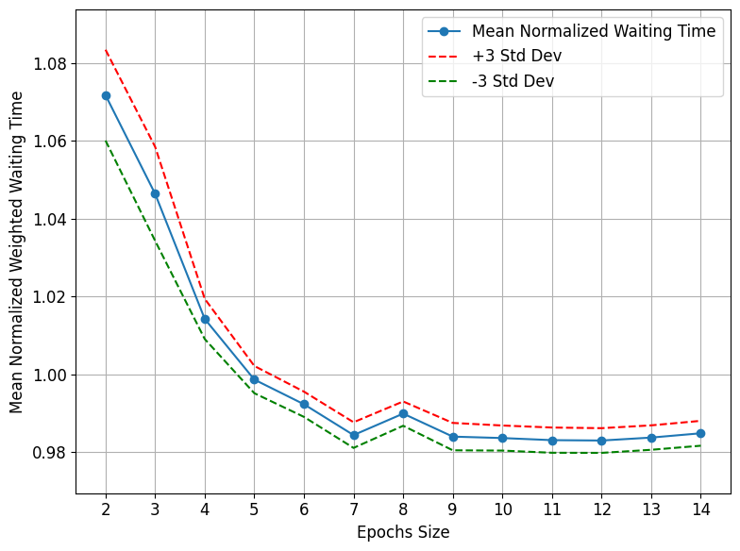
Waiting Time Results - Low Variability Environment (μ=20, σ=0.2)
Decision Tree Model
Deep Learning Model
Statistical significance only in configurations with 6 groups or fewer.
Statistical significance only in configurations with 6 rounds or fewer.
Notes:
Here both models suggest more complex prediction for lower environment. More than 6 groups in the decision tree model and more than 6 rounds in the deep learning models.

Slide 14
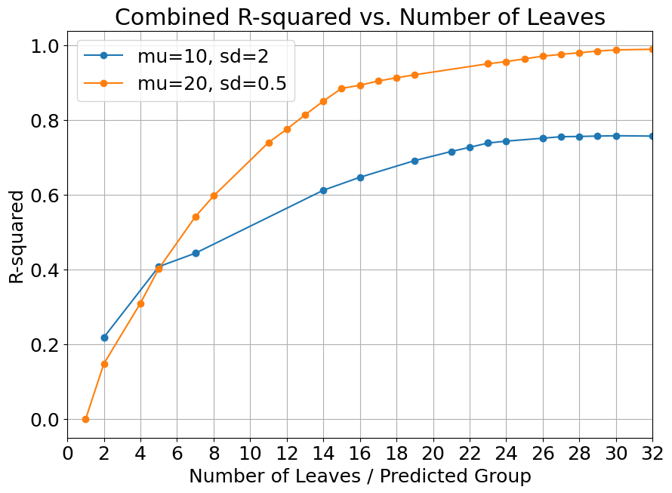
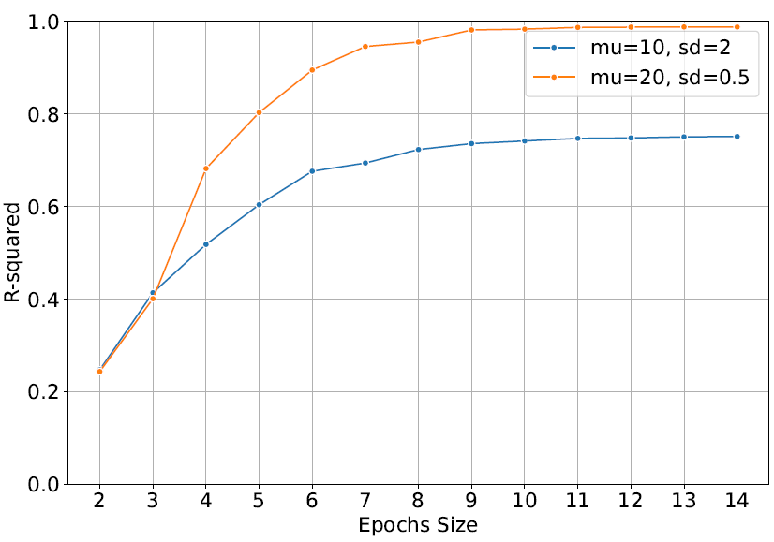
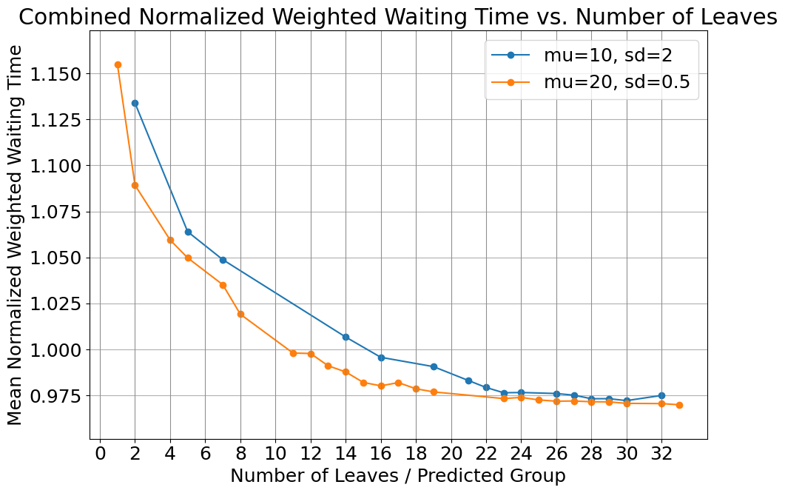
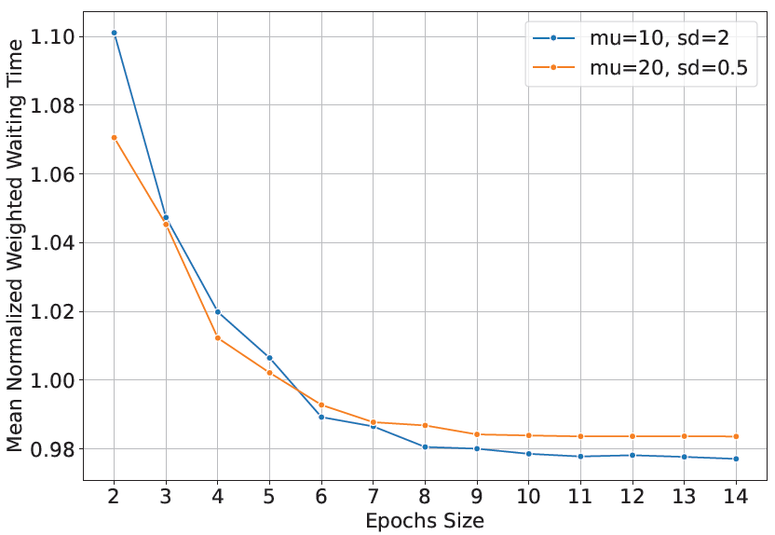
Waiting Time Results - by Variability Environment (summary)
Deep Learning Model
Decision Tree Model
Deep Learning Model
Insights:
Higher R² in a low variability environment.
Deep learning “complex” models impact wait time more in high variability environment.
The decision tree impact wait time more in low variability environment.
Notes:
We can see that an environment with lower variance translates to higher explained variance. This is not surprising, but it's good to validate the results.
We can see that an environment with low variance shows advantages for reducing waiting times for the decision tree model, but shows opposite results for the deep learning model.

Slide 15
Research Implications
Bridging the Gap Connects statistical solutions with business impact for complex systems.
Practical Guidelines Guide practitioners toward appropriate tools based on system characteristics.
Integration Innovation Combining prediction, optimization, and simulation creates innovative operational
Notes:
In summary, we see that we successfully demonstrated the gap and how to narrow it between the statistical results of data scientists and those responsible for the organization's economic performance.
We gained insights about the relationship between models with high variance and internal complexity and the need (or more accurately, the lack of need) to use complex forecasting models. In practice, simpler models doesn't require high expertise and therefore allows faster penetration of such models into implementation.
.
And of course, we can see here potential for combining models from data mining, optimization, and simulation to improve organizational performance.

Slide 16

Thank You for your attention!
Code used in this presentation:
Deep Leaning Model
https://drive.google.com/file/d/1lIWld9MM8w8alPQKbjEurV0FySFXEe6Q/view?usp=sharing
Decision Tree (CART):
https://drive.google.com/file/d/1ktlzY8I_TobeobRGbHw2pAjBWt2MmDCo/view?usp=sharing
E-mail: myariv@braude.ac.il

