Slide 1

Bayesian Hierarchical Modeling for Large-Scale Sensors Deployments and Applications
Anna Ballario^{1,2}, Francesca Pennecchi¹, Alessandro Schiavi¹, Andrea Prato¹
¹INRiM – Istituto Nazionale di Ricerca Metrologica
²PoliTo – Politecnico di Torino
ENBIS Spring Meeting 2026
Granada, May 27-28, 2026

Slide 2


Introduction
Millions of low-cost sensors being produced weekly:
  impossibility to apply standard calibration procedures
  large-scale calibration methods need to be introduced
Statistical methods:
  in-lab calibration of a small sample and virtual calibration of the entire batch
  number of required experimental (“in-lab”) calibrations reduced
  CONS: increased uncertainty and less reliability
2

Slide 3
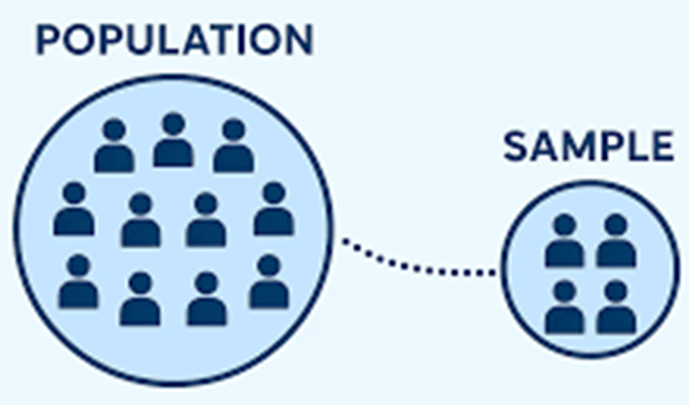
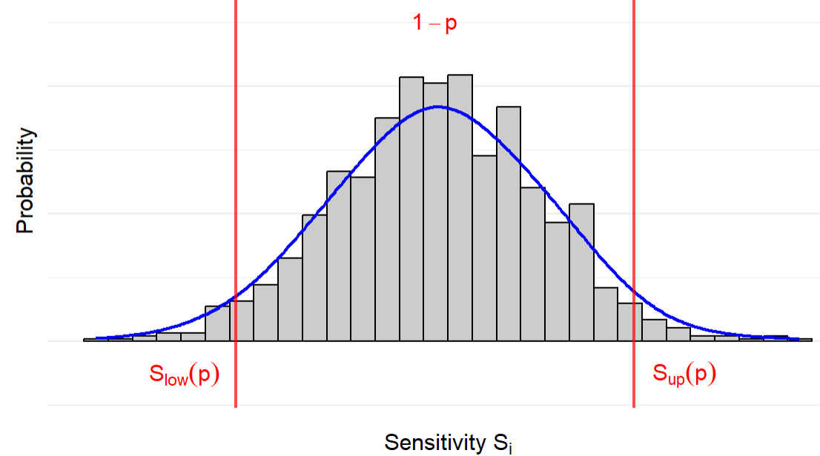
Virtual Calibration
Exploiting data from a reference, fully in-lab calibrated lot of N sensors
  mixture distribution of N Normal(S_{i}, u(S_{i})) modeling the sensitivities of the reference lot
  determination of an interval of acceptable sensitivity values [S_{low}(p), S_{up}(p)]
For any new lot from the same production, in-lab calibration of a small sample of sensors n << N
Bayesian inference on the remaining N-n sensors
Evaluation of the reliability and estimation of sensitivity

Slide 4
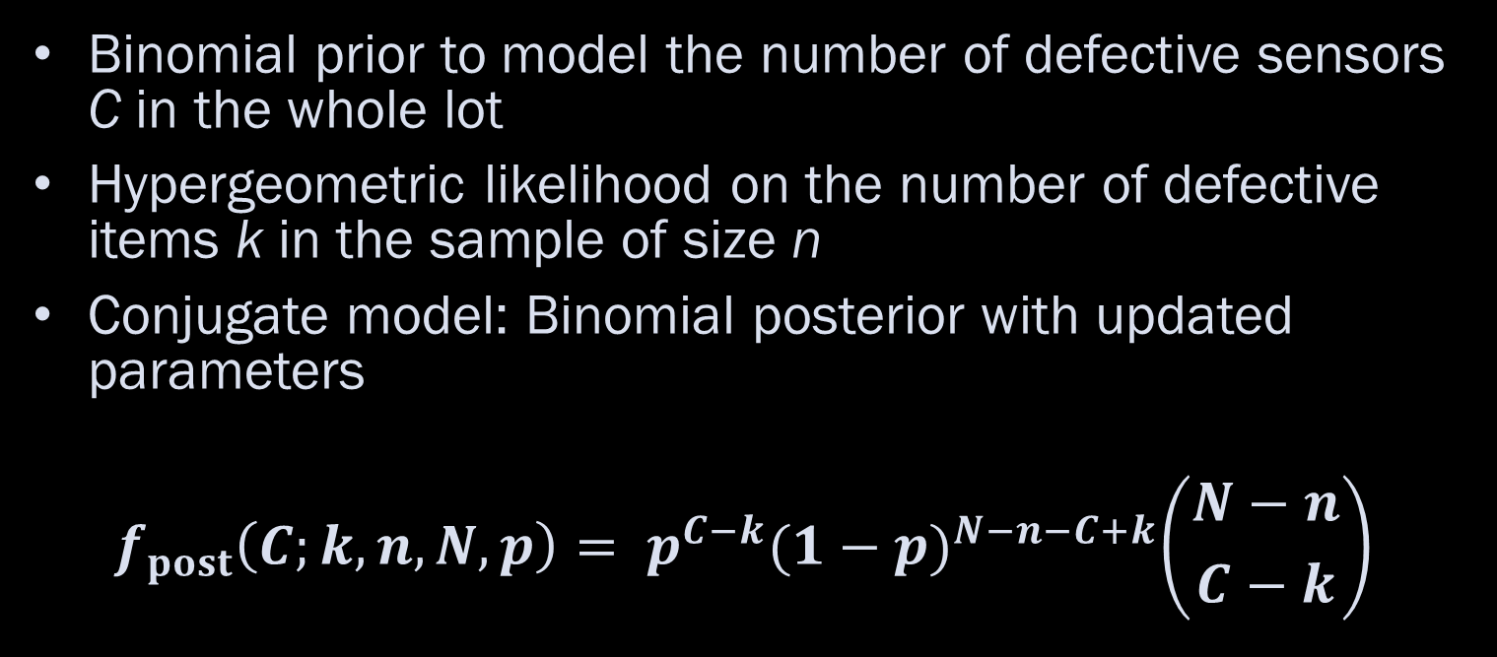
A Bayesian model
Binomial prior to model the number of defective sensors C in the whole lot
Hypergeometric likelihood on the number of defective items k in the sample of size n
Conjugate model: Binomial posterior with updated parameters
$$f_{post}\left(C;k,n,N,p\right)= p^{C−k}{(1−p)}^{N−n−C+k}\left({N−n \atop C−k}\right)$$

Slide 5
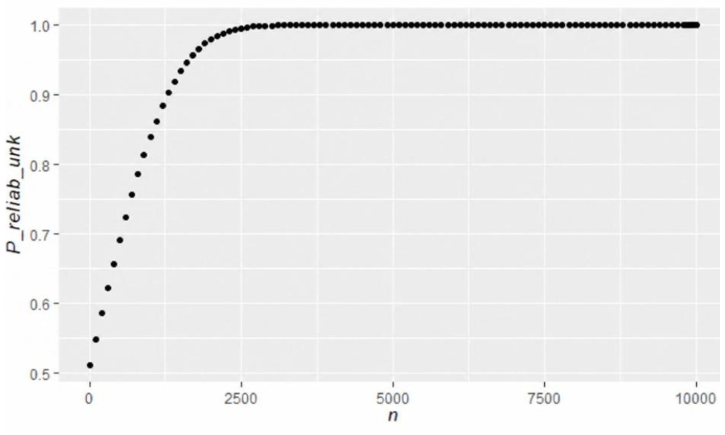


A metric for the reliability
A metric for batch reliability is defined based on posterior cumulative probability:
$P_{reliab,unk}=ℙ_{post}=\sum_{C=k}^{C_{bench}}{p^{C−k}{(1−p)}^{N−n−C+k}\left({N−n \atop C−k}\right)}$
95 % of reliability with:
at least n = 1630
max k = 49
Figure. Variation of the probability $P_{reliab,unk}$ as a function of n

Slide 6
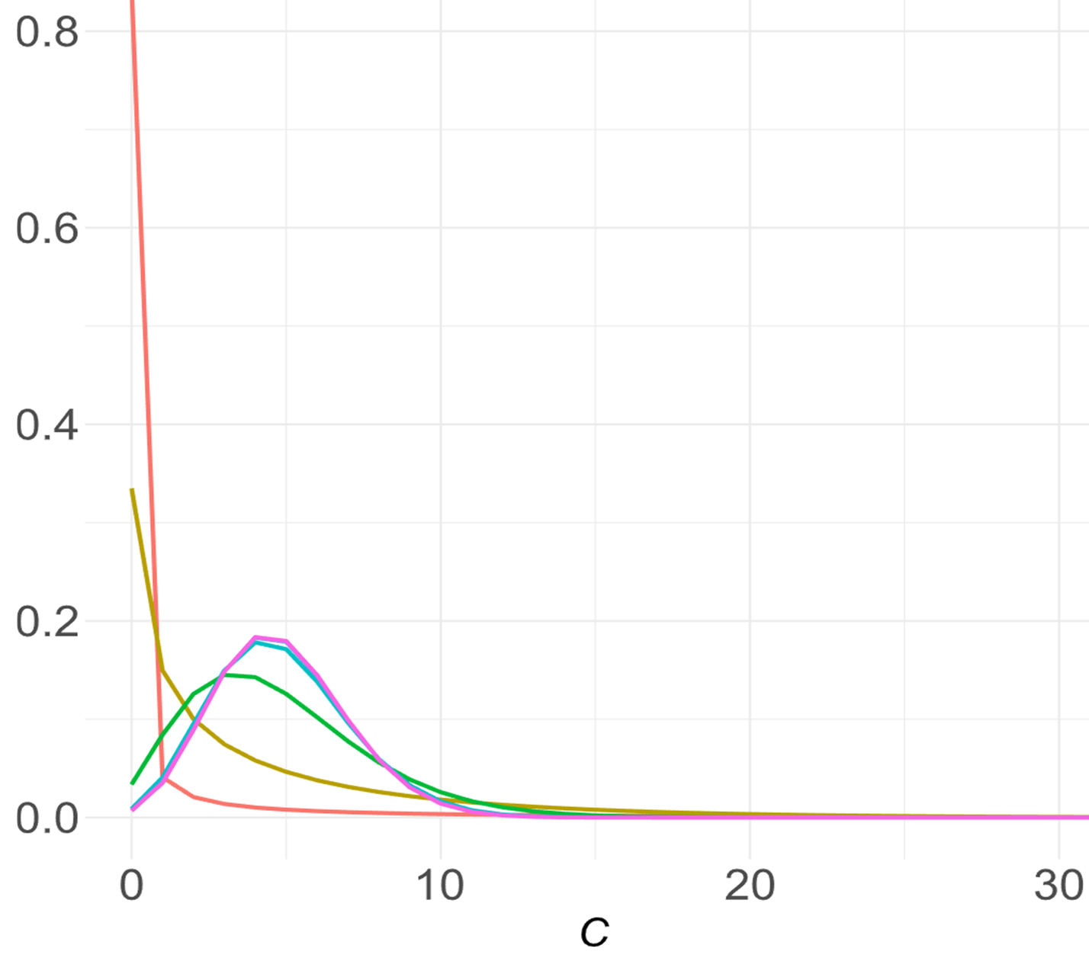
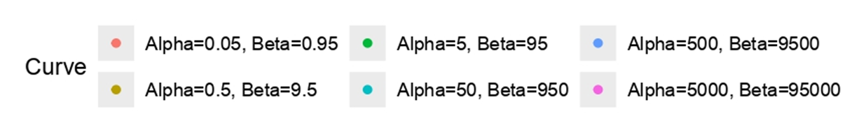
Hierarchical extension
Introduction of a Beta hyperprior on the probability p of defective sensors
  direct integration of prior industrial knowledge
  explicit control over parameter variability
  improvement in flexibility and robustness of the reliability
CRUCIAL STEP: elicitation of hyperprior parameters to ensure the model coherently and accurately reflects prior knowledge
Figure. Comparsion of the posterior distribution for different Beta hyperprior
$f_{post}= \left({N−n \atop C−k}\right)\frac{Γ(C + α) Γ(N−C+β)}{Γ(α+β+N)}$ $\frac{Γ(α+β+n)}{Γ(α+k)Γ(n−k+β)}$

Slide 7
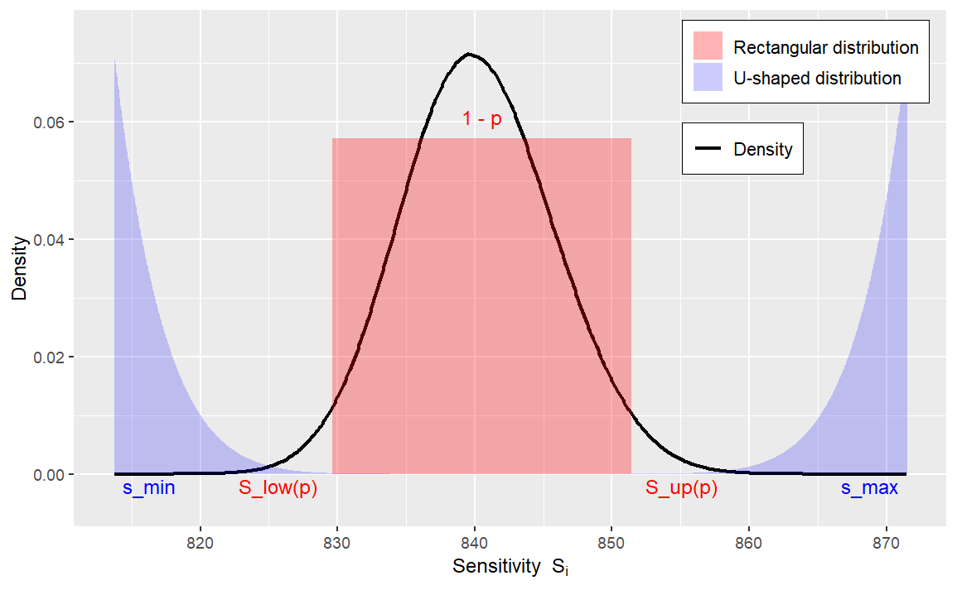
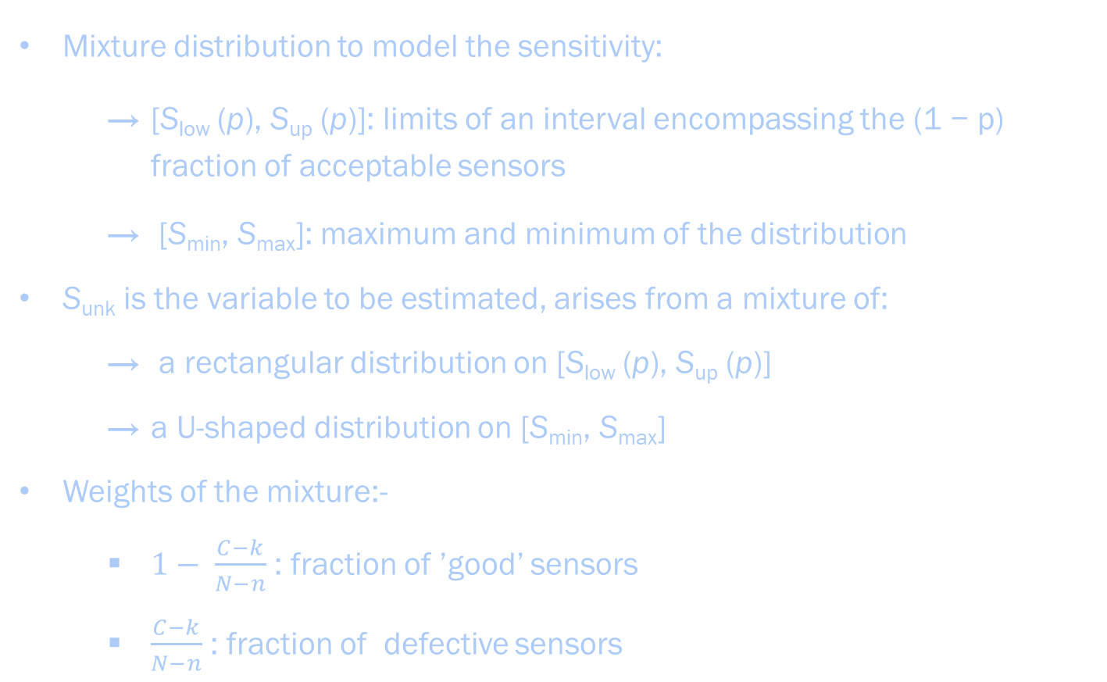
Sensitivity estimate and uncertainty evaluation
Mixture distribution to model the sensitivity:
  [S_{low} (p), S_{up} (p)]: limits of an interval encompassing the (1 − p) fraction of acceptable sensors
  [S_{min}, S_{max}]: maximum and minimum of the distribution
S_{unk} is the variable to be estimated, arises from a mixture of:
  a rectangular distribution on [S_{low} (p), S_{up} (p)]
  a U-shaped distribution on [S_{min}, S_{max}]
Weights of the mixture:-
  $1− \frac{C−k}{N−n}$ : fraction of ’good’ sensors
  $\frac{C−k}{N−n}$ : fraction of defective sensors

Slide 8
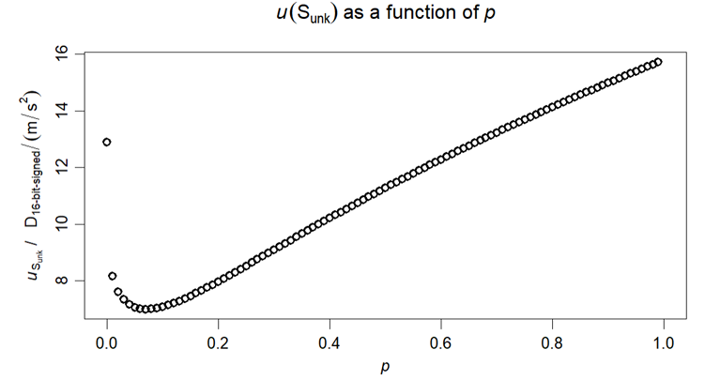

  Sensitivity:
  $S_{unk}(p) = \frac{S_{low}(p)+ S_{up}(p)}{2}$
  Uncertainty:
  $$u(S_{unk}) = \sqrt{\sum_{D=0}^{N−n}{p_{d}\left[\left(1−\frac{D}{N−n}\right)\frac{ {(S}_{up}(p)− S_{low}(p))^{2}}{12}+\frac{D}{N−n}\frac{{(S_{max}−S_{min})}^{2}}{8}\right]}}$$
  where p_{d}= $ℙ$(D = d)
Figure. Value of the uncertainty as a function of p

Slide 9
Case study
100 nominally identical MEMS calibrated at INRiM
Dataset randomly split: 50 benchmark — 50 unknown batch
Acceptance interval:
[S_{low}, S_{up}] = [833.18, 849.14] (for p = 0.06)
Wider range for uncertainty evaluation:
[S_{min}, S_{max}] = [827.69, 855.06]
Estimate of the sensitivity: S_{unk} = 841.16 D_{16-bit-signed}/(ms⁻²)
n = 5, k = 0 sensors counted outside acceptance interval
True number of defective sensors: C = 0
Prior model | Mean | Mode | Reliability | u(S_{unk})
Beta(0.06, 0.94) | 0.4 | 0 | 0.959 | 4.684
Beta(0.6, 9.4) | 1.8 | 0 | 0.821 | 4.910
Beta(6, 94) | 2.6 | 2 | 0.730 | 5.035
Beta(60, 940) | 2.7 | 2 | 0.717 | 5.054
Original Model | 2.7 | 2 | 0.717 | 5.056

Slide 10
Conclusion
Industrial impact: drastically reduced times and costs for sensors network deployment while maintaining traceability
Hierarchical modeling insight: better captures prior information structure, but highly sensitive to hyperparameter choice; weakly informative priors may lead to high reliability while increasing posterior variance
A decision framework employing utility functions is under development to provide optimal sampling plans while keeping into account posterior variance

Slide 11
References
[1] A. Prato, F. Pennecchi, G. Genta and A. Schiavi, A Bayesian statistical method for large-scale MEMS-based sensors calibration, Metrologia 61 (2024) 015005
[2] Prato A, Mazzoleni F and Schiavi A, Traceability of digital 3-axis MEMS accelerometer: simultaneous determination of main and transverse sensitivities in the frequency domain, Metrologia 57 (2020) 035013
[3] Ballario A., Prato A., Schiavi A., Pennecchi F., Bayesian Hierarchical Modelling for Large-Scale Sensor Calibration, submitted to Quality and Reliability Engineering International, under review

Slide 12
Thank you for the attention!

