Slide 1
Enhancing photogrammetric measurement systems through Gaussian Splatting
Mattia Trombini, Giacomo Maculotti
Gianfranco Genta, Maurizio Galetto
Presenting author
Mattia Trombini
Dept. of Management and Production Eng., Politecnico di Torino, Italy
mattia.trombini@polito.it
Firenze, 8th September 2026

Slide 2
Agenda
Introduction
Problem statement
Methodology
Innovative approach
Experimental setup
Discussion and conclusions
Enhancing photogrammetric measurement systems through Gaussian Splatting
M. Trombini, G. Maculotti, G. Genta, M. Galetto
8th September 2026
02

Slide 3



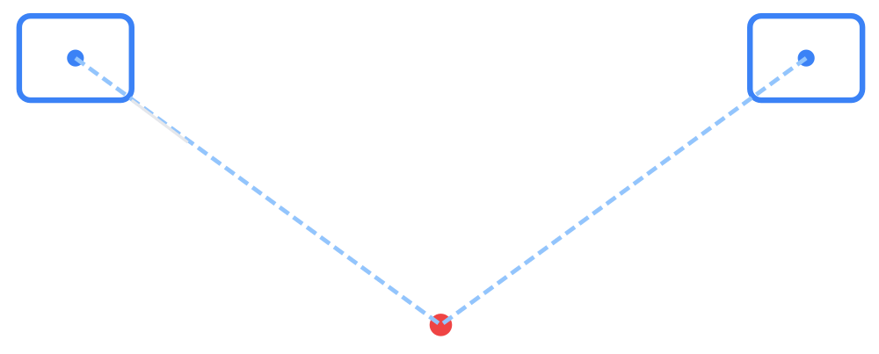
INTRODUCTION
/
MACHINE VISION AND PHOTOGRAMMETRY
Photogrammetry fundamentals
From images to metric 3D geometry
Definition
Image-based technique using (affordable) cameras to generate high-detail 3D dense point clouds and textured meshes.
Acquisition
Point Cloud
Mesh
Physical Images
Dense Geometry
Surface Model
Alignment
Based on collinearity equation. A single view gives direction; multiple views (at least 2) allow intersection to find 3D coordinates (X, Y, Z).
Structure-from-Motion (SfM)
Camera i
Camera j
Key process steps
Feature Extraction (keypoints)
Matching (tiepoints)
Dense reconstruction (MVS)
Ray 1
Ray 2
Calibration
Requires solving internal parameters (focal length, distortion) and external parameters (pose) for metric accuracy.
Enhancing photogrammetric measurement systems through Gaussian Splatting 8th September 2026
03

Slide 4
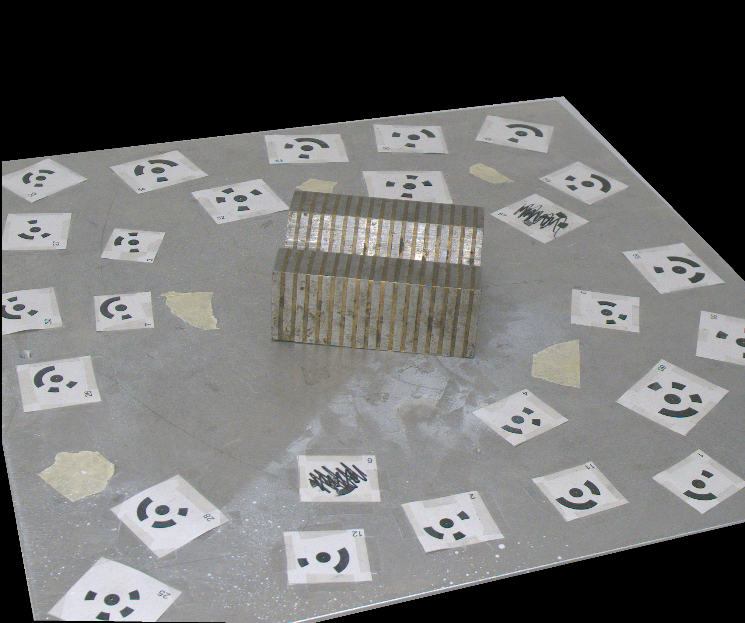


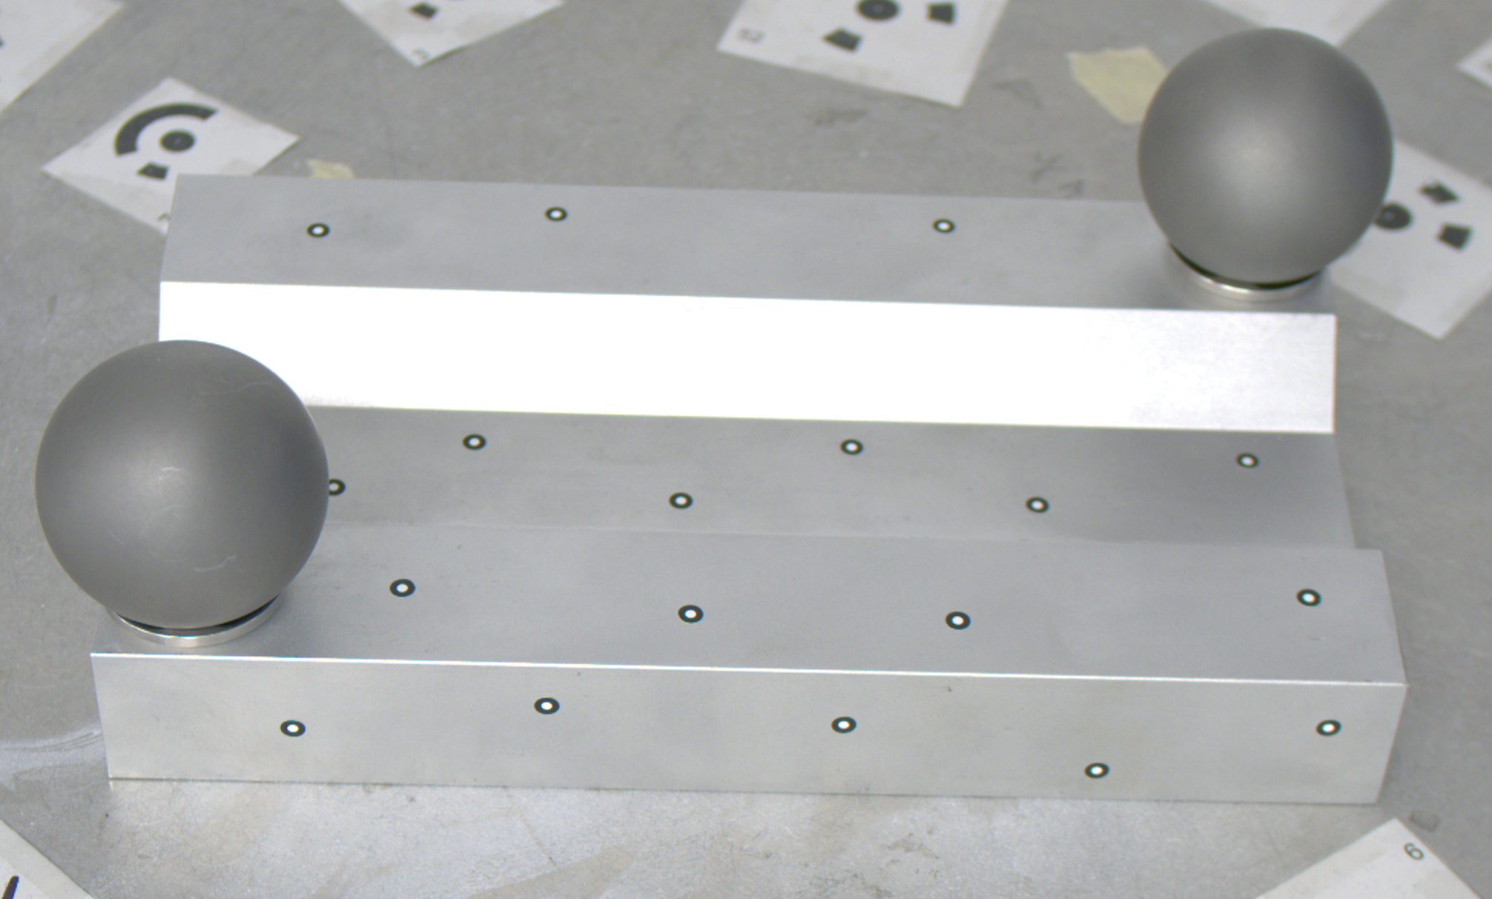
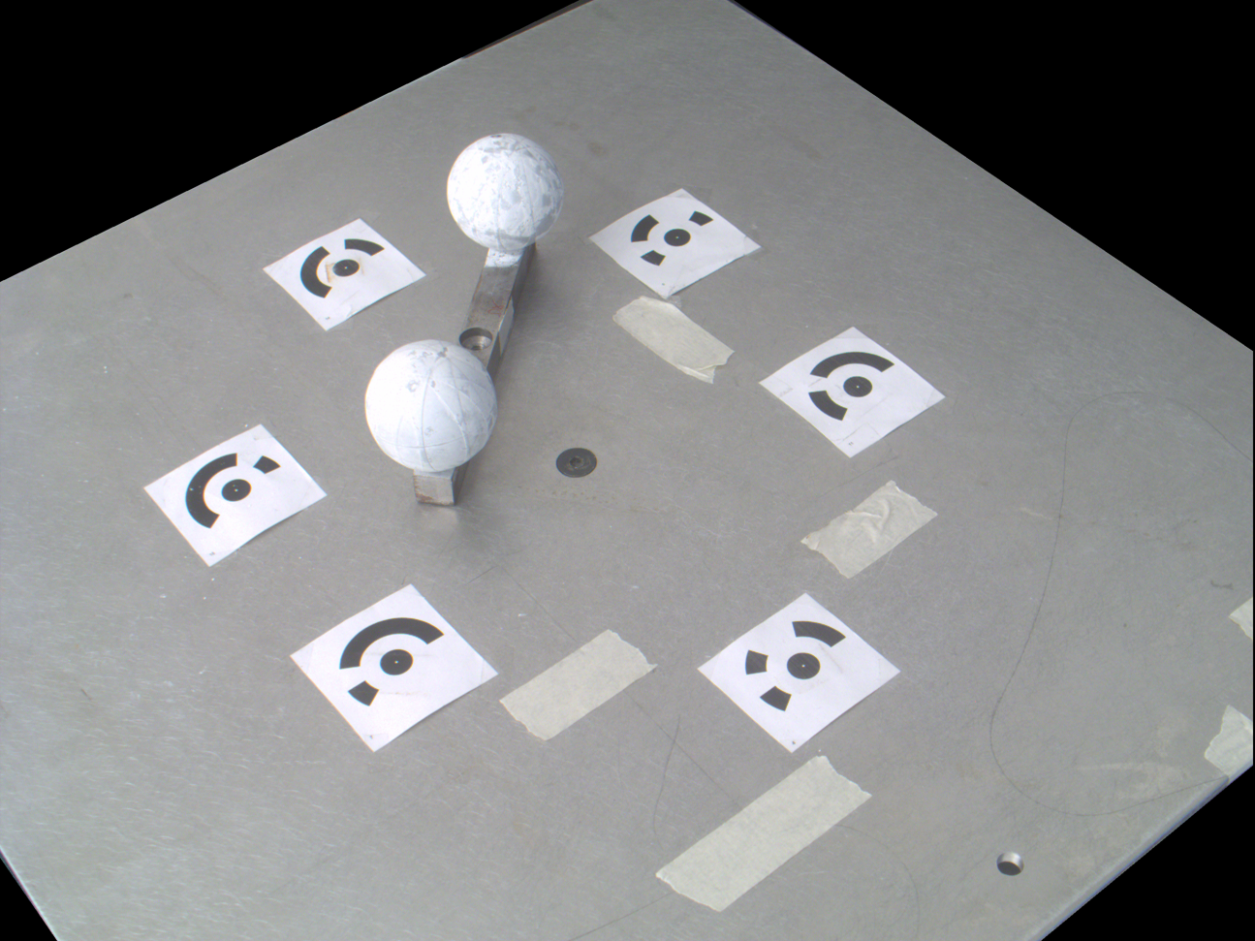

PROBLEM STATEMENT
/
PROBLEM DEFINITION
Static-in-time inspection
Static reconstructions and coverage gaps
Density of reconstruction
KEY LIMITATIONS
Local Incompleteness
Dense point clouds fail in regions where image coverage is insufficient or angles are suboptimal.
Bound to t₀
Information is frozen at the acquisition instant. The physical state cannot be revisited once access is lost or the object evolves.
No Retrospective Analysis
Prevents confirming if a new defect existed earlier or tracking its evolution over time.
Low
High
Target Object
CONCEPT OF STATIC-IN-TIME
Conventional photogrammetry loses the temporal dimension.
Enhancing photogrammetric measurement systems through Gaussian Splatting 8th September 2026
04

Slide 5



PROBLEM STATEMENT
/
RESEARCH GAP AND OBJECTIVE
Proposed paradigm shift
From temporal limitations to enhancement
CURRENT
t₀
t₁
Static Capture
Limited Inspection
Inspection Day
Future Need
Object present
Object gone
“Temporal Gap”
PARADIGM
SHIFT
PROPOSED
Snapshot Limitation
Navigable
Scene
Viewpoint
Synthesis
Enhanced
Inspection
Traditional photogrammetry yields a model of one specific capture session.
Geometry
+
Appearance
+
Navigability
Generate renders from new viewpoints at t₀
Revisit and reinspect the past state
Back-in-Time
Inaccessibility
If new questions arise later (e.g., “was that scratch there?”), the object is often gone or remote (inaccessible).
Gaps
Sparse point clouds lose high-definition visual context, making small defect characterisation difficult without new acquisitions.
Enhancing photogrammetric measurement systems through Gaussian Splatting 8th September 2026
05

Slide 6
/
METHODOLOGY
CONCEPT OF 3D SCENE
From static models to navigable 3D scenes
Free navigability, viewpoint synthesis and temporal preservation
PARADIGM SHIFT
Geometry
Free navigability
Unlike static photogrammetry, a 3D scene allows virtual “walkarounds” to explore perspectives that were never physically acquired by the camera.
Appearance
3D SCENE
Camera Perspectives
Viewpoint synthesis
Synthetic renders can be generated from any coordinate within the scene, effectively emulating photographs taken at the preserved time t₀.
Temporal Coherence
Dataset augmentation
Renders belong to the same temporal state of original images. It is possible to generate an augmented dataset with views on the same temporal line.
Enhancing photogrammetric measurement systems through Gaussian Splatting 8th September 2026
06

Slide 7
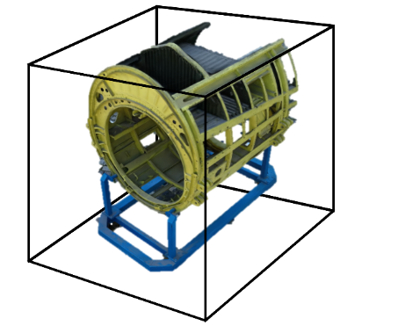
/
METHODOLOGY
RADIANCE FIELD
Explicit radiance field
A 3D scene can be defined as a digital high-fidelity representation of an object or environment in a precise temporal state.
Geometric information
Details on colour, textures, shading, lighting, and camera perspectives
Free navigation
A radiance field is a representation of light distribution in a 3D space, which captures how light interacts with surfaces and materials in the environment.
An implicit radiance field represents light distribution in a scene without explicitly defining the geometry of the scene.
NeRF
An explicit radiance field directly represents the distribution of light in a discrete spatial structure, such as a voxel grid or a set of points.
Ray
Ray
Enhancing photogrammetric measurement systems through Gaussian Splatting 8th September 2026
07

Slide 8
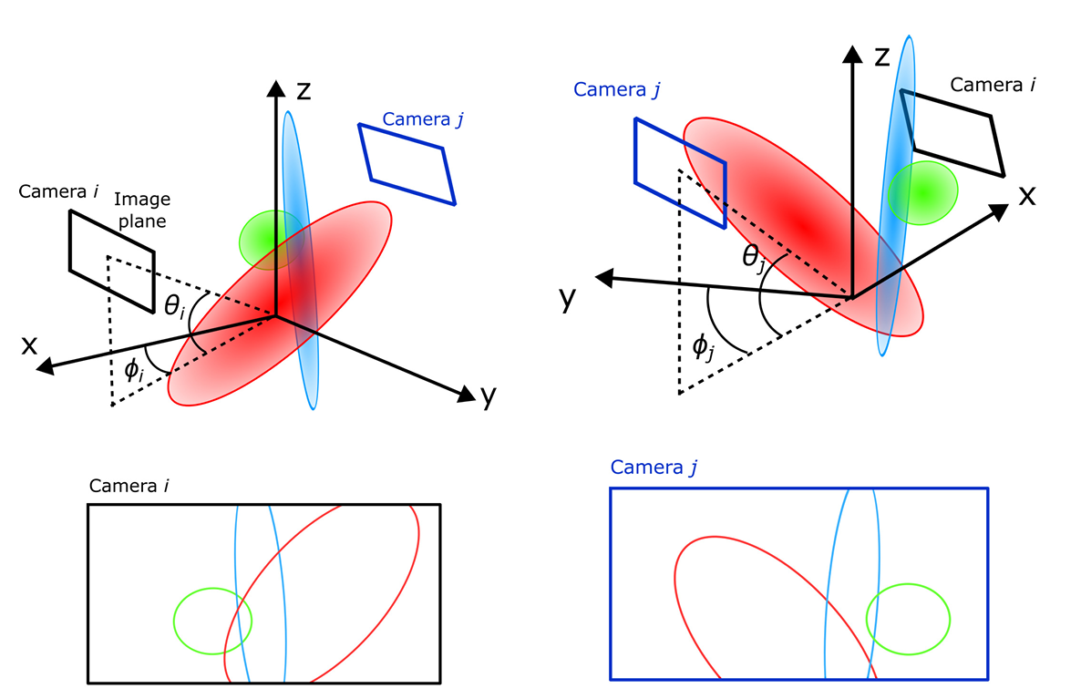
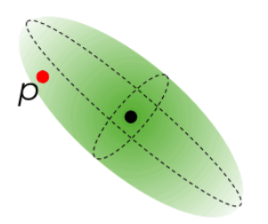

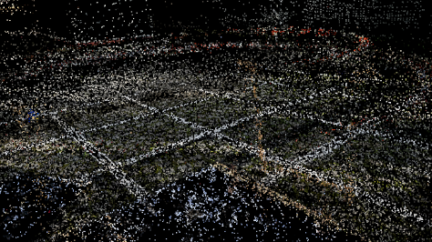
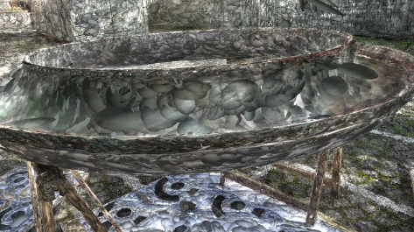
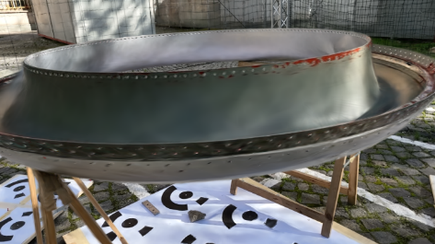
/
METHODOLOGY
GS PIPELINE
Gaussian Splatting for real-time navigable scenes
Optimization pipeline from sparse geometry to visual representation
Projection on image plane
GS OPTIMIZATION PIPELINE
Learnable ellipsoids (millions)
SfM Initialization
Sparse point cloud + camera alignment
Sparse point cloud input
3D Gaussians
μ
Position, Covariance, Color, Opacity
Rasterisation
Real-time projection & blending
Enhancing photogrammetric measurement systems through Gaussian Splatting 8th September 2026
08

Slide 9
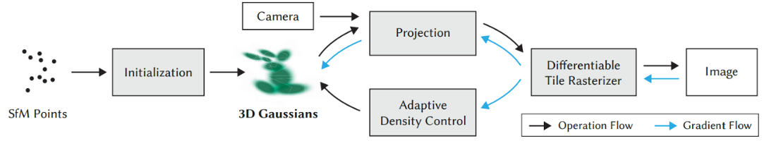
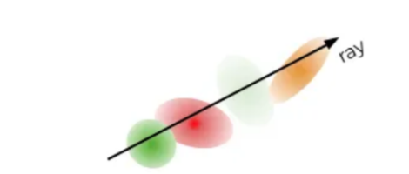
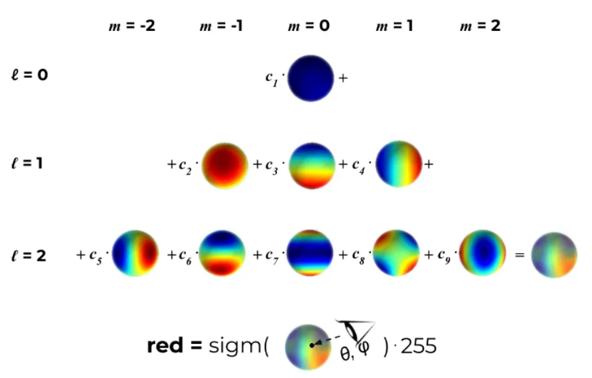
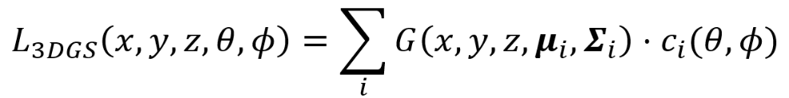
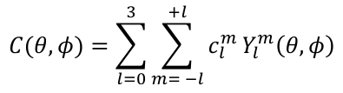
/
METHODOLOGY
DETAILS ON SPHERICAL HARMONICS
How spherical harmonics defines colour
Gaussian Splatting (G) is an explicit radiance field with the advantages of implicit radiance field. It makes use of learnable 3D anisotropic Gaussians as a flexible, efficient representation. Optimized with multiview images, this differentiable pipeline merges gradient flow with explicit data storage. This hybrid approach enables real-time, high-quality rendering with reduced training time, even for complex, high-resolution scenes.
Spherical harmonics of degree l and order m
Enhancing photogrammetric measurement systems through Gaussian Splatting 8th September 2026
09

Slide 10

/
INNOVATIVE APPROACH
SYNERGYSTIC INTEGRATION
Synergistic photogrammetry-GS inspection approach
Scene-driven enrichment through virtual navigation and synthetic views
1
2
3
4
Data acquisition
GS scene generation
Virtual navigation
Enriched P-Cloud
Input: Physical RGB images captured by (UAV) camera.
Process: Train Gaussian Splatting model from images.
Action: Navigate to new viewpoints not physically captured.
Result: Synthetic views into photogrammetry pipeline.
Increases density and fills coverage gaps.
Standard photogrammetry.
Creates navigable 3D scene.
Render high-fidelity 2D images.
Physical images
3D-GS scene
Synthetic renders
Enriched output
This procedure allows “new” images to be generated long after the object is gone.
Enhancing photogrammetric measurement systems through Gaussian Splatting 8th September 2026
10

Slide 11
/
INNOVATIVE APPROACH
BENEFITS OF INTEGRATION
Benefits of integrating GS into photogrammetry
A
Image-set augmentation
Renders can be added to the original set of physical images with the aim of increasing the number of available observations
B
Virtualisation of the photogrammetric acquisition process
Because camera positions and orientations can be explicitly controlled within the reconstructed scene, virtual image acquisition can be performed without the physical accessibility constraints associated with a physical acquisition campaign.
Enhancing photogrammetric measurement systems through Gaussian Splatting 8th September 2026
11

Slide 12
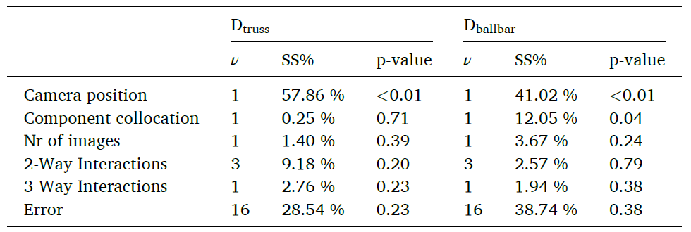
EXPERIMENTAL SETUP
/
CASE STUDY
Small-scale ballbar
Calibration
structured light project system ATOS GOM ScanBox Series 4;
The ATOS GOM calibrated according to ISO 10360–13:2021;
Length measurement error of 0.004 mm on a length of 160 mm (MPE of 34 μm);
Spherical size measurement error of 0.0045 mm on a diameter of 25 mm (MPE of 15 μm).
Instrumentation
Basler acA2500-14uc camera, with 2590 x 1942 pixels, a sensor format of 1/2.5”, pixel size measuring 2.2 × 2.2 μm, and a frame rate of 14 fps;
Basler Lens C125-0818-5M-P, focal length of 8.11 mm with a tolerance of ±5 %, an optimum working distance of 0.5 m, and an optimum magnification of 0.016.
Enhancing photogrammetric measurement systems through Gaussian Splatting 8th September 2026
12

Slide 13
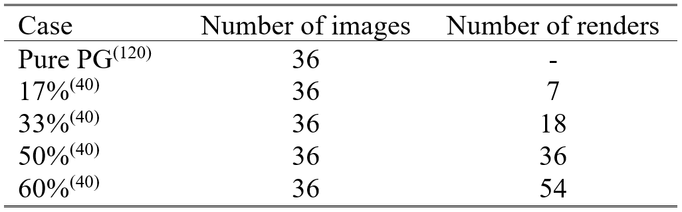
EXPERIMENTAL SETUP
/
AUGMENTED PHOTOGRAMMETRY
Bias evaluation across measurands
GS scene is generated with 36 images extracted from a set of 72. Images are not random, but collected on two different camera elevations, with a relative angular distance of 20°.
Renders are generated from the 36 missing poses and a certain percentage of random digital images is used for dataset augmentation.
Enhancing photogrammetric measurement systems through Gaussian Splatting 8th September 2026
13

Slide 14
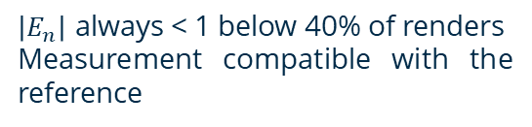

EXPERIMENTAL SETUP
/
NORMALISED ERROR
Normalised error
Extra cases: physical Images are now random, but collected on two different camera elevations, with a relative angular distance of 20°.
Renders are generated from the 36 missing poses and a certain percentage of random digital images is used for dataset augmentation.
$$E_{n}=\frac{u_{GS}−u_{REF}}{\sqrt{U_{GS}^{2}+U_{REF}^{2}}}$$
Sources of uncertainty
Reproducibility
Traceability
Resolution
$\left|E_{n}\right|$ always < 1 below 40% of renders
Measurement compatible with the reference
Enhancing photogrammetric measurement systems through Gaussian Splatting 8th September 2026
14

Slide 15
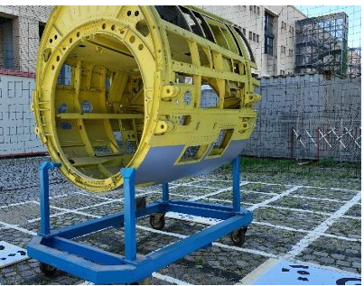
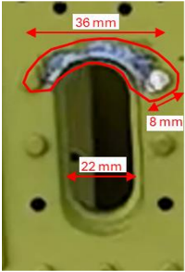
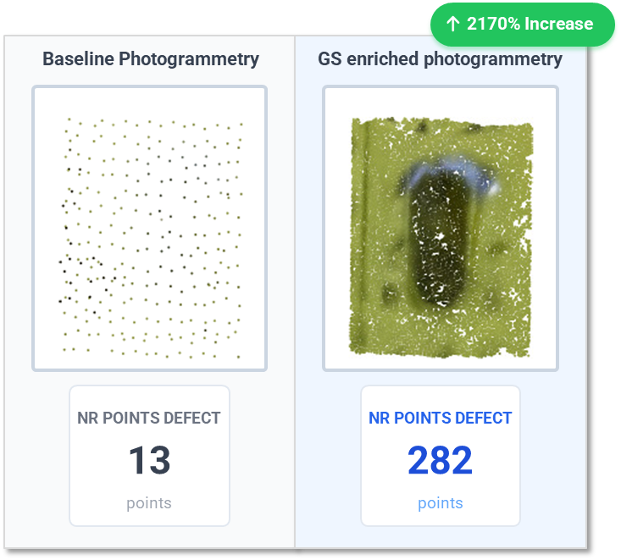
EXPERIMENTAL SETUP
/
ENRICHED PHOTOGRAMMETRY
Enriched photogrammetry: density and feature recovery
Massive density leap
Feature recovery
Robustness verified
Over 20x increase in point count allows for detection of small features previously missed.
Bolts, rivet holes, and scratch edges clearly defined even with inaccessible or removed physical views.
GS synthesised missing viewpoints to create a dense and adequate 3D dense point cloud.
Enhancing photogrammetric measurement systems through Gaussian Splatting 8th September 2026
15

Slide 16
DISCUSSION
Limitations and new perspective
OPEN QUESTION
1
Computational cost
Renders can be freely used as images if within 40%?
GS requires high-end GPU resources (e.g., NVIDIA A100)
2
Static scene constraint
Object must remain perfectly static during acquisition
3
Limited interoperability
GS output not yet standard in metrology context
Enhancing photogrammetric measurement systems through Gaussian Splatting 8th September 2026
16

Slide 17




CONCLUSIONS
Summary key research contributions
Back-in-time repeatability
Photogrammetry + GS synergy
Validated traceability
Established a novel paradigm using "3D Navigable Scenes" to enable retrospective inspection of past asset states, overcoming the temporal limitations of traditional photogrammetry.
Developed a synergistic workflow where Gaussian Splatting (digital) renders enrich photogrammetric reconstruction, increasing local density by ~10x and improving defect definition.
Significant improvements in feature matching and reconstruction quality, validating the method for safety-critical LVS inspection. GS can serve as standalone inspective technique.
ACKNOWLEDGMENTS
Quality Engineering and Management Group
Mind4Lab
Q & A Session
Dept. of Management & Production Eng.
Politecnico di Torino
Enhancing photogrammetric measurement systems through Gaussian Splatting 8th September 2026
17

Slide 18
Enhancing photogrammetric measurement systems through Gaussian Splatting
Mattia Trombini, Giacomo Maculotti
Gianfranco Genta, Maurizio Galetto
Presenting author
Mattia Trombini
Dept. of Management and Production Eng., Politecnico di Torino, Italy
mattia.trombini@polito.it
Firenze, 8th September 2026

Slide 19
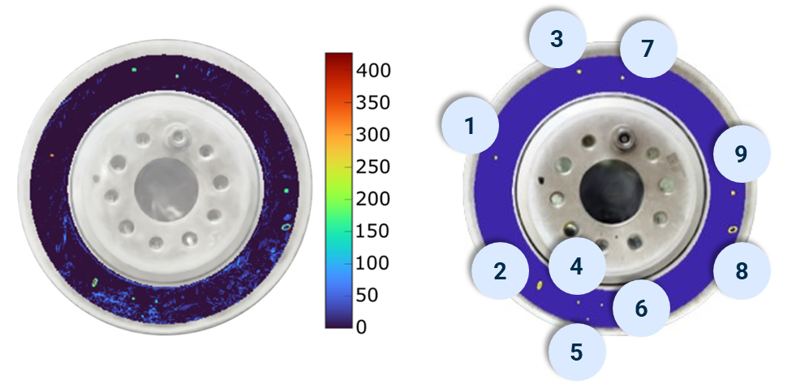
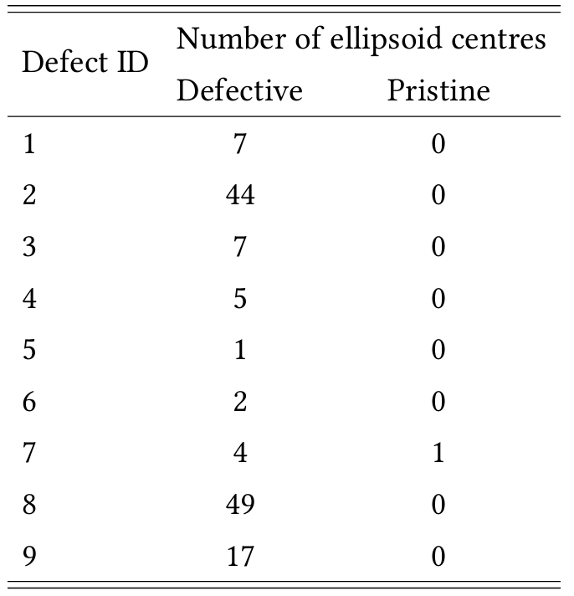
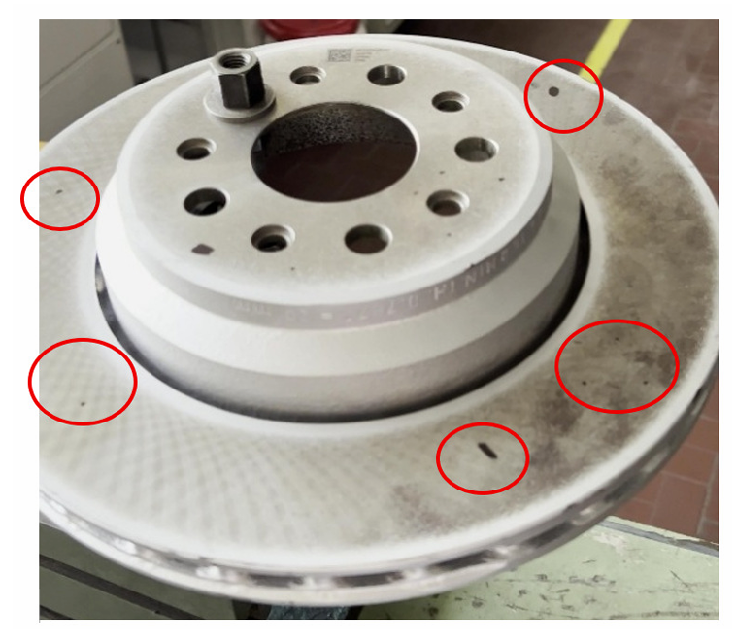
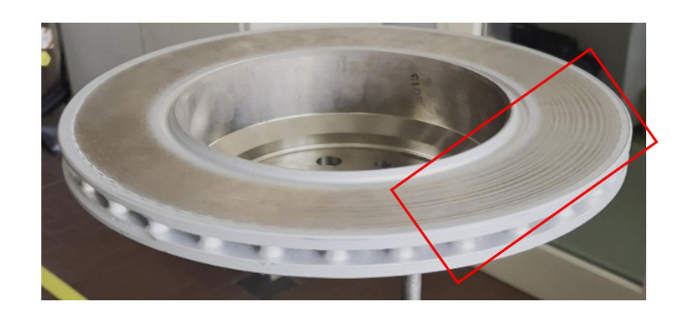
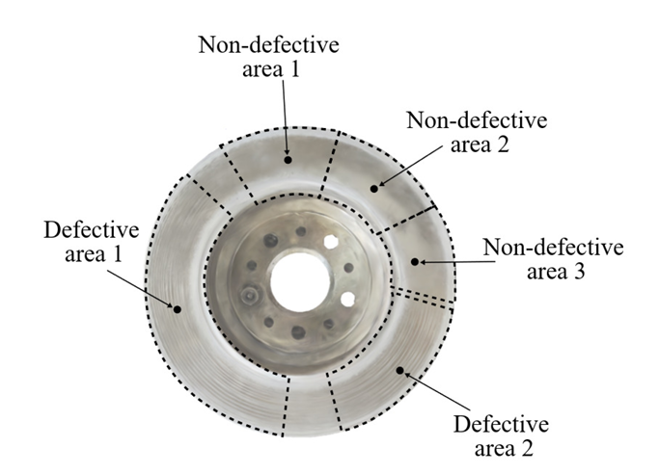
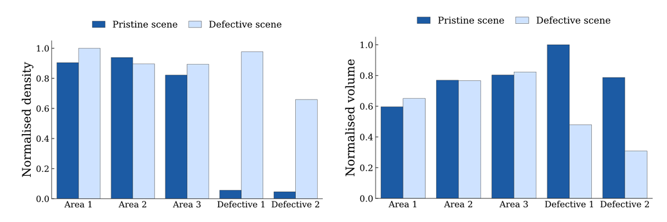
/
BACKUP
BRAKE DISC
Semi-automatic defect detection
SEMI-AUTOMATIC DETECTION
Scene comparison
Direct comparison between “pristine” (t₀) and “defective” (t₁) scenes using geometric and chromatic differences.
Detection logic
Oxidation points: detected via gradient map + density increase. Scratches: detected via area sampling + increase density + decreased volume.
Semi-automatic workflow
Automates the identification of potential anomalies, reducing operator workload while keeping human-in-the-loop for final verification.
Supplementary material
19

Slide 20
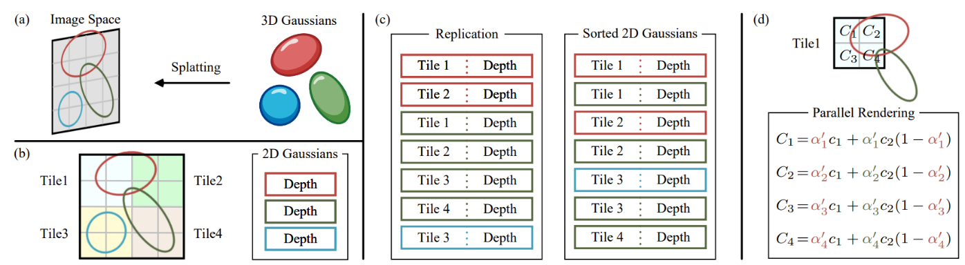
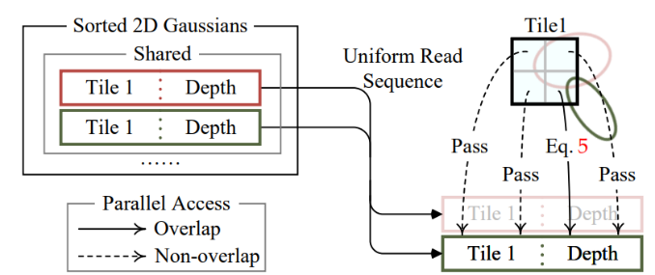
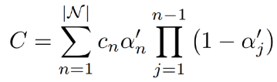

/
BACKUP
CONCEPT OF “SPLATTING”
“Splatting”
Supplementary material
20

Slide 21
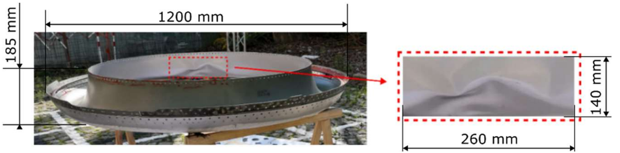
/
BACKUP
RESULTS ON ENGINE LIP
Experimental setup – engine lip
Instrumentation
Matrice 350RTK
Zenmuse L2 high-resolution camera
Agisoft Metashape© for P
Python with PyTorch framework and custom CUDA © for G
System for Image-Based Rendering (SIBR) for render extraction
Dataset
200 ground-truth images (3840x2160 pixels)
30 localised renders
Case A: baseline P
Case B: enriched P + 30 G renders
A portion of the surface shows visible damage defined as a bump consistent with the impact caused by the collision with a flock of birds (bird strike).
Supplementary material
21

Slide 22
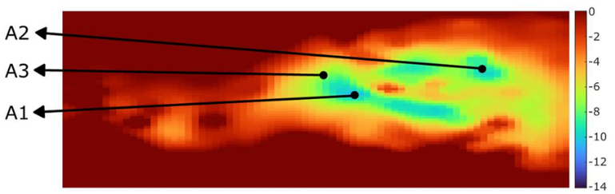
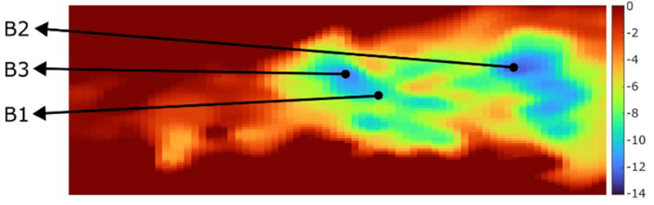
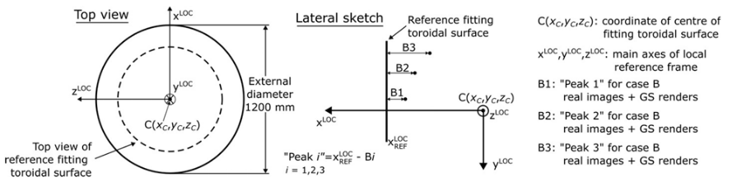
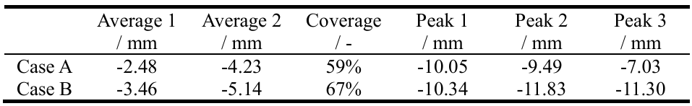
/
BACKUP
RESULTS ON ENGINE LIP
Experimental setup – engine lip
Point cloud is projected from 3D onto the 2D image plane where the image of the bump lies.
Points are superimposed onto the image, creating a density map where the colour represents the computed distances with respect to the theoretical inner surface.
Case A
Case B
Supplementary material
22

Slide 23

/
BACKUP
RESULTS ON FUSELAGE LOG
Experimental setup – fuselage log
Instrumentation
Matrice 350RTK
Zenmuse L2 high-resolution camera
Agisoft Metashape© for P
Python with PyTorch framework and custom CUDA © for G
System for Image-Based Rendering (SIBR) for render extraction
Dataset
260 ground-truth images (3840x2160 pixels)
G.1 scene from 260 images
G.2 scene from 253 images
G.3 scene from 248 images
Case A.1: baseline P
Case B.1.1: enriched P + 15 G.1 renders
Case B.1.2: enriched P + 15 G.2 renders
Case B.1.3: enriched P + 15 G.3 renders
Supplementary material
23

Slide 24
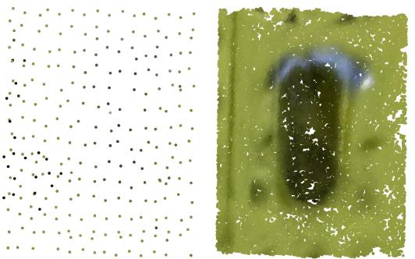
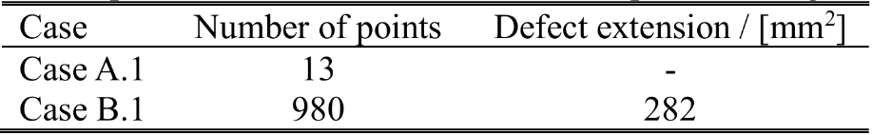
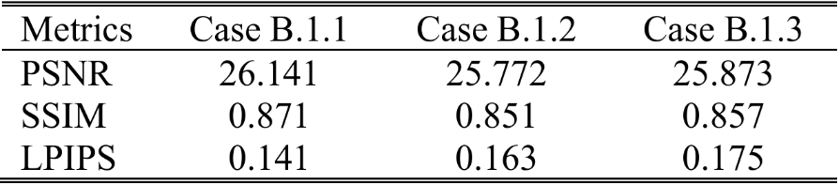

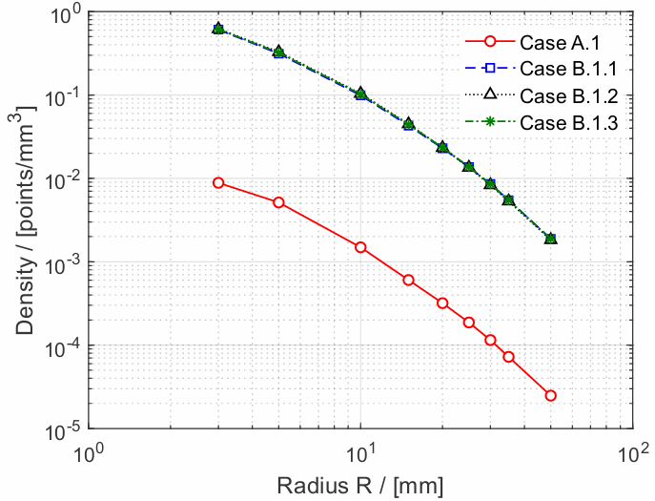


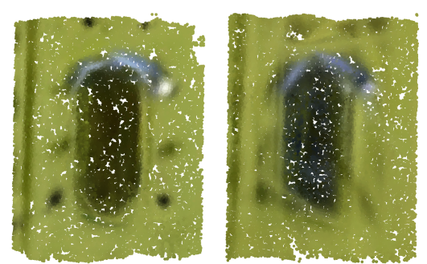


/
BACKUP
RESULTS ON FUSELAGE LOG
Experimental setup – fuselage log
By selectively removing images of the defective area, the experiment simulates challenging inspection conditions and evaluates whether G scene can generate accurate renders for photogrammetric enrichment.
Density within the defective region
PSNR (↑): range [0; ∞]
SSIM (↑): range [-1; 1]
LPIPS (↓): range [0; 1]
The enhancement of local portions of the reconstructed domain is relevant in increasing local density.
Collecting renders in the defect surroundings allows for a better definition of all the local parts of the object, with all the constituents (e.g., bolts, holes, defects, etc.) more clearly distinguishable.
Supplementary material
24

