Slide 1
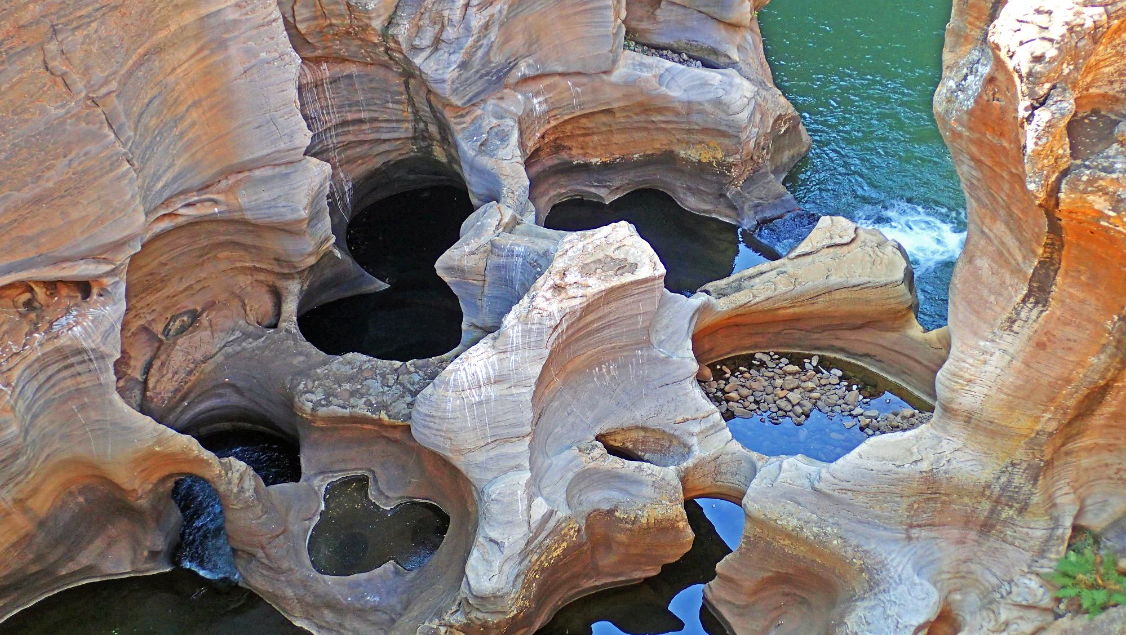


Multivariate sensitivity analysis for risk analysis with spatial (FUNCTIONAL) outputs:
A comparison exercise
Jeremy Rohmer, French geological survey BRGM, j.rohmer@brgm.fr
Corinna Perchtold, French geological survey BRGM, c.perchtold@brgm.fr

Slide 2

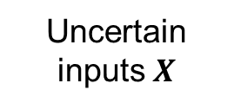

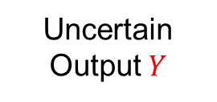
Objective of Sensitvity Analysis SA [1]:
Investigate how important is each model input in determining its output
Scope here
Global methods GSA: behaviour of the model under given input parameter distributions
pdf
111
pdf
$$Y=ℳ(X)$$
Decompositon of Y uncertainty
X₁
X₃
Uncertain inputs $X$
Black box model
Uncertain Output $Y$
X₁
X₂
X₂
X₃
Interaction
GSA
[1] Iooss and Saltelli (2017)

Slide 3
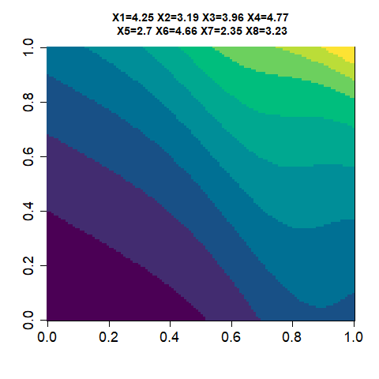
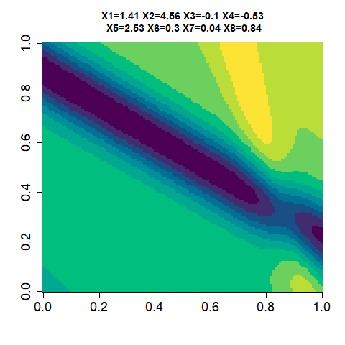
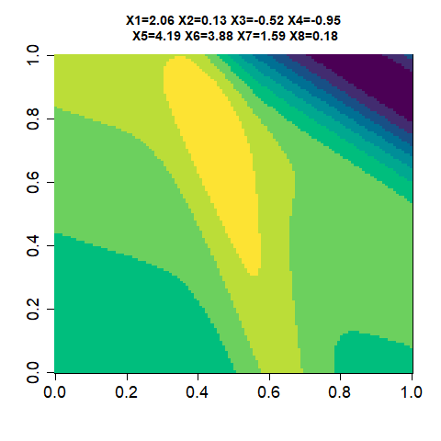

Objective of Sensitvity Analysis SA [1]:
Investigate how important is each model input in determining its output
Scope here
Global methods GSA: behaviour of the model under given input parameter distributions
The output is functional and for the real application case here spatially varying
pdf
111
$$Y=ℳ(X)$$
X₁
X₃
Uncertain inputs $X$
Black box model
X₂
Uncertain Spatial Output $Y$
GSA
[1] Iooss and Saltelli (2017)

Slide 4
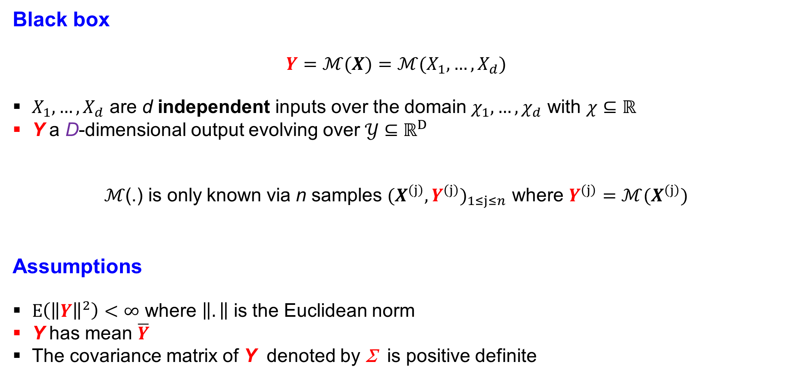
Framework of computer experiments
Black box
$$Y=ℳ(X)=ℳ(X_{1},…,X_{d})$$
$X_{1},…,X_{d}$ are d independent inputs over the domain $χ_{1},…,χ_{d}$ with $χ⊆ℝ$
Y a D-dimensional output evolving over 𝒴 $⊆ℝ^{D}$
ℳ(.) is only known via n samples ${(X^{\left(j\right)}, Y^{\left(j\right)})}_{1≤j≤n}$ where $Y^{\left(j\right)}=ℳ(X^{\left(j\right)})$
Assumptions
$Ε\left({\left\|Y\right\|}^{2}\right)<∞$ where $\left\|.\right\|$ is the Euclidean norm
Y has mean $\overline{Y}$
The covariance matrix of Y denoted by Σ is positive definite

Slide 5

Three main GSA approaches for functional outputs
Step 1. Dimensionality Reduction
D-dimensional output
$$Y$$
K << D
Based on:
Principal Component Analysis PCA

Slide 6
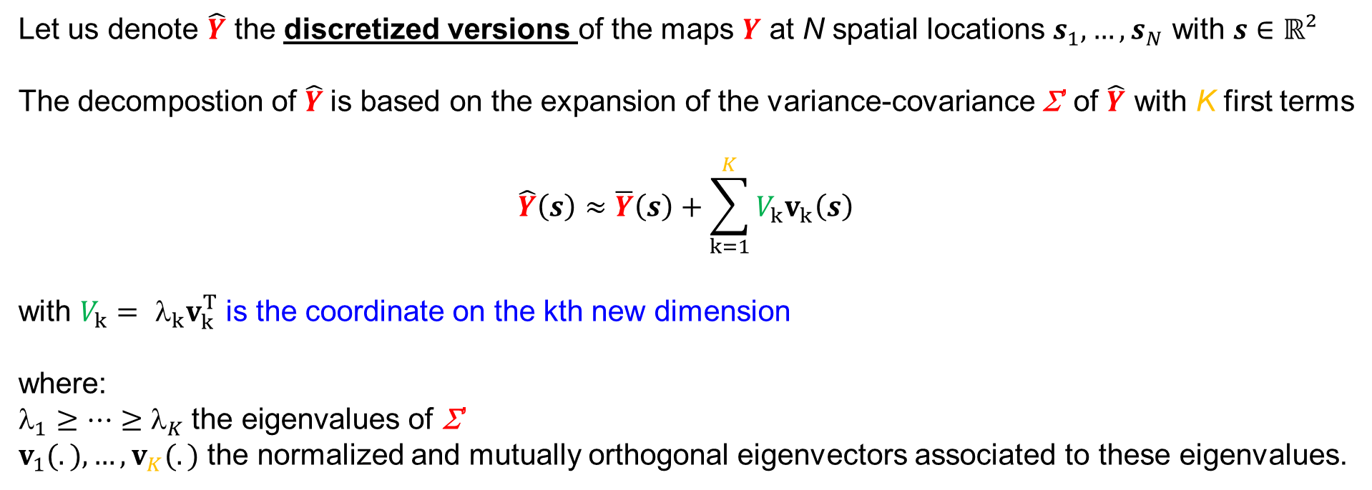
Principal Component Analysis PCA [1]
Let us denote $\hat{Y}$ the discretized versions of the maps $Y$ at N spatial locations $s_{1},…,s_{N}$ with $s∈ℝ²$
The decompostion of $\hat{Y}$is based on the expansion of the variance-covariance Σ’ of $\hat{Y}$ with K first terms
$$\hat{Y}\left(s\right)≈\overline{Y}\left(s\right)+\sum_{k=1}^{K}{V_{k}v_{k}\left(s\right)}$$
with $V_{k}={ }_{k}v_{k}^{T}$ is the coordinate on the kth new dimension
where:
$_{1}≥…≥$ $_{K} \text{the} \text{eigenvalues} \text{of}$ Σ’
$v_{1}(.),…,v_{K}(.)$ the normalized and mutually orthogonal eigenvectors associated to these eigenvalues.
[1] Ramsay and Silverman, 2005

Slide 7
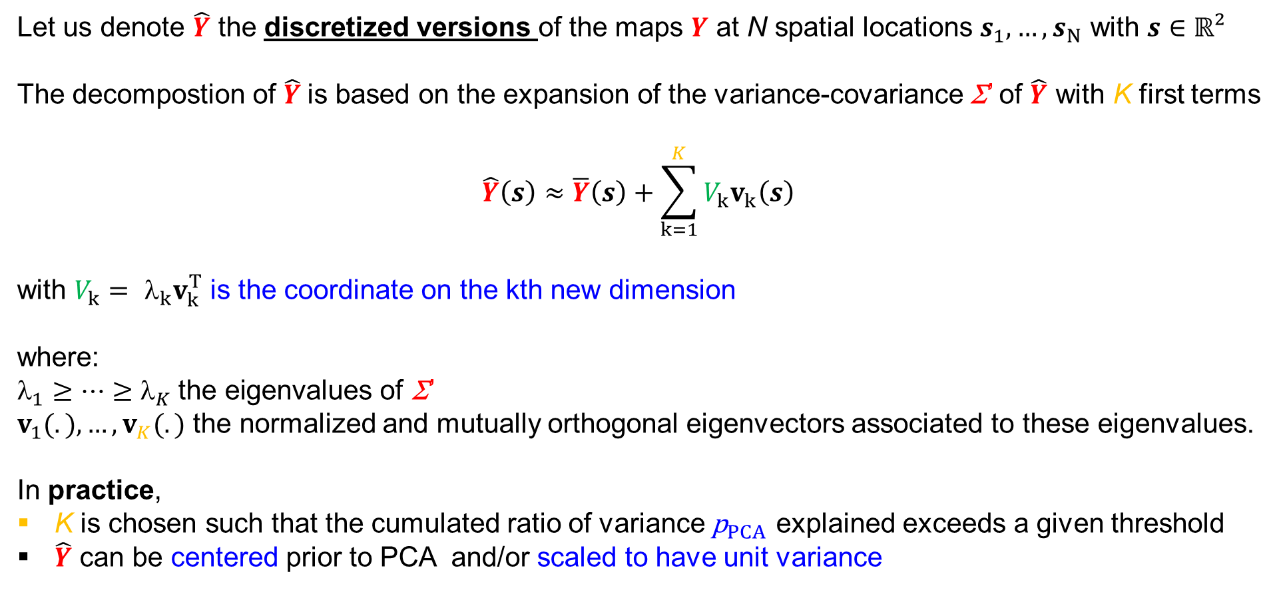
Principal Component Analysis PCA [1]
Let us denote $\hat{Y}$ the discretized versions of the maps $Y$ at N spatial locations $s_{1},…,s_{N}$ with $s∈ℝ²$
The decompostion of $\hat{Y}$is based on the expansion of the variance-covariance Σ’ of $\hat{Y}$ with K first terms
$$\hat{Y}\left(s\right)≈\overline{Y}\left(s\right)+\sum_{k=1}^{K}{V_{k}v_{k}\left(s\right)}$$
with $V_{k}={ }_{k}v_{k}^{T}$ is the coordinate on the kth new dimension
where:
$_{1}≥…≥$ $_{K} \text{the} \text{eigenvalues} \text{of}$ Σ’
$v_{1}(.),…,v_{K}(.)$ the normalized and mutually orthogonal eigenvectors associated to these eigenvalues.
In practice,
K is chosen such that the cumulated ratio of variance ${\text{p}}_{PCA}$ explained exceeds a given threshold
$\hat{Y}$ can be centered prior to PCA and/or scaled to have unit variance
[1] Ramsay and Silverman, 2005

Slide 8

Three main GSA approaches for functional outputs
Step 1. Dimensionality Reduction
Step 2. GSA
in latent space V
Based on:
Generalised Sobol’ Indices GSI [1,2]
Optimal transport: OTSA [3,4]
Dependence measures: HSICspa [5,6]
D-dimensional output
$$Y$$
K << D
Based on:
Principal Component Analysis PCA
[1] Lamboni et al. (2011); [2] Gamboa et al. (2014)
[3] Borgonovo et al., (2025); [4] Chiani et al. (2025)
[5] El Amri and Marrel (2024); [6] da Veiga (2015)

Slide 9
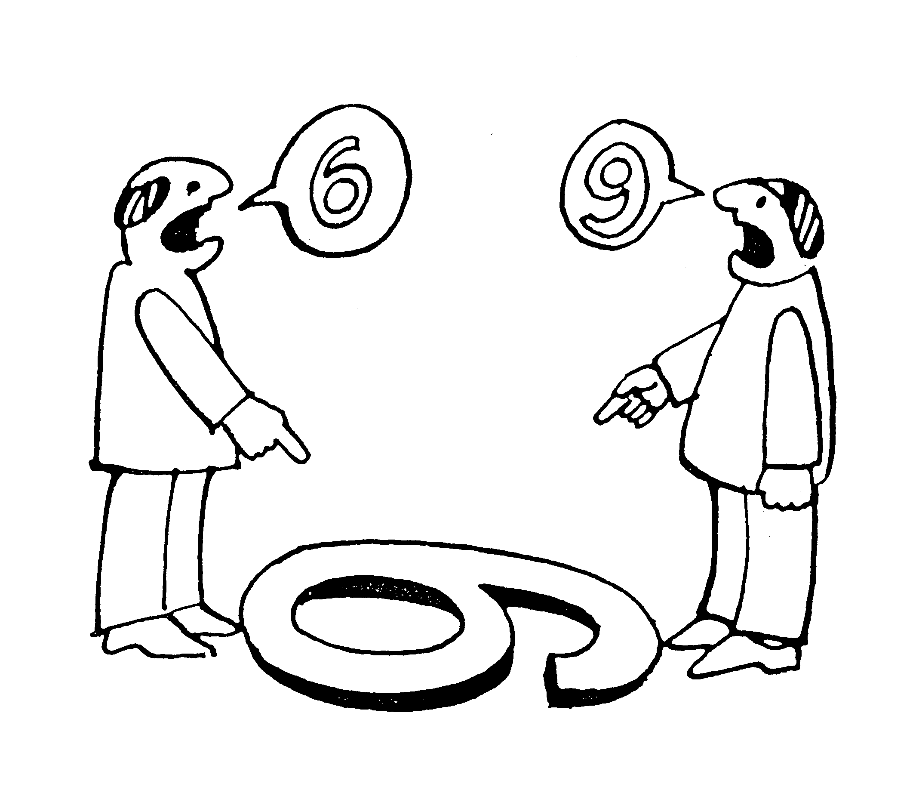
Three main GSA approaches for functional outputs
Step 1. Dimensionality Reduction
Step 2. GSA
in latent space V
Based on:
Generalised Sobol’ Indices GSI [1,2]
Optimal transport: OTSA [3,4]
Dependence measures: HSICspa [5,6]
D-dimensional output
$$Y$$
K << D
Based on:
Principal Component Analysis PCA
Objectives: ‘Sensitivity of the sensitivity’ [7]
Compare
Informativeness on the influence
Robustness to the parameterization of: 1. PCA & 2. GSA
Computational effort (convergence)
[1] Lamboni et al. (2011); [2] Gamboa et al. (2014)
[3] Borgonovo et al., (2025); [4] Chiani et al. (2025)
[5] El Amri and Marrel (2024); [6] da Veiga (2015)
[7] Razavi et al. (2021)

Slide 10
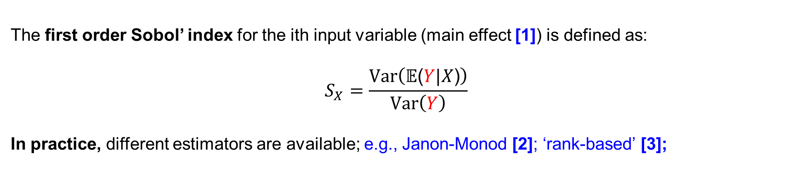
Approach 1: GSA based on Sobol’ indices
Assume that Y is univariate
The first order Sobol’ index for the ith input variable (main effect [1]) is defined as:
$$S_{X}=\frac{Var\left(\text{𝔼}\text{(}Y\text{|}X\text{)}\right)}{Var\left(Y\right)}$$
In practice, different estimators are available; e.g., Janon-Monod [2]; ‘rank-based’ [3];
[1] Saltelli et al. (2008); [2] Janon et al. (2014); [3] Gamboa et al. (2020)

Slide 11
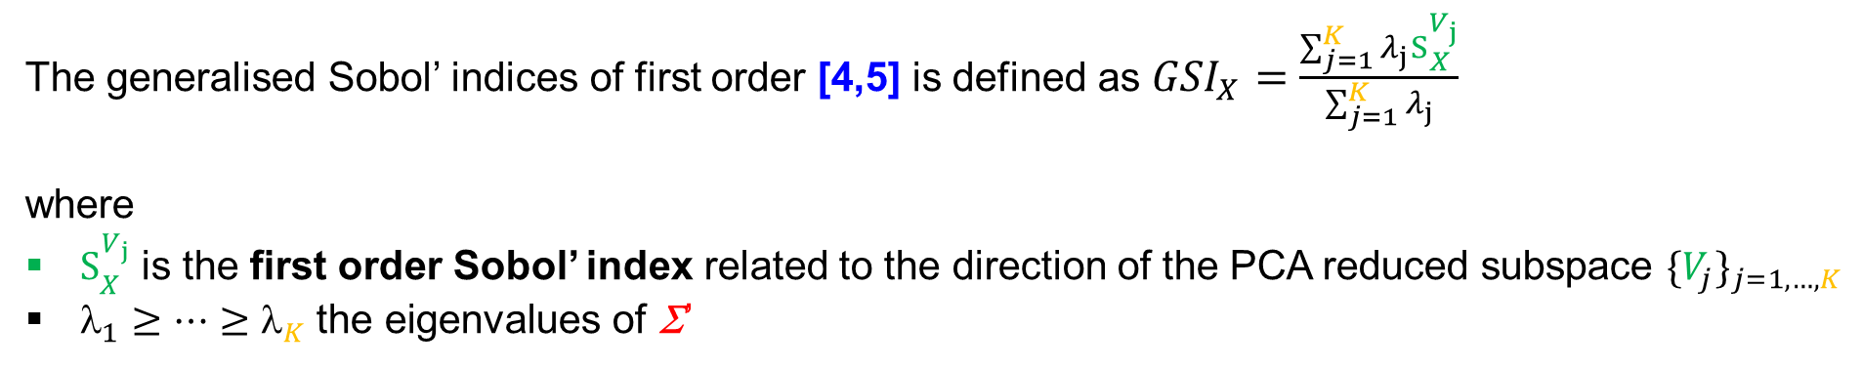
Approach 1: GSA based on Sobol’ indices
Assume that Y is univariate
The first order Sobol’ index for the ith input variable (main effect [1]) is defined as:
$$S_{X}=\frac{Var\left(\text{𝔼}\text{(}Y\text{|}X\text{)}\right)}{Var\left(Y\right)}$$
In practice, different estimators are available; e.g., Janon-Monod [2]; ‘rank-based’ [3];
Assume that Y is multivariate
The generalised Sobol’ indices of first order [4,5] is defined as ${GSI}_{X}=\frac{\sum_{j=1}^{K}{λ_{j}S_{X}^{V_{j}}}}{\sum_{j=1}^{K}{λ_{j}}}$
where
$S_{X}^{V_{j}}$is the first order Sobol’ index related to the direction of the PCA reduced subspace ${\{V_{j}\}}_{j=1,…,K}$
$_{1}≥…≥$ $_{K} \text{the} \text{eigenvalues} \text{of}$ Σ’
[1] Saltelli et al. (2008); [2] Janon et al. (2014); [3] Gamboa et al. (2020); [4] Lamboni et al. (2011); [5] Gamboa et al. (2014)

Slide 12
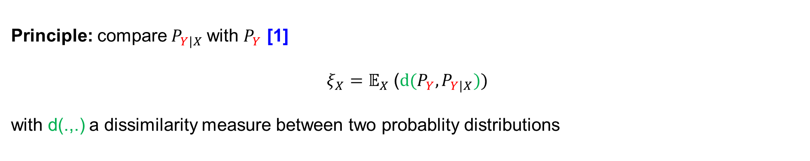
Approach 2: GSA and optimal transport (OT)
Assume that Y is univariate
Principle: compare${ P}_{Y|X}$with $P_{Y}$ [1]
$$ξ_{X}={\text{𝔼}}_{X} \text{(}d(P_{Y},P_{Y|X}))$$
with d(.,.) a dissimilarity measure between two probablity distributions
[1] Borgonovo et al., (2016); [2] Borgonovo et al., (2025)

Slide 13

Approach 2: GSA and optimal transport (OT)
Assume that Y is univariate
Principle: compare${ P}_{Y|X}$with $P_{Y}$ [1]
$$ξ_{X}={\text{𝔼}}_{X} \text{(}d(P_{Y},P_{Y|X}))$$
with d(.,.) a dissimilarity measure between two probablity distributions
In practice,
Many choices are possible, at least in the univariate case (KS, KL, Hellinger, Borgonovo, etc.) [2]
If we choose $d(P_{Y},P_{Y|X}) =\text{(}\text{𝔼}\text{(}\text{Y}\text{)} \text{−} \text{𝔼}\text{(}Y|X\text{)}$)², $ξ_{x}=S_{x}$ (Sobol!)
d(.,.) based on the Wasserstein metric W as used for OT [2]
$ξ_{X}$ can estimated via averaging over M-discretisation of X (binning) [1]
[1] Borgonovo et al., (2016); [2] Borgonovo et al., (2025)

Slide 14
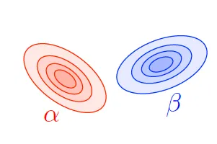

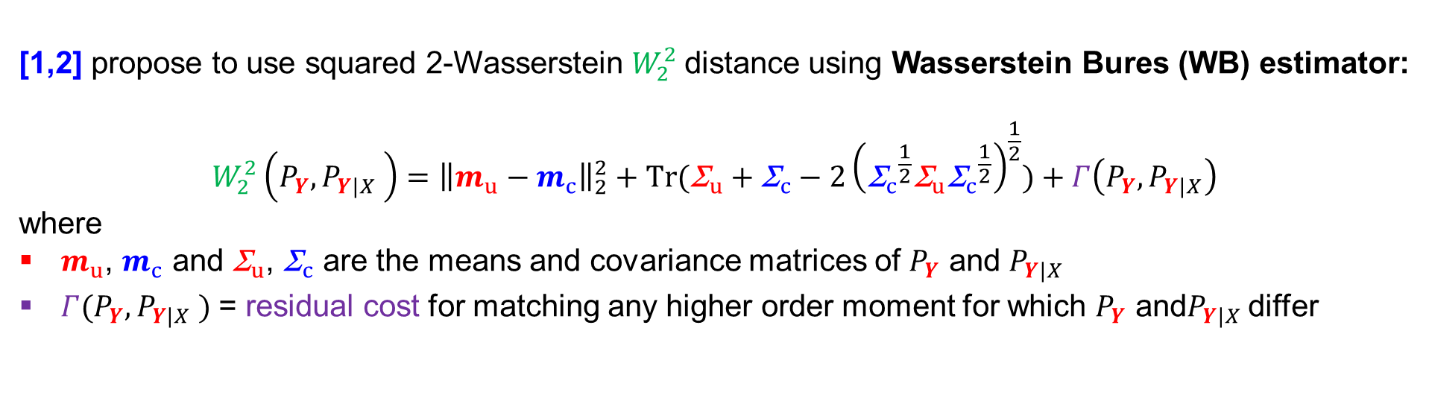



Approach 2: GSA and optimal transport (OT)
Assume that Y is multivariate
[1,2] propose to use squared 2-Wasserstein $W_{2}^{2}$distance using Wasserstein Bures (WB) estimator:
$$W_{2}^{2}\left(P_{Y},{P_{Y|X}}_{ }\right)={\left\|m_{u}−m_{c}\right\|}_{2}^{2}+Tr({\text{}}_{u}+{\text{}}_{c}−2{\left({{\text{}}_{c}}^{\frac{1}{2}}{\text{}}_{u}{{\text{}}_{c}}^{\frac{1}{2}}\right)}^{\frac{1}{2}})+Γ\left(P_{Y},P_{Y|X}\right)$$
where
$m_{u}$, $m_{c}$ and ${\text{}}_{u}$, ${\text{}}_{c}$ are the means and covariance matrices of $P_{Y}$ and ${P_{Y|X}}_{ }$
$Γ(P_{Y},{P_{Y|X}}_{ })$ = residual cost for matching any higher order moment for which $P_{Y}$ and${P_{Y|X}}_{ }$differ
$m_{u}$, ${\text{}}_{u}$
$m_{c}$, ${\text{}}_{c}$
$$P_{Y|X}$$
$P_{Y}$
[1] Chiani et al. (2025); [2] Borgonovo et al., (2025)

Slide 15

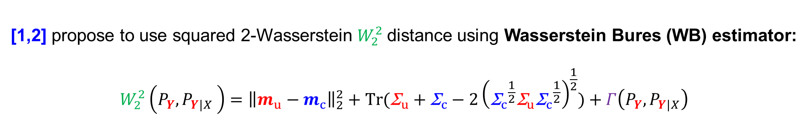

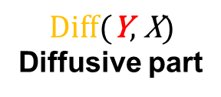
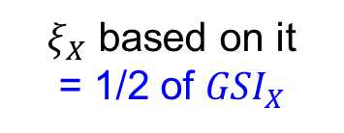
Approach 2: GSA and optimal transport (OT)
Assume that Y is multivariate
[1,2] propose to use squared 2-Wasserstein $W_{2}^{2}$distance using Wasserstein Bures (WB) estimator:
$$W_{2}^{2}\left(P_{Y},{P_{Y|X}}_{ }\right)={\left\|m_{u}−m_{c}\right\|}_{2}^{2}+Tr({\text{}}_{u}+{\text{}}_{c}−2{\left({{\text{}}_{c}}^{\frac{1}{2}}{\text{}}_{u}{{\text{}}_{c}}^{\frac{1}{2}}\right)}^{\frac{1}{2}})+Γ\left(P_{Y},P_{Y|X}\right)$$
$$\text{Adv}\text{(}\text{Y}\text{,} \text{X}\text{)}$$
Advective part
$$\text{Diff}\text{(}\text{Y}\text{, }\text{X}\text{)}$$
Diffusive part
$Residual$ part
$ξ_{X}$ based on it
= 1/2 of ${GSI}_{X}$
[1] Chiani et al. (2025); [2] Borgonovo et al., (2025)

Slide 16
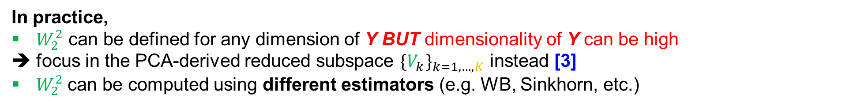
Approach 2: GSA and optimal transport (OT)
Assume that Y is multivariate
[1,2] propose to use squared 2-Wasserstein $W_{2}^{2}$distance using Wasserstein Bures (WB) estimator:
$$W_{2}^{2}\left(P_{Y},{P_{Y|X}}_{ }\right)={\left\|m_{u}−m_{c}\right\|}_{2}^{2}+Tr({\text{}}_{u}+{\text{}}_{c}−2{\left({{\text{}}_{c}}^{\frac{1}{2}}{\text{}}_{u}{{\text{}}_{c}}^{\frac{1}{2}}\right)}^{\frac{1}{2}})+Γ\left(P_{Y},P_{Y|X}\right)$$
$$\text{Adv}\text{(}\text{Y}\text{,} \text{X}\text{)}$$
Advective part
$$\text{Diff}\text{(}\text{Y}\text{, }\text{X}\text{)}$$
Diffusive part
$Residual$ part
$ξ_{X}$ based on it
= 1/2 of ${GSI}_{X}$
In practice,
$W_{2}^{2}$ can be defined for any dimension of Y BUT dimensionality of Y can be high
➔ focus in the PCA-derived reduced subspace ${{\{V}_{k}\}}_{k=1,…,K}$ instead [3]
$W_{2}^{2}$ can be computed using different estimators (e.g. WB, Sinkhorn, etc.)
[1] Chiani et al. (2025); [2] Borgonovo et al., (2025); [3] Perchtold et al. (2026)

Slide 17
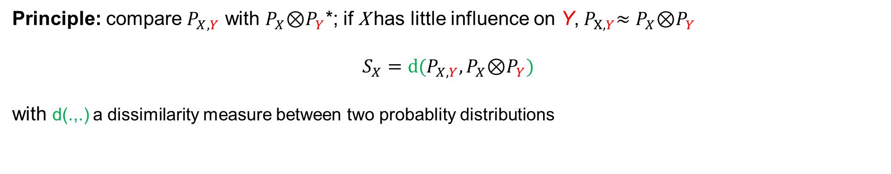
Approach 3: Hilbert-Schmidt Independence Criterion (HSIC) [1,2]
Assume that Y is univariate
Principle: compare $P_{X,Y}$ with $P_{X}$⊗$P_{Y}$*; if$\text{X}$ has little influence on Y,${ P}_{X,Y}≈P_{X}$⊗$P_{Y}$
$$S_{X}=d(P_{X,Y},P_{X}\text{⊗}P_{Y})$$
with d(.,.) a dissimilarity measure between two probablity distributions
[1] Gretton et al. 2005; [2] da Veiga 2015
*joint probability and product of marginals

Slide 18
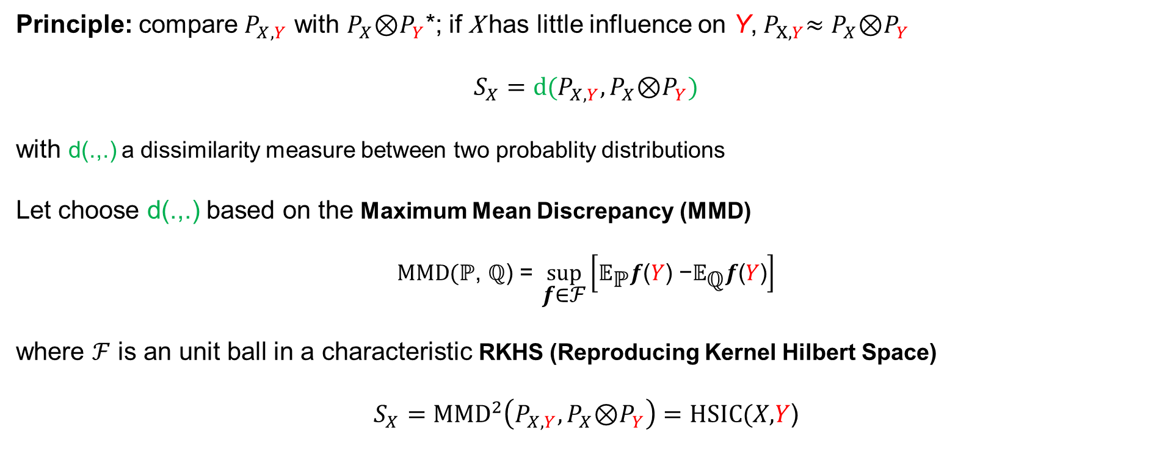
Approach 3: Hilbert-Schmidt Independence Criterion (HSIC) [1,2]
Assume that Y is univariate
Principle: compare $P_{X,Y}$ with $P_{X}$⊗$P_{Y}$*; if$\text{X}$ has little influence on Y,${ P}_{X,Y}≈P_{X}$⊗$P_{Y}$
$$S_{X}=d(P_{X,Y},P_{X}\text{⊗}P_{Y})$$
with d(.,.) a dissimilarity measure between two probablity distributions
Let choose d(.,.) based on the Maximum Mean Discrepancy (MMD)
$$MMD(\text{ℙ}\text{, }\text{ℚ}\text{)}\text{ = }\sup_{\text{f}\text{∈}\text{ℱ}}\left[{\text{𝔼}}_{\text{ℙ}}\text{f}\text{(}Y\text{)}\text{ −}{\text{𝔼}}_{\text{ℚ}}\text{f}\text{(}Y\text{)}\right]$$
where $\text{ℱ}$ is an unit ball in a characteristic RKHS (Reproducing Kernel Hilbert Space)
$$S_{X}={MMD}^{2}\left(P_{X,Y},P_{X}\text{⊗}P_{Y}\right)=HSIC(X\text{,}Y\text{)}$$
[1] Gretton et al. 2005; [2] da Veiga 2015
*joint probability and product of marginals

Slide 19
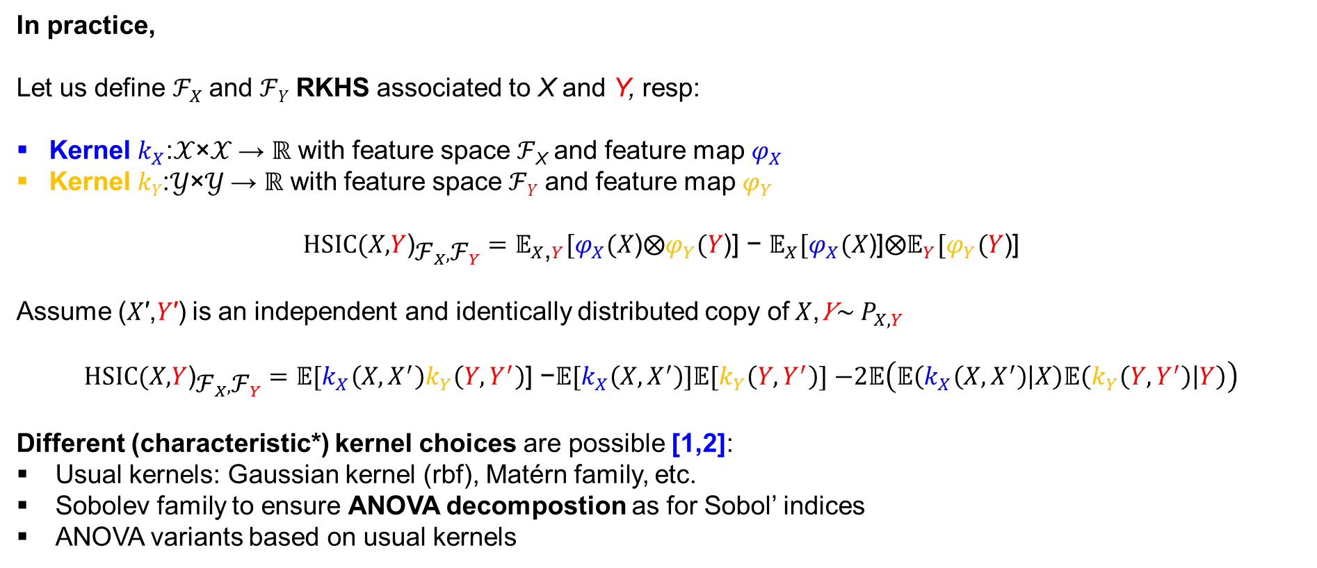
It is all about the kernel…
Assume that Y is univariate
In practice,
Let us define ${\text{ℱ}}_{X}$ and ℱ_{𝑌} RKHS associated to X and Y, resp:
Kernel $k_{X}$:𝒳×𝒳 → ℝ with feature space ℱ_{X} and feature map ${\text{φ}}_{X}$
Kernel 𝑘_{𝑌}:𝒴×𝒴 → ℝ with feature space ℱ_{𝑌} and feature map ${\text{φ}}_{Y}$
${HSIC(X\text{,}Y\text{)}}_{{\text{ℱ}}_{X},{\text{ℱ}}_{Y}}={\text{𝔼}}_{X\text{,}Y}\text{[}{\text{φ}}_{X}(X\text{)}\text{⨂}{\text{φ}}_{Y}(Y\text{)}\text{] }\text{−} {\text{𝔼}}_{X}[{\text{φ}}_{X}(X\text{)}\text{]}\text{⨂}{\text{𝔼}}_{Y}\text{[}{\text{φ}}_{Y}(Y\text{)}\text{]}$
Assume (𝑋′,𝑌′) is an independent and identically distributed copy of$X$,𝑌∼ $P_{X,Y}$
${HSIC(X\text{,}Y\text{)}}_{{\text{ℱ}}_{X},{\text{ℱ}}_{Y}}=\text{𝔼}\text{[}k_{X}\left(X,X^{′}\right)k_{Y}\left(Y,Y^{′}\right)\text{] −}\text{𝔼}\text{[}k_{X}\left(X,X^{′}\right)]\text{𝔼}\text{[}k_{Y}\left(Y,Y^{′}\right)]$ $−2\text{𝔼}\left(\text{𝔼}\left(k_{X}\left(X,X^{′}\right) | X\right)\text{𝔼}\left(k_{Y}\left(Y,Y^{′}\right) | Y\right)\right)$
Different (characteristic*) kernel choices are possible [1,2]:
Usual kernels: Gaussian kernel (rbf), Matérn family, etc.
Sobolev family to ensure ANOVA decompostion as for Sobol’ indices
ANOVA variants based on usual kernels
[1] da Veiga (2021); [2] Sarazin et al. (2023)
*Characteristic kernels and RKHS ⇨Embedding of probability measures is injective

Slide 20
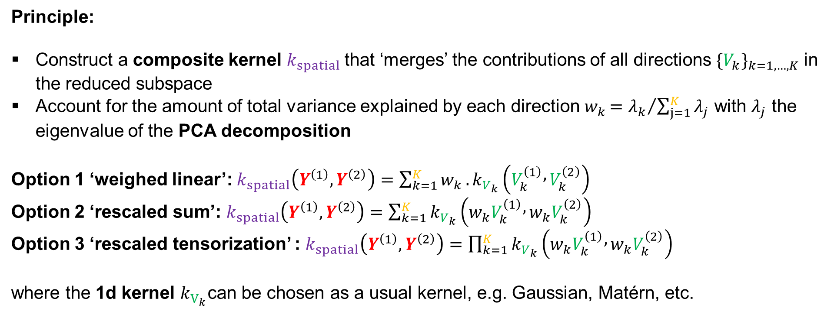
A kernel adapted to functional outputs [1,2]
Assume that Y is multivariate
Principle:
Construct a composite kernel $k_{spatial}$that ‘merges’ the contributions of all directions ${{\{V}_{k}\}}_{k=1,…,K}$in the reduced subspace
Account for the amount of total variance explained by each direction $w_{k}{=λ_{k}}/{\sum_{j=1}^{K}{λ_{j}}}$ with $λ_{j}$ the eigenvalue of the PCA decomposition
Option 1 ‘weighed linear’: $k_{spatial}\left(Y^{\left(1\right)},Y^{\left(2\right)}\right)=\sum_{k=1}^{K}{w_{k}}.k_{V_{k}}\left(V_{k}^{\left(1\right)} , V_{k}^{\left(2\right)}\right)$
Option 2 ‘rescaled sum’: $k_{spatial}\left(Y^{\left(1\right)},Y^{\left(2\right)}\right)=\sum_{k=1}^{K}{k_{V_{k}}\left({w_{k}V}_{k}^{\left(1\right)} , w_{k}V_{k}^{\left(2\right)}\right)}$
Option 3 ‘rescaled tensorization’ : $k_{spatial}\left(Y^{\left(1\right)},Y^{\left(2\right)}\right)=\prod_{k=1}^{K}{k_{V_{k}}\left({w_{k}V}_{k}^{\left(1\right)} , w_{k}V_{k}^{\left(2\right)}\right)}$
where the 1d kernel $k_{V_{k}}$can be chosen as a usual kernel, e.g. Gaussian, Matérn, etc.
[1] El Amri and Marrel (2024); [2] da Veiga (2015)

Slide 21
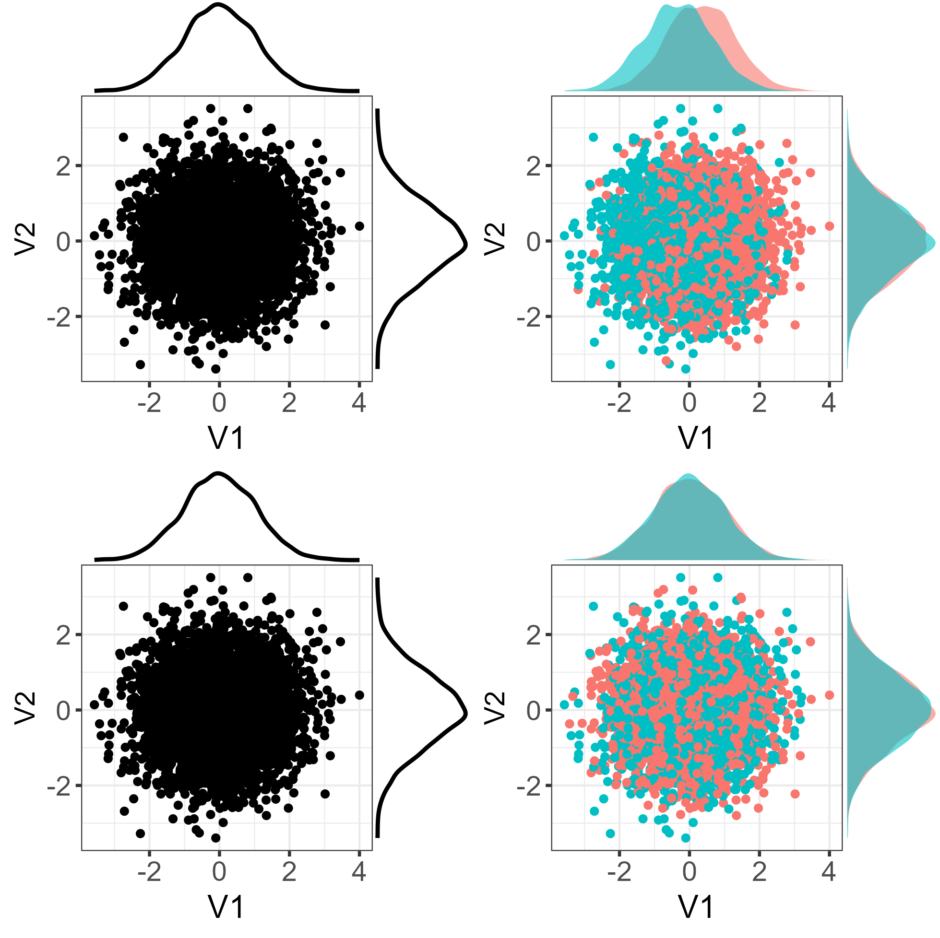

Informativeness on the influence
Effect of X1
$X_{1,...2}\sim Ν(0,1/4)$
$$Y_{1}\sim Ν\left(0,1\right)$$
$$Y_{2}=Y_{1}+ 2X_{1}$$
PCA applied to $Y=(Y_{1},Y_{2})$
1,000 random samples
PCA-based V structure
Effect of X2
V2
V1

Slide 22
Informativeness on the influence
Effect of X1
$X_{1,...2}\sim Ν(0,1/4)$
$$Y_{1}\sim Ν\left(0,1\right)$$
$$Y_{2}=Y_{1}+ 2X_{1}$$
PCA applied to $Y=(Y_{1},Y_{2})$
X1 >0
V2
Shift of the mean
PCA-based V structure
V1
Effect of X2
V2
V2
No effect
V1
V1

Slide 23
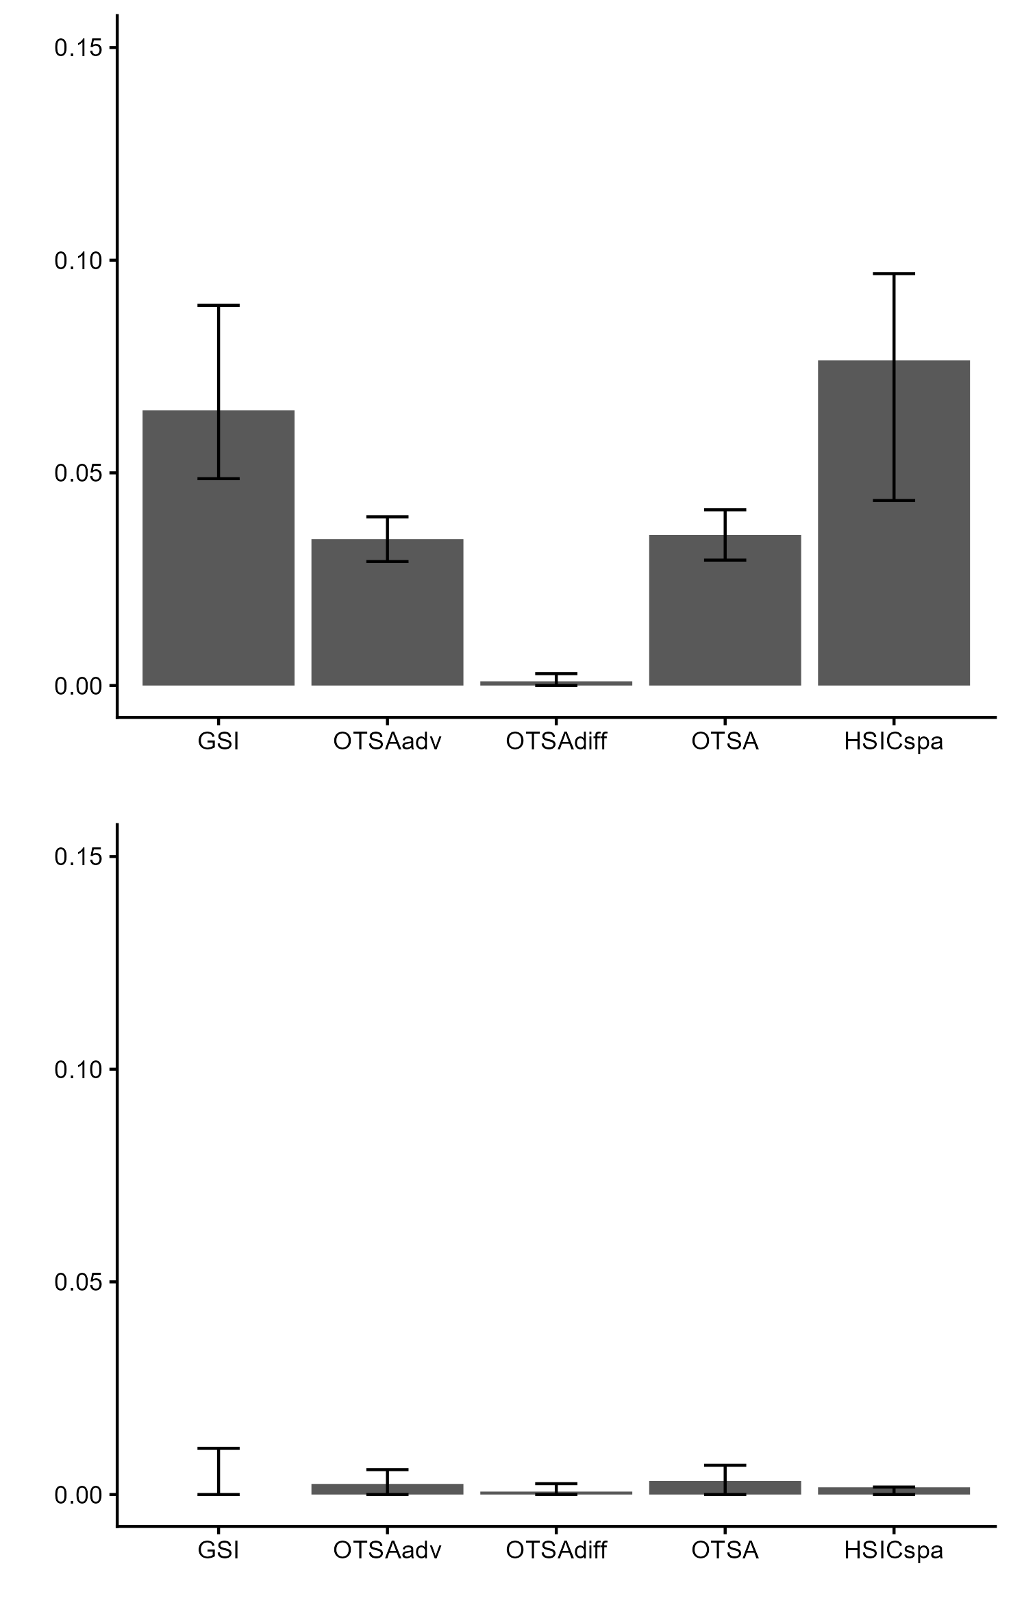
Informativeness on the influence
Sensitivity measure of X1
Effect of X1
$X_{1,...2}\sim Ν(0,1/4)$
$$Y_{1}\sim Ν\left(0,1\right)$$
$$Y_{2}=Y_{1}+ 2X_{1}$$
PCA applied to $Y=(Y_{1},Y_{2})$
X1 >0
V2
PCA-based V structure
Sensitivity measure of X2
V1
Implementation
PCA: centering, scaling, p_{PCA}=0.99
GSI: rank estimator
Effect of X2
V2
V2
V1
V1

Slide 24
Informativeness on the influence
Sensitivity measure of X1
Effect of X1
$X_{1,...2}\sim Ν(0,1/4)$
$$Y_{1}\sim Ν\left(0,1\right)$$
$$Y_{2}=Y_{1}+ 2X_{1}$$
PCA applied to $Y=(Y_{1},Y_{2})$
X1 >0
½ GSI
V2
PCA-based V structure
Sensitivity measure of X2
V1
Implementation
PCA: centering, scaling, p_{PCA}=0.99
GSI: rank estimator
OTSA:
  M=20 binning
  WB estimator
Effect of X2
V2
V2
V1
V1

Slide 25
Informativeness on the influence
Sensitivity measure of X1
Effect of X1
$X_{1,...2}\sim Ν(0,1/4)$
$$Y_{1}\sim Ν\left(0,1\right)$$
$$Y_{2}=Y_{1}+ 2X_{1}$$
PCA applied to $Y=(Y_{1},Y_{2})$
X1 >0
V2
PCA-based V structure
Sensitivity measure of X2
V1
Implementation
PCA: centering, scaling, p_{PCA}=0.99
GSI: rank estimator
OTSA:
  M=20 binning
  WB estimator
HSICspa:
  V-stat estimator
  Option: rescaled sum
  rbf 1d kernel
Effect of X2
V2
V2
V1
V1

Slide 26
Informativeness on the influence
Sensitivity measure of X1
Effect of X1
$X_{1,...2}\sim Ν(0,1/4)$
$$Y_{1}\sim Ν\left(0,1\right)$$
$$Y_{2}=Y_{1}+ 2X_{1}$$
PCA applied to $Y=(Y_{1},Y_{2})$
X1 >0
V2
PCA-based V structure
V1
Sensitivity measure of X2
Effect of X2
V2
V2
V1
V1

Slide 27
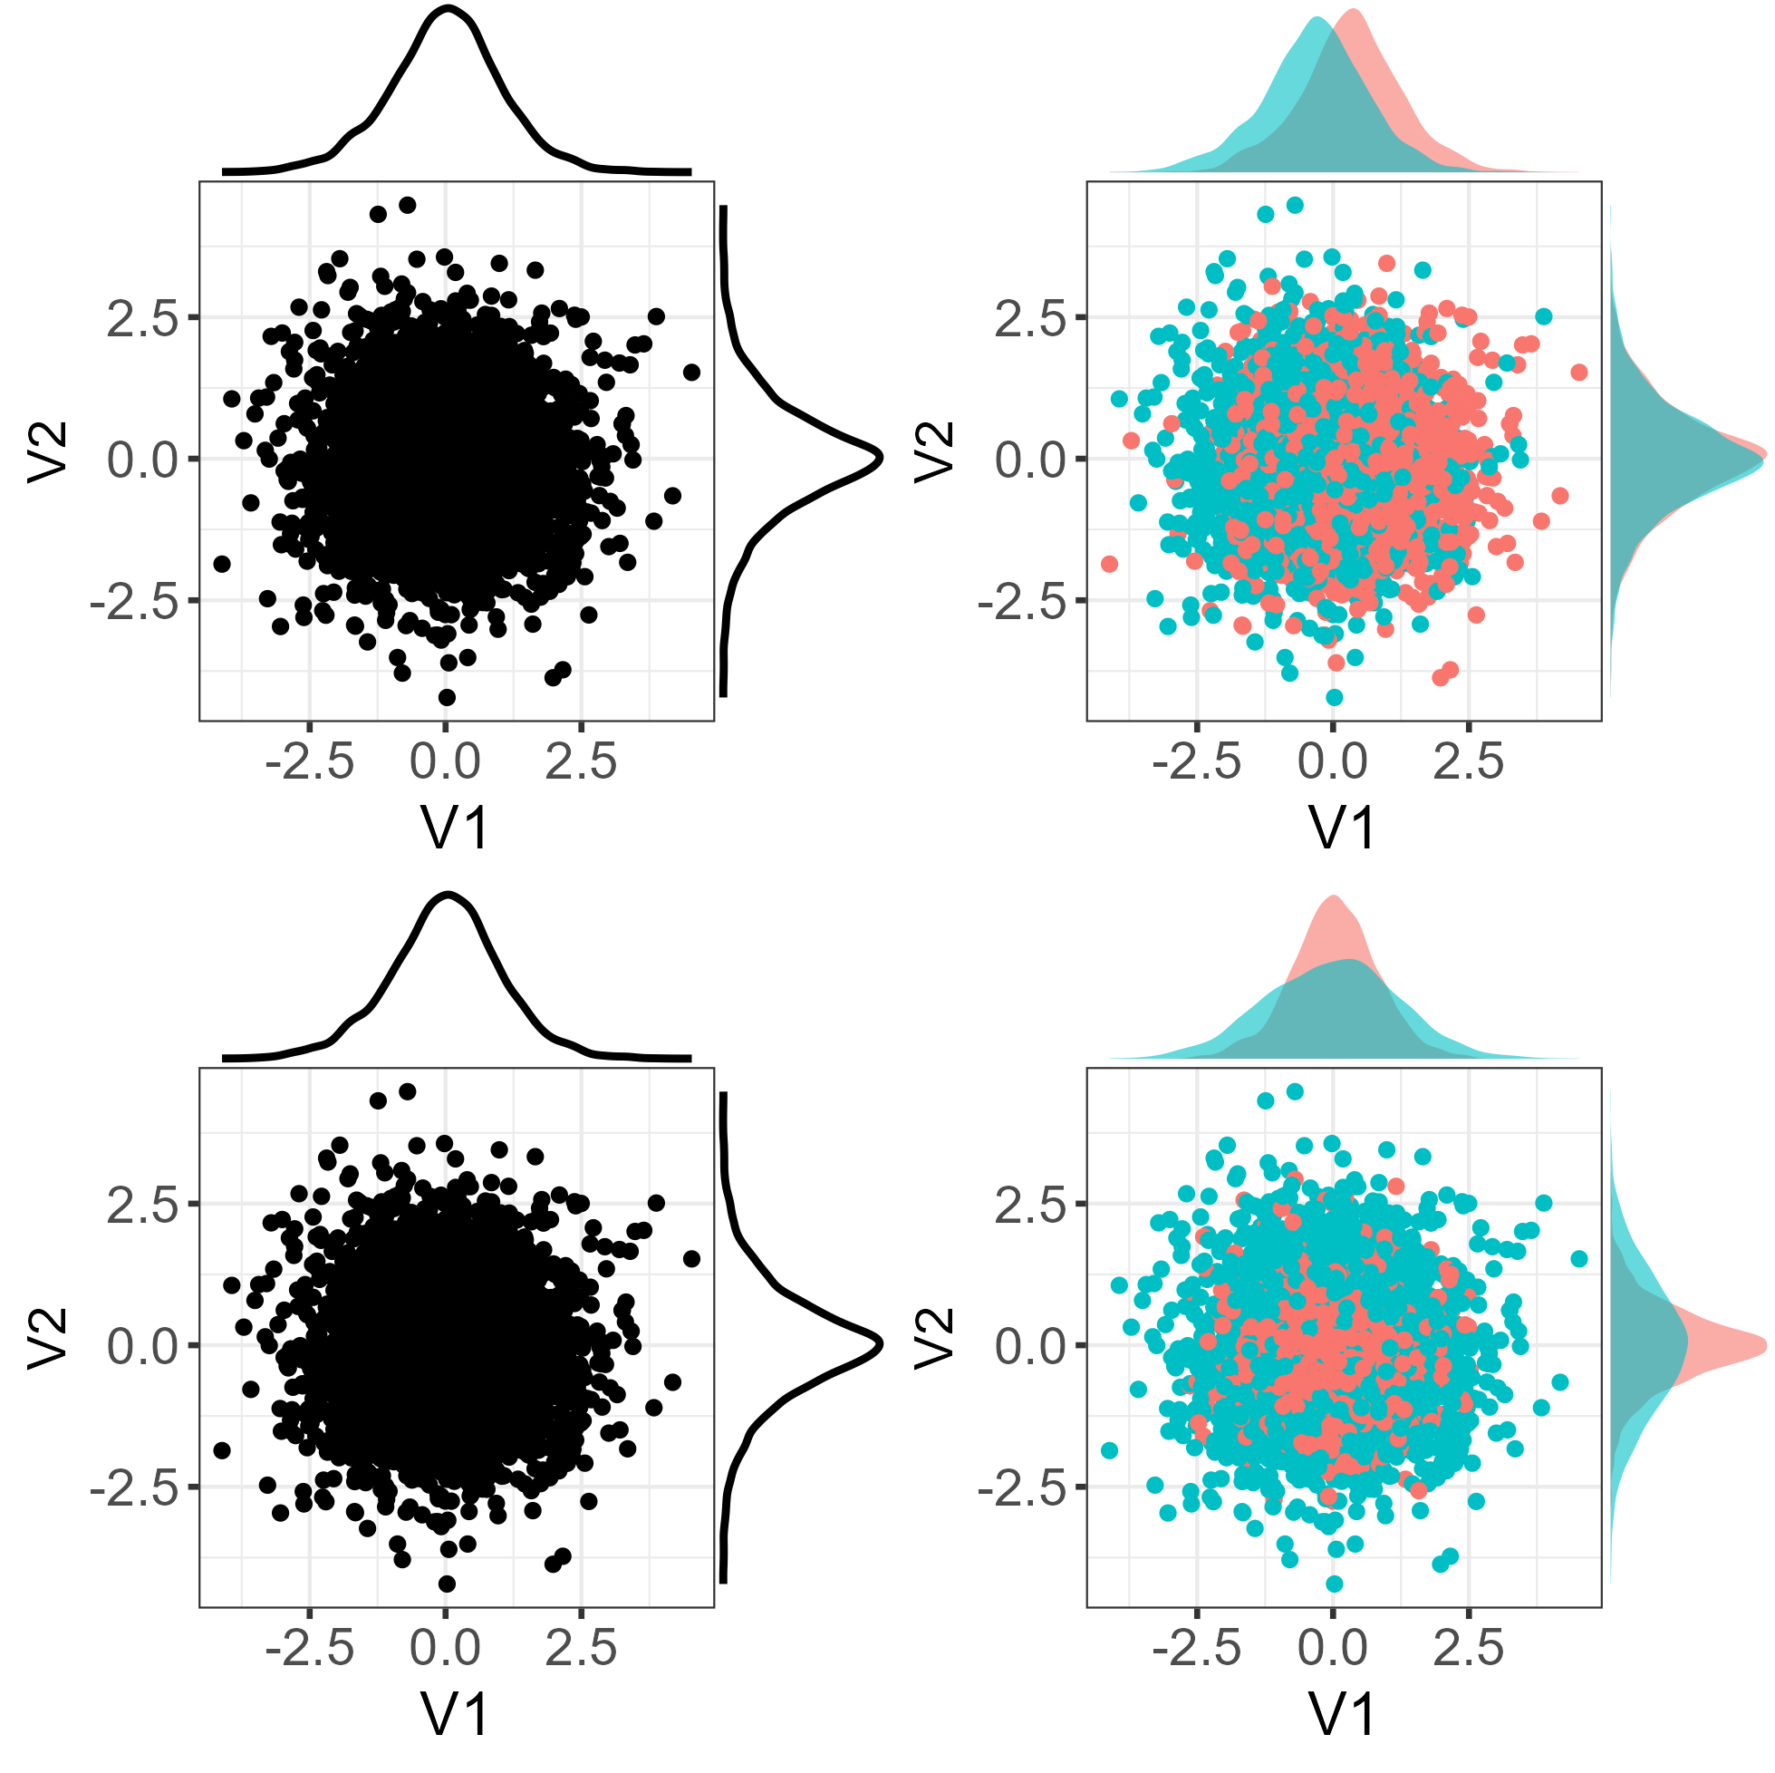

Informativeness on the influence
Effect of X1
$X_{1,...2}\sim Ν(0,1/4)$
$$Y_{1}\sim Ν\left(0,1\right)$$
$$Y_{2}=Y_{1}X_{2}+ 2X_{1}$$
PCA applied to $Y=(Y_{1},Y_{2})$
X1 >0
V2
Shift of the mean
PCA-based V structure
V1
Effect of X2
X2 >0
V2
V2
Effect on the variance
X2 >0
V1
V1

Slide 28
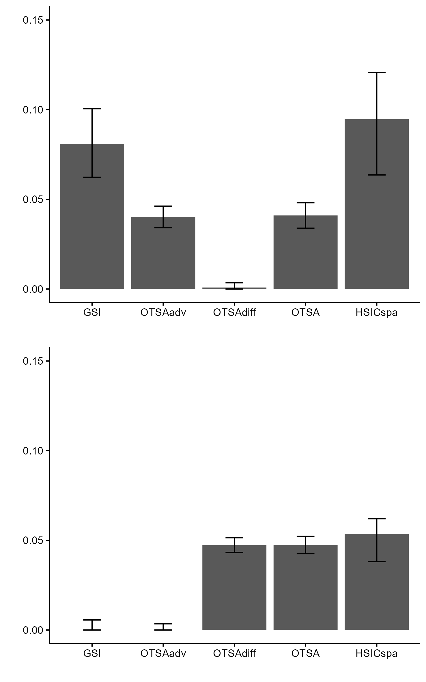
Informativeness on the influence
Sensitivity measure of X1
Effect of X1
$X_{1,...2}\sim Ν(0,1/4)$
$$Y_{1}\sim Ν\left(0,1\right)$$
$$Y_{2}=Y_{1}X_{2}+ 2X_{1}$$
PCA applied to $Y=(Y_{1},Y_{2})$
X1 >0
V2
PCA-based V structure
V1
Sensitivity measure of X2
Effect of X2
X2 >0
V2
V2
X2 >0
V1
V1

Slide 29
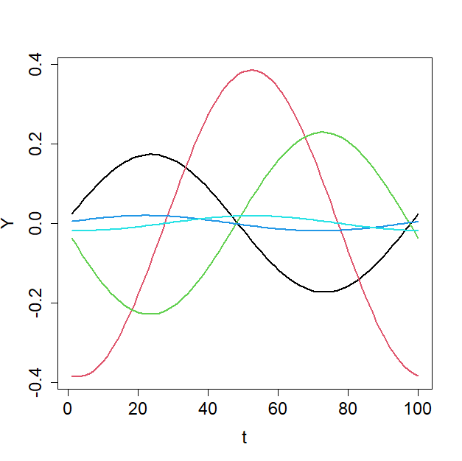
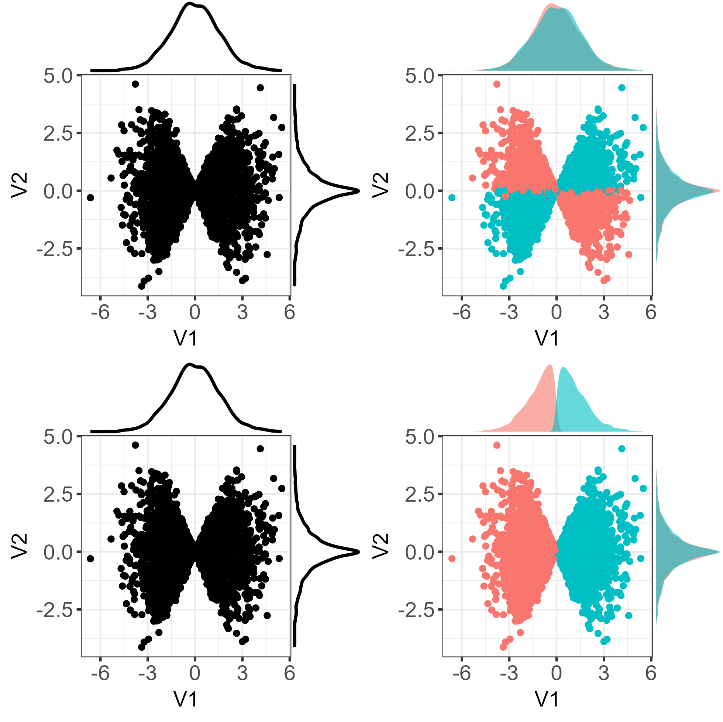

Informativeness on the influence
Some realisations of Y
$X_{2}\sim U(0,.5), X_{2}\sim Ν(0,.5)$
$Y_{t}=sin(4X_{1}t+ε)×X_{2}/2$,
$$t=i.2π/100, i=1,..., 100$$
PCA applied to the
100-dimensionsal vector $Y$
PCA-based V structure

Slide 30

Informativeness on the influence
$X_{2}\sim U(0,.5), X_{2}\sim Ν(0,.5)$
$Y_{t}=sin(4X_{1}t+ε)×X_{2}/2$,
$$t=i.2π/100, i=1,..., 100$$
PCA applied to the
100-dimensionsal vector $Y$
1,000 random samples
PCA-based V structure
V2
‘Horse-shoe’-like effect [1]
V1
[1] Goodall (1954)

Slide 31
Informativeness on the influence
Effect of X1
$X_{2}\sim U(0,.5), X_{2}\sim Ν(0,.5)$
$Y_{t}=sin(4X_{1}t+ε)×X_{2}/2$,
$$t=i.2π/100, i=1,..., 100$$
PCA applied to the
100-dimensionsal vector $Y$
X1 >0
No effect on the marginals but on the covariance!
V2
PCA-based V structure
V1
Effect of X2
X2 >0
V2
V2
Mean and variance effect
V1
V1

Slide 32
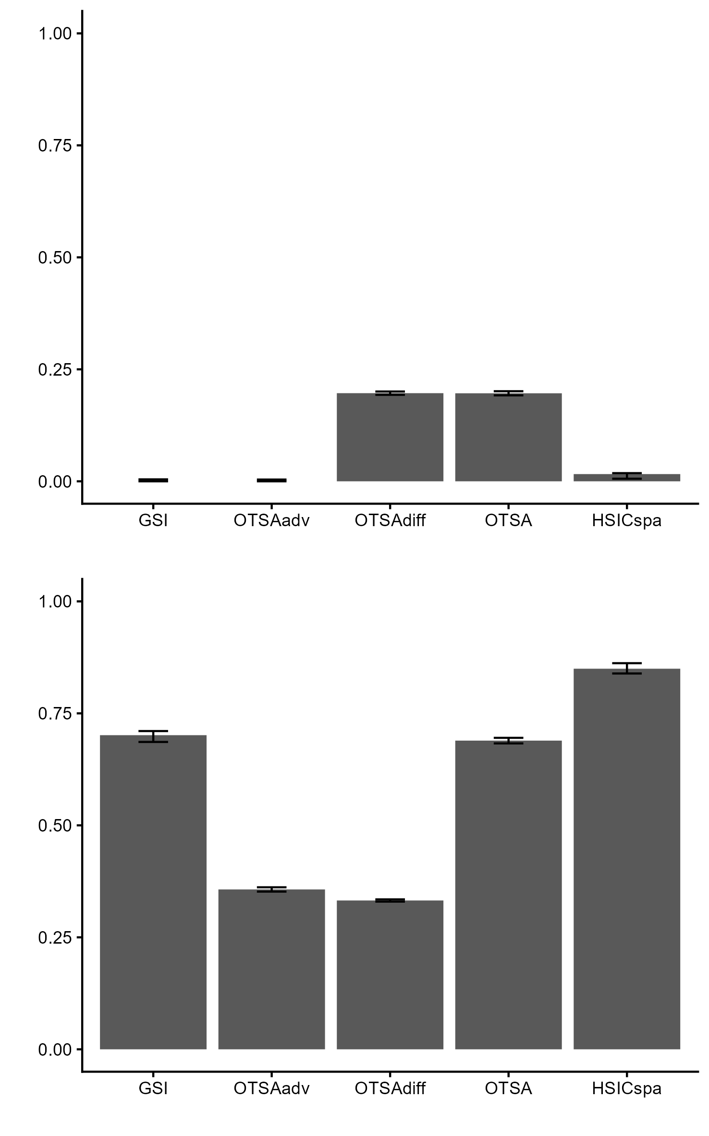

Informativeness on the influence
Sensitivity measure of X1
Effect of X1
$X_{2}\sim U(0,.5), X_{2}\sim Ν(0,.5)$
$Y_{t}=sin(4X_{1}t+ε)×X_{2}/2$, $t=i.2π/100, i=1,..., 100$
PCA applied to the
100-dimensionsal vector $Y$
X1 >0
V2
PCA-based V structure
V1
Sensitivity measure of X2
Effect of X2
X2 >0
V2
V2
V1
V1

Slide 33
Informativeness on the influence
Sensitivity measure of X1
Effect of X1
$X_{2}\sim U(0,.5), X_{2}\sim Ν(0,.5)$
$Y_{t}=sin(4X_{1}t+ε)×X_{2}/2$,
$$t=i.2π/100, i=1,..., 100$$
PCA applied to the
100-dimensionsal vector $Y$
X1 >0
HSIC kernel: rescaled sum
V2
PCA-based V structure
V1
Sensitivity measure of X2
Effect of X2
X2 >0
V2
V2
V1
V1

Slide 34
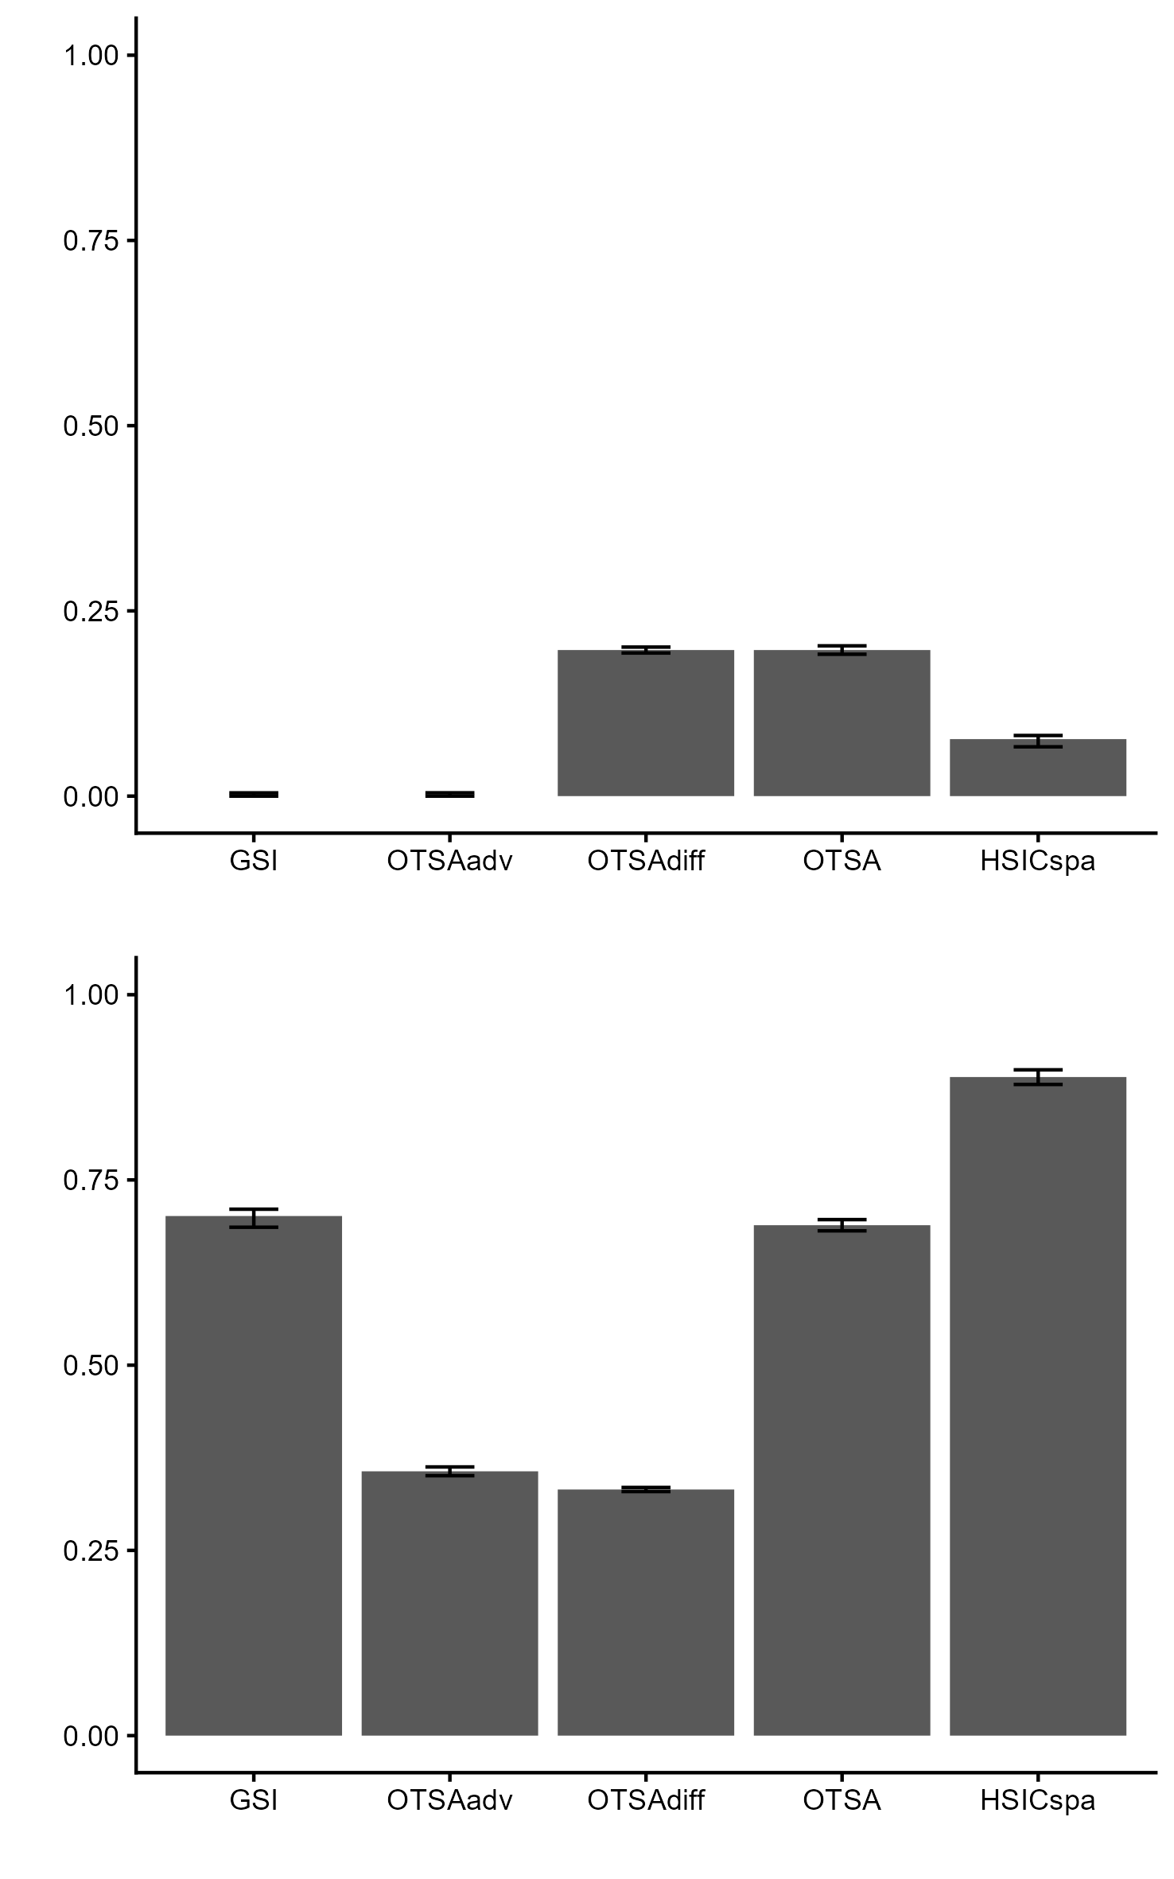
Informativeness on the influence
Sensitivity measure of X1
Effect of X1
$X_{2}\sim U(0,.5), X_{2}\sim Ν(0,.5)$
$Y_{t}=sin(4X_{1}t+ε)×X_{2}/2$,
$$t=i.2π/100, i=1,..., 100$$
PCA applied to the
100-dimensionsal vector $Y$
X1 >0
HSIC kernel: rescaled product
V2
PCA-based V structure
V1
Sensitivity measure of X2
Effect of X2
X2 >0
V2
V2
V1
V1

Slide 35
Informativeness on the influence
Sensitivity measure of X1
Effect of X1
$X_{2}\sim U(0,.5), X_{2}\sim Ν(0,.5)$
$Y_{t}=sin(4X_{1}t+ε)×X_{2}/2$,
$$t=i.2π/100, i=1,..., 100$$
PCA applied to the
100-dimensionsal vector $Y$
X1 >0
V2
PCA-based V structure
V1
Sensitivity measure of X2
Effect of X2
X2 >0
V2
V2
V1
V1

Slide 36
Robustness to parametrization
Objective: analysis of changes in sensitivity measures by varying different factors
Varied factors:
Number of maps
n=100,…,5000

Slide 37
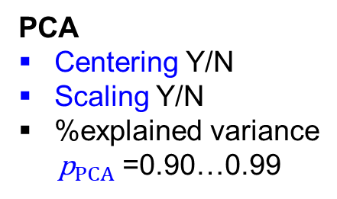
Robustness to parametrization
Objective: analysis of changes in sensitivity measures by varying different factors
Varied factors:
PCA
Centering Y/N
Scaling Y/N
%explained variance
${\text{p}}_{PCA}$=0.90…0.99
Number of maps
n=100,…,5000

Slide 38
Robustness to parametrization
Objective: analysis of changes in sensitivity measures by varying different factors
Varied factors:
PCA
Centering Y/N
Scaling Y/N
%explained variance
${\text{p}}_{PCA}$=0.90…0.99
GSI:
Estimator (rank, Janon-Monod)
Number of maps
n=100,…,5000

Slide 39
Robustness to parametrization
Objective: analysis of changes in sensitivity measures by varying different factors
Varied factors:
PCA
Centering Y/N
Scaling Y/N
%explained variance
${\text{p}}_{PCA}$=0.90…0.99
GSI:
Estimator (rank, Janon-Monod)
Number of maps
n=100,…,5000
OTSA:
Estimator (Sinkhorn, WB)
Binning M

Slide 40
Robustness to parametrization
Objective: analysis of changes in sensitivity measures by varying different factors
Varied factors:
PCA
Centering Y/N
Scaling Y/N
%explained variance
${\text{p}}_{PCA}$=0.90…0.99
GSI:
Estimator (rank, Janon-Monod)
Number of maps
n=100,…,5000
OTSA:
Estimator (Sinkhorn, WB)
Binning M
HSICspa:
Estimator (V-stat, U-stat)
1d kernelV (rbf, Matérn),
Weighing (in/out)
Agreggation oper. (sum, product)

Slide 41
Robustness to parametrization
Objective: analysis of changes in sensitivity measures by varying different factors
Varied factors:
PCA
Centering Y/N
Scaling Y/N
%explained variance
${\text{p}}_{PCA}$=0.90…0.99
GSI:
Estimator (rank, Janon-Monod)
Number of maps
n=100,…,5000
OTSA:
Estimator (Sinkhorn, WB)
Binning M
HSICspa:
Estimator (V-stat, U-stat)
1d kernelV (rbf, Matérn),
Weighing (in/out)
Agreggation oper. (sum, product)
Method: HSIC-ANOVA GSA applied to the sensitivity measures
Kernels:
Inputs: ANOVA variant of categorical kernels
Outputs:
  Analysis for the most influential input: rbf kernel
  Analysis for all inputs: tensorisation of 1d rbf kernels

Slide 42
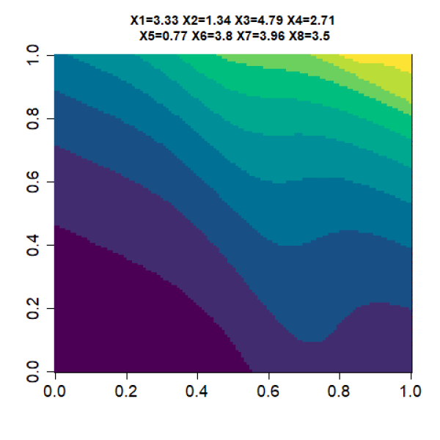
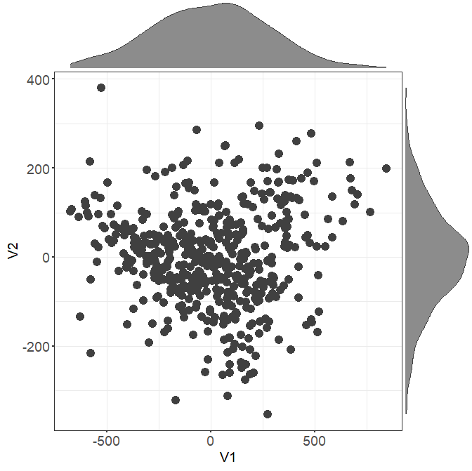
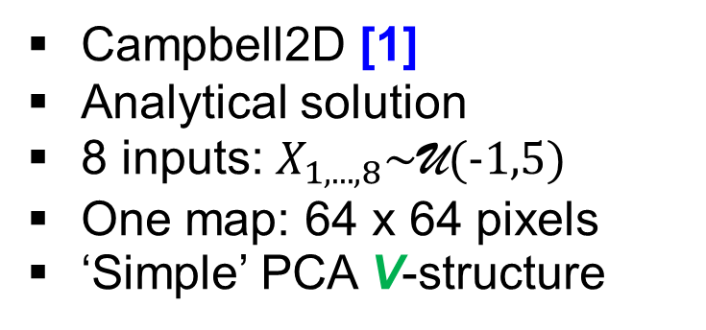
Application cases
>90% of total variance explained
Campbell2D [1]
Analytical solution
8 inputs: $X_{1,...,8}\sim \text{U}(−1,5)$
One map: 64 x 64 pixels
‘Simple’ PCA V-structure
V2
V1
[1] Marrel et al. 2015; [2] Rohmer et al. 2023

Slide 43

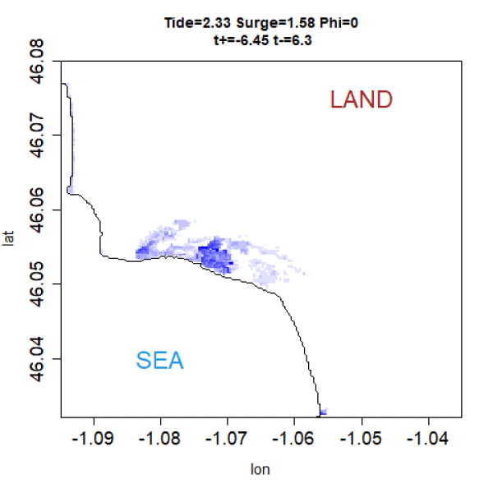
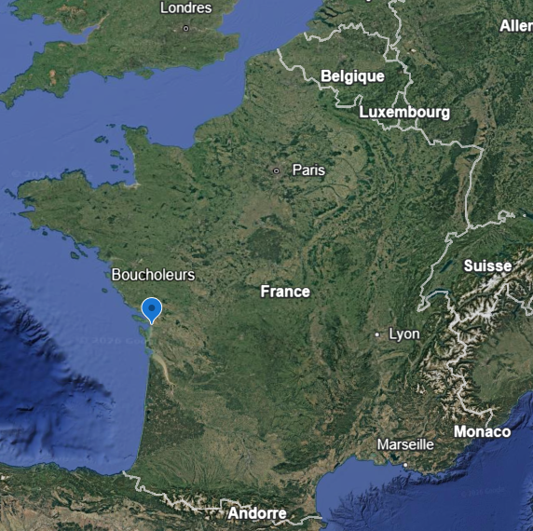
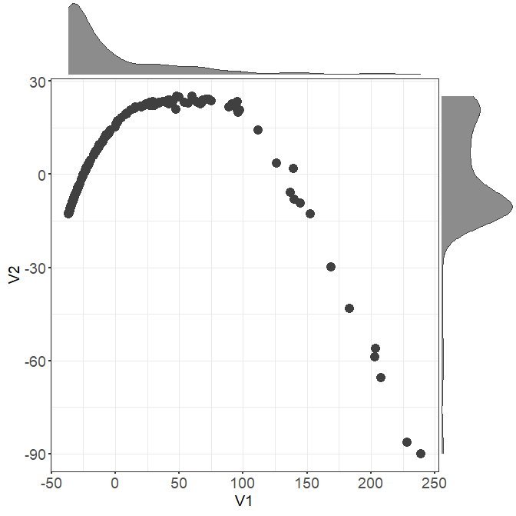

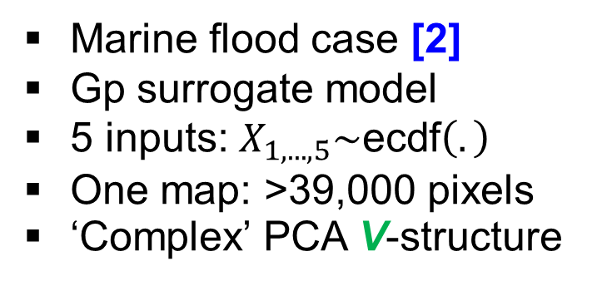
Application cases
>90% of total variance explained
Campbell2D [1]
Analytical solution
8 inputs: $X_{1,...,8}\sim \text{U}(−1,5)$
One map: 64 x 64 pixels
‘Simple’ PCA V-structure
V2
V1
Marine flood case [2]
Gp surrogate model
5 inputs: $X_{1,...,5}\sim \text{ecdf}\left(.\right)$
One map: >39,000 pixels
‘Complex’ PCA V-structure
V2
V1
[1] Marrel et al. 2015; [2] Rohmer et al. 2023

Slide 44
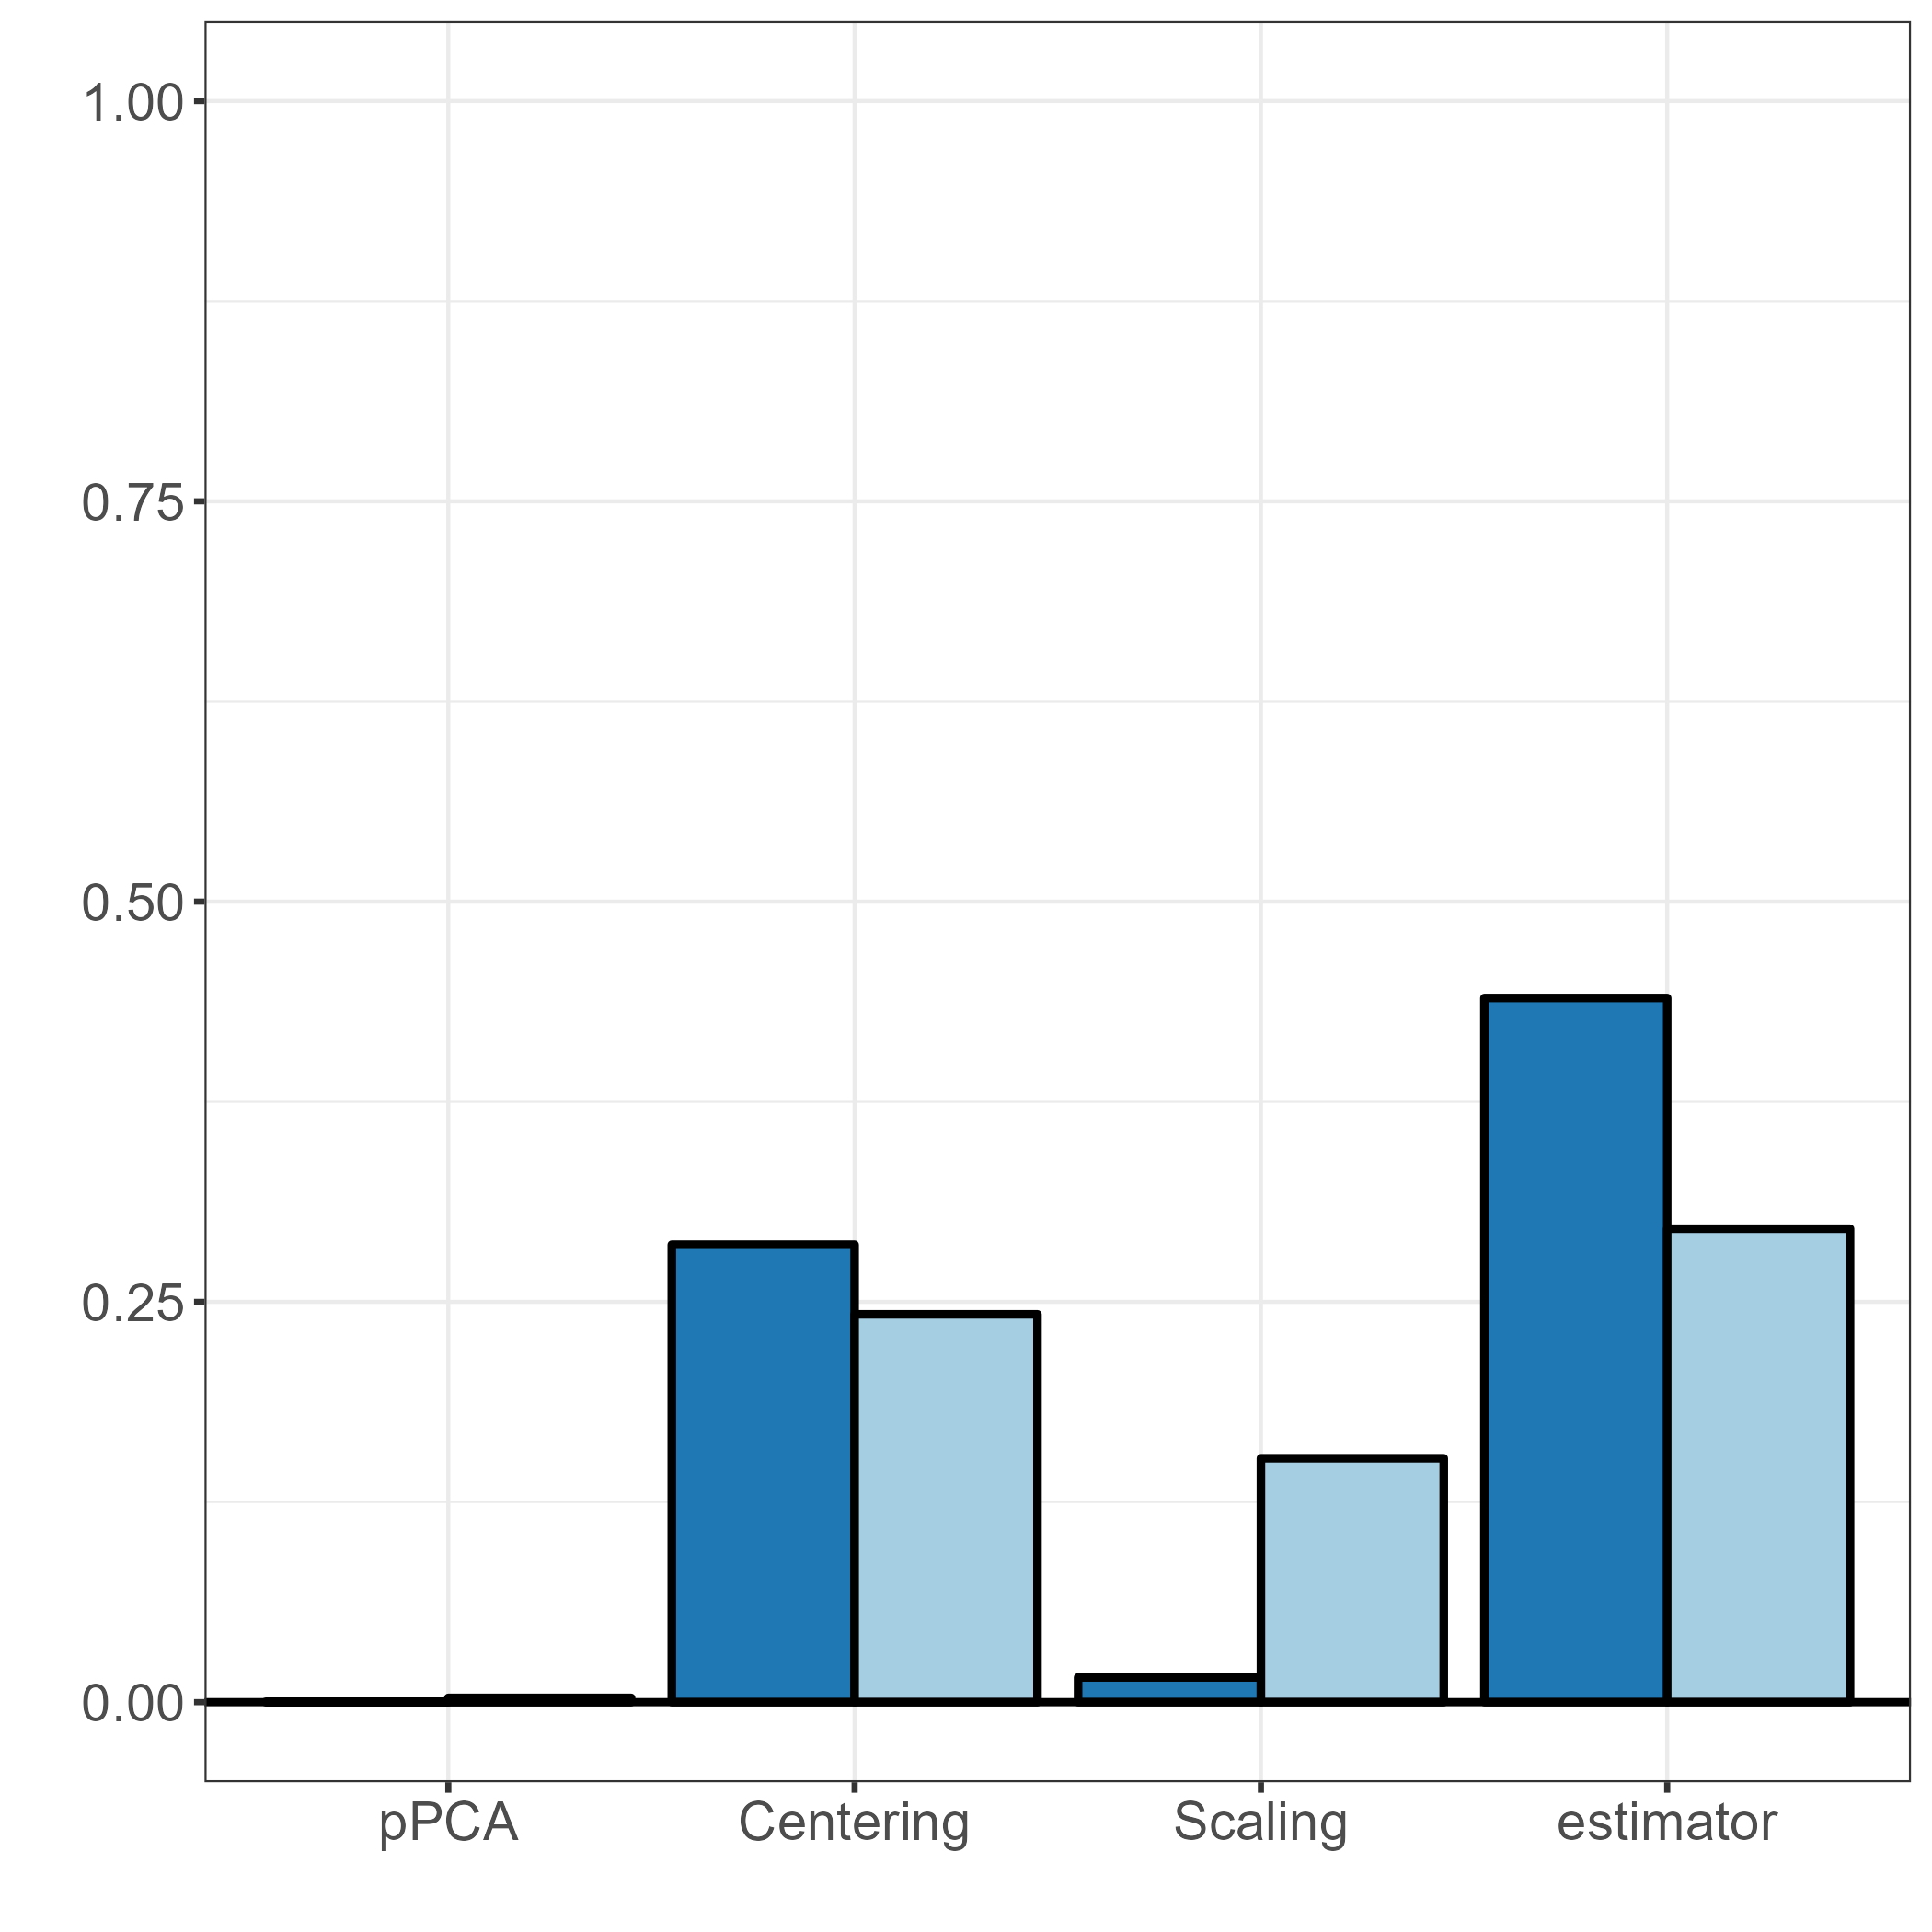
Robustness to parametrization
Case: Campbell2D
All variables
GSI
High influence
The most influential variable
with n=1000 maps
PCA factors
High influence of transformation prior to PCA (centering, scaling)
High influence of the choice in the estimator
Little influence of the proportion of explained variance pPCA (verified via hypothese testing*)
GSA factors
First order ANOVA-HSIC index
*Using HSIC-based procedure of El Amri & Marrel (2022)

Slide 45
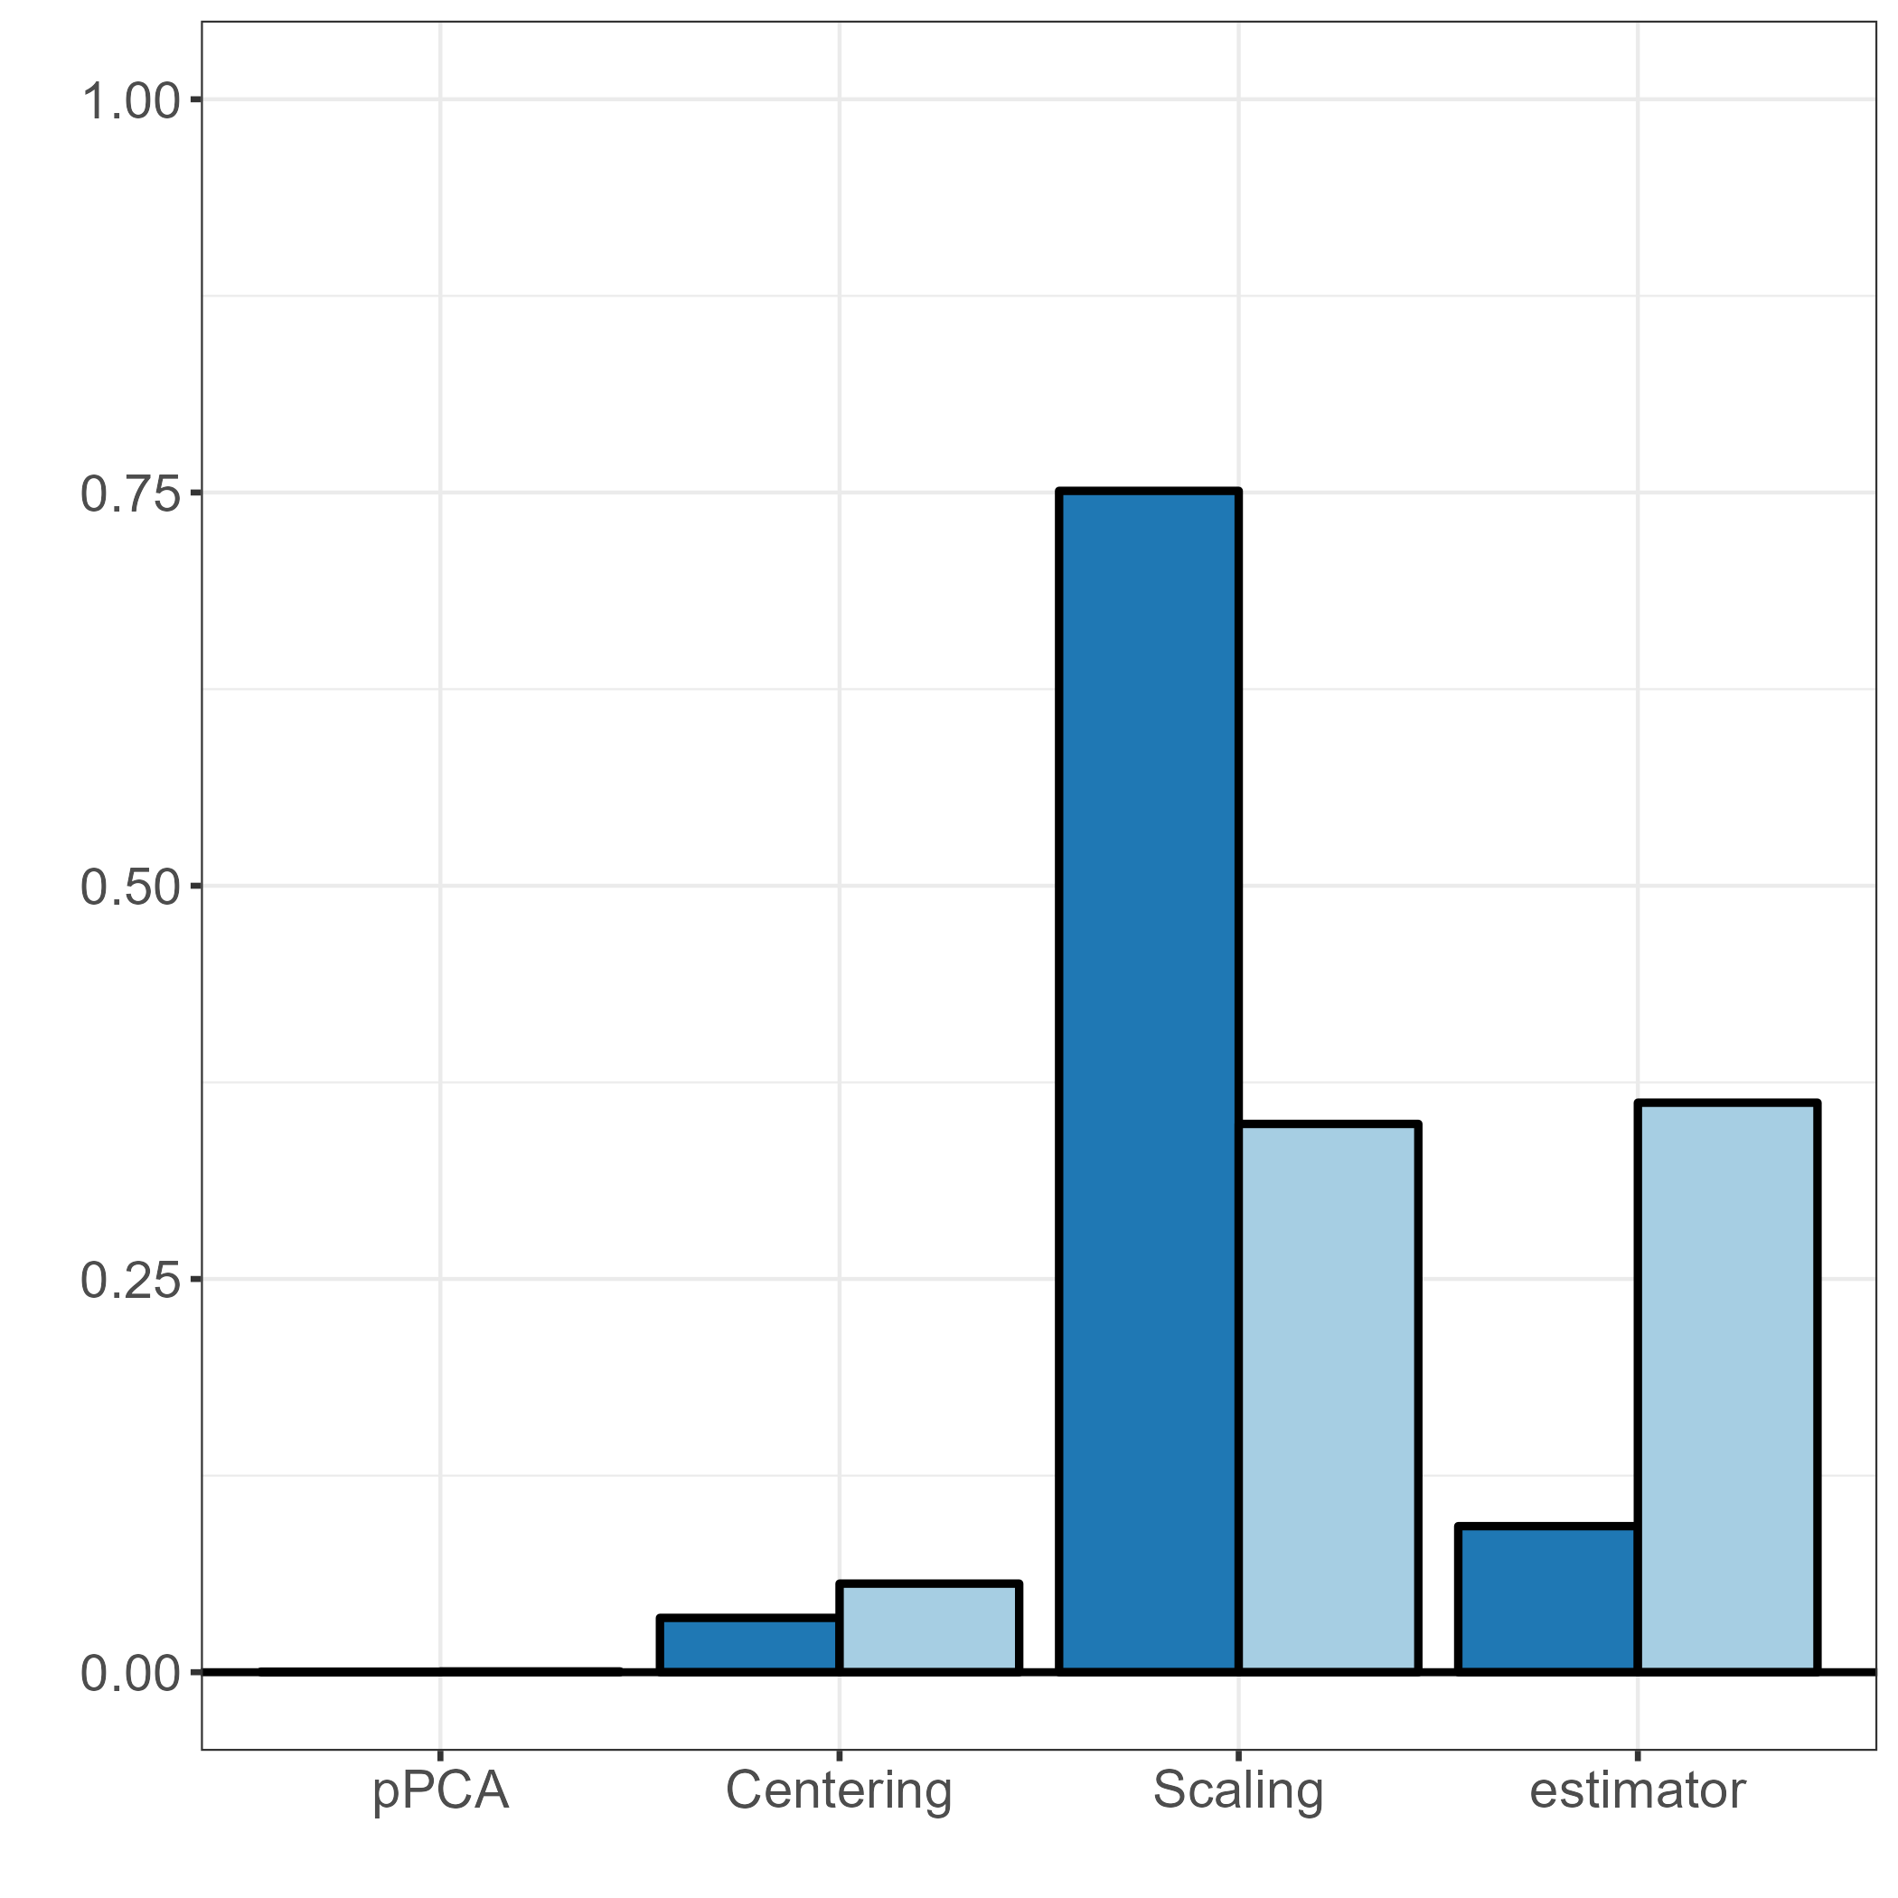
Robustness to parametrization
Case: Campbell2D
Case: Flood
All variables
GSI
The most influential variable
with n=1000 maps
PCA factors
GSA factors
First order ANOVA-HSIC index
First order ANOVA-HSIC index

Slide 46
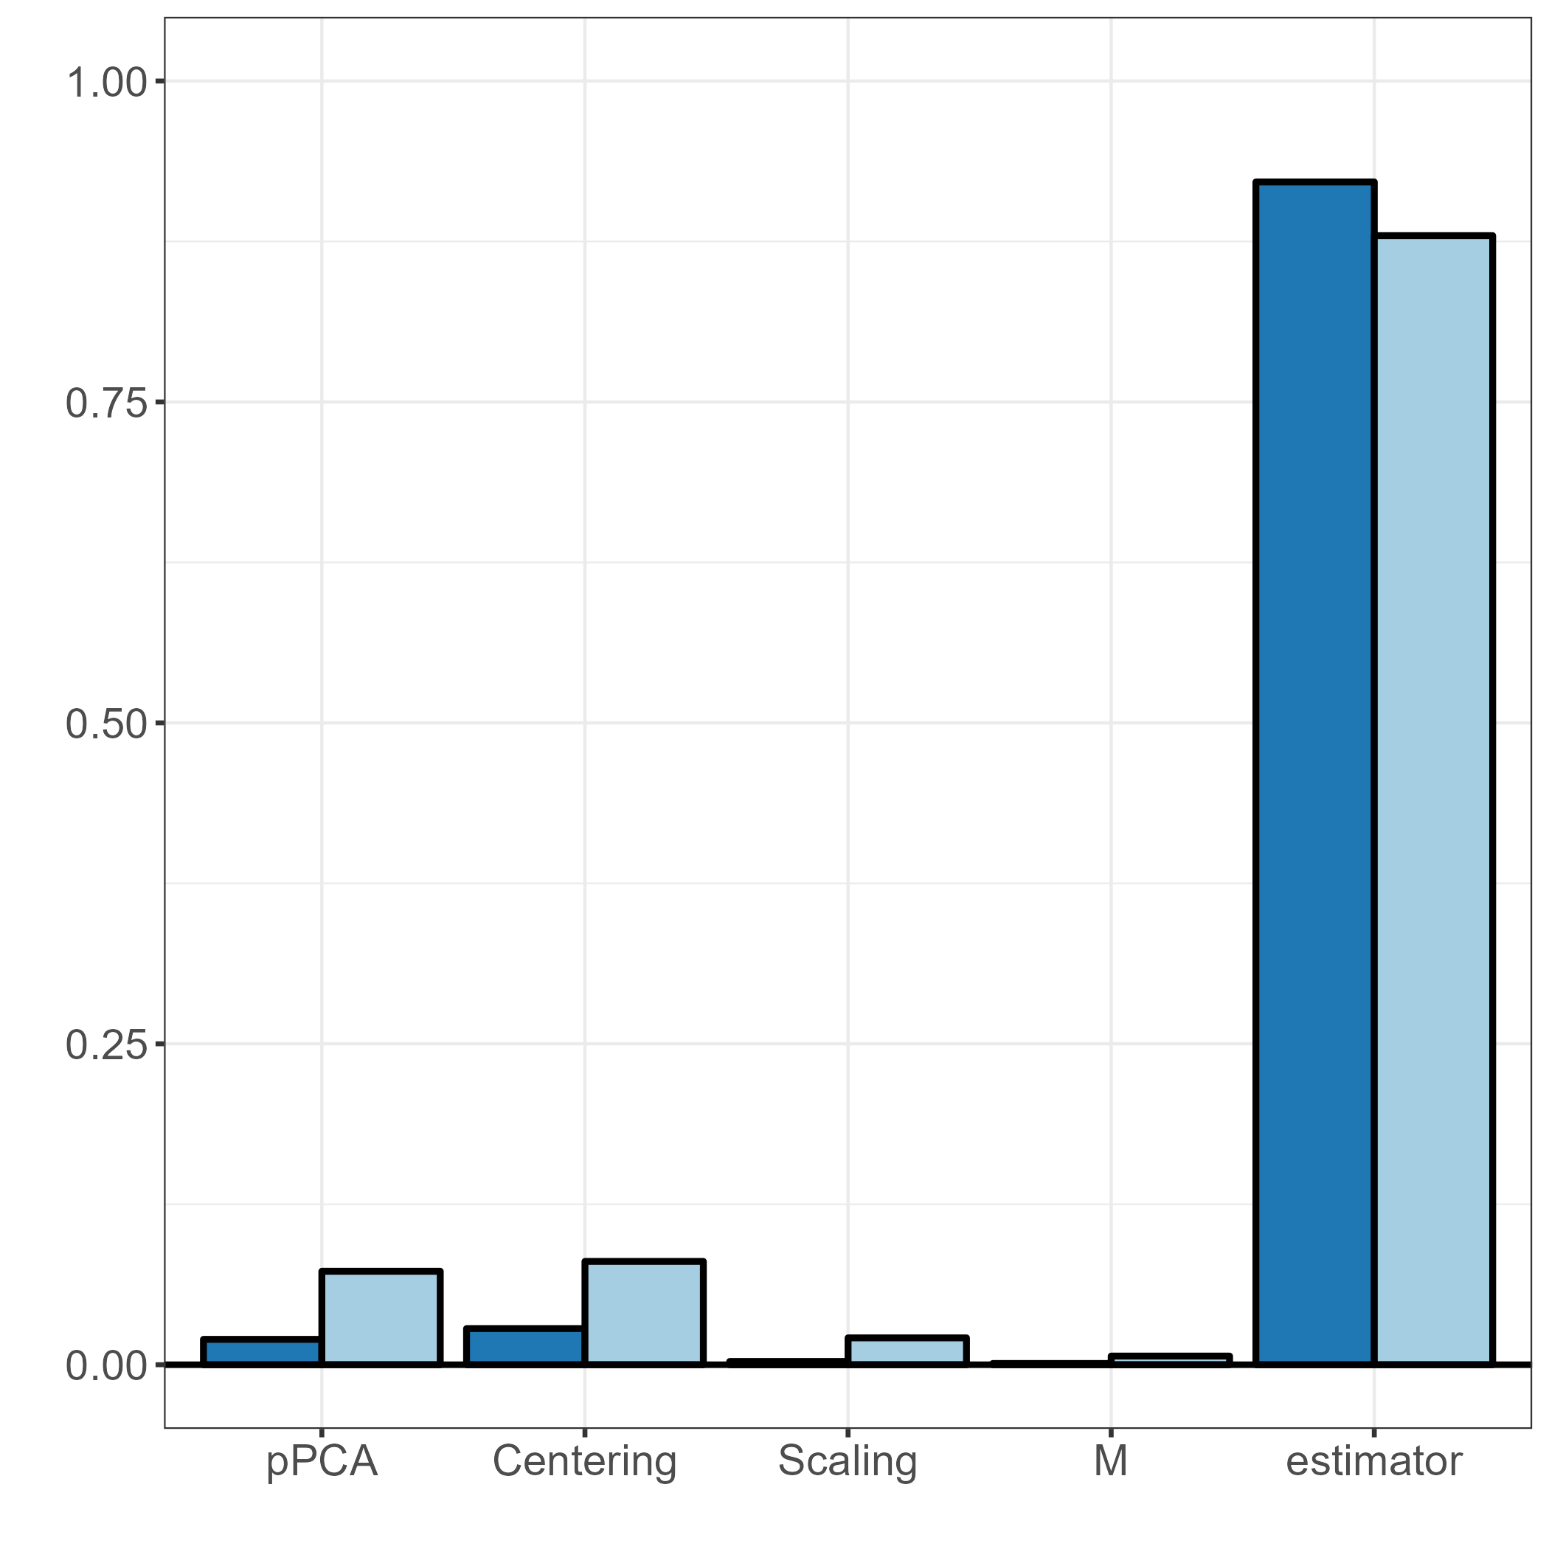
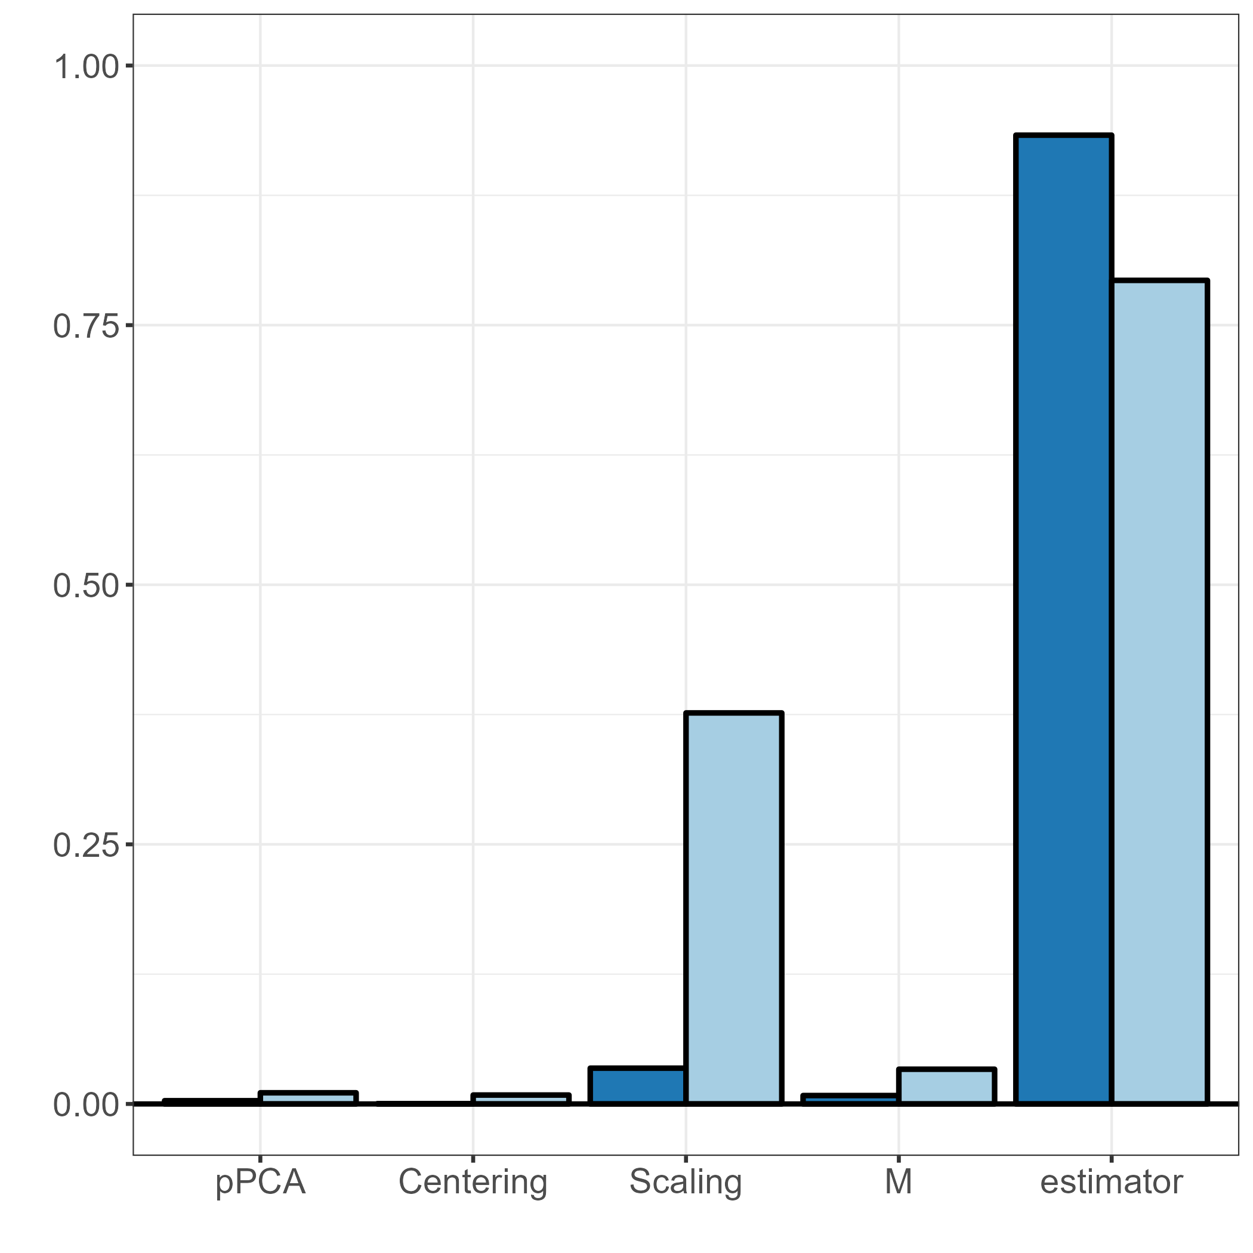
Robustness to parametrization
Case: Campbell2D
Case: Flood
OTSA
OTSA
All variables
All variables
The most influential variable
The most influential variable
with n=5000 maps
with n=1000 maps
PCA factors
GSA factors
First order ANOVA-HSIC index
First order ANOVA-HSIC index

Slide 47
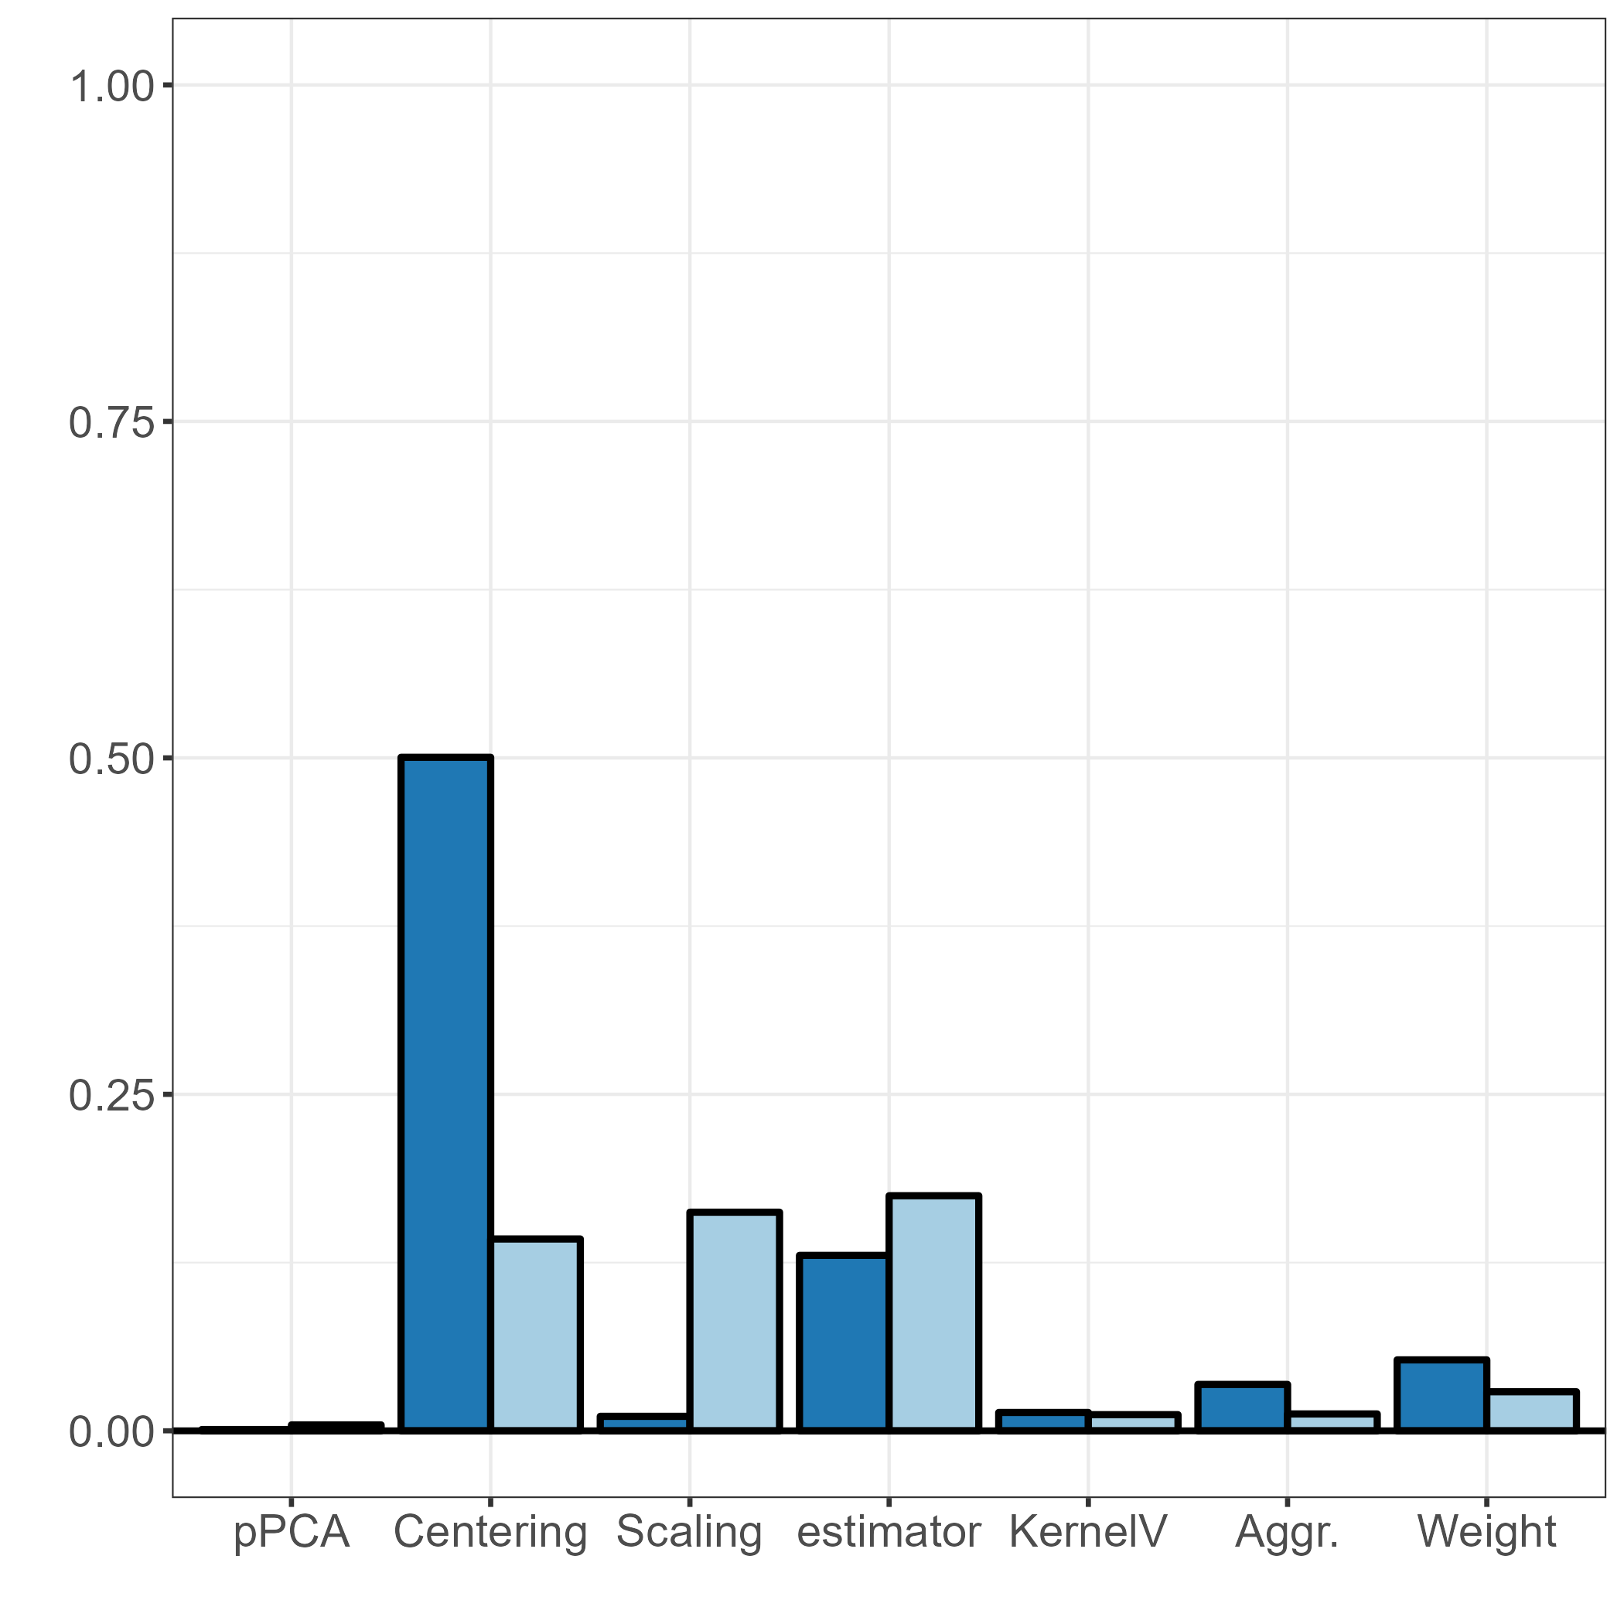
Robustness to parametrization
Case: Campbell2D
HSICspa
All variables
The most influential variable
with n=1000 maps
PCA factors
High influence of transformation prior to PCA (centering, scaling)
High influence of the choice in the estimator
Low influence of parametrisation of the spatial kernel (1D KernelV, Aggregation, Weighting) but still influential*
GSA factors
First order ANOVA-HSIC index
*Using HSIC-based procedure of El Amri & Marrel (2022)

Slide 48

Robustness to parametrization
Case: Campbell2D
Case: Flood
HSICspa
All variables
All variables
The most influential variable
The most influential variable
with n=1000 maps
with n=5000 maps
PCA factors
GSA factors
First order ANOVA-HSIC index
First order ANOVA-HSIC index

Slide 49



Case: Campbell2D
Convergence
GSI*
Number of maps n
Ratio sensivity measure @ n / sensivity measure @ 5,000
OTSA**
Number of maps n
HSICspa***
*rank estimator
**WB estimator
*** V-stat
Number of maps n

Slide 50



Case: Campbell2D
Convergence
GSI*
Number of maps n
OTSA**
Ratio sensivity measure @ n / sensivity measure @ 5,000
Number of maps n
HSICspa***
*rank estimator
**WB estimator
*** V-stat
Number of maps n

Slide 51



Case: Campbell2D
Case: Flood
GSI*
Number of maps n
OTSA**
Ratio sensivity measure @ n / sensivity measure @ 5,000
Number of maps n
HSICspa***
Number of maps n

Slide 52

Case: Campbell2D
Variable index
GSI
Ranking
Number of maps n

Slide 53


Case: Campbell2D
Variable index
GSI
Number of maps n
OTSA
Evolution of the ranking
Number of maps n
HSICspa
Number of maps n

Slide 54



Case: Campbell2D
Variable index
Case: Flood
Variable index
GSI
Number of maps n
OTSA
Evolution of the ranking
Evolution of the ranking
Number of maps n
HSICspa
Number of maps n

Slide 55


Take home messages*
Typical problems
Method | Informativeness | Most influential hyperpara. | PCA choices’ impact | Converg.
GSI | ANOVA-type decomposition But cannot capture influence on variance-covariance | Estimator | Low | Slow
OTSA | Decomposition via WB But no ANOVA-type decomposition | Estimator | Moderate | Moderate
HSICspa | ANOVA-type decomposition But given the kernel, some situations not captured | Estimator | High | Fast
*based on the tests on the two real cases and synthetic cases

Slide 56
Take home messages*
Method | Informativeness | Most influential hyperpara. | PCA choices’ impact | Converg.
GSI | ANOVA-type decomposition But cannot capture influence on variance-covariance | Estimator | Low | Slow
OTSA | Decomposition via WB But no ANOVA-type decomposition | Estimator+ | Moderate | Moderate
HSICspa | ANOVA-type decomposition But given the kernel, some situations not captured | Estimator | High | Fast
*based on the tests on the two real cases and synthetic cases

Slide 57
Take home messages*
Method | Informativeness | Most influential hyperpara. | PCA choices’ impact | Converg.
GSI | ANOVA-type decomposition But cannot capture influence on variance-covariance | Estimator | High | Slow
OTSA | Decomposition via WB But no ANOVA-type decomposition | Estimator+ | Low- Moderate | Moderate
HSICspa | ANOVA-type decomposition But given the kernel, some situations not captured | Estimator | High | Fast
*based on the tests on the two real cases and synthetic cases

Slide 58
Take home messages*
Method | Informativeness | Most influential hyperpara. | PCA choices’ impact | Converg.
GSI | ANOVA-type decomposition But cannot capture influence on variance-covariance | Estimator | High | Slow
OTSA | Decomposition via WB But no ANOVA-type decomposition | Estimator+ | Low- Moderate | Moderate
HSICspa | ANOVA-type decomposition But given the kernel, some situations not captured | Estimator | High | Fast
*based on the tests on the two real cases and synthetic cases

Slide 59




THANK YOU FOR YOUR ATTENTION !
An excellent statistician looking for
postdoc/job opportunity
Contact: corinna-perchtold@gmx.at
We acknowledge financial funding by ANR-HOUSES
(grant number: ANR-22-CE56-0006)
https://anrhouses.github.io/

Slide 60
Appendices

Slide 61

HSIC-based hypothese testing of “negligible influence”
${HSIC(X_{i}\text{,}Y\text{)}}_{{\text{ℱ}}_{X_{i}},{\text{ℱ}}_{Y}}= 0 ⇔X\text{⊥}\text{Y}\text{ (}$with characteristic kernels!)
Null hypothesis: $H_{0}: X\text{⊥}\text{Y} against{ H}_{1}:\text{X}\text{∦}\text{Y}$
Decision rule: $H_{0} is rejected iff n\hat{HSIC} (X_{i}\text{,}Y\text{)}\text{>}{\text{q}}_{1−α}$ where ${\text{q}}_{1−α}$ is the $1−α$ quantile of $n\hat{HSIC} (X_{i}\text{,}Y\text{)}$ under $H_{0}$
Test procedure selected according to the sample size and the chosen test statistic:
Asymptotic test procedure of Zhang et al.(2018)
Permutation-based test procedure of De Lozzo & Marrel (2016)
Sequential permutation-based test procedure of El Amri & Marrel (2022)
Non-asymptotic Gamma test procedure of El Amri & Marrel (2023)

Slide 62


HSIC-based hypothese testing of “negligible influence”
Case: Campbell2D
Case: Flood
GSI
Variable identified as of negligible influence
Variable identified as important
P-value ANOVA-HSIC index
P-value ANOVA-HSIC index

Slide 63


HSIC-based hypothese testing of “negligible influence”
Case: Campbell2D
Case: Flood
OTSA
Variable identified as of negligible influence
Variable identified as important
P-value ANOVA-HSIC index
P-value ANOVA-HSIC index

Slide 64


HSIC-based hypothese testing of “negligible influence”
Case: Campbell2D
Case: Flood
HSICspa
Variable identified as of negligible influence
Variable identified as important
P-value ANOVA-HSIC index
P-value ANOVA-HSIC index

