Slide 1
Ups and Downs with AI and Old Data
ENBIS conference, Florence, Sept 2026
Shirley Coleman
Newcastle University
Co-authors: Andrea Ahlemeyer-Stubbe, Robert Shiel, Darren Evans

Slide 2
Outline of talk
Introducing the hay yield data
Explosion of possibilities and opportunities with Artificial Intelligence (AI)
Revisiting the hay yield data analysis
Cautions and Conclusions

Slide 3
Hay yield data
Introducing

Slide 4
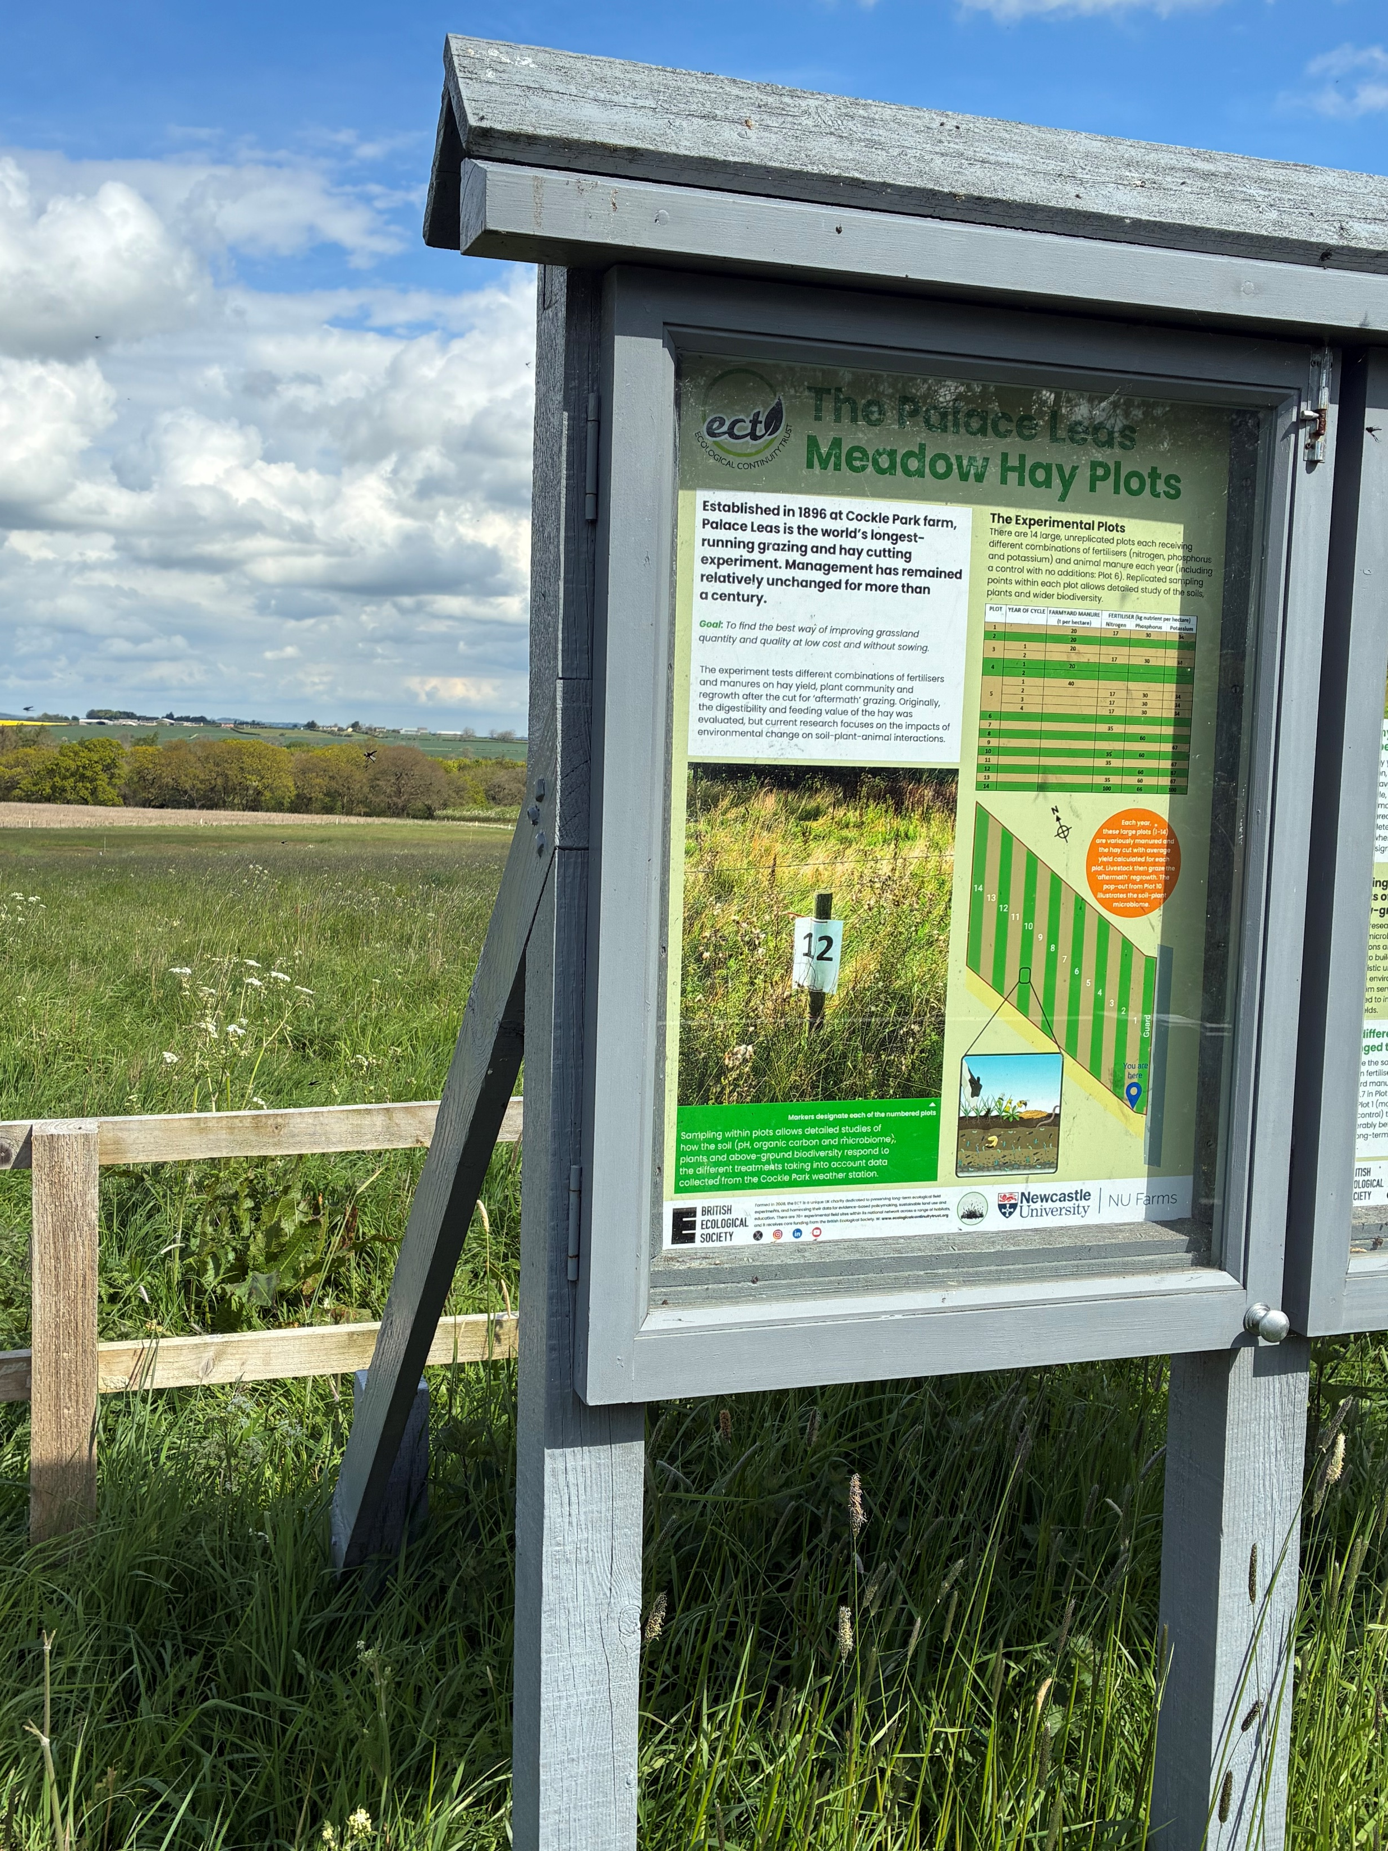
Hay yields
Experiments to assess the effects of fertilisers and fertiliser regimes were started in Rothamsted Research Lab in 1856 and Cockle Park farm in 1897.
Cockle Park farm is owned by Newcastle University.
The same 14 strips of Palace Leas field have been fertilised in an augmented 2³ factorial experiment meticulously and continuously every year since 1897.
A meteorological weather station is cited in the adjacent field and gives co-located readings of wind, rain, temperature, sunlight etc

Slide 5
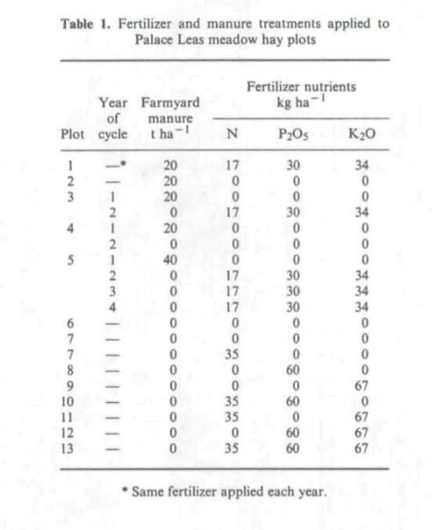
Hay yield analysis
Hay yields from 1897 were analysed in 1952 by D.G.Bushnell,
In 1960 by H.C.Pawson,
then in 1980 by Coleman et al who also looked at the effects of weather,
Grass and Forage Science (1987) 42, 353-358.
Notes:
“The effects of weather and nutrition on the yield of
hay from Palace Leas meadow hay plots, at Cockle Park
Experimental Farm, over the period from 1897 to 1980”
Grass and Forage Science (1987) 42, 353-358.
S. Y. COLEMAN,* R. S. SHIEL AND
D. A. EVANS
Departments of Mathematics and Soil Science,
The University. Newcastle upon Tyne, NEl 7RIJ.

Slide 6
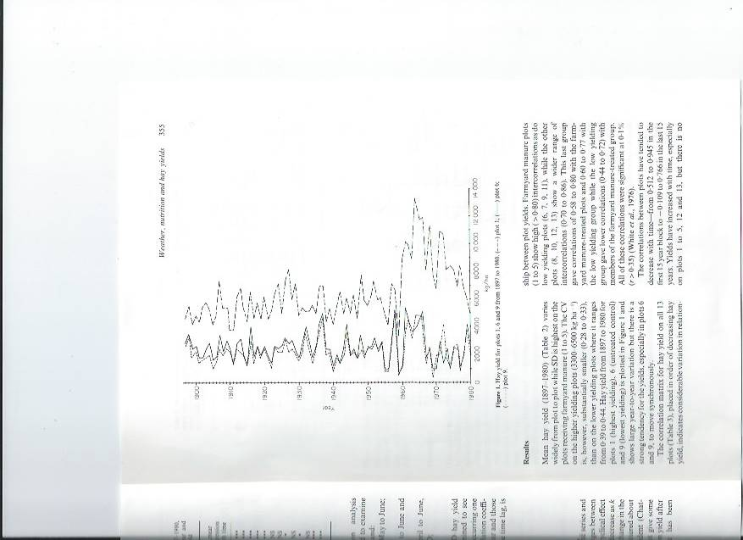
Hay yield analysis
Uncertainty about the location and nature of recent hay yield measurements inhibited further analysis.
Timely to update the data set, and reanalyse.
Notes:
“The effects of weather and nutrition on the yield of
hay from Palace Leas meadow hay plots, at Cockle Park
Experimental Farm, over the period from 1897 to 1980”
Grass and Forage Science (1987) 42, 353-358.
S. Y. COLEMAN,* R. S. SHIEL AND
D. A. EVANS
Departments of Mathematics and Soil Science,
The University. Newcastle upon Tyne, NEl 7RIJ.

Slide 7
Artificial Intelligence to the rescue
Initially AI was used to convert hand-written figures to spreadsheet, then when other historic spreadsheets were located, AI amalgamated these into a combined updated spreadsheet.
Similarly, AI attached the experimental design for each year, some meteorological data, and site notes from the researchers.
So, AI produced data of different levels, types and granulations.

Slide 8
Explosion of possibilities
AI allows easy transfer of information from any source format into analysable data.
Allowing AI to look at a photo of data and convert it to spreadsheet is amazing.
Initial analysis can be carried out with a simple request to an AI tool.
This is the upside of AI.

Slide 9
Project overview
Goal: consolidate hay yield data from multiple historical sources into one clean spreadsheet
Sources: Hay Yields.xlsx (207 historical columns, multiple authors) + Hay Cut 2012–2024.xlsx (13 annual sheets)
Tool: Claude Code (AI coding assistant) — used to parse, verify, consolidate and analyse

Slide 10
Hay yield data
Revisiting

Slide 11
AI vocabulary (attempting to act like a human)
Burrowing
Undilating
Pontificating
Creating
Scampering
Bebopping
Galivanting
Osmosing
Boondoggling
Herding

Slide 12
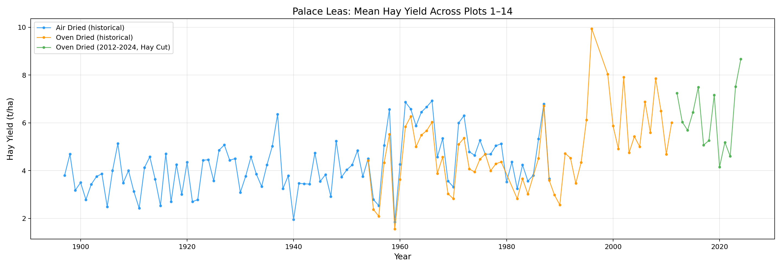
Full Time Series: Mean Yield Across All Plots
Blue = Air Dried, Orange = Oven Dried (historical), Green = Modern (2012–2024)

Slide 13
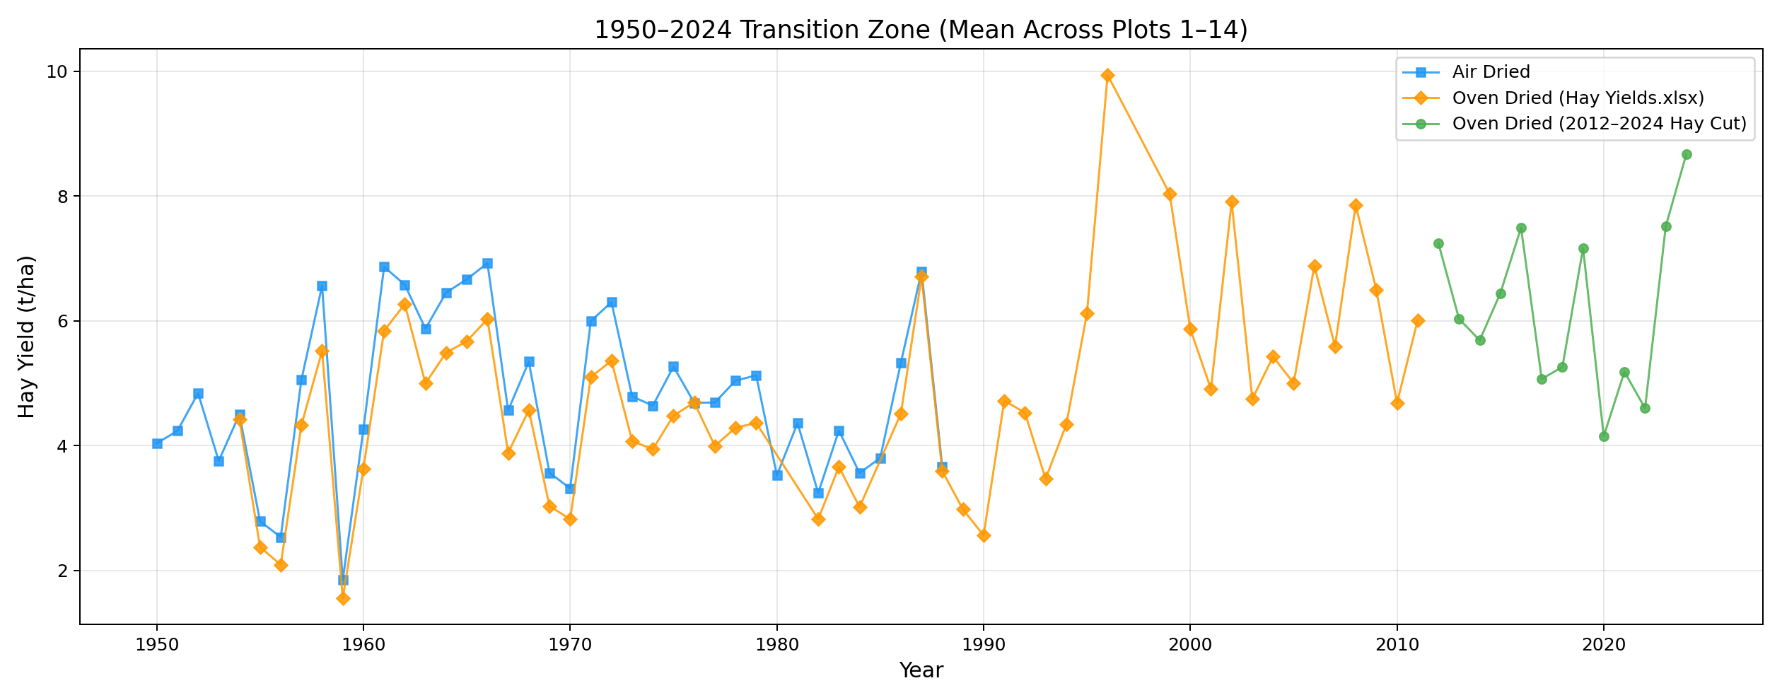
Transition Zone: 1950–2024
The oven-dried historical series connects naturally with the modern Hay Cut data

Slide 14
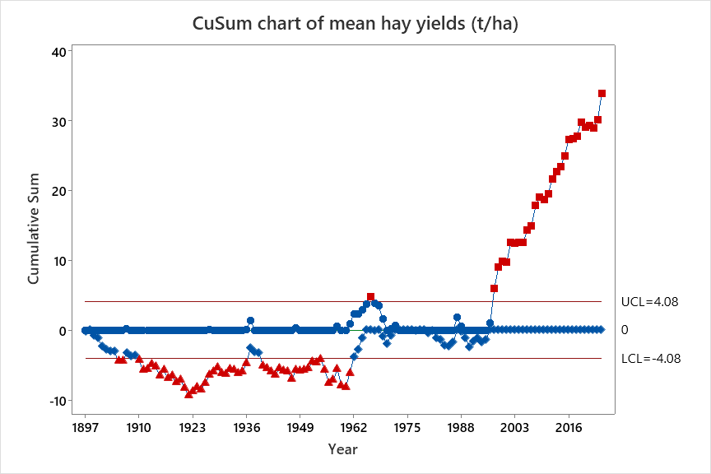

Slide 15
Ai narrative

Slide 16
Verification Strategy by AI
1. Used 2013 & 2014 as ground truth — already manually entered in the target sheet
2. Script extracted the same values independently from the source, then compared
→ All 28 values matched perfectly (within floating-point precision)
3. After writing the output, re-read it and verified every cell against the source
4. Cross-checked 2012 by computing sub-plot means manually vs script output
5. Visual inspection: time series plots show no anomalies or discontinuities
6. All code is saved alongside the data — fully reproducible
Final verification Strategy by human

Slide 17
Pros of Using Claude Code
Speed: parsed 207 source columns + 13 annual sheets in seconds
Accuracy: exact floating-point match with manually entered values
Transparency: every step logged, all code saved, fully auditable
Exploratory analysis: generated 6 publication-quality figures on demand
Flexibility: easy to re-run with different parameters or add new years
Documentation: the code IS the documentation of what was done
It made this PowerPoint too (and added a joke, as requested)

Slide 18
Cons / Caveats
Domain knowledge: Claude didn't know which drying method to prefer — it presented options and we chose
Ambiguity: some columns labelled "POSSIBLY OVEN DRY MATTER" — Claude flagged these but a human must decide
Trust but verify: AI can make confident-sounding mistakes; verification steps are essential
Requires oversight: works best as a tool guided by someone who understands the data
Setup: requires Python environment with openpyxl, matplotlib, etc.
Not a replacement for understanding the science behind the measurements

Slide 19
Cautions and conclusions

Slide 20
Observations
The data is still hard to handle.
Missing data, duplicate measurements, different units.
Which version to use?

Slide 21
Top down rather than bottom up
AI leads to a top-down approach rather than bottom up.
Tempting to take the data at face value rather than look beneath it.
Allows casual analysis without checking on minor details.
Still need attention to aim of research and value of outcomes.

Slide 22
Conclusions
A clean set of annual hay yields for each plot is now available for further extensive analysis:
  Effects of N, P and K
  Effects of weather year on year
  Longer term trends reflecting changes in overall conditions including climate change
A new open data resource for use by the global research community.

Slide 23
And finally...(the AI joke)
Why did the hay yield data go to therapy?
It had been through too many drying experiences
and couldn't tell if it was air-ing its feelings
or oven-thinking things.
Thank you! 🌾

Slide 24
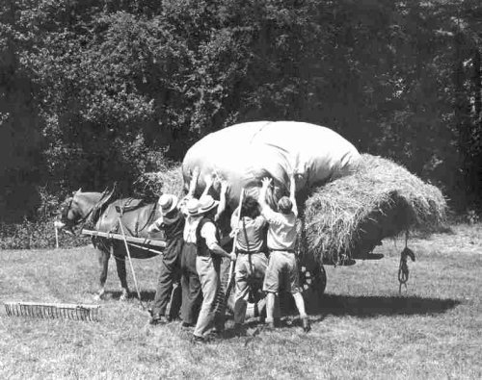
Each data point is hard won.
Notes:
Each data point is hard won.

