Slide 1
“Predict complex system behaviour within uncertain scenario” alias
How to estimate during systems life-cycle, a critical system performance
Presented by:
Carlo Leardi: ESEP, AISE founder, training and certification

Slide 2

Leardi Carlo
AISE, INCOSE Italian Chapter
carlo.leardi@incose.net
Carlo Leardi, graduated in electronic engineering in Genova Italy.
His professional background starts with quality assurance responsibility and evolved to full verification,
validation and testing commitment within complex systems development deployment projects in the
following areas: automotive, freight railways and packaging industry. As a passion before and today as a
full job, he is dealing with Quantitative Systems Engineering on a day-to-day application and coaching of a
full range of statistical and simulation methodologies supporting the decisional process. He published several
articles in Engineering and Systems Engineering journals.
ESEP, TLI member, one of the founders and past President of the INCOSE Italian Chapter. founder of AISE, the Italian association of Systems Engineering.
He taught at the Systems Engineering Master, ForteMare and Strategos.
He is serving the Incose Italian Chapter for training and certification.

Slide 3
Agenda
Context
The case and the challenge
System complexity aspects
Simulation purpose
Rationales for the initial modelling choice
Initial modelling choice
Characterize behaviour based on legacy test evidences
Simulation evolution, strengths and limits
Opportunities for improvement and scope extension

Slide 4

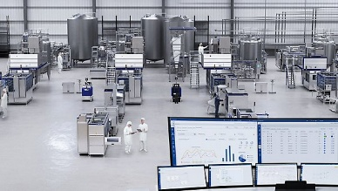


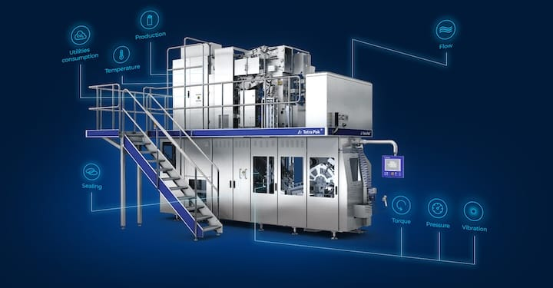


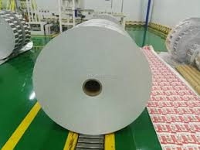
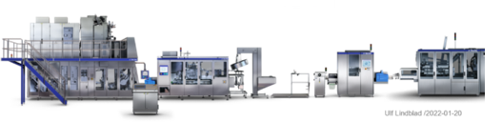
Context: Complex system in the liquid food packaging industry
Human being
Processed milk
Package
Handling use and recycling
AI density
Packaging material
Packaging Line

Slide 5
The case and the challenge
A new family of products is under development in the liquid food packaging industry.
The integration of advanced technologies with well established ones, in the context of a new architecture, severely reduce the prediction capability of the specialists.
Product protection is requested to more than double from an excellent consolidated baseline
No models or specific rigs available or sustainable to test the product protection.
➔
Simulation approach supporting system life-cycle

Slide 6
System’s complexity aspects
Complicated: scaled-up, dynamic interdependencies
Emergent: un-expected behaviours linked to enhanced automation and AI
Difficult: modeling sub-systems relationships, step increase of a key performance
Uncertain: efficient integration of different technologies in the system’s architecture
The simulation approach must take into account:
Focus on one critical performance: Product Protection
A common system architecture which will be deployed into several products
Non linear, non adjacent effects propagation
Non homogeneous inputs
Continuous system evolution
Different “questions” to be answered during system’s life-cycle

Slide 7
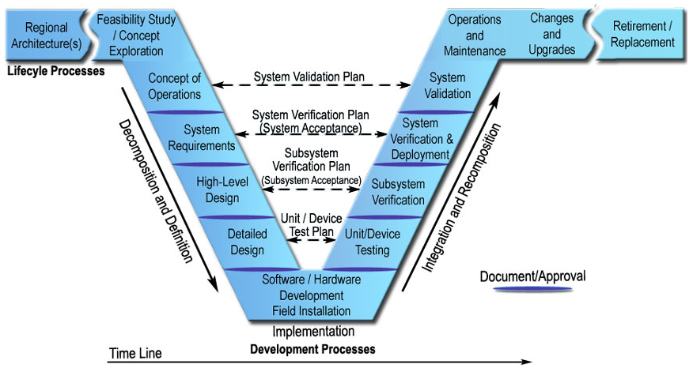
Simulation purpose:
probability of success failure during system’s life-cycle:
first configuration opportunity
vs.
potential family scope
first configuration opportunity
vs.
potential family scope
Validation inputs obsolescence
Environmental noises
First customer operations?
Experimental evidence
Integration of well established and new technologies?
AI (and ML?) evolution

Slide 8
Rationales for the initial modelling choice
Fault Tree Analysis simulation:
The great majority of the non-homogeneous inputs of the FTA basic events derive from:
FMEA items
Legacy values and Experts opinions
Empirical evidences from preliminary tests
Experimental evidence from the field test installation
The architecture and the process flow drives the FTA tree structure
Available SW licenses and expertise
 | FMEA Failure modes and Effects Analysis | FTA Fault Tree Analysis
Results | Heterogeneous impacts given defined causes | Unique top event as an effect of internal and external events
Unit of measure | RPN = SeverityxOccurrencexDetection | Equalized frequence ➔ 1 out <...> pkgs at 90% c.l.
Objective | Prioritize risk management effort | Identify main offenders, estimate top event failure frequency
Objective | Overall life-cycle, at all system’s levels | Preventive estimates, estimating alternatives, sustaining root cause analysis
Approach | Bottom-up, inductive | Top down, deductive
Structure | Table, independent rows | Logic Diagram, tree suitable for simulations

Slide 9
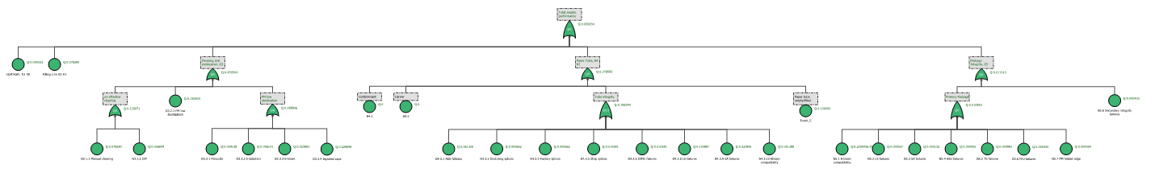
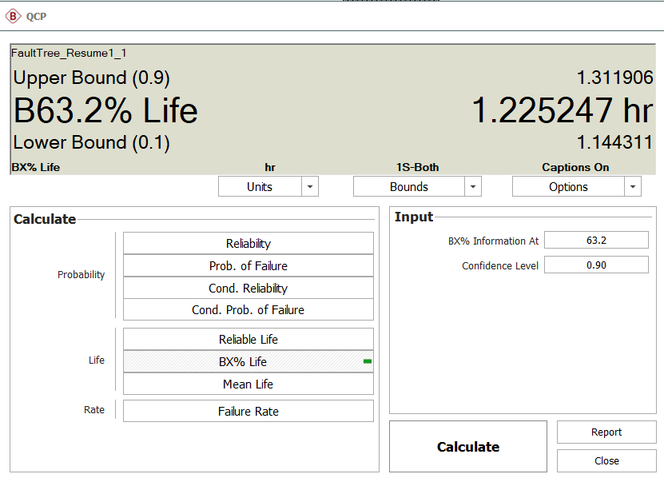

Initial modelling choice
Fault Tree Analysis
Full model: >300 basic events, >50 logic gates, 7 levels: operational although too complex and difficult to maintain
Two-levels manageable model:
Over-simplified model for communication: 5 events, one gate, one level.
Scope | Scope | structure | levels | Gates | Events | Values | Visualization
Initial approach | System | full | 9 | >50 | >300 | standardized | 13 sub-pages
Focused on Generalized to Estimations by | External demonstration | full | 5 | 29 | 90 | standardized | One page <10%
 | High level system | reduced | 2 | 7 | 25 | Not standardized | One page 27%
 | Each of them | resume | 1 | 1 | 5 | Not standardized | One page 100%

Slide 10
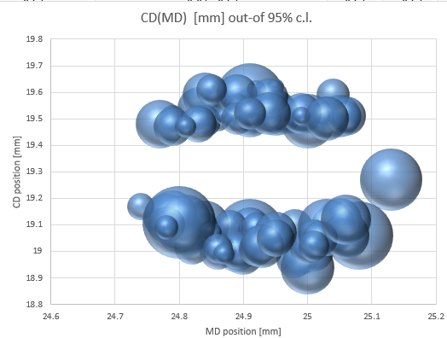
Characterize behaviour based on legacy tests
Task: Characterize behaviour based on several legacy test evidences
Test were performed in the past with implicit different reasons.
Control factors not fully registered or given for granted as settled
Single components intrinsically confused
Statistical relevance √
But... representativeness?
How to mix apples and oranges?
Variability: Input boundaries definition
Uncertainty: Measurement system accuracy and settings
Ontological: Test objectives
Semantic: Different naming
Description | Typology | Type | Variation
Input materials variability | Accidental & systematic | B | Stdev/quantiles
Measure | Accidental | A | StDev
Actuation | Accidental | A | StDev
Other mechanical settings | Systematic | A | Range
Mechanical settings | Systematic | B | Range
A: hypothesized
B: estimated from experiments or data-sheets

Slide 11
Simulation evolution, strengths and limits
FTA inputs evolution:
FMEA quality and experimental estimates evolution
Empirical evidences from physical robustness testing and Root Analyses outputs
Huge availability of ancillary data from sensors, cameras, AI driven control from prototype(s)
Strengths:
It is possible to update the estimate according to the original approach
First experimental evidence confirms the estimation
Limits:
FTA estimate decreases by adding basic events, increases by single evidences reduction
Dependencies, apart duplications, pass through logic operators, no events phasing
Dependency from the operational scenario
Model complexity un-manageable ➔ reduce: # of levels, # of basic events, and statistical models
Difficulty of communication/review linked to visualization
Lack of flexibility to support/describe root cause analysis

Slide 12
Opportunities for improvement and scope extension
Same approach to simulation:
Maintain, simplify and update initial simulation
Reduce complexity without loosing relevance
Generalize the approach for another type of performance and metrics
Simulation alternatives to address bi-directional change propagation:
Neural networks plus Bayesian desirability objective
Design Structure Matrices plus Bayesian propagation
Bayesian networks: R-prototype
MCMC expert systems

Slide 13
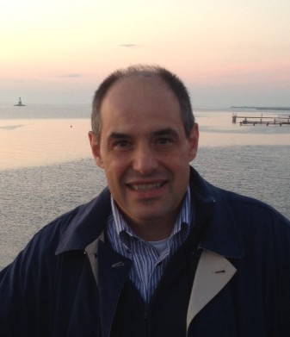

References, How to Contact us
ISO/IEC/IEEE 15288:2023 Systems and software engineering — System life cycle processes
Incose Handbook 5.0: Systems Engineering Handbook – A guide for system life cycle processes and activities
Incose SeBok 2.13 Body of Knowledge and Curriculum to Advance Systems Engineering
Decision Making in Systems Engineering and Management Gregory S. Parnell, PHd, Patrick J. Driscoll, Dale L. Henderson, Wiley 2008
Handbook od Decision Analysis, Gregory S. Parnell, PhD, Wiley 2013
Prospect Theory: An analysis of decision under risk by Daniel Kahneman and Amos Tversky, Econometrica Vol.47, March 1979 N.2
Managing Variations in Meaning: Guidance for Using “Complexity” and Related Terms, J. Sutherland, D. Beale, F. Dazzi... Insight 08/2025
Carlo Leardi, carlo.leardi@incose.net

