Slide 1

A study of prior sensitivity in random effects models
Application to decisions in interlaboratory comparisons
Séverine demeyer, lne
Gerd wübbeler, ptb
ENBIS-26 conference, Florence, 6-10 September 2026

Slide 2

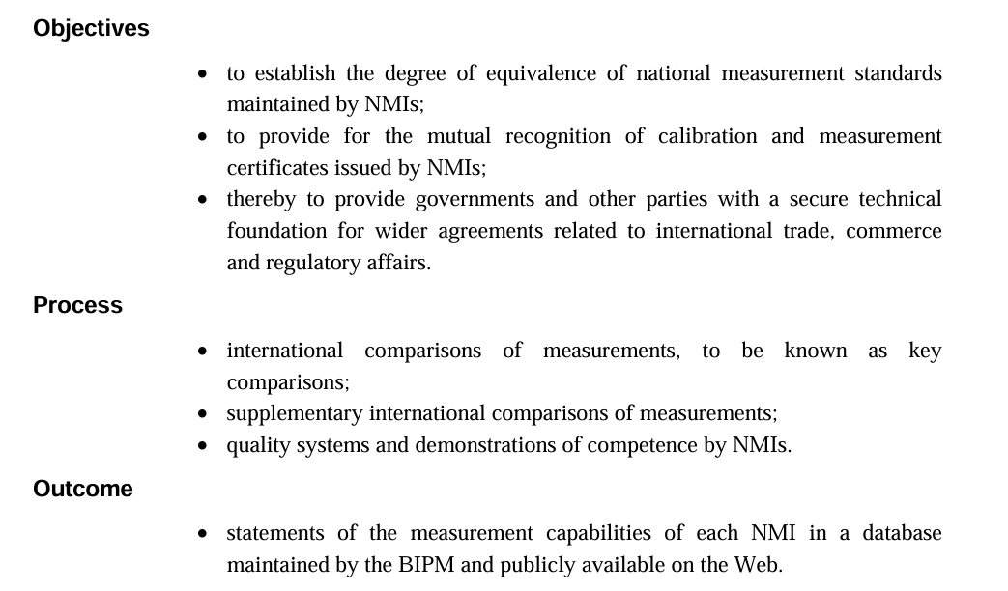
CIPM MRA – Comité international des poids et mesures, sèvres, france
Estimate degrees of equivalence
Organize key comparisons
Make a statement/decision
https://www.bipm.org/en/cipm-mra/cipm-mra-documents

Slide 3
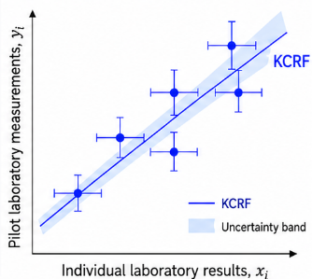
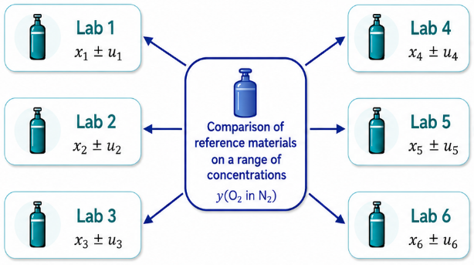
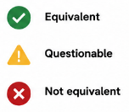

Inter-laboratory comparisons (ILC)
Objective: assess the equivalence of produced reference materials through key comparison reference function (KCRF) and degrees of equivalence to KCRF (DOE)
ILC
Analysis
Decision
CCQM-K53 Oxygen in nitrogen

Slide 4
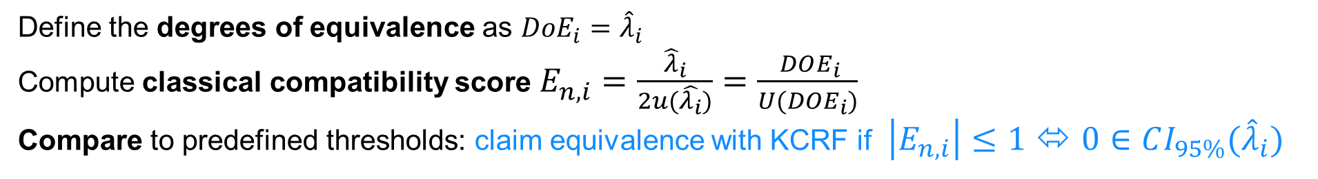
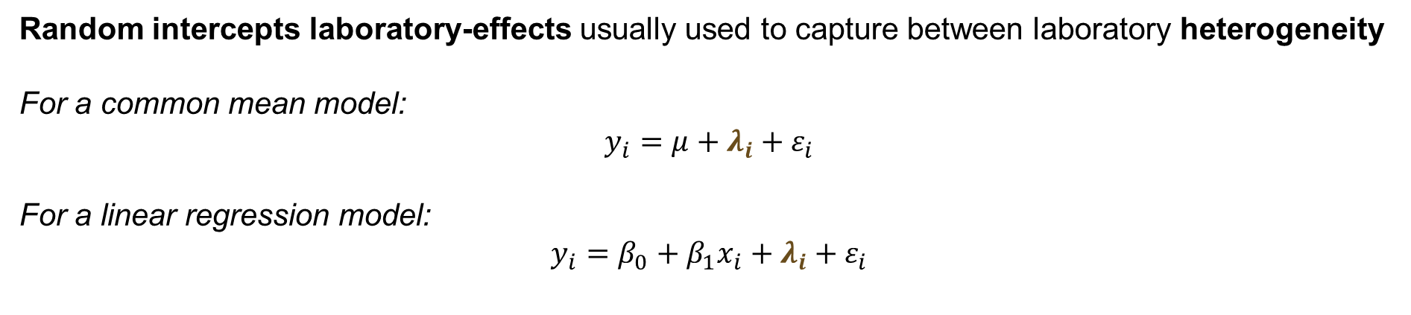

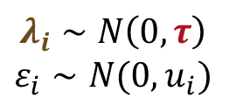
Modelling and deciding in ILC
MODEL
ING
Random intercepts laboratory-effects usually used to capture between laboratory heterogeneity
For a common mean model:
$$y_{i}=μ+λ_{i}+ε_{i}$$
For a linear regression model:
$$y_{i}=β_{0}+β_{1}x_{i}+λ_{i}+ε_{i}$$
$$λ_{i}∼N\left(0,τ\right)$$
$$ε_{i}∼N(0,u_{i})$$
$τ$: dark uncertainty
DECIDING
Define the degrees of equivalence as ${DoE}_{i}={\hat{λ}}_{i}$
Compute classical compatibility score $E_{n,i}^{}=\frac{{\hat{λ}}_{i}}{2u(\hat{λ_{i}})}=\frac{ DOE_{i}}{U(DOE_{i})}$
Compare to predefined thresholds: claim equivalence with KCRF if $\left|E_{n,i}\right|≤1$ ⬄ $0∈CI_{95\%}({\hat{λ}}_{i})$
→ binary decisions, no associated uncertainty !

Slide 5

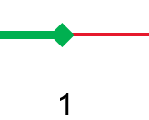


Focus on Metrology issue
Equivalence claim
1.11
reject or accept ?
-1
1
$$E_{n}$$
Rejecting based on binary criterion has adverse consequences:
the laboratory must demonstrate the validity of its procedure
additional bilateral comparisons are required
May delay the equivalence claim of several months/years !
Or require the laboratory to increase its reported uncertainty (very much undesirable)
$E_{n}$ is not a hypothesis test!
→ Need to strenghten confidence in the equivalence statements from ILC analyses, accounting for reported uncertainties and modelling assumptions

Slide 6
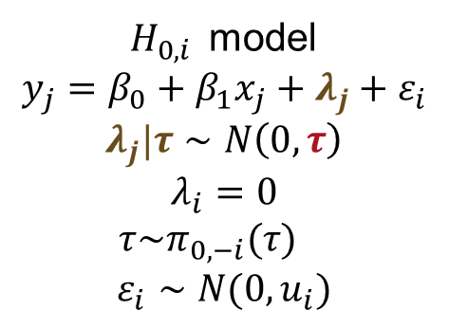

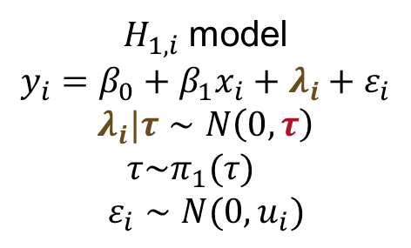

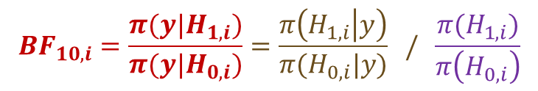
Probabilistic framework using Bayesian Hypothesis testing
For laboratory i, test
$H_{0,i }$ model
$$y_{j}=β_{0}+β_{1}x_{j}+λ_{j}+ε_{i}$$
$$λ_{j}|τ∼N\left(0,τ\right)$$
$$λ_{i}=0$$
$τ\sim π_{0,−i}(τ)$
$$ε_{i}∼N(0,u_{i})$$
$H_{1,i}$ model
$$y_{i}=β_{0}+β_{1}x_{i}+λ_{i}+ε_{i}$$
$$λ_{i}|τ∼N\left(0,τ\right)$$
$τ\sim π_{1}(τ)$
$$ε_{i}∼N(0,u_{i})$$
$H_{0,i}:λ_{i}=0$ against $H_{1,i}:λ_{i}∼N\left(0,τ\right)$
Bayes factor (BF) for laboratory $i$quantifies how much more likely $H_{1,i}$ is against $H_{0,i}$
$$BF_{10,i}=\frac{π(y|H_{1,i})}{π(y|H_{0,i})}=\frac{π\left(H_{1,i} | y\right)}{π(H_{0,i}|y)} / \frac{π(H_{1,i})}{π\left(H_{0,i}\right)}$$
$$BF_{10}=1/{BF}_{01}$$
Bayes factor
Posterior odds
Prior odds
BF offers a finer scale than En for analysing significance of laboratory effects
Computationnally expensive, sensitive on the prior of $τ$

Slide 7
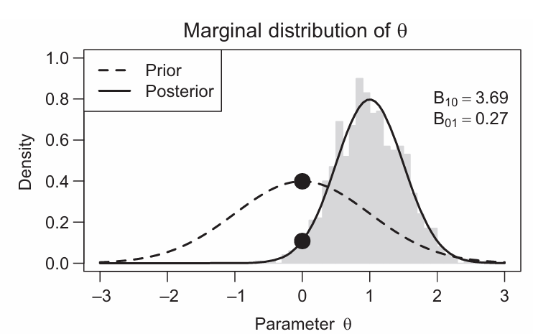
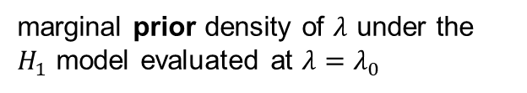
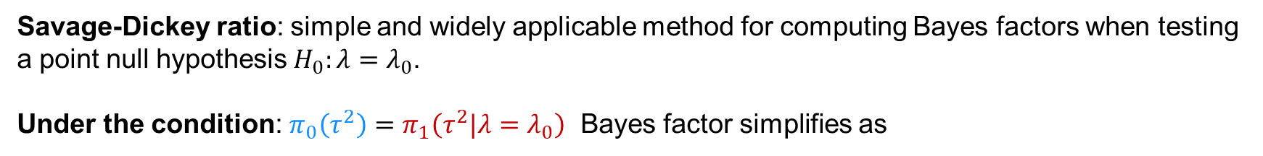
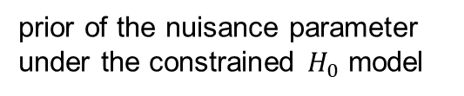
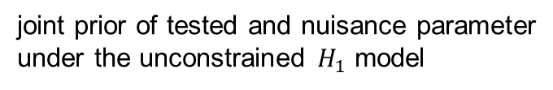
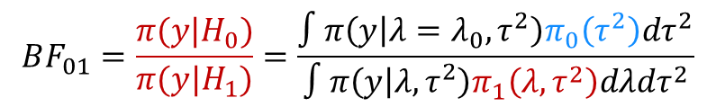
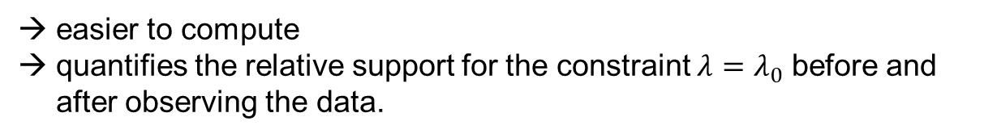
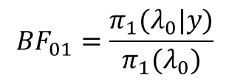
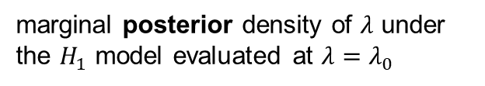
Savage-dickey density ratio
Bayes factor
prior of the nuisance parameter under the constrained $H_{0}$ model
$$BF_{01}=\frac{π(y|H_{0})}{π(y|H_{1})}=\frac{∫π\left(y | λ=λ_{0},τ^{2}\right)π_{0}\left(τ^{2}\right)dτ^{2}}{∫π\left(y | λ,τ^{2}\right)π_{1}\left(λ,τ^{2}\right)dλdτ^{2}}$$
joint prior of tested and nuisance parameter under the unconstrained $H_{1}$ model
Savage-Dickey ratio: simple and widely applicable method for computing Bayes factors when testing a point null hypothesis $H_{0}:λ=λ_{0}$.
Under the condition: $π_{0}\left(τ^{2}\right)=π_{1}\left(τ^{2}|λ=λ_{0}\right)$ Bayes factor simplifies as
$$BF_{01}=\frac{π_{1}(λ_{0}|y)}{π_{1}(λ_{0})}$$
marginal posterior density of $λ$ under the $H_{1}$ model evaluated at $λ=λ_{0}$
marginal prior density of $λ$ under the $H_{1}$ model evaluated at $λ=λ_{0}$
easier to compute
quantifies the relative support for the constraint $λ=λ_{0}$ before and after observing the data.
Credit of the figure: Heck, 2019

Slide 8



Priors on scale parameter
Bayes factor highly sensitive to the common scale parameter of the random effects $τ$
For estimating $τ,$ a Half-Cauchy prior is recommended following Polson et al(2012) and Gelman(2006)
Bayes factor estimation is instable with this prior using Savage Dickey
Choice of inverse chi squared prior under $H_{1,i}=H_{1}$
$$π_{1}\left(τ^{2}\right)∼Inv−X^{2}(ν,s)$$
Induced prior under $H_{0,i}$
$$π_{0}(τ^{2})∼Inv−X^{2}(ν+1,\frac{ν}{ν+1}s^{2})$$
→ constrained prior for $τ^{2}$ under $H_{0}$, that says that $π_{0}\left(τ^{2}\right)$ should be shifted towards lower values than $π_{1}(τ^{2})$ since we impose one $λ_{i}=0$!

Slide 9
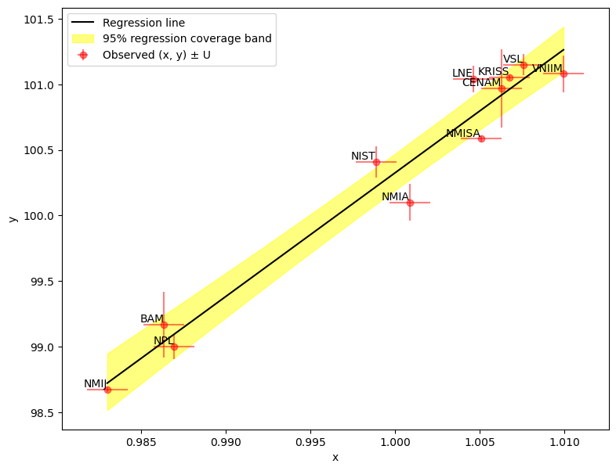
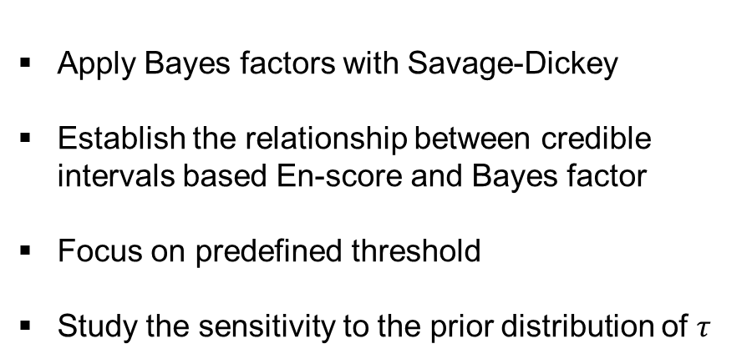
Case Study: CCQM-K53 Oxygen in nitrogen
Key comparison CCQM-K53 is intended to support CMC claims for gravimetric preparation and analysis on primary gas mixtures from 10 μmol/mol to 10 mmol/mol of oxygen in nitrogen.
Apply Bayes factors with Savage-Dickey
Establish the relationship between credible intervals based En-score and Bayes factor
Focus on predefined threshold
Study the sensitivity to the prior distribution of $τ$
Decision

Slide 10
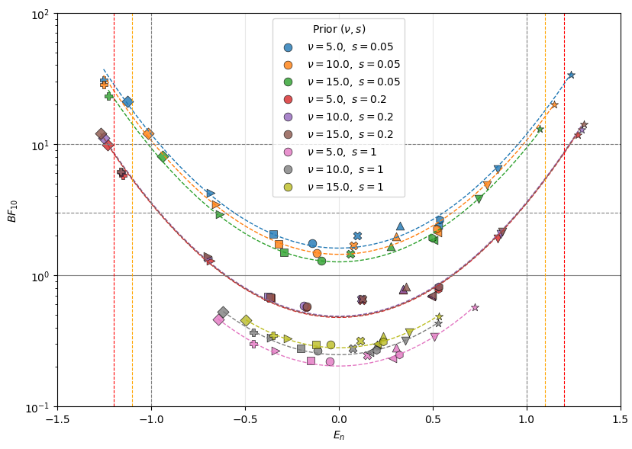



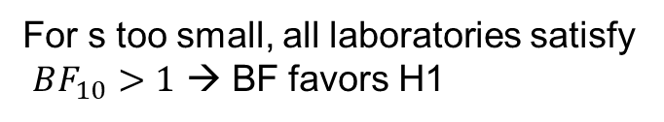
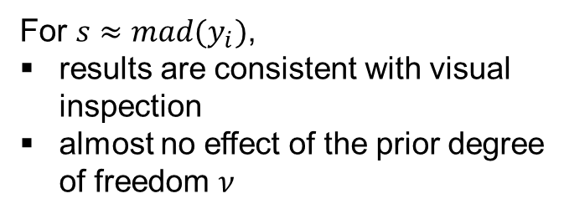
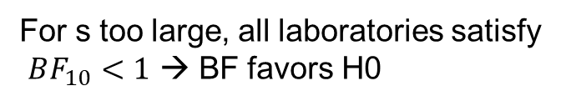
Effect of the prior on the Bayes factors
$$τ^{2}∼Inv−chi^{2}(ν,s)$$
For s too small, all laboratories satisfy
$BF_{10}>1$ → BF favors H1
small s
For s too large, all laboratories satisfy
$BF_{10}<1$ → BF favors H0
What is a good candidate for s?
For $s≈mad(y_{i})$,
results are consistent with visual inspection
almost no effect of the prior degree of freedom $ν$
large s

Slide 11
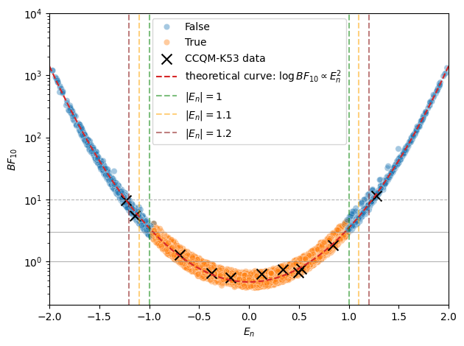





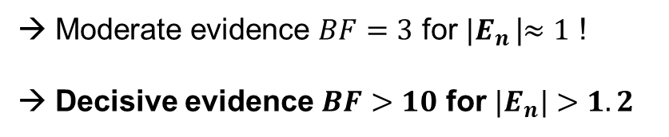

Interpretation of the E_{n} Criterion
Plot of ${\text{(}E_{n,i}^{}\text{,}BF_{10,i})}_{i}$ from 1000 posterior predictive datasets
→ The plot verifies the theoretical equivalence
$$0∉CI_{95\%}$$
$$0∈CI_{95\%}$$
${|E}_{n,i}^{}$|$<1$
→ The empirical BF₁₀ plot can be compared with Jeffreys’ scale (no evidence – moderate evidence – decisive evidence)
Moderate evidence $BF=3$ for ${|E}_{n}^{}$|$≈1$ !
Decisive evidence $BF>10$ for ${|E}_{n}|>1.2$
Increased sensitivity of the Bayes factor to quantify the robustness of the decision
Proposal to introduce a guard band [1-1.2]

Slide 12
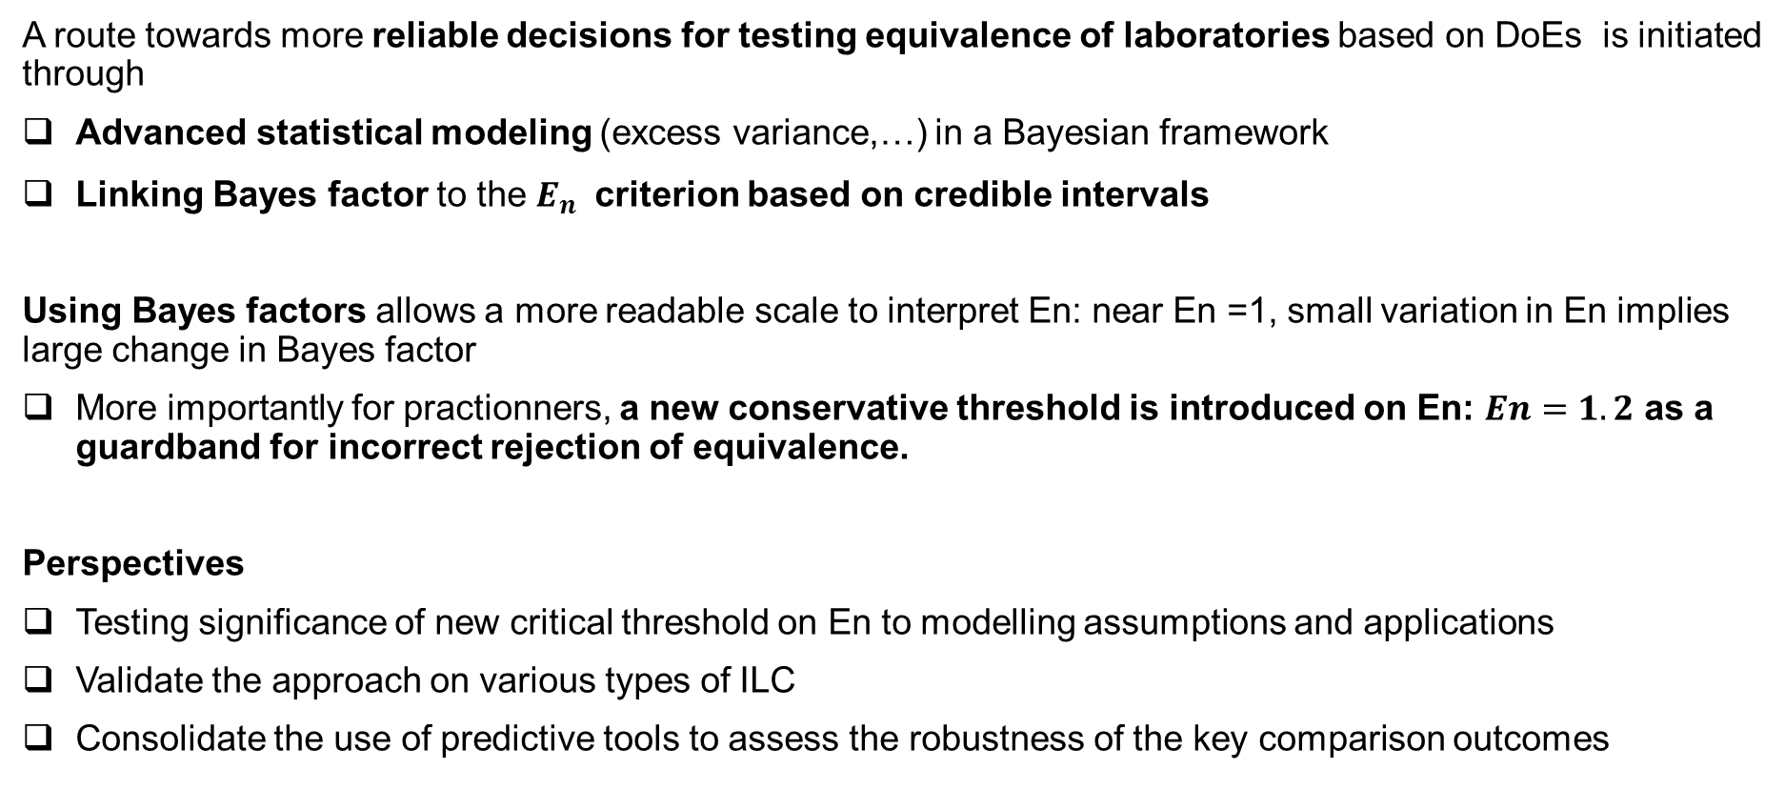
Conclusion and perspectives
A route towards more reliable decisions for testing equivalence of laboratories based on DoEs is initiated through
Advanced statistical modeling (excess variance,…) in a Bayesian framework
Linking Bayes factor to the $E_{n}^{}$ criterion based on credible intervals
Using Bayes factors allows a more readable scale to interpret En: near En =1, small variation in En implies large change in Bayes factor
More importantly for practionners, a new conservative threshold is introduced on En: $En=1.2$ as a guardband for incorrect rejection of equivalence.
Perspectives
Testing significance of new critical threshold on En to modelling assumptions and applications
Validate the approach on various types of ILC
Consolidate the use of predictive tools to assess the robustness of the key comparison outcomes

Slide 13
THANKS FOR YOUR ATTENTION
severine.demeyer@lne.fr
gerd.wuebbeler@ptb.de

Slide 14
references
Heck, A caveat on the Savage–Dickey density ratio: The case of computing Bayes factors for regression parameters British Journal of Mathematical and Statistical Psychology (2019), 72, 316–333
Verdinelli,I., &Wasserman,L.(1995).Computing Bayes factors using a generalization of the Savage Dickey density ratio. Journal of the American Statistical Association, 90, 614–618
Gelman, A, Prior distributions for variance parameters in hierarchical models, Bayesian analysis, 1, 3, 515-533
Polson, N G, On the Half-Cauchy Prior for a Global Scale Parameter, Bayesian analysis, 7, 4, 887-902
Lee J, Lee JB, Moon DM, Kim JS, van der Veen AMH, Besley L, et al. Final report on international key comparison CCQM-K53: Oxygen in nitrogen. Metrologia.2010;47

Slide 15

Applying Savage-dickey density ratio
Condition for using Savage-Dickey ratio: the prior of nuisance parameters in the constrained model is identical to the conditional prior of the unconstrained model given the equality constraint on the test-relevant parameters.
$$π_{0}\left(τ^{2}\right)=π_{1}\left(τ^{2}|λ_{i}=0\right)$$
Generally fulfilled if parameters are independant.
For interlaboratory comparaisons, the dark uncertainty $τ$ is common to all $λ_{i}$’s → condition not fulfilled
The conditions defines a contrained prior for $τ^{2}$ under $H_{0}$, that says that $π_{0}\left(τ^{2}\right)$ should be shifted towards lower values than $π_{1}(τ^{2})$ since we impose one $λ_{i}=0$!
Generalized Savage-Dickey ratio
Heck, A caveat on the Savage–Dickey density ratio: The case of computing Bayes factors for regression parameters British Journal of Mathematical and Statistical Psychology (2019), 72, 316–333
Verdinelli,I., &Wasserman,L.(1995).Computing Bayes factors using a generalization of the Savage Dickey density ratio. Journal of the American Statistical Association, 90, 614–618

