Slide 1


Gradient-Based Line Search for
Continuous Optimal Designs in Spatial Statistics
H. Waldl
Department of Applied Statistics, Johannes Kepler University Linz, Austria
Notes:
1

Slide 2
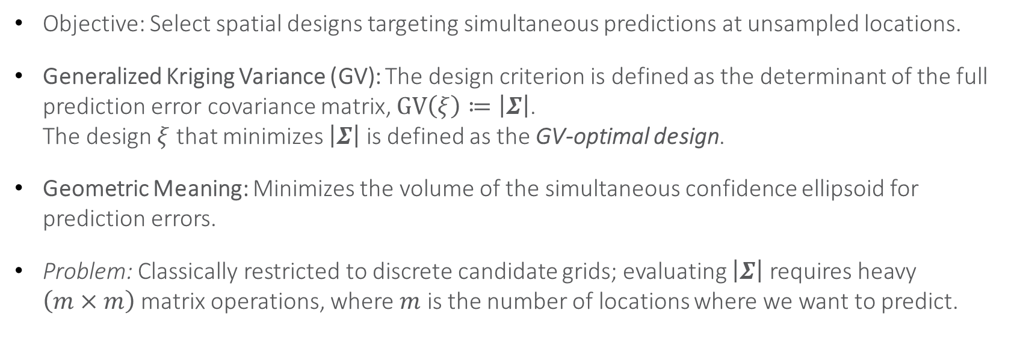
Recap: GV-Optimality for Simultaneous Predictions
Objective: Select spatial designs targeting simultaneous predictions at unsampled locations.
Generalized Kriging Variance (GV): The design criterion is defined as the determinant of the full prediction error covariance matrix, $GV\left(ξ\right)≔\left|Σ\right|$.
The design $ξ$ that minimizes $\left|Σ\right|$ is defined as the GV-optimal design.
Geometric Meaning: Minimizes the volume of the simultaneous confidence ellipsoid for prediction errors.
Problem: Classically restricted to discrete candidate grids; evaluating $\left|Σ\right|$ requires heavy $\left(m×m\right)$matrix operations, where $m$ is the number of locations where we want to predict.
Notes:
State that since I presented the GV framework here two years ago, we know its geometric power (ellipsoid volume reduction). Today, we break free from the grid restrictions that used to limit it.

Slide 3
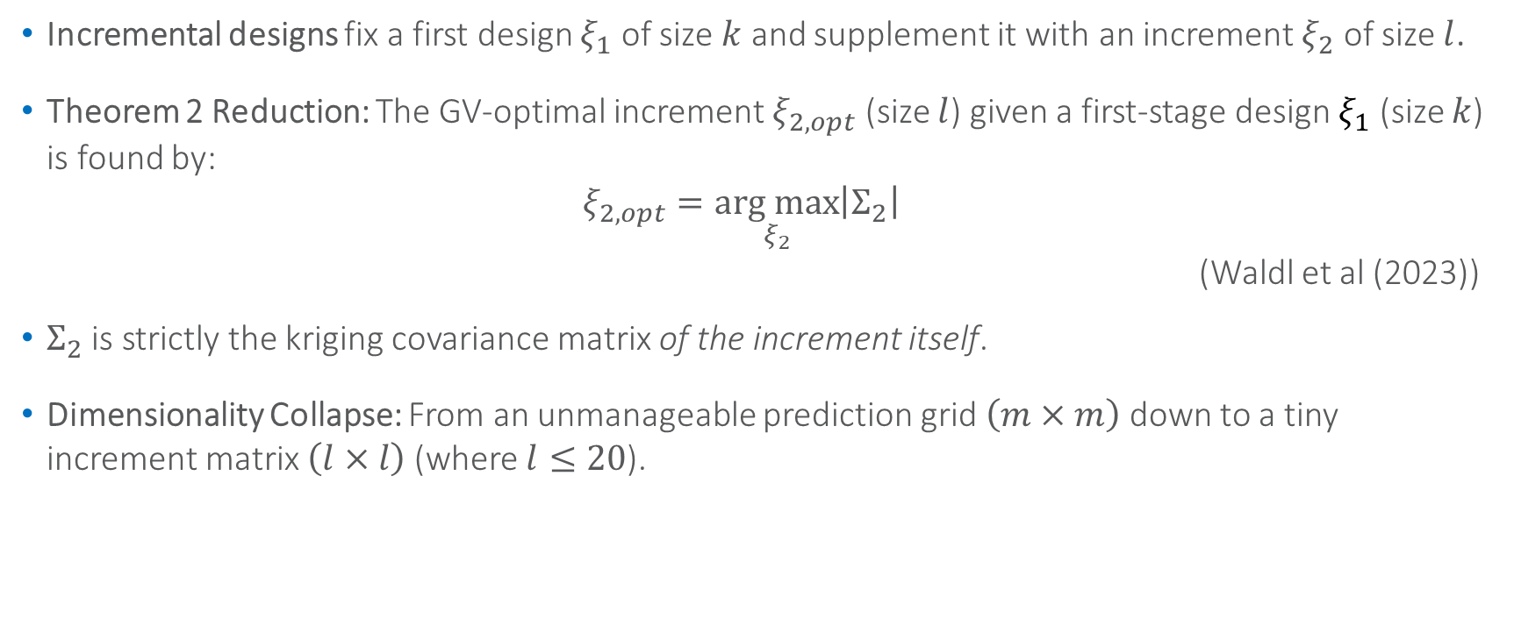
The Gateway: Theorem 2
    Incremental designs fix a first design $ξ_{1}$ of size $k$ and supplement it with an increment $ξ_{2}$ of size $l$.
    Theorem 2 Reduction: The GV-optimal increment $ξ_{2,opt}$ (size $l$) given a first-stage design $ξ_{1}$ (size $k$) is found by:
    $ξ_{2,opt}=\underset{ξ_{2}}{arg max}\left|Σ_{2}\right|$
    (Waldl et al (2023))
    $Σ_{2}$is strictly the kriging covariance matrix of the increment itself.
    Dimensionality Collapse: From an unmanageable prediction grid $\left(m×m\right)$ down to a tiny increment matrix $\left(l×l\right)$ (where $l≤20$).
Notes:
Remind them of Theorem 2. Because $Σ_{2}$ depends only on the few increment coordinates, the background prediction field of m points disappears from our optimization cycle completely.
3

Slide 4
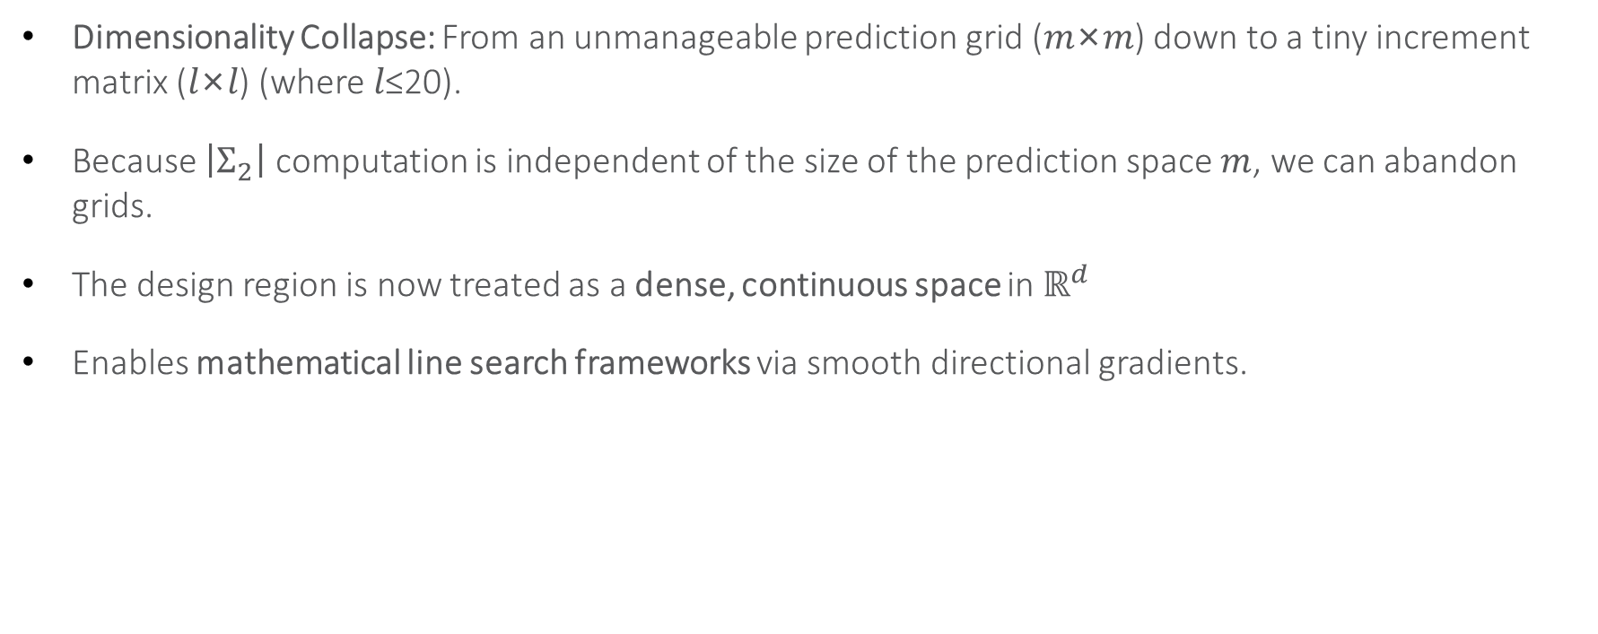
Shifting to Continuous Design Spaces $ℝ^{d}$
Dimensionality Collapse: From an unmanageable prediction grid (𝑚×𝑚) down to a tiny increment matrix (𝑙×𝑙) (where 𝑙≤20).
Because $\left|Σ_{2}\right|$ computation is independent of the size of the prediction space $m$, we can abandon grids.
The design region is now treated as a dense, continuous space in $ℝ^{d}$
Enables mathematical line search frameworks via smooth directional gradients.
Notes:
This is the core shift. Since we no longer need a candidate grid to calculate the criterion, we can let our coordinates vary continuously and use standard calculus.
4

Slide 5
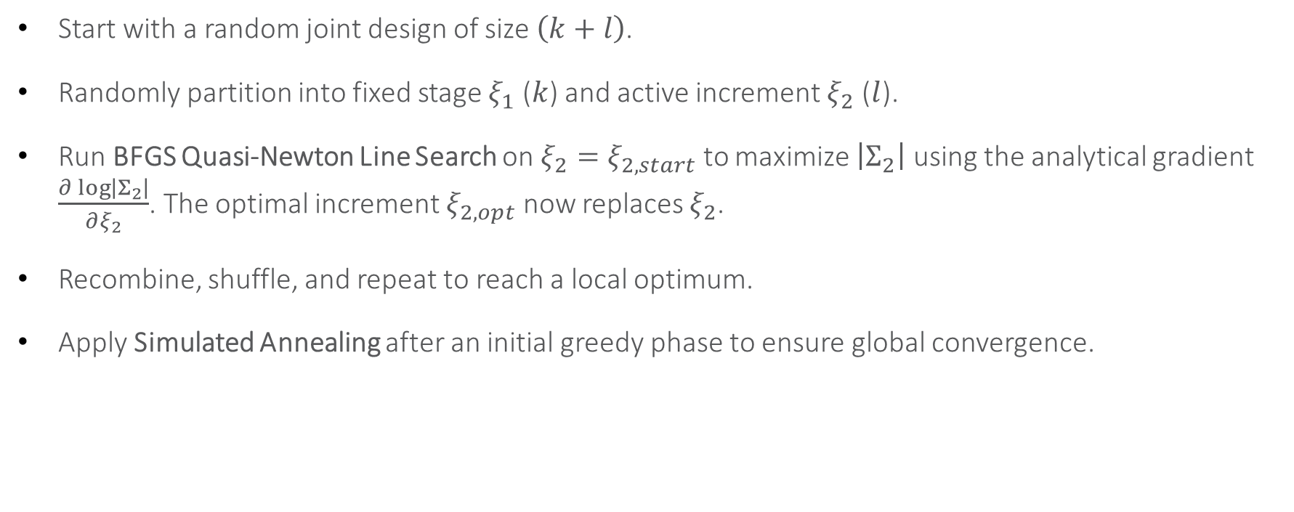
The Global Algorithm: Rolling Random Partitions
Start with a random joint design of size $\left(k+l\right)$.
Randomly partition into fixed stage $ξ_{1}$ ($k$) and active increment $ξ_{2}$ ($l$).
Run BFGS Quasi-Newton Line Search on $ξ_{2}=ξ_{2,start}$ to maximize $\left|Σ_{2}\right|$ using the analytical gradient $\frac{∂\log\left|Σ_{2}\right|}{∂ξ_{2}}$. The optimal increment $ξ_{2,opt}$ now replaces $ξ_{2}$.
Recombine, shuffle, and repeat to reach a local optimum.
Apply Simulated Annealing after an initial greedy phase to ensure global convergence.
Notes:
Explain the overarching metaheuristic. The random shuffling combined with gradient line-search allows us to optimize the whole design piece-by-piece.
5

Slide 6

The Optimization Objective & Gradient Challenge
Objective: Maximize $\log\left|Σ_{2}\right|$ instead of $\left|Σ_{2}\right|$ (monotone transformation, drastically simplifies derivatives).
$Σ_{2}$ depends dynamically on spatial coordinates via trend-matrix $F_{2}$, cross-covariance-matrix $C_{12}$, and inner-increment covariance-matrix $C_{2}$.
Standard differential calculus leads directly to higher-dimensional tensors due to matrix positioning.
Notes:
Point out that taking gradients of coordinate matrices usually throws you into tensor algebra, which destroys computational speed in environments like R.
6

Slide 7
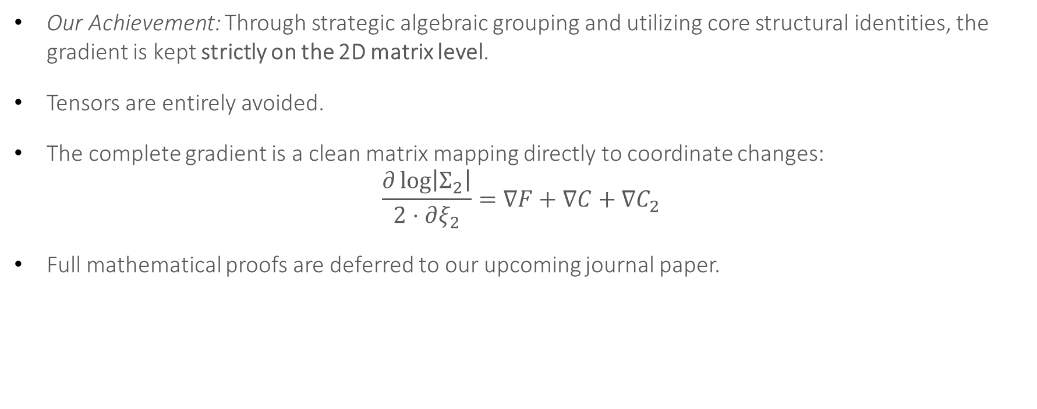
The Tensor-Free Solution
Our Achievement: Through strategic algebraic grouping and utilizing core structural identities, the gradient is kept strictly on the 2D matrix level.
Tensors are entirely avoided.
The complete gradient is a clean matrix mapping directly to coordinate changes:
$\frac{∂\log\left|Σ_{2}\right|}{2⋅∂ξ_{2}}=∇F+∇C+∇C_{2}$
Full mathematical proofs are deferred to our upcoming journal paper.
Notes:
Reassure the audience that you won't torture them with 3 pages of matrix algebra. The takeaway is: we bypassed tensors completely, keeping the code lightning-fast. Let's look at how this gradient behaves.
7

Slide 8
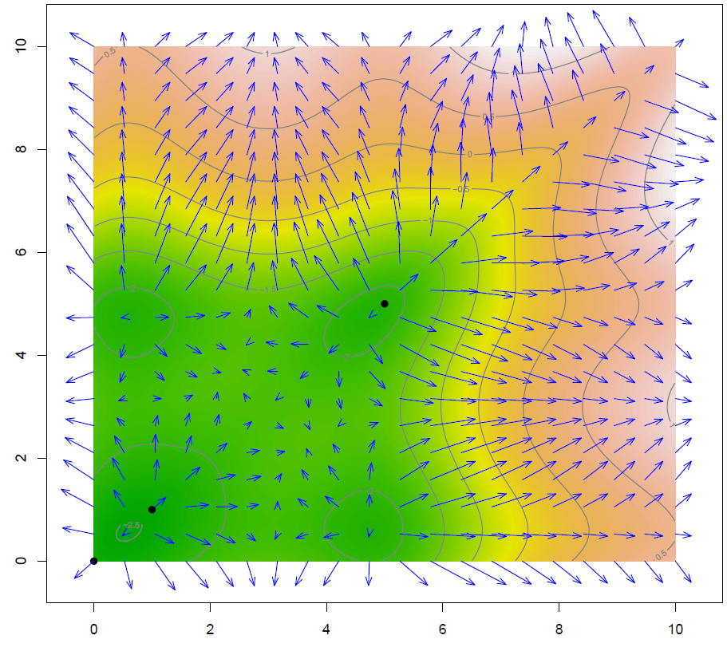
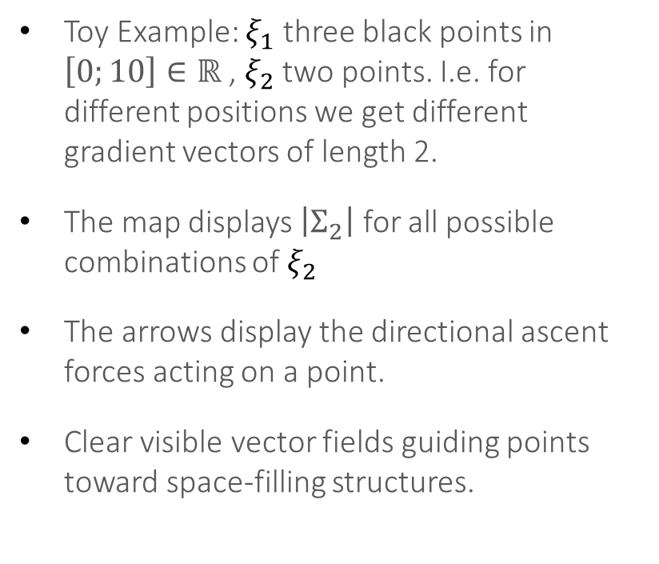
Visualizing the Gradient Field (1/2)
Toy Example: $ξ_{1}$ three black points in $\left[0;10\right]∈ℝ$ , $ξ_{2}$ two points. I.e. for different positions we get different
gradient vectors of length 2.
The map displays $\left|Σ_{2}\right|$ for all possible combinations of $ξ_{2}$
The arrows display the directional ascent forces acting on a point.
Clear visible vector fields guiding points toward space-filling structures.
Notes:
Show the plot with the arrows. Explain that this trivial example visualizes the raw forces calculated by our matrix gradient, showing how smoothly the field pushes points away from existing ones.
8

Slide 9
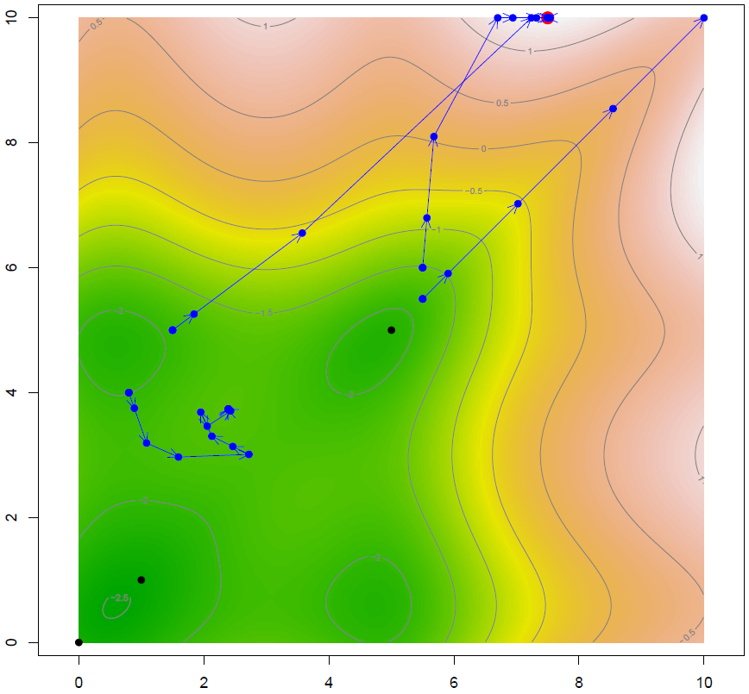
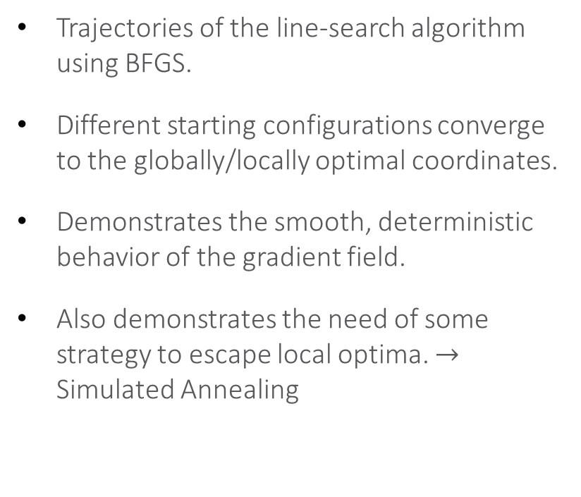
Visualizing the Gradient Field (2/2)
Trajectories of the line-search algorithm using BFGS.
Different starting configurations converge to the globally/locally optimal coordinates.
Demonstrates the smooth, deterministic behavior of the gradient field.
Also demonstrates the need of some strategy to escape local optima. $→$ Simulated Annealing
Notes:
This slide proves it works. No matter where you randomly drop the starting point, the gradient field behaves like a gravity well, pulling the coordinates along optimal tracks.
9

Slide 10
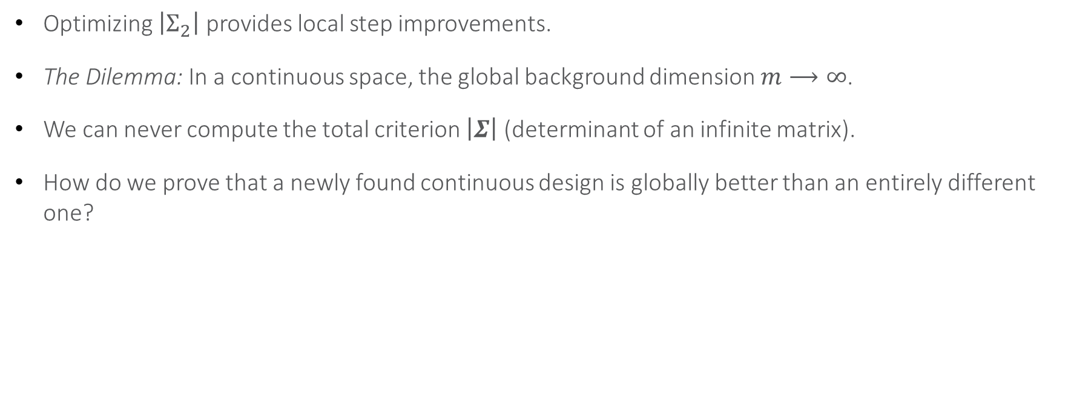
The Theoretical Conundrum:
Comparing Continuous Designs
Optimizing $\left|Σ_{2}\right|$ provides local step improvements.
The Dilemma: In a continuous space, the global background dimension $m⟶∞$.
We can never compute the total criterion $\left|Σ\right|$ (determinant of an infinite matrix).
How do we prove that a newly found continuous design is globally better than an entirely different one?
Notes:
Raise the fundamental mathematical question. If we move away from grids, the baseline criterion $\left|Σ\right|$ becomes an infinite determinant. We need a way to compare two completely independent designs without computing $\left|Σ\right|$.
10

Slide 11
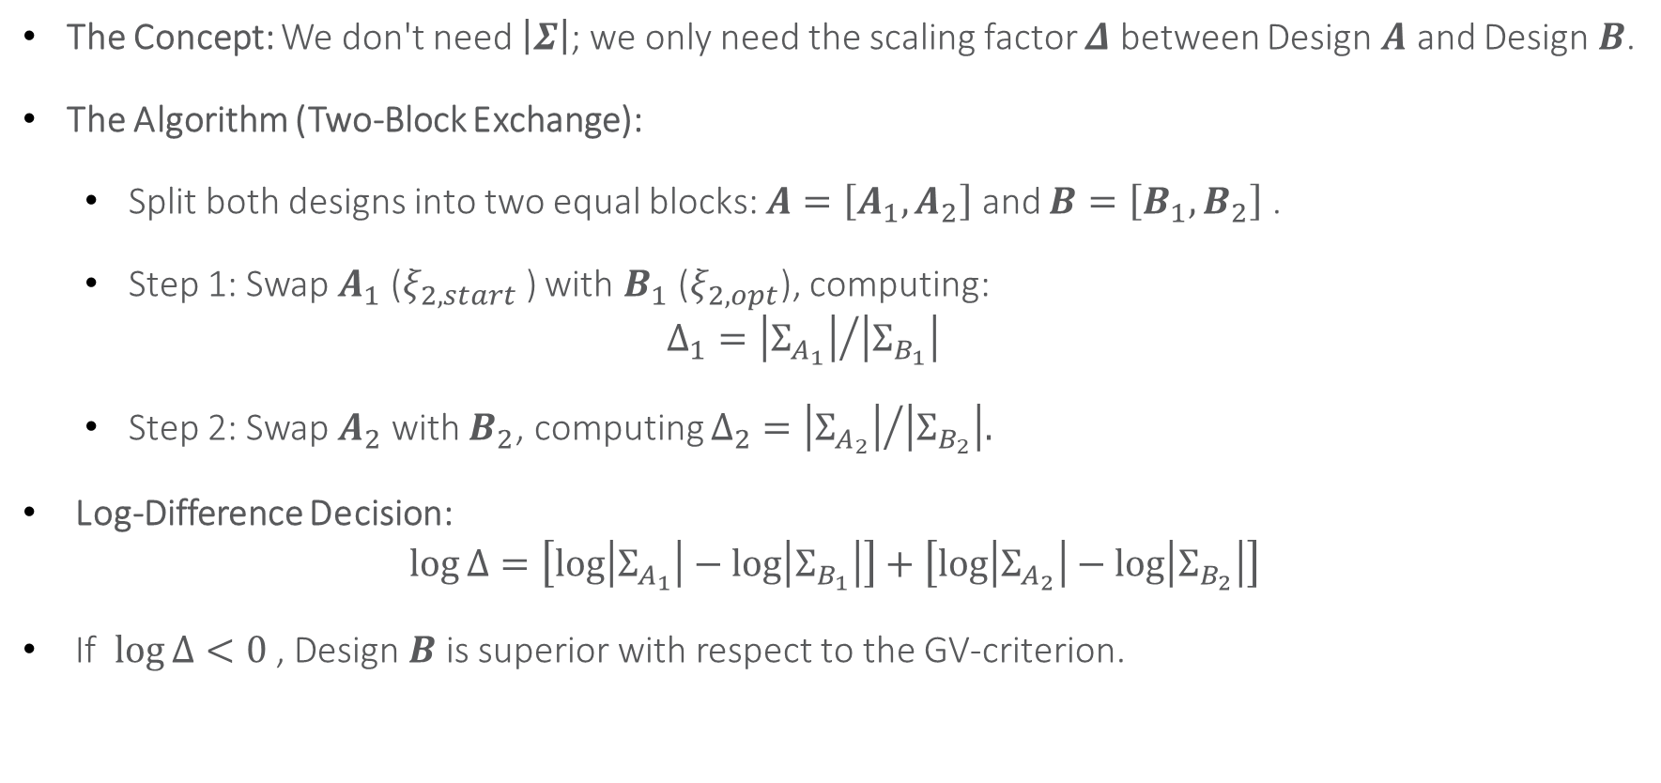
The Schur-Chaining Trick
The Concept: We don't need $\left|Σ\right|$; we only need the scaling factor $Δ$ between Design $A$ and Design $B$.
The Algorithm (Two-Block Exchange):
  Split both designs into two equal blocks: $A=\left[A_{1},A_{2}\right]$ and $B=\left[B_{1},B_{2}\right]$ .
  Step 1: Swap $A_{1}$ ($ξ_{2,start}$) with $B_{1}$ ($ξ_{2,opt}$), computing:
  $Δ_{1}={\left|Σ_{A_{1}}\right|}/{\left|Σ_{B_{1}}\right|}$
  Step 2: Swap $A_{2}$ with $B_{2}$, computing $Δ_{2}={\left|Σ_{A_{2}}\right|}/{\left|Σ_{B_{2}}\right|.}$
Log-Difference Decision:
$\log{Δ}=\left[\log\left|Σ_{A_{1}}\right|−\log\left|Σ_{B_{1}}\right|\right]+\left[\log\left|Σ_{A_{2}}\right|−\log\left|Σ_{B_{2}}\right|\right]$
If $\log{Δ}<0$ , Design $B$ is superior with respect to the GV-criterion.
Notes:
Explain this elegant chaining of Schur complements. By systematically swapping blocks and multiplying the determinants' ratios (or summing the log-differences), the infinite dimensions perfectly cancel out. We can evaluate design quality anywhere in $ℝ^{d}$
11

Slide 12
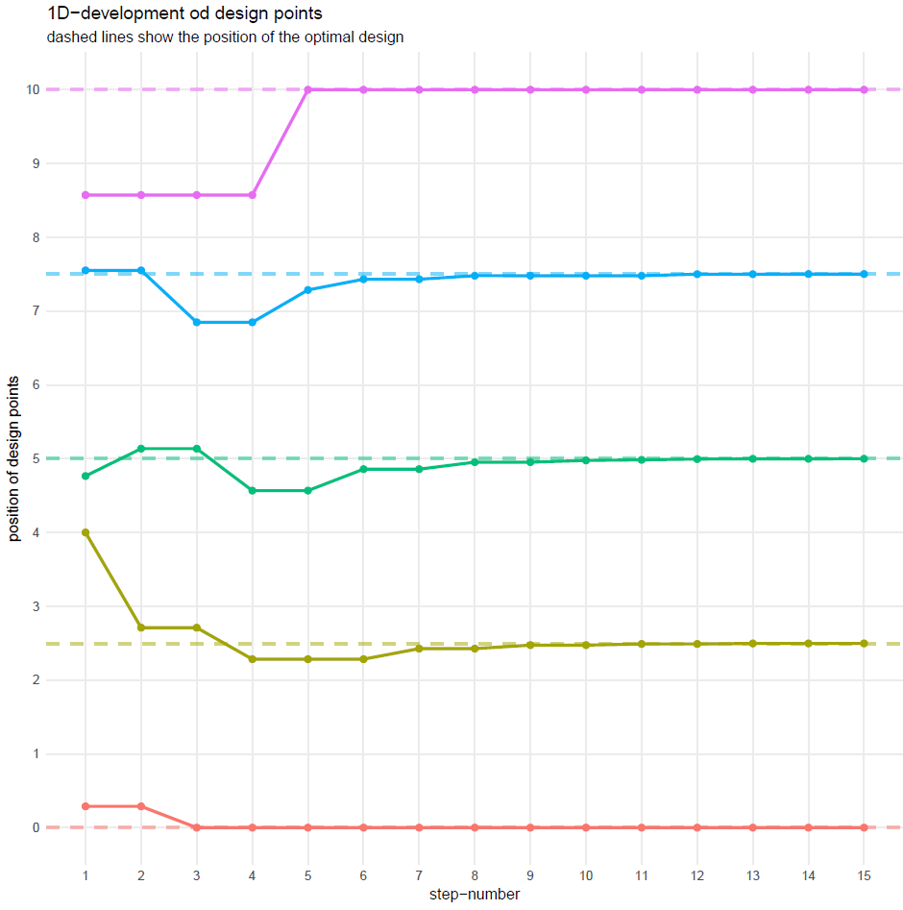
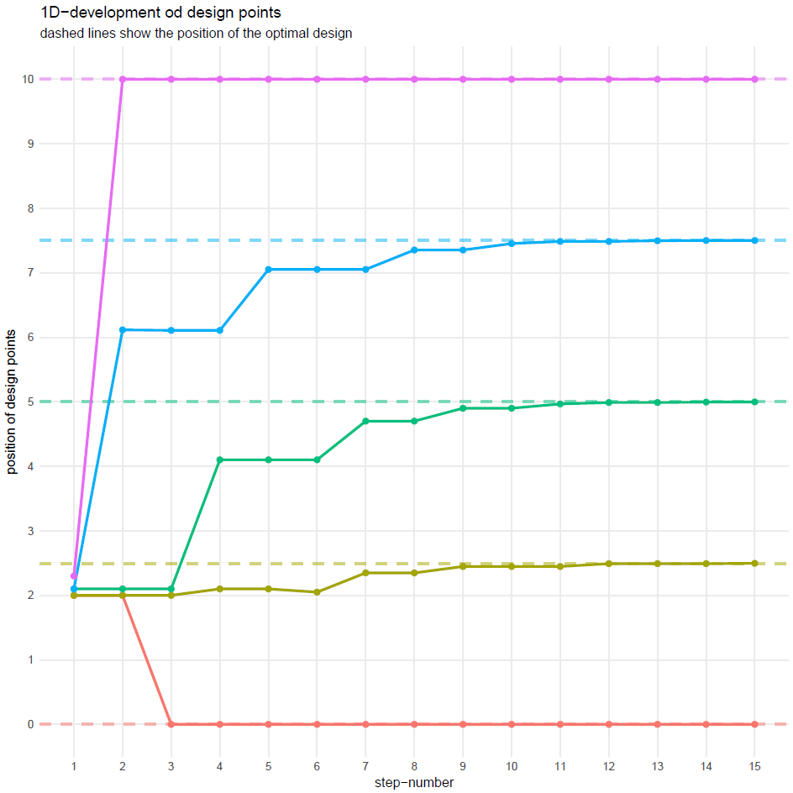
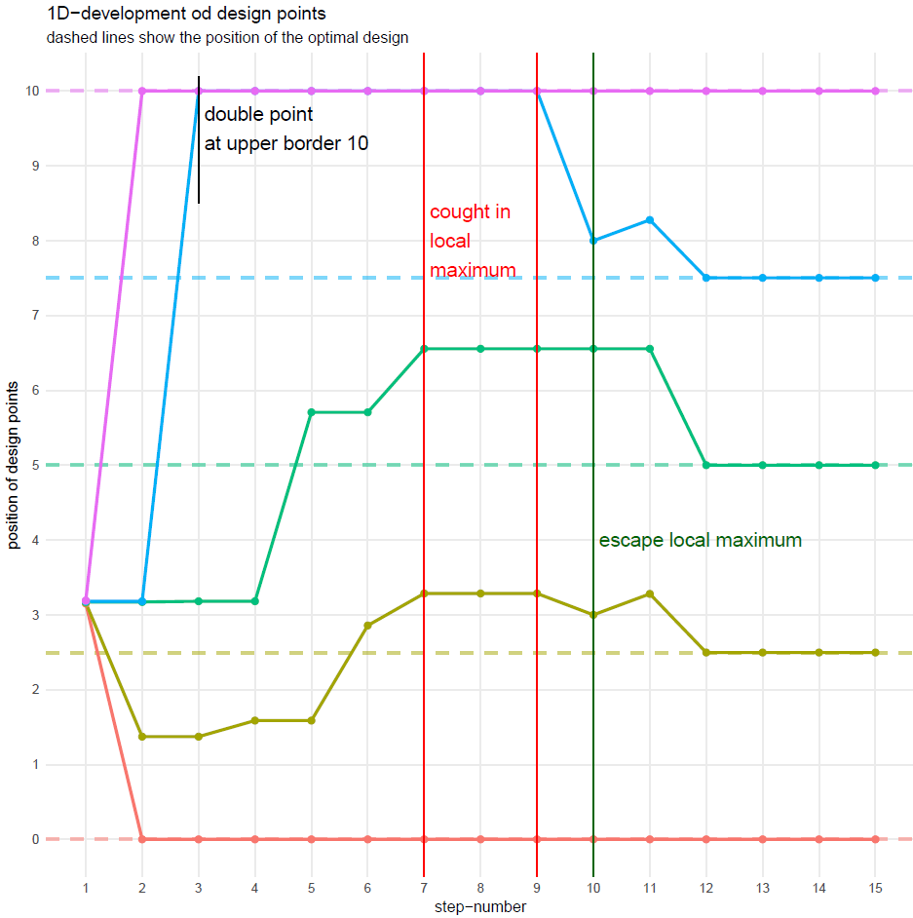
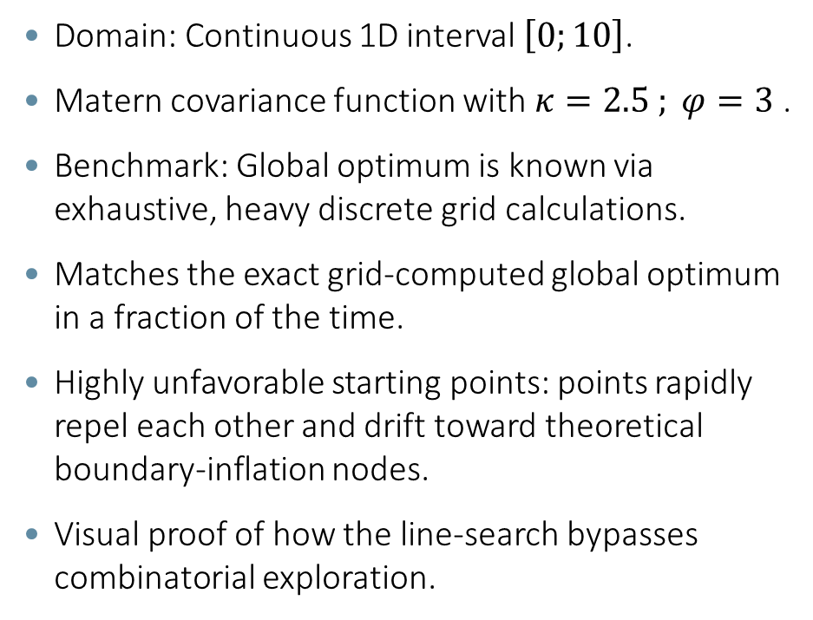
1D Simulation Setup & the Convergence Trajectory
    Domain: Continuous 1D interval $\left[0;10\right]$.
    Matern covariance function with $κ=2.5 ; φ=3$ .
    Benchmark: Global optimum is known via exhaustive, heavy discrete grid calculations.
    Matches the exact grid-computed global optimum in a fraction of the time.
    Highly unfavorable starting points: points rapidly repel each other and drift toward theoretical boundary-inflation nodes.
    Visual proof of how the line-search bypasses combinatorial exploration.
Notes:
Introduce the 1D test case. We chose an intentionally bad starting layout to test the recovery speed of the gradient. Point to the trajectory plot. Show how quickly the lines straighten out and find the optimal spacing, showcasing the sheer speed of gradient descent over grid-searching.

Slide 13
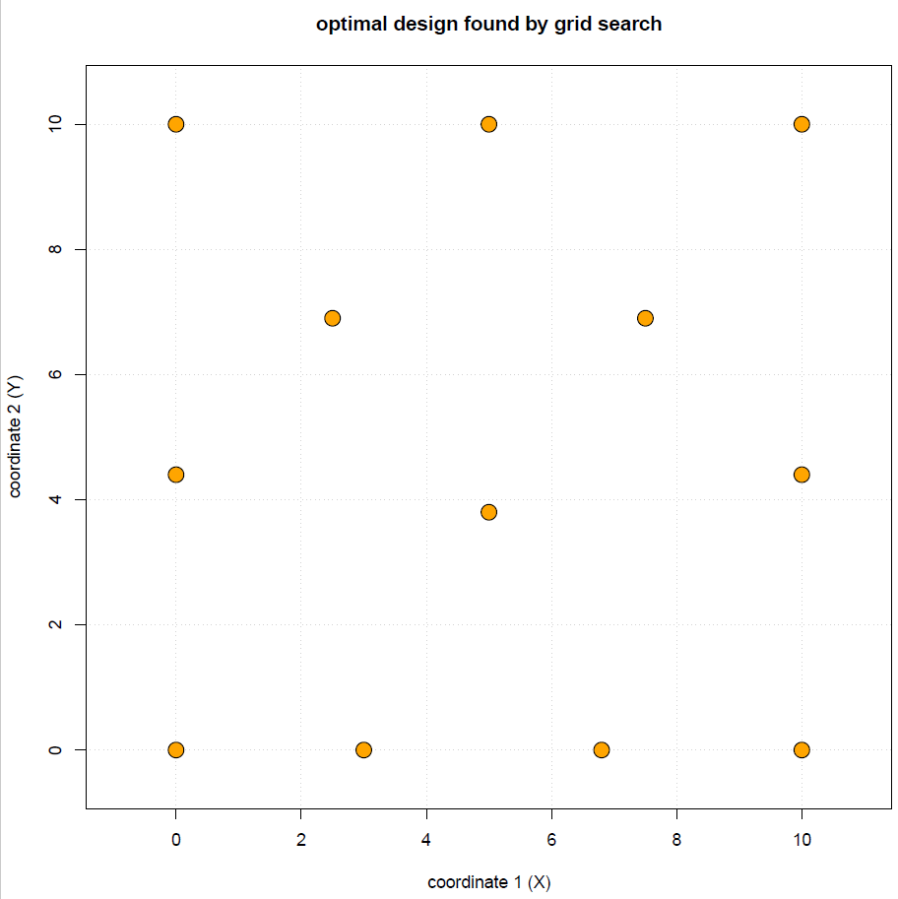
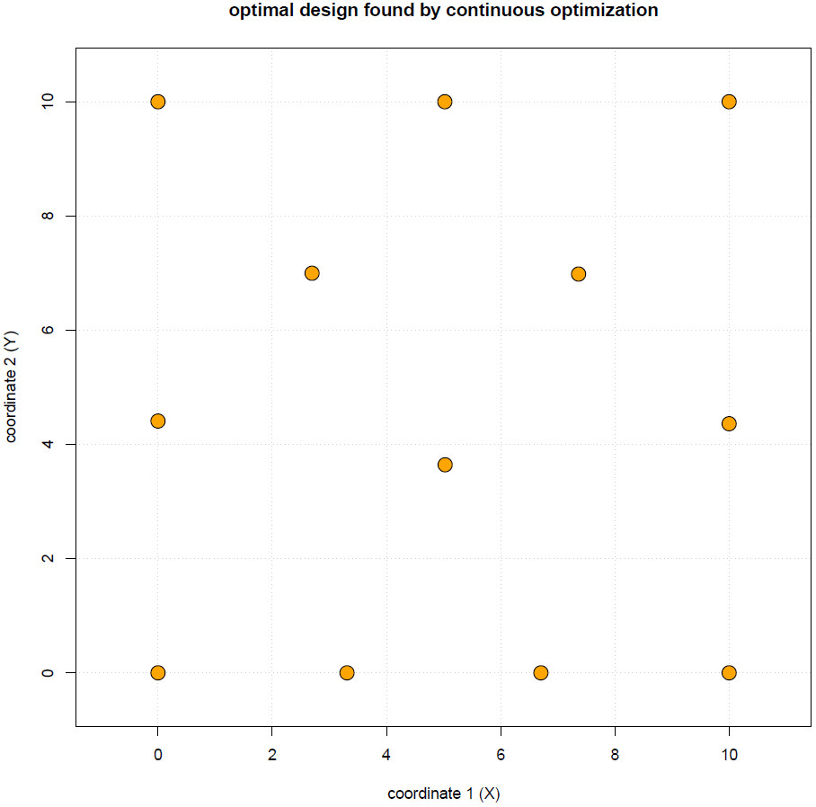
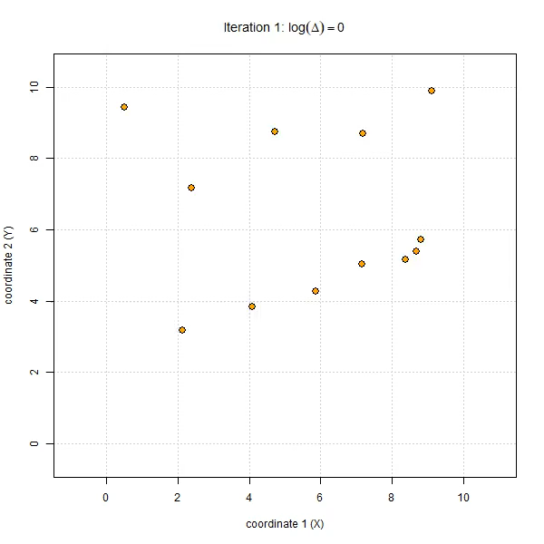
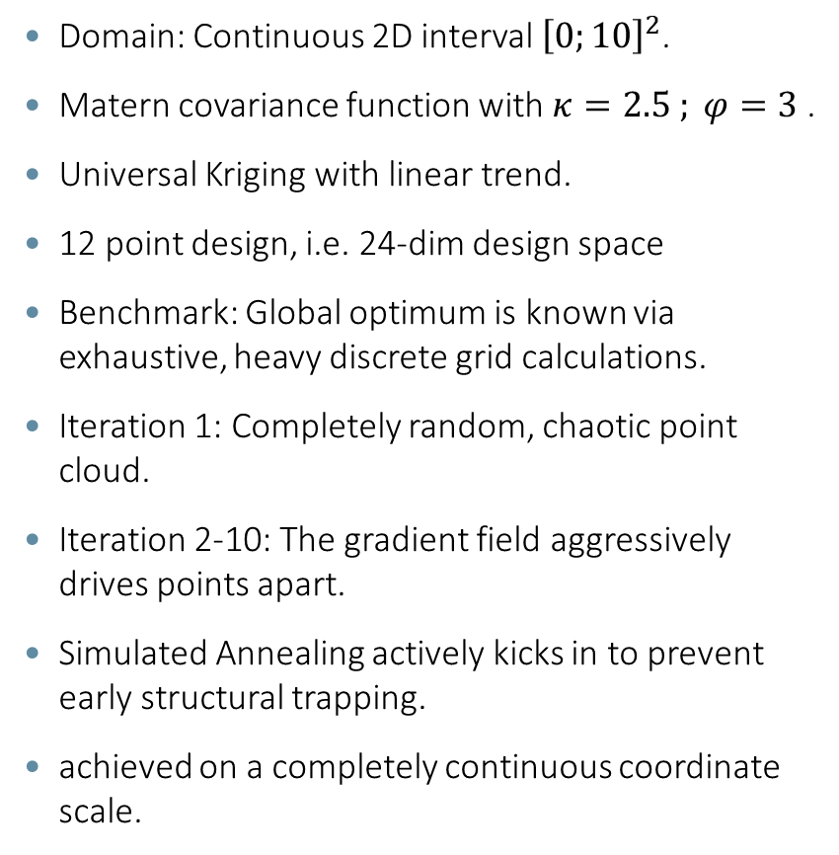
2D Continuous Simulation Setup
    Domain: Continuous 2D interval ${\left[0;10\right]}^{2}$.
    Matern covariance function with $κ=2.5 ; φ=3$ .
    Universal Kriging with linear trend.
    12 point design, i.e. 24-dim design space
    Benchmark: Global optimum is known via exhaustive, heavy discrete grid calculations.
    Iteration 1: Completely random, chaotic point cloud.
    Iteration 2-10: The gradient field aggressively drives points apart.
    Simulated Annealing actively kicks in to prevent early structural trapping.
    achieved on a completely continuous coordinate scale.
Notes:
Now we move to a complex 2D setup. We are using a linear trend, which complicates the landscape significantly. Note how messy the design looks at the start. Traditional exchange algorithms would take thousands of random point swaps to fix this. As you see in the animation, the points behave like repelling electrons, quickly distributing themselves across the square while filling the space dynamically. Final State: Perfectly stabilized space-filling layout with characteristic edge/corner positioning. Typically for small range parameters the optimal design concentrates the points on the border and corners of the design region, if we increase the range parameter, the optimal design gets more and more space filling.

Slide 14
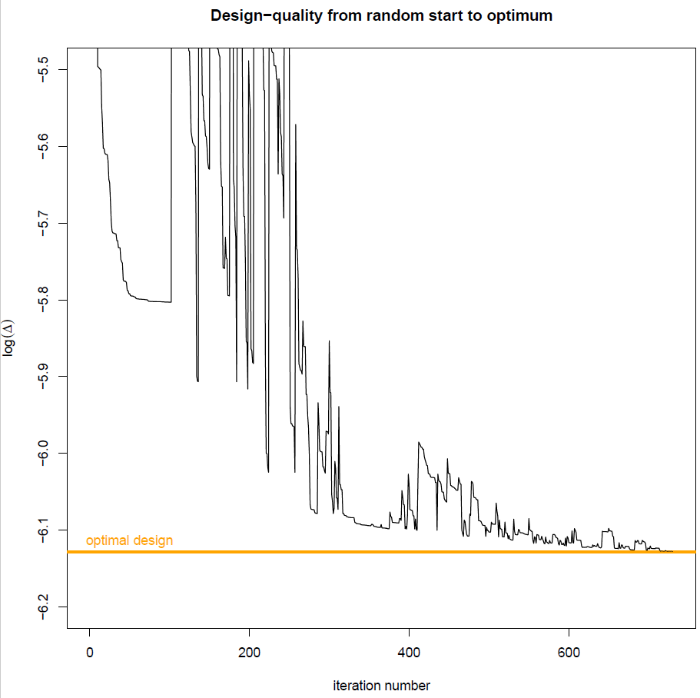
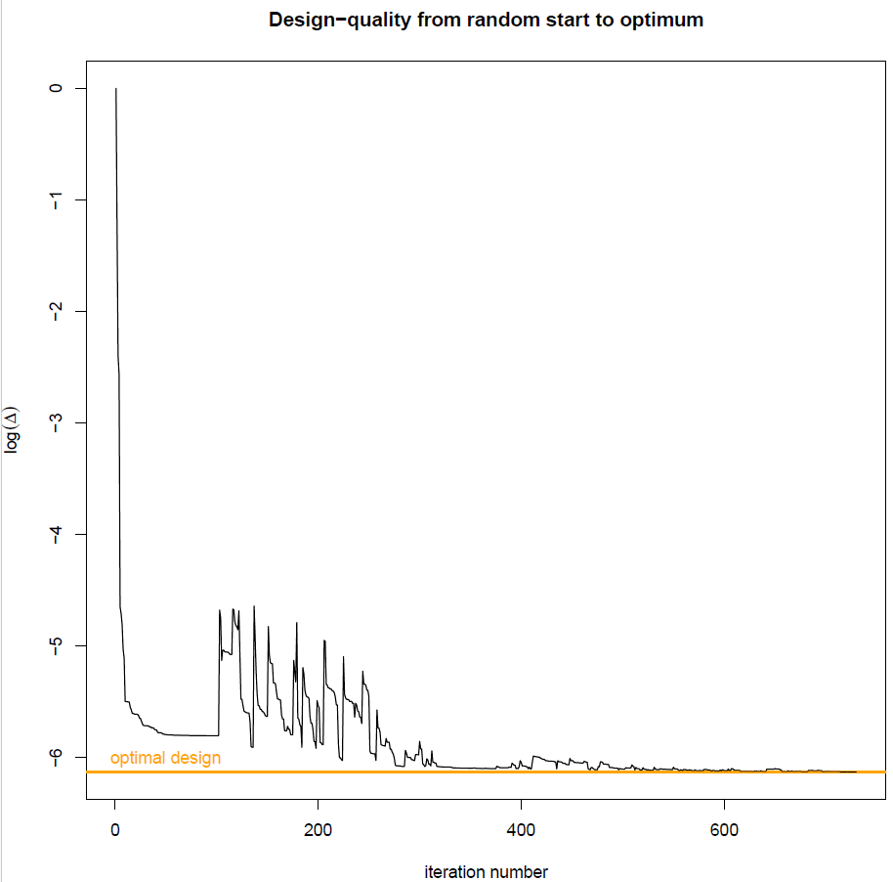
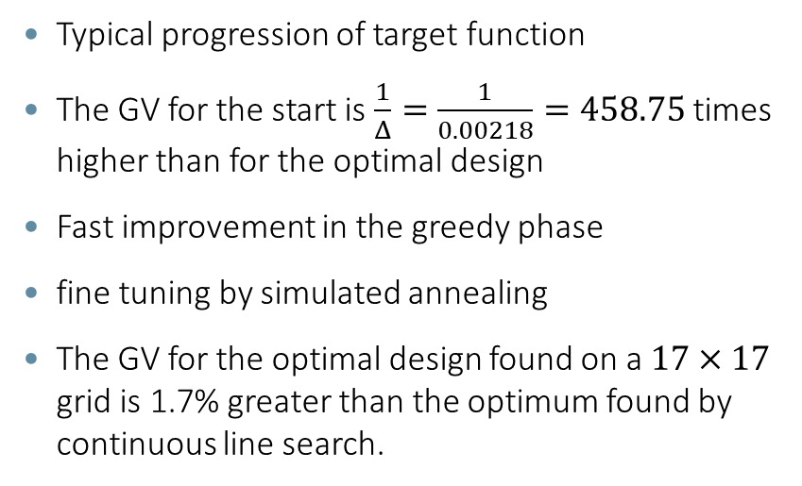
2D Example – Progression of Target Function
    Typical progression of target function
    The GV for the start is $\frac{1}{Δ}=\frac{1}{0.00218}=458.75$ times higher than for the optimal design
    Fast improvement in the greedy phase
    fine tuning by simulated annealing
    The GV for the optimal design found on a $17×17$ grid is 1.7% greater than the optimum found by continuous line search.

Slide 15
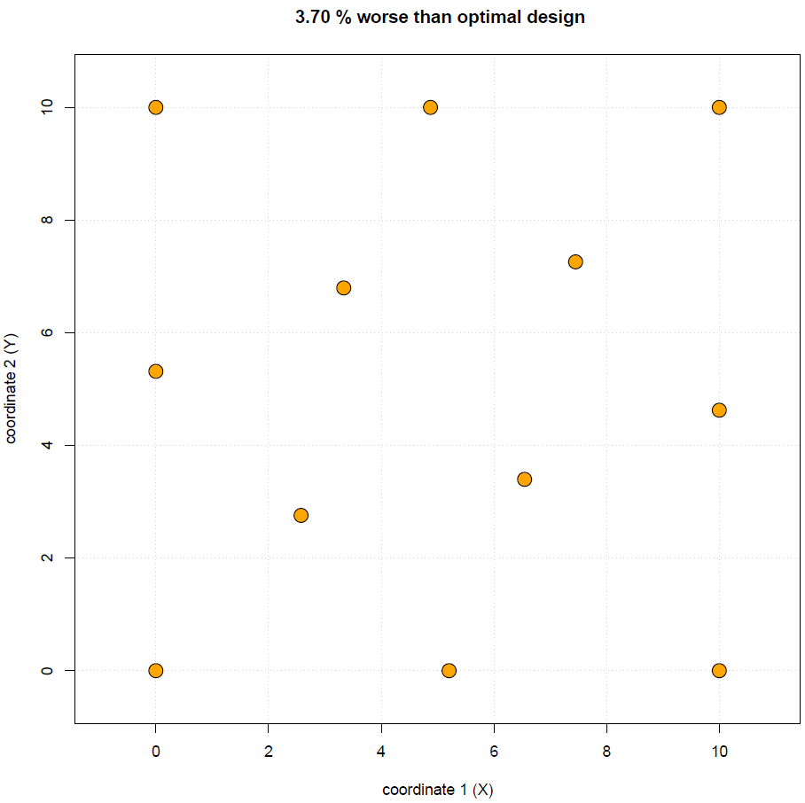
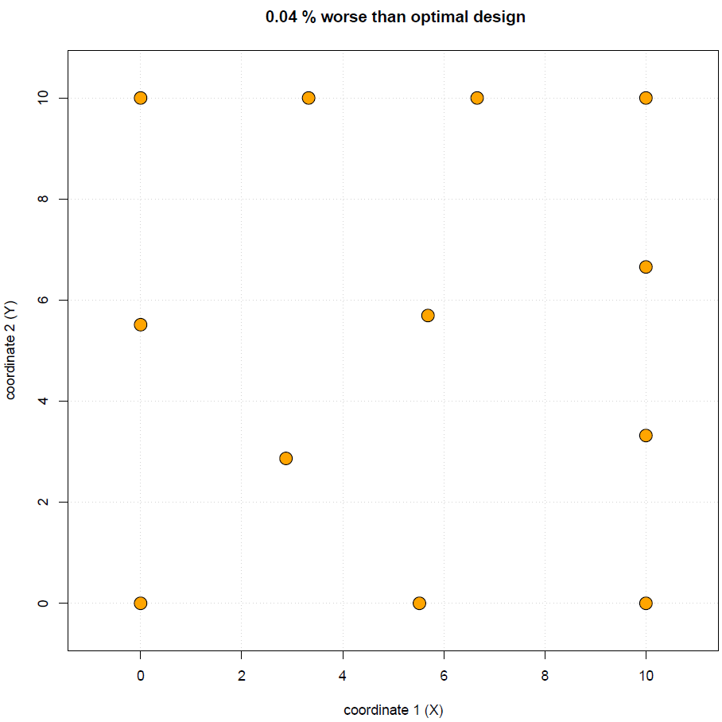
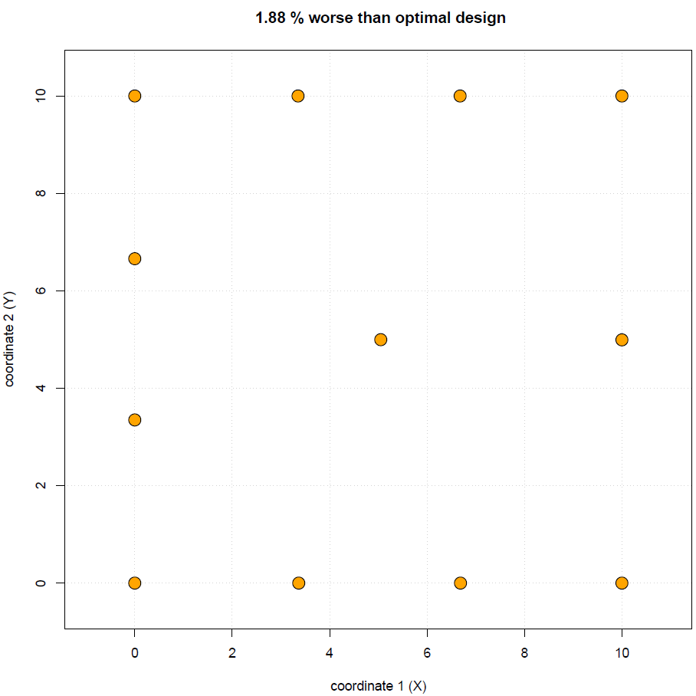
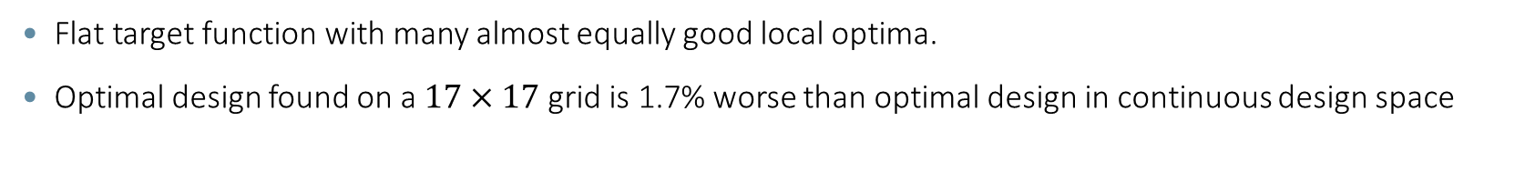
2D Example – Local Optima
3.7% worse
0.04% worse
1.88% worse
    Flat target function with many almost equally good local optima.
    Optimal design found on a $17×17$ grid is 1.7% worse than optimal design in continuous design space
Notes:
The target function is very flat for this setup with multiple local optima.

Slide 16
Computational Performance –
Why This Outperforms Discrete Exchange
Implemented entirely in R.
Discrete algorithms (with Simulated Annealing) on fine grids frequently stall or take hours.
Our continuous line-search framework achieves convergence in a fraction of this time (some minutes).
Convergence rate to global optimum: almost 100% on tested continuous fields.
No grid artifacts or rounding errors on boundaries
Evaluates far fewer function calls due to precise Newton-step directions.
more accurate because points land on the exact mathematical coordinates required.
Notes:
Present the runtime breakthrough. We are talking about shifting the time scale from hours of discrete swapping down to minutes of continuous optimization. Summarize the practical superiority. We aren't just faster; we are more accurate because our points can land on the exact mathematical coordinates required.

Slide 17
Conclusion & Core Takeaways
Theorem 2 allows GV-optimality to break free from discrete grids into continuous spaces.
The analytical gradient can be kept on the matrix level, avoiding tensor explosion.
The Schur-Chaining trick enables exact design comparison without infinite matrix calculations.
Massive acceleration in R, making continuous optimal designs highly practical for spatial big data.
Notes:
Conclude your talk by highlighting the three pillars: Continuous space transition, Tensor-free gradient, and the Schur comparison trick. Thank the audience and open the floor for questions.

Slide 18
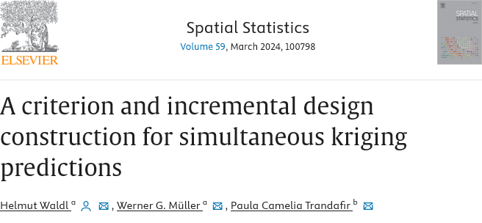
References
    Full article on the original GV criterion available on: https://doi.org/10.1016/j.spasta.2023.100798
    Kiefer J. (1959). Optimum Experimental Designs. Journal of the Royal Statistical Society. Series B, 21, 272–319.
    Nocedal, J., & Wright, S. J. (2006). Numerical Optimization (2nd ed.), Springer Science & Business Media.
    Pollock, D.S.G. (1985). Tensor products and matrix differential calculus, Linear Algebra and its Applications 67, 169–193.
    Wald, A. (1943). On the efficient design of statistical investigations. Ann. Math. Statist., 14, 134–140.
    Wilks, S.S. (1932). Certain generalizations in the analysis of variance. Biometrika, 24, 471–494.

