Slide 1



Spring Meeting 2027
Linz, Austria
31.03. – 01.04.
Department of Applied Statistics, Johannes Kepler University Linz, Austria
Notes:
1

Slide 2

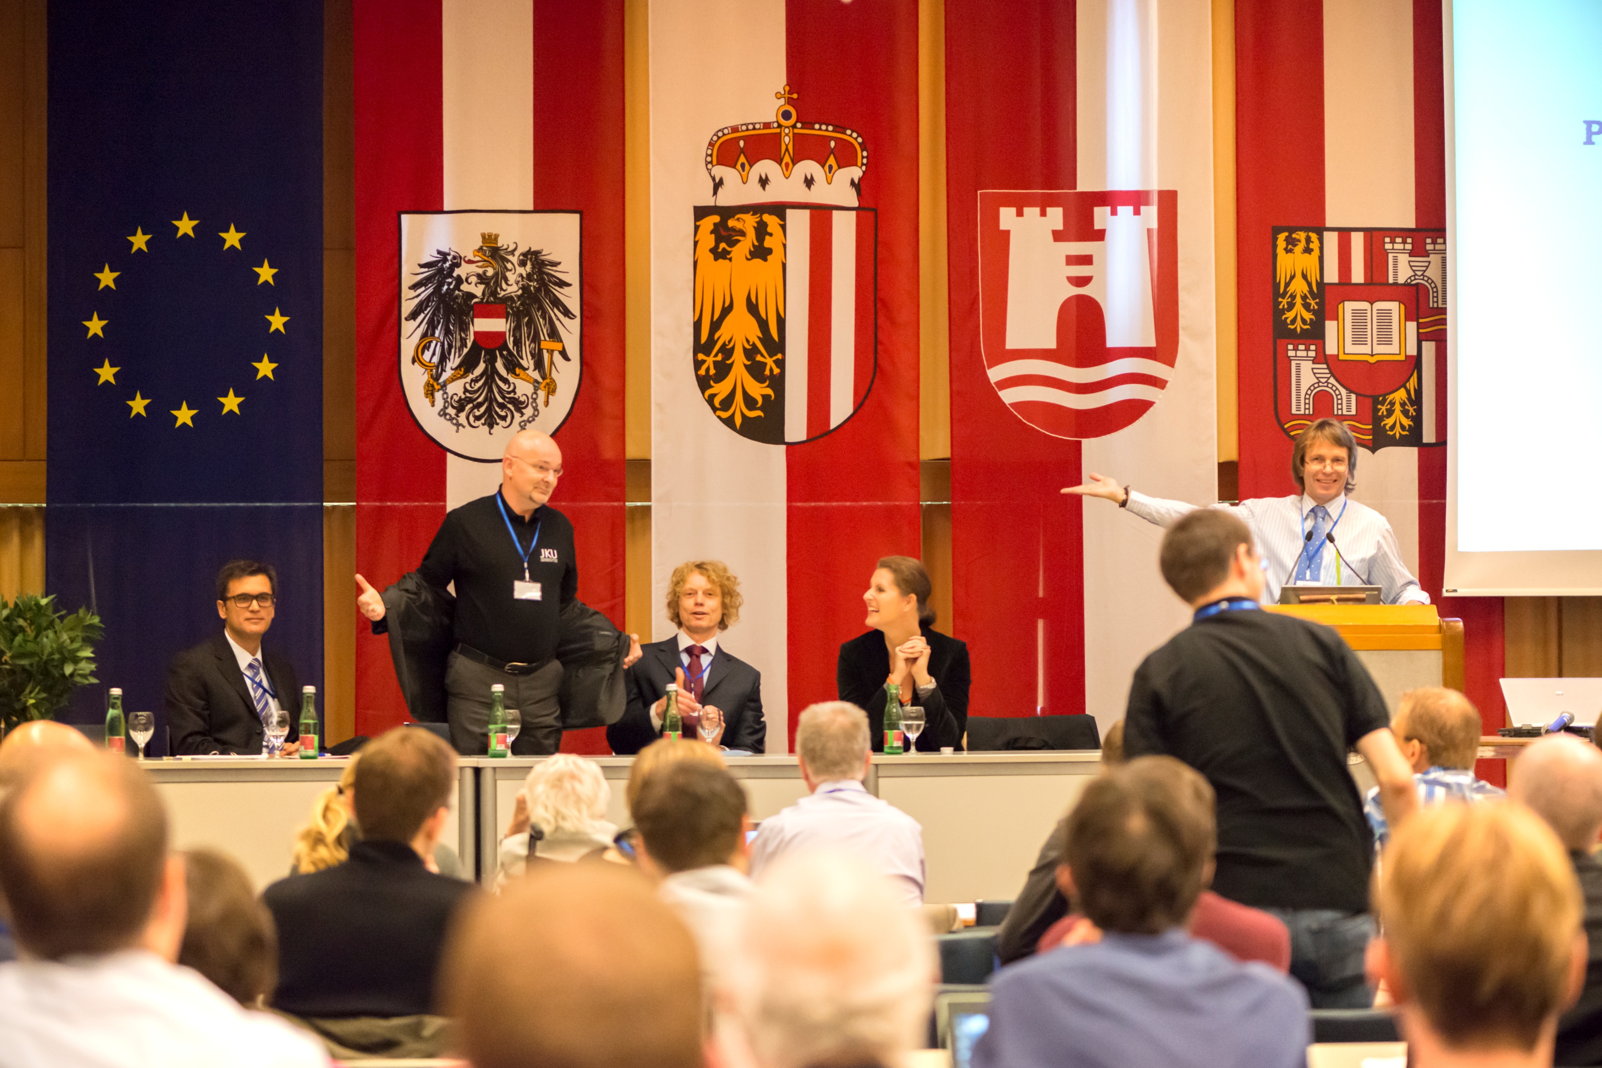
Retrospect: ENBIS-14 in Linz
Until then the most successful annual meeting
161 participants
53 sessions
141 talks

Slide 3

The Venue: Johannes Kepler University
    4 faculties
    100 study programs
    27000 students
    4000 employees
    Central Europe's first university with a Statistics program.
    A modern university with a large suburban campus, presently marking its 60th anniversary.
Notes:
3

Slide 4
Key Focus: Statistics and Explainable AI
Topics of interest:
Interpretable machine learning and statistical models
Local and global model explanation techniques (LIME, SHAP, etc.)
Causal inference and counterfactual explanations
Bayesian methods for interpretable AI models
Uncertainty quantification and sensitivity analysis in XAI
Design of experiments for AI model validation and explainability
Statistical reliability and robustness of explanation methods
Trustworthy AI and fairness of predictive models
Explainable AI in medicine and healthcare
Evaluation and validation of XAI systems
XAI for time series forecasting and process monitoring
Ethical, legal, and social implications of XAI
Trust and transparency in AI-driven decision-making
Notes:
Topics of interest include, but are not limited to
4

Slide 5


We look forward to welcoming you to the event.
Werner G. Müller
IFAS
Chair of the scientific
program committee
Werner.Mueller@jku.at
Helmut Waldl
IFAS
Chair of the organizing committee
helmut.waldl@jku.at
CU in Linz!
Spring Meeting, 31.03. – 01.04.2027
Notes:
5

