Slide 1
Powerful Foldover Designs
Jon Stallrich
NCSU Statistics

Slide 2
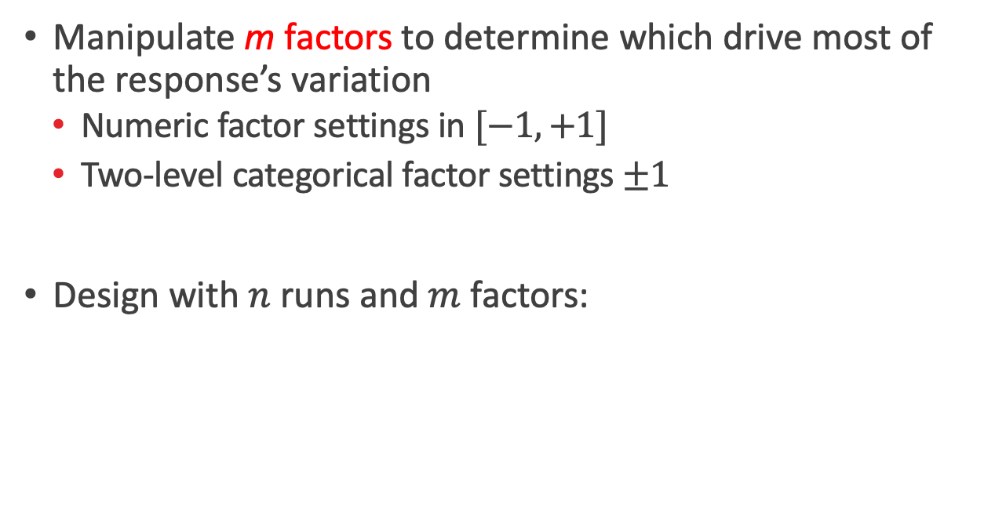
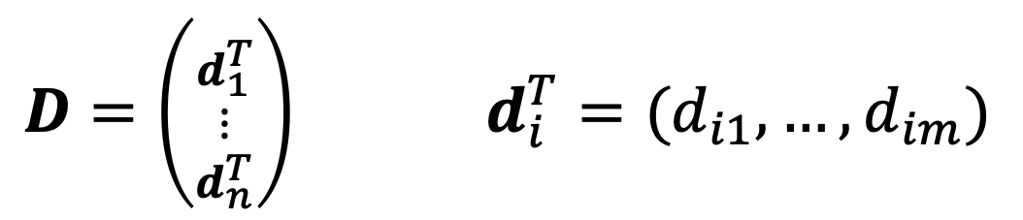
Screening Experiments
Manipulate m factors to determine which drive most of the response’s variation
  Numeric factor settings in $[−1,+1]$
  Two-level categorical factor settings $±1$
Design with $n$ runs and $m$ factors:
$D=\left({d_{1}^{T} \atop \begin{matrix}⋮ \\ d_{n}^{T}\end{matrix}}\right)$ $d_{i}^{T}=(d_{i1},…,d_{im})$

Slide 3
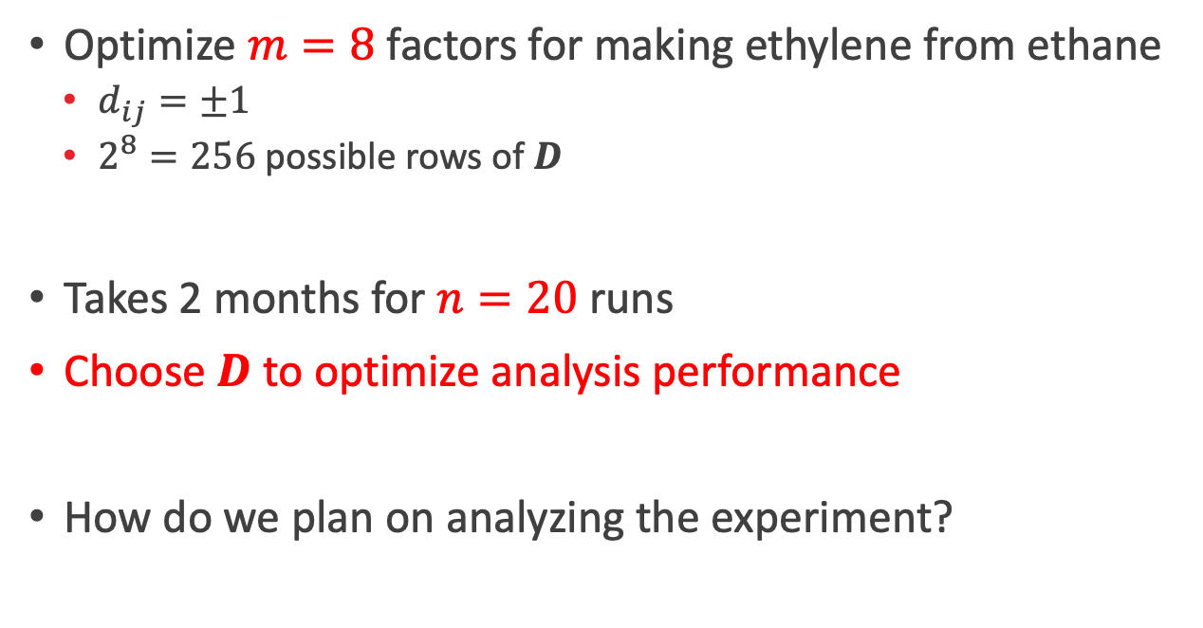
Ethylene Experiment
Optimize $m=8$ factors for making ethylene from ethane
  $d_{ij}=±1$
  $2^{8}=256$ possible rows of $D$
Takes 2 months for $n=20$ runs
Choose $D$ to optimize analysis performance
How do we plan on analyzing the experiment?

Slide 4
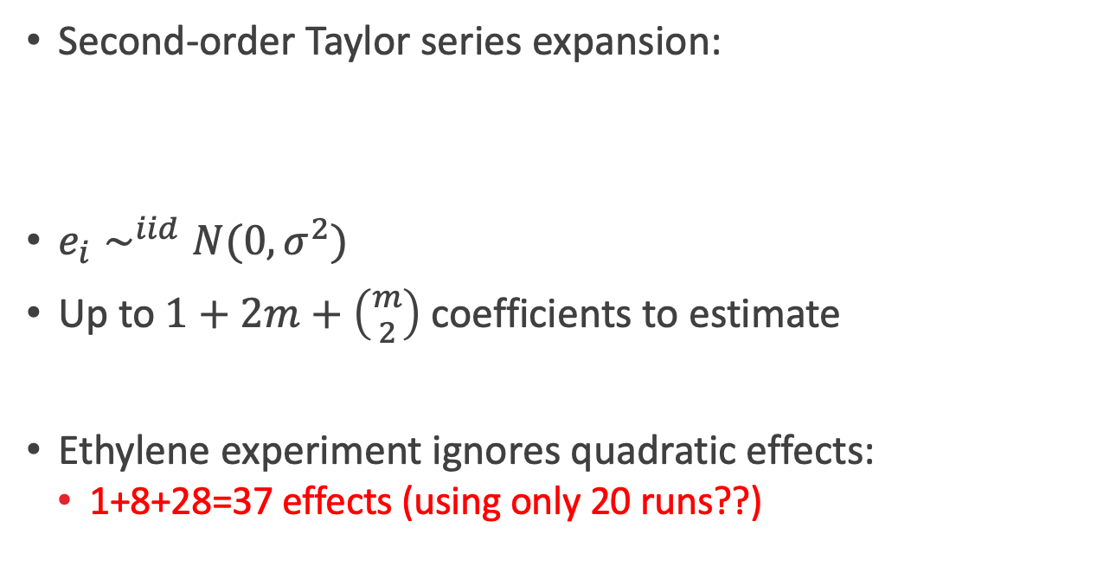
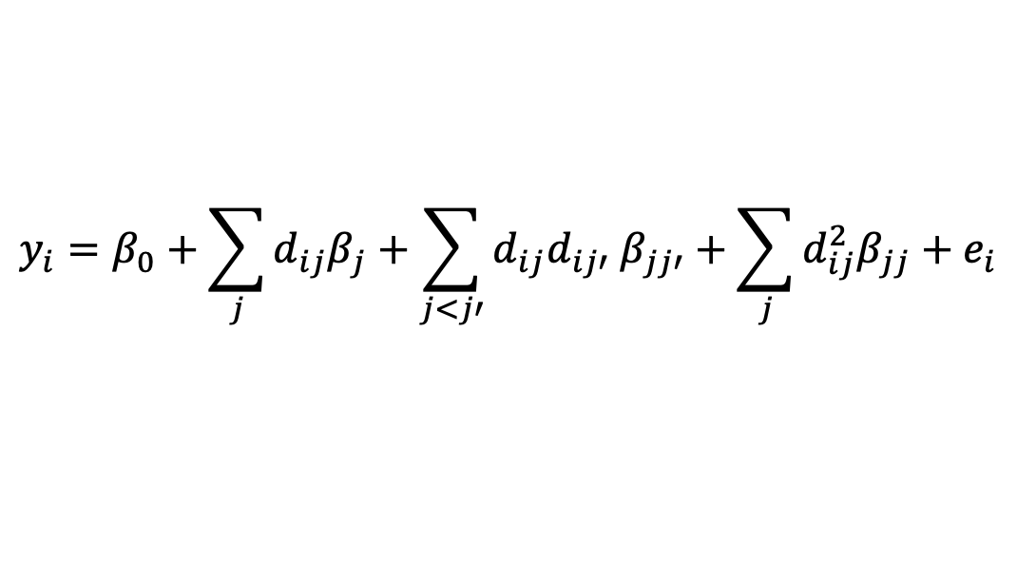
Response Surface Model
Second-order Taylor series expansion:
$e_{i}∼^{iid}N(0,σ^{2})$
Up to $1+2m+\left({m \atop 2}\right)$ coefficients to estimate
Ethylene experiment ignores quadratic effects:
  1+8+28=37 effects (using only 20 runs??)
$$y_{i}=β_{0}+\sum_{j}{d_{ij}β_{j}+\sum_{j<j′}{d_{ij}d_{ij′} β_{jj′}}}+\sum_{j}{d_{ij}^{2}β_{jj}}+e_{i}$$

Slide 5

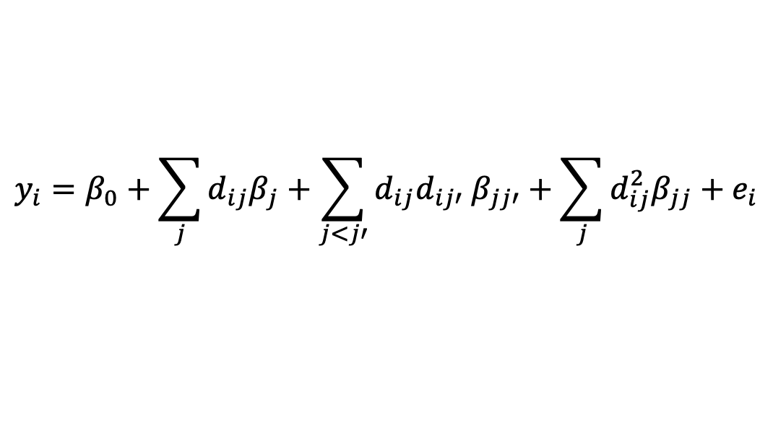
Response Surface Model: Effect Principles
Partition model
Hierarchy: $β_{j}$’s larger than the $β_{jj′} , β_{jj}$
Sparsity: Few effects active, not all factors are important
Heredity: Active $β_{2}$ involve at least one active factor
$$y_{i}=β_{0}+\sum_{j}{d_{ij}β_{j}+\sum_{j<j′}{d_{ij}d_{ij′} β_{jj′}}}+\sum_{j}{d_{ij}^{2}β_{jj}}+e_{i}$$
$$y={ X}_{1}β_{1} +{ X}_{2}β_{2} +e$$

Slide 6
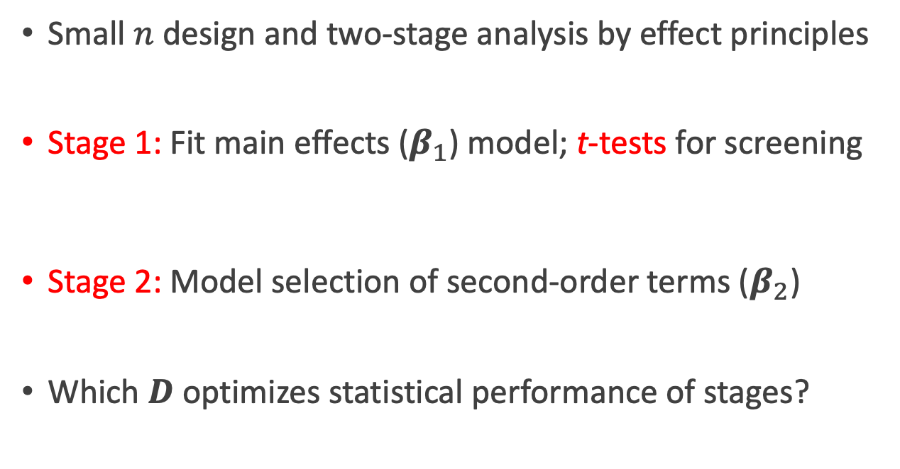
Two-Stage Screening and Inference
Small $n$ design and two-stage analysis by effect principles
Stage 1: Fit main effects ($β_{1}$) model; t-tests for screening
Stage 2: Model selection of second-order terms ($β_{2}$)
Which $D$ optimizes statistical performance of stages?
${\hat{β}}_{1}={\left(X_{1}^{T}X_{1}\right)}^{−1}X_{1}^{T}y$ $Var\left({\hat{β}}_{1}\right)=σ^{2}{\left(X_{1}^{T}X_{1}\right)}^{−1}$

Slide 7
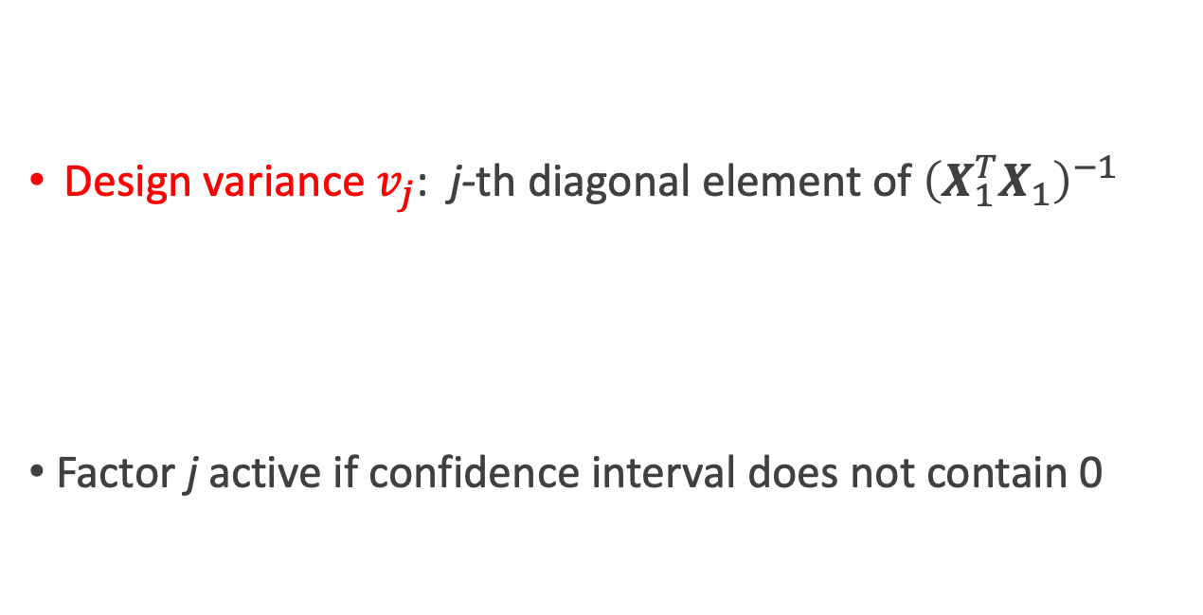
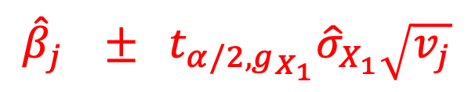


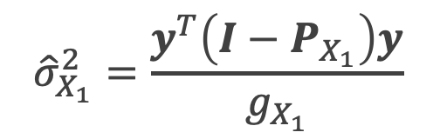
Stage 1 Inference via Confidence Intervals
$${\hat{β}}_{j} ± t_{α/2,g_{X_{1}}}{\hat{σ}}_{X_{1}}\sqrt{v_{j}}$$
Design variance $v_{j}$: j-th diagonal element of ${\left(X_{1}^{T}X_{1}\right)}^{−1}$
Factor j active if confidence interval does not contain 0
$${\hat{σ}}_{X_{1}}^{2}=\frac{y^{T}\left(I−P_{X_{1}}\right)y}{g_{X_{1}}}$$
$$P_{X_{1}}=X_{1}{\left(X_{1}^{T}X_{1}\right)}^{−1}X_{1}^{T}$$
$$g_{X_{1}}=n−r(X_{1})$$

Slide 8
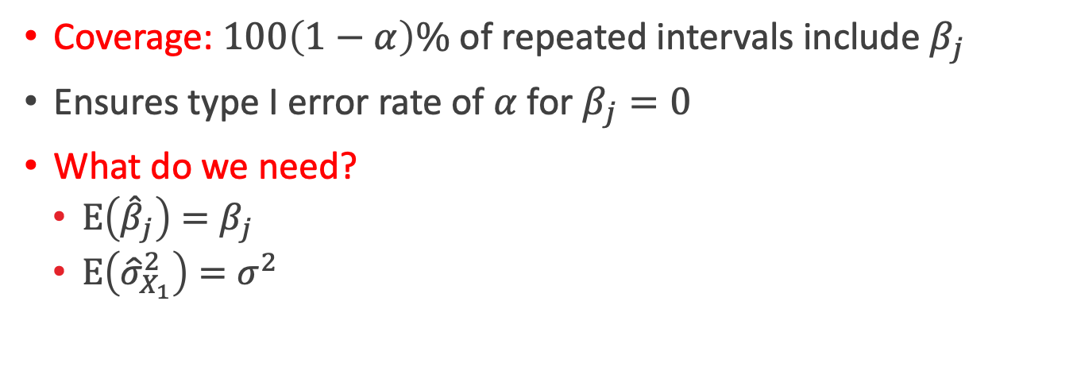
Desirable Properties of Confidence Interval
$${\hat{β}}_{j} ± t_{α/2,g_{X_{1}}}{\hat{σ}}_{X_{1}}\sqrt{v_{j}}$$
Coverage: $100\left(1−α\right)\%$ of repeated intervals include $β_{j}$
Ensures type I error rate of $α$for $β_{j}=0$
What do we need?
  $E\left({\hat{β}}_{j}\right)=β_{j}$
  $E\left({\hat{σ}}_{X_{1}}^{2}\right)=σ^{2}$

Slide 9
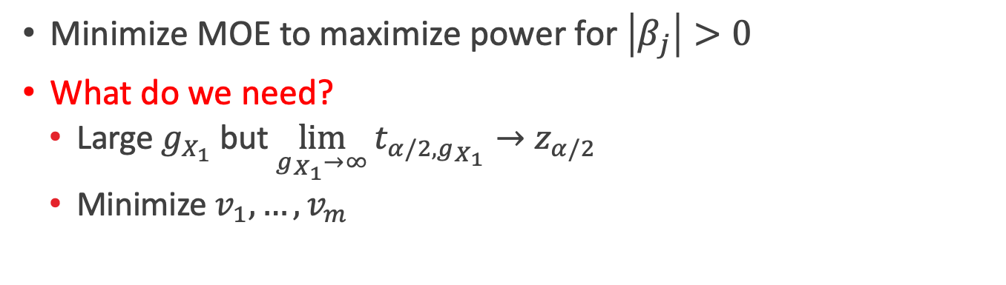
Desirable Properties of Confidence Interval
$${\hat{β}}_{j} ± t_{α/2,g_{X_{1}}}{\hat{σ}}_{X_{1}}\sqrt{v_{j}}$$
Margin of Error (MOE)
Minimize MOE to maximize power for $\left|β_{j}\right|>0$
What do we need?
  Large $g_{X_{1}}$ but $\lim_{g_{X_{1}}→∞}{t_{α/2,g_{X_{1}}}}→z_{α/2}$
  Minimize $v_{1},…,v_{m}$

Slide 10

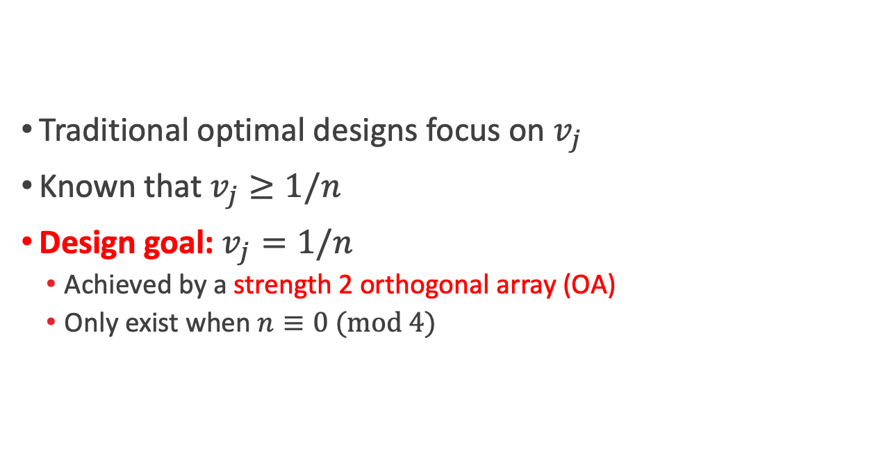
Stage 1: Minimizing $v_{1},…,v_{m}$
$${\hat{β}}_{j} ± t_{α/2,g_{X_{1}}}{\hat{σ}}_{X_{1}}\sqrt{v_{j}}$$
Traditional optimal designs focus on $v_{j}$
Known that $v_{j}≥1/n$
Design goal: $v_{j}=1/n$
  Achieved by a strength 2 orthogonal array (OA)
  Only exist when $n≡0 (mod 4)$

Slide 11

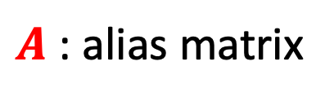

Stage 1: $E\left({\hat{β}}_{j}\right)=β_{j}$
$${\hat{β}}_{j} ± t_{α/2,g_{X_{1}}}{\hat{σ}}_{X_{1}}\sqrt{v_{j}}$$
$E\left({\hat{β}}_{1}\right)=β_{1}+{\left(X_{1}^{T}X_{1}\right)}^{−1}X_{1}^{T}X_{2}β_{2}$
Design goal: $A=0$
$A$ : alias matrix

Slide 12

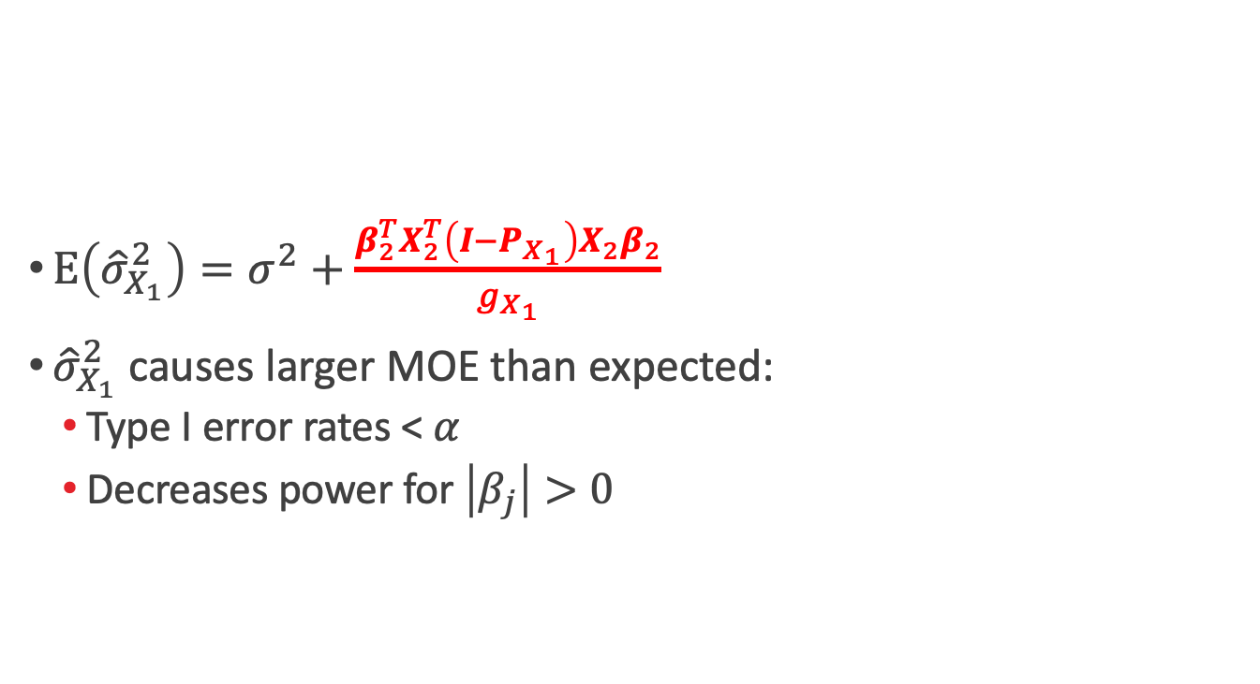
Stage 1: $E\left({\hat{σ}}_{X_{1}}^{2}\right)=σ^{2}$ and Large $g_{X_{1}}$
$${\hat{β}}_{j} ± t_{α/2,g_{X_{1}}}{\hat{σ}}_{X_{1}}\sqrt{v_{j}}$$
$E\left({\hat{σ}}_{X_{1}}^{2}\right)=σ^{2}+\frac{β_{2}^{T}X_{2}^{T}\left(I−P_{X_{1}}\right)X_{2}β_{2}}{g_{X_{1}}}$
${\hat{σ}}_{X_{1}}^{2}$ causes larger MOE than expected:
  Type I error rates < $α$
  Decreases power for $\left|β_{j}\right|>0$

Slide 13

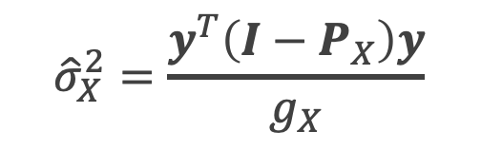
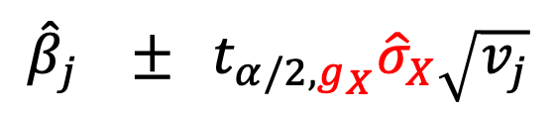

Pre-selection Variance Estimator, ${\hat{σ}}_{X}^{2}$
Design goal: For $X=(X_{1}|X_{2})$, want $g_{X}=n−r\left(X\right)>0$
${E(\hat{σ}}_{X}^{2})=σ^{2}$
Type I error rate = $α$
Maximizing $g_{X}$ increases power
$${\hat{σ}}_{X}^{2}=\frac{y^{T}\left(I−P_{X}\right)y}{g_{X}}$$
$${\hat{β}}_{j} ± t_{α/2,g_{X}}{\hat{σ}}_{X}\sqrt{v_{j}}$$

Slide 14
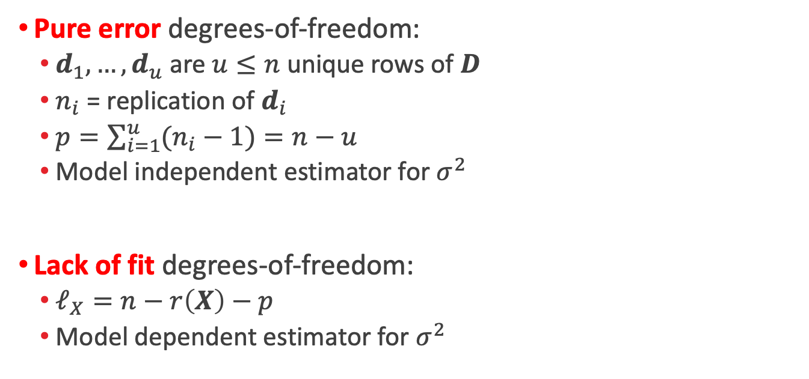

Decomposing $g_{X}=p+ℓ_{X}$
Pure error degrees-of-freedom:
  $d_{1},…,d_{u}$are $u≤n$unique rows of $D$
  $n_{i}$ = replication of $d_{i}$
  $p=\sum_{i=1}^{u}{(n_{i}−1)}=n−u$
  Model independent estimator for $σ^{2}$
Lack of fit degrees-of-freedom:
  $ℓ_{X}=n−r\left(X\right)−p$
  Model dependent estimator for $σ^{2}$

Slide 15
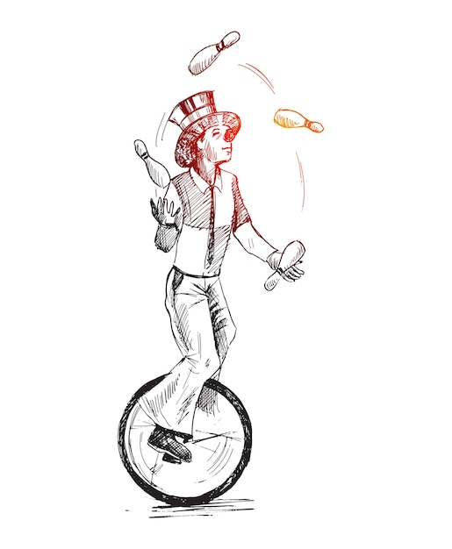

Multi-objective Optimization
$v_{j}→1/n$
$A→0$
Large $g_{X}$
Variance-first approach: identify strength 2 OAs and then find the one that
minimizes aliasing
Reverse the approach!

Slide 16

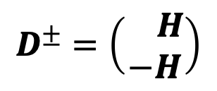
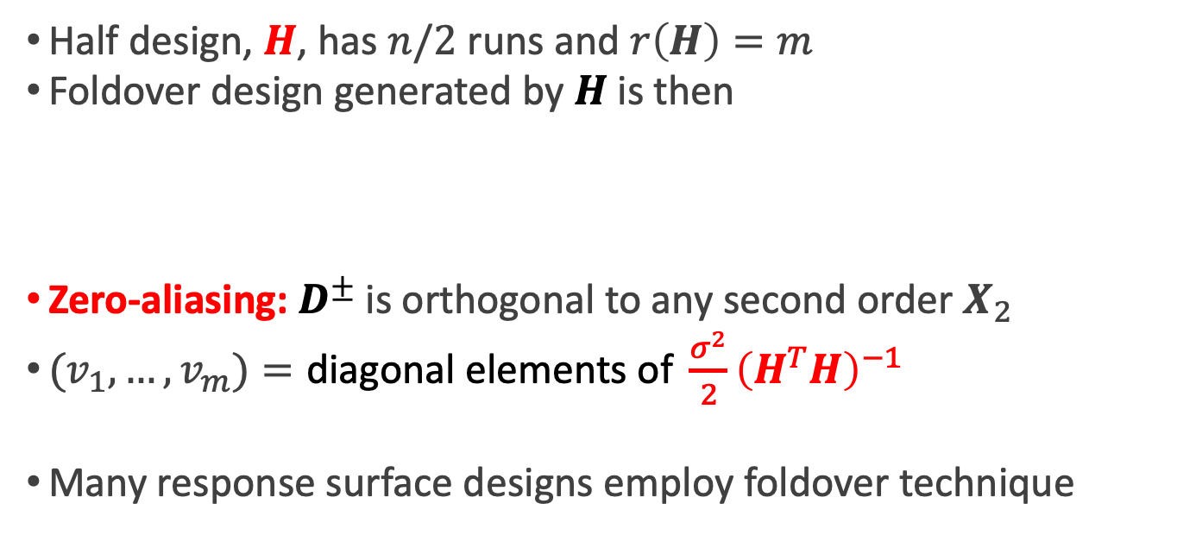
Foldover Designs Guarantee $A=0$
Half design, $H$, has $n/2$ runs and $r\left(H\right)=m$
Foldover design generated by $H$ is then
Zero-aliasing: $D^{±}$ is orthogonal to any second order $X_{2}$
$(v_{1},…,v_{m})=\text{diagonal elements of} \frac{σ^{2}}{2}{\left(H^{T}H\right)}^{−1}$
Many response surface designs employ foldover technique
$$D^{±}=\left(\begin{matrix} H \\ −H\end{matrix}\right)$$

Slide 17


Foldover Designs Can Have $g_{X}>0$
Partition rows of $H$ into $G+1$ groups:
  $n_{0}≥0$ center runs ($h_{0}=0)$
  $n_{1}>0$ rows of $h_{1}≠0$ or mirror ($−h_{1})$
  $⋮$
  $n_{G}>0$ rows of $h_{G}≠0$ or mirror ($−h_{G})$
Partition $D^{±}$ into $G+1$ groups:
  ${2n}_{0}≥0$ center runs ($h_{0}=0)$
  $n_{1}$ rows of $h_{1}≠0$ and $n_{1}$ rows of $−h_{1}$
  $⋮$
  $n_{G}$ rows of $h_{G}≠0$ and $n_{G}$ rows of $−h_{G}$

Slide 18

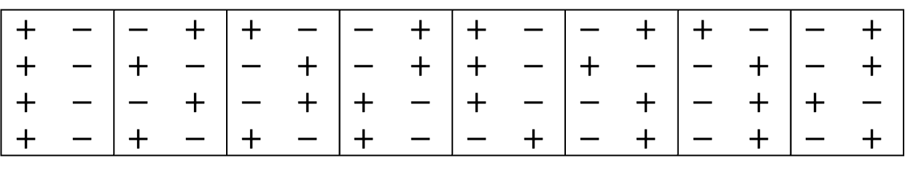

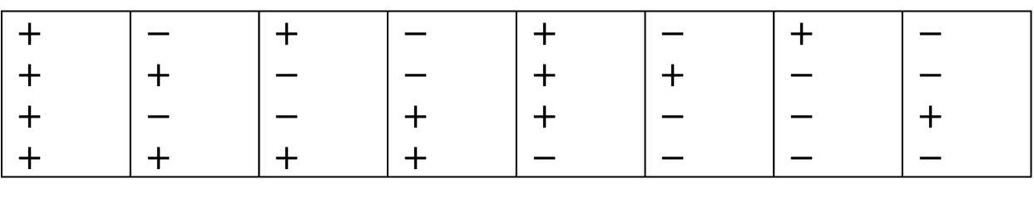
Foldover Designs Can Have $g_{X}>0$
$$+$$ |  | $$−$$ |  | $$+$$ |  | $$−$$ |  | $$+$$ |  | $$−$$ |  | $$+$$ |  | $$−$$
$$+$$ |  | $$+$$ |  | $$−$$ |  | $$−$$ |  | $$+$$ |  | $$+$$ |  | $$−$$ |  | $$−$$
$$+$$ |  | $$−$$ |  | $$−$$ |  | $$+$$ |  | $$+$$ |  | $$−$$ |  | $$−$$ |  | $$+$$
$$+$$ |  | $$+$$ |  | $$+$$ |  | $$+$$ |  | $$−$$ |  | $$−$$ |  | $$−$$ |  | $$−$$
$$H_{1}=$$
$$+$$ | $$−$$ | $$−$$ | $$+$$ | $$+$$ | $$−$$ | $$−$$ | $$+$$ | $$+$$ | $$−$$ | $$−$$ | $$+$$ | $$+$$ | $$−$$ | $$−$$ | $$+$$
$$+$$ | $$−$$ | $$+$$ | $$−$$ | $$−$$ | $$+$$ | $$−$$ | $$+$$ | $$+$$ | $$−$$ | $$+$$ | $$−$$ | $$−$$ | $$+$$ | $$−$$ | $$+$$
$$+$$ | $$−$$ | $$−$$ | $$+$$ | $$−$$ | $$+$$ | $$+$$ | $$−$$ | $$+$$ | $$−$$ | $$−$$ | $$+$$ | $$−$$ | $$+$$ | $$+$$ | $$−$$
$$+$$ | $$−$$ | $$+$$ | $$−$$ | $$+$$ | $$−$$ | $$+$$ | $$−$$ | $$−$$ | $$+$$ | $$−$$ | $$+$$ | $$−$$ | $$+$$ | $$−$$ | $$+$$
$$D_{1}^{±}=$$
0 pure error df

Slide 19
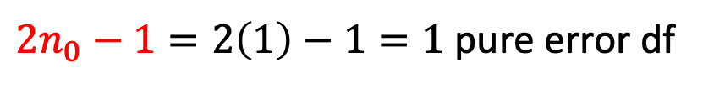

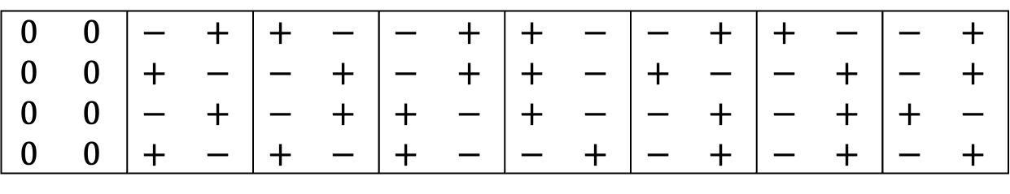

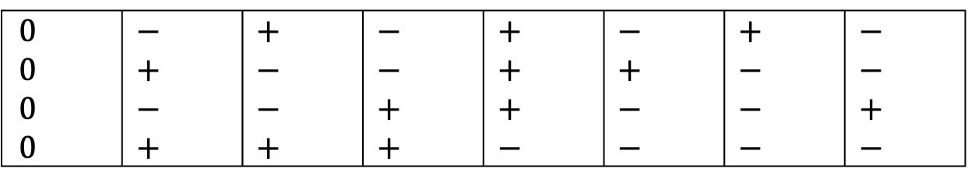
Foldover Designs Can Have $g_{X}>0$
$$0$$ |  | $$−$$ |  | $$+$$ |  | $$−$$ |  | $$+$$ |  | $$−$$ |  | $$+$$ |  | $$−$$
$$0$$ |  | $$+$$ |  | $$−$$ |  | $$−$$ |  | $$+$$ |  | $$+$$ |  | $$−$$ |  | $$−$$
$$0$$ |  | $$−$$ |  | $$−$$ |  | $$+$$ |  | $$+$$ |  | $$−$$ |  | $$−$$ |  | $$+$$
$$0$$ |  | $$+$$ |  | $$+$$ |  | $$+$$ |  | $$−$$ |  | $$−$$ |  | $$−$$ |  | $$−$$
$$H_{2}=$$
$$0$$ | $$0$$ | $$−$$ | $$+$$ | $$+$$ | $$−$$ | $$−$$ | $$+$$ | $$+$$ | $$−$$ | $$−$$ | $$+$$ | $$+$$ | $$−$$ | $$−$$ | $$+$$
$$0$$ | $$0$$ | $$+$$ | $$−$$ | $$−$$ | $$+$$ | $$−$$ | $$+$$ | $$+$$ | $$−$$ | $$+$$ | $$−$$ | $$−$$ | $$+$$ | $$−$$ | $$+$$
$$0$$ | $$0$$ | $$−$$ | $$+$$ | $$−$$ | $$+$$ | $$+$$ | $$−$$ | $$+$$ | $$−$$ | $$−$$ | $$+$$ | $$−$$ | $$+$$ | $$+$$ | $$−$$
$$0$$ | $$0$$ | $$+$$ | $$−$$ | $$+$$ | $$−$$ | $$+$$ | $$−$$ | $$−$$ | $$+$$ | $$−$$ | $$+$$ | $$−$$ | $$+$$ | $$−$$ | $$+$$
$$D_{2}^{±}=$$
$2n_{0}−1=2\left(1\right)−1=1$ pure error df

Slide 20
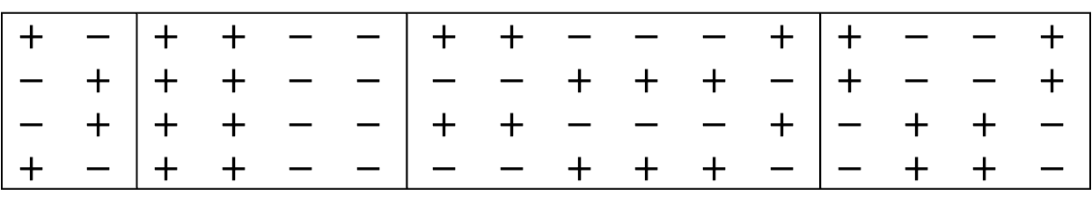


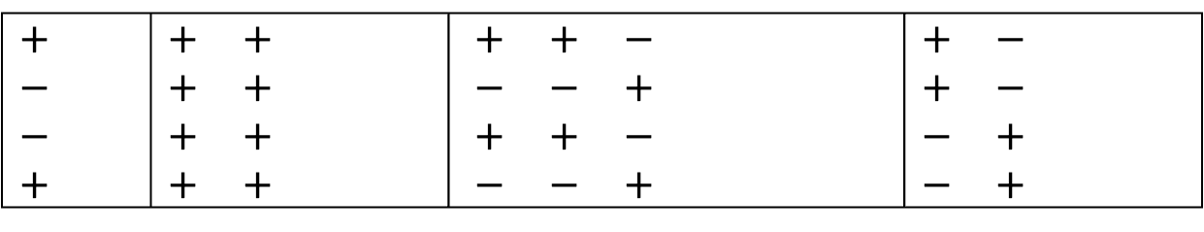
Foldover Designs Can Have $g_{X}>0$
$$+$$ |  | $$+$$ | $$+$$ |  |  |  | $$+$$ | $$+$$ | $$−$$ |  |  |  | $$+$$ | $$−$$
$$−$$ |  | $$+$$ | $$+$$ |  |  |  | $$−$$ | $$−$$ | $$+$$ |  |  |  | $$+$$ | $$−$$
$$−$$ |  | $$+$$ | $$+$$ |  |  |  | $$+$$ | $$+$$ | $$−$$ |  |  |  | $$−$$ | $$+$$
$$+$$ |  | $$+$$ | $$+$$ |  |  |  | $$−$$ | $$−$$ | $$+$$ |  |  |  | $$−$$ | $$+$$
$$H_{3}=$$
$$+$$ | $$−$$ | $$+$$ | $$+$$ | $$−$$ | $$−$$ |  | $$+$$ | $$+$$ | $$−$$ | $$−$$ | $$−$$ | $$+$$ | $$+$$ | $$−$$ | $$−$$ | $$+$$
$$−$$ | $$+$$ | $$+$$ | $$+$$ | $$−$$ | $$−$$ |  | $$−$$ | $$−$$ | $$+$$ | $$+$$ | $$+$$ | $$−$$ | $$+$$ | $$−$$ | $$−$$ | $$+$$
$$−$$ | $$+$$ | $$+$$ | $$+$$ | $$−$$ | $$−$$ |  | $$+$$ | $$+$$ | $$−$$ | $$−$$ | $$−$$ | $$+$$ | $$−$$ | $$+$$ | $$+$$ | $$−$$
$$+$$ | $$−$$ | $$+$$ | $$+$$ | $$−$$ | $$−$$ |  | $$−$$ | $$−$$ | $$+$$ | $$+$$ | $$+$$ | $$−$$ | $$−$$ | $$+$$ | $$+$$ | $$−$$
$$D_{3}^{±}=$$
$2\left(n_{2}−1\right)+2\left(n_{3}−1\right)+2\left(n_{4}−1\right)=8$ pure error df

Slide 21

The Foldover Theorem
For $H$ with $m+v$ runs forming $G+1$ groups, $D^{±}$ has
  $A=0$
  $g_{X}=p+ℓ_{X}≥v$
  $p =\max\left(0,2n_{0}−1\right)+2$ $\sum_{i=1}^{G}{(n_{i}−1)}$
  $ℓ_{X}≥v−n_{0}−\sum_{i=1}^{G}{(n_{i}−1)}$
Jones and Nachtsheim (2017): $H=$ conference matrix of order $m+2$to generate $ℓ_{X}=2, p=0$
What’s the best foldover design for stage 1 inference?

Slide 22

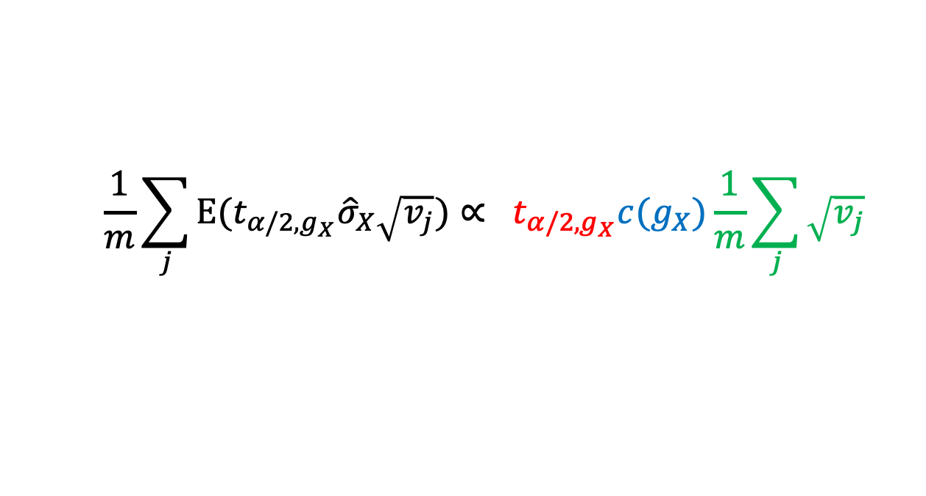
Average Expected Margin of Error & Power
Minimize Avg $E\left(MOE\right)$ across foldover designs
Interpretation: minimum $β_{j}/σ$ to achieve power $≥1−α$
Avg $E\left(MOE\right)=1$ with $α=0.05$: successfully detect factors with $β_{j}/σ≥1$ with at least 95% probability
$$\frac{1}{m}\sum_{j}{E{(t}_{α/2,g_{X}}{\hat{σ}}_{X}\sqrt{v_{j}}\text{)}}∝ t_{α/2,g_{X}}c(g_{X})\frac{1}{m}\sum_{j}{\sqrt{v_{j}}}$$

Slide 23

Construction Algorithm
Find optimal $H$ for Avg $E\left(MOE\right)$:
  $α$ level (usually 0.05)
  Minimum number of $n_{0}$ runs
  Minimum $\sum_{i=1}^{G}{(n_{i}−1)}$
More replicates possible if it improves Avg $E\left(MOE\right)$
Allows mix of two-level categorical and numeric factors
Require one 0 level into $H$ for each numeric factor to ensure estimation of quadratic effects

Slide 24
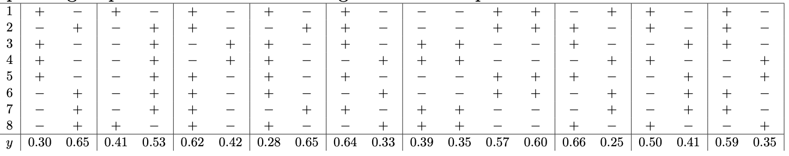
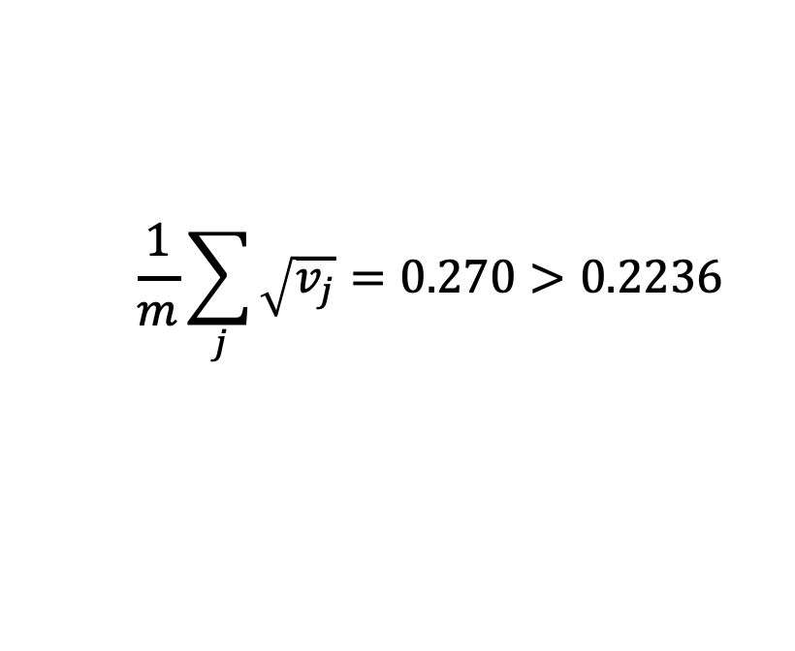

Ethylene Experiment
$$\frac{1}{m}\sum_{j}{\sqrt{v_{j}}}=0.270>0.2236$$
$$g_{X}=3 p=2 ℓ_{X}=1$$
Avg E(MOE) = 0.791

Slide 25

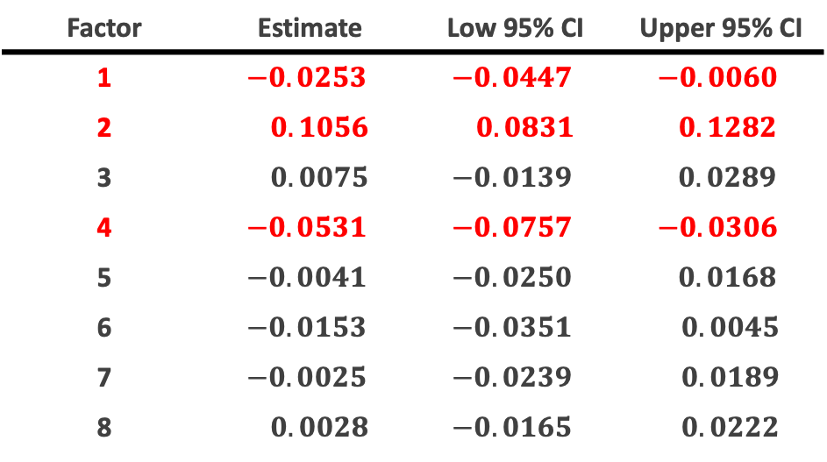
Ethylene Experiment: Stage 1 Analysis
Response: % Ethylene Yield ${\hat{σ}}_{X}=0.0244$
Factor | Estimate | Low 95% CI | Upper 95% CI
1 | $$−0.0253$$ | $$−0.0447$$ | $$−0.0060$$
2 | $$0.1056$$ | $$0.0831$$ | $0.1282$
3 | $$0.0075$$ | $$−0.0139$$ | $$0.0289$$
4 | $$−0.0531$$ | $$−0.0757$$ | $$−0.0306$$
5 | $$−0.0041$$ | $$−0.0250$$ | $$0.0168$$
6 | $$−0.0153$$ | $$−0.0351$$ | $$0.0045$$
7 | $$−0.0025$$ | $$−0.0239$$ | $$0.0189$$
8 | $$0.0028$$ | $$−0.0165$$ | $$0.0222$$

Slide 26
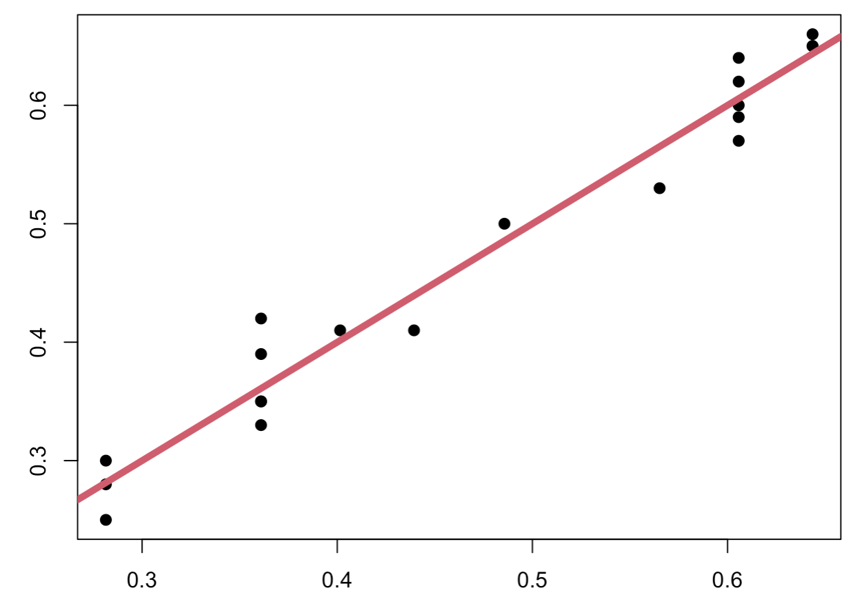




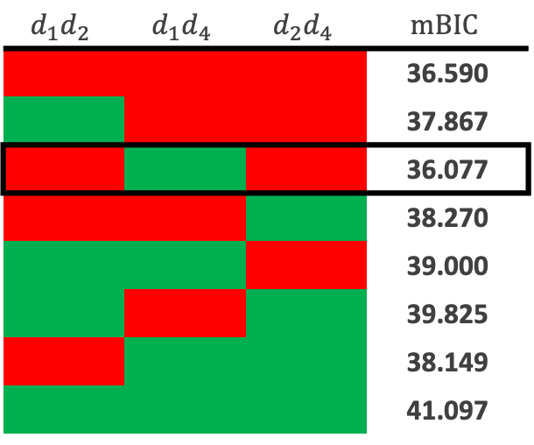
Ethylene Experiment: Stage 2 Analysis
Heredity: All-subsets including $d_{1}d_{2}$, $d_{1}d_{4}$, $d_{2}d_{4}$
$$d_{1}d_{2}$$ | $$d_{1}d_{4}$$ | $$d_{2}d_{4}$$ | $$mBIC$$
 |  |  | 36.590
 |  |  | 37.867
 |  |  | 36.077
 |  |  | 38.270
 |  |  | 39.000
 |  |  | 39.825
 |  |  | 38.149
 |  |  | 41.097
$$R^{2}=0.9666$$
$$y$$
$$\hat{y}$$

Slide 27
Summary
Foldover designs are more powerful than originally thought
Two stage analysis from foldover design ensures detection of important main effects, even for supersaturated models
Fast construction algorithm for desired replication
Recommend augmented design and analysis approach for larger designs

Slide 28
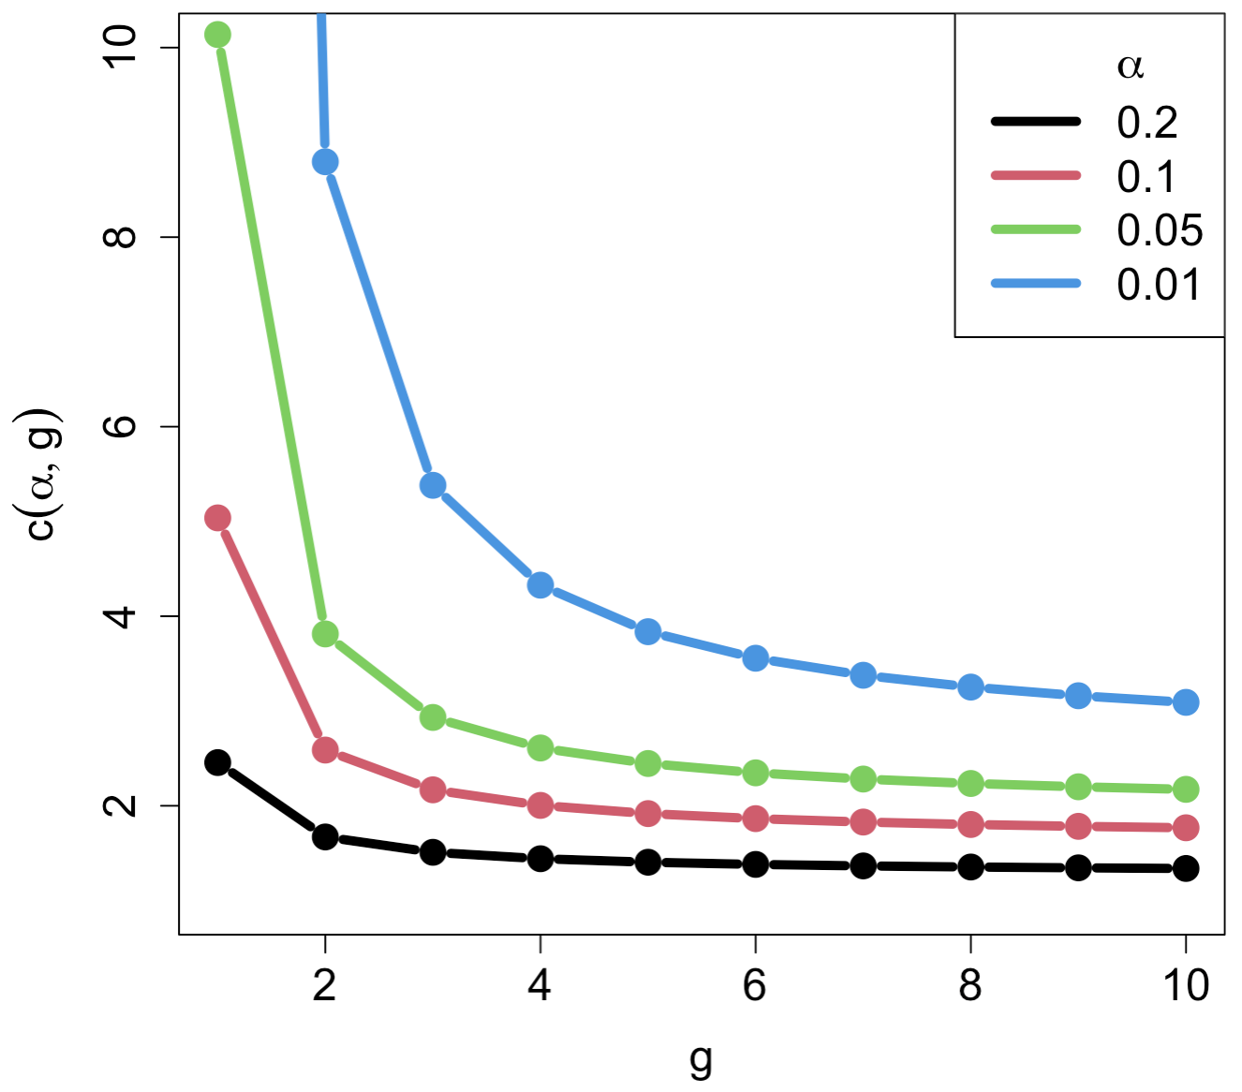
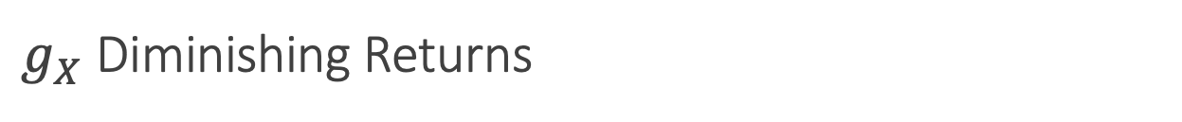
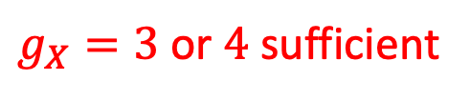


$g_{X}$ Diminishing Returns
$$c\left(g_{X}\right)t_{α/2,g_{X}}$$
$g_{X}=3$ or $4$ sufficient
$$g_{X}$$

Slide 29

Revisiting the Foldover Theorem
Example: $n=40$ and $m=8$
  $H$ has $n/2=20=8+12$ runs
  $g_{X}≥12$ is much larger than needed
Increasing $g_{X}$ comes at the cost of estimating $β_{2}$
Causes issues with stage 2 analysis
How do we fix this?

Slide 30
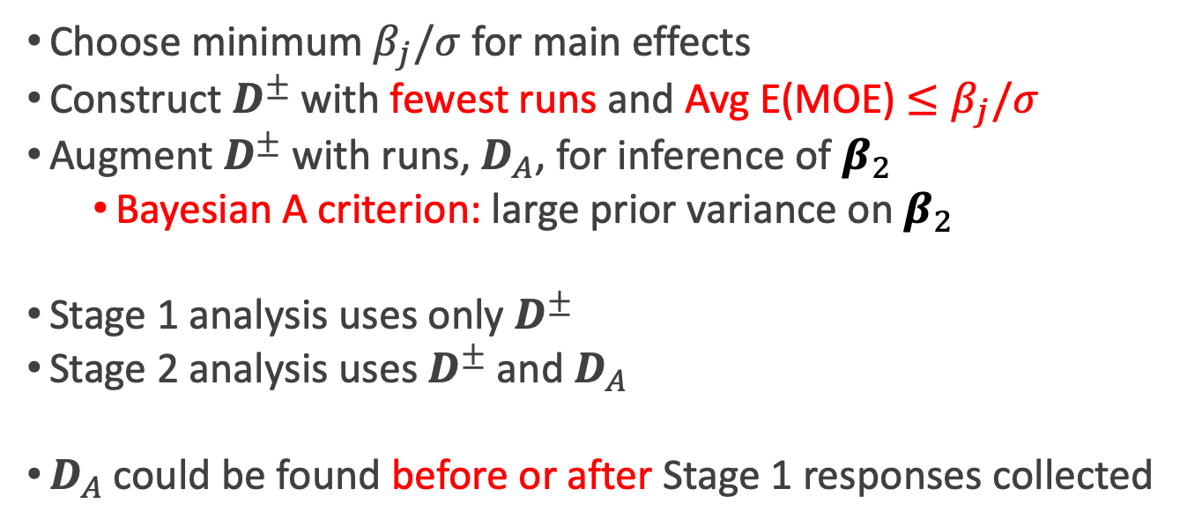
Augmented Design and Analysis
Choose minimum $β_{j}/σ$for main effects
Construct $D^{±}$ with fewest runs and Avg E(MOE) $≤β_{j}/σ$
Augment $D^{±}$ with runs, $D_{A}$, for inference of $β_{2}$
  Bayesian A criterion: large prior variance on $β_{2}$
Stage 1 analysis uses only $D^{±}$
Stage 2 analysis uses $D^{±}$ and $D_{A}$
$D_{A}$ could be found before or after Stage 1 responses collected

Slide 31
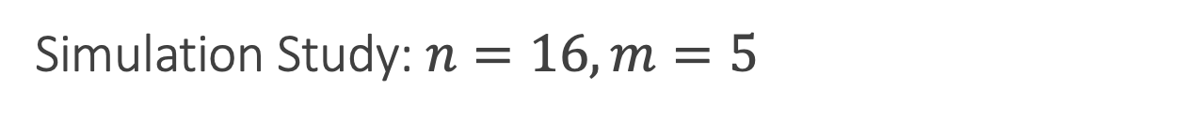

Simulation Study: $n=16, m=5$
Two factor interaction model has 16 parameters to estimate
Half fractional factorial design is popular choice
  All parameters estimated orthogonally with $v_{j}=1/16$
  No estimation of $σ^{2}$
  Lenth method generates a ${\hat{σ}}^{2}$ assuming effect principles
  Can fail if these principles fail to hold!
Generated three $D^{±}$ with 14 runs and $D_{A}$ with 2 runs

Slide 32







Simulation Study: $n=16, m=5$
Avg $E(MOE)$
Avg $\sqrt{v_{j}}$
$$(ℓ_{X},p,g_{X})$$
$$(2, 0, 2)$$
$$(0, 4, 4)$$
$$(1, 2, 3)$$

Slide 33
Simulation Study: $n=16, m=5$
Simulated 500 responses from different models based on:
  # Active Main Effects, # Active 2FIs
  Effects generated from Exp(1)+SN and random signs
  Assume strong heredity for active 2FIs
Analyze using augmented two stage analysis
True Positive Rate (TPR) and False Positive Rate (FPR) across main effects and 2FIs

Slide 34
Simulation Study: $n=16, m=5$
Scenario | Main Effect # Active (SN) | Interaction Effect # Active (SN) | Issues?
1 | 3 (2.00) | 2 (1.0) | None
2 | 3 (0.75) | 2 (0.5) | Small SN
3 | 4 (2.00) | 3 (1.0) | None
4 | 4 (0.75) | 3 (0.5) | Small SN
5 | 5 (2.00) | 5 (1.0) | Many effects
6 | 5 (0.75) | 5 (0.5) | Many effects

Slide 35


Simulation Study: $n=16, m=5$
C3
R1.a05
R1.a75
FFD
TPR
FPR

